Slide 1
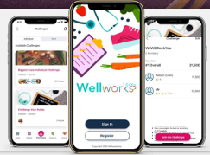

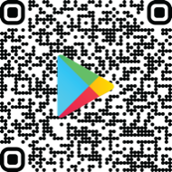



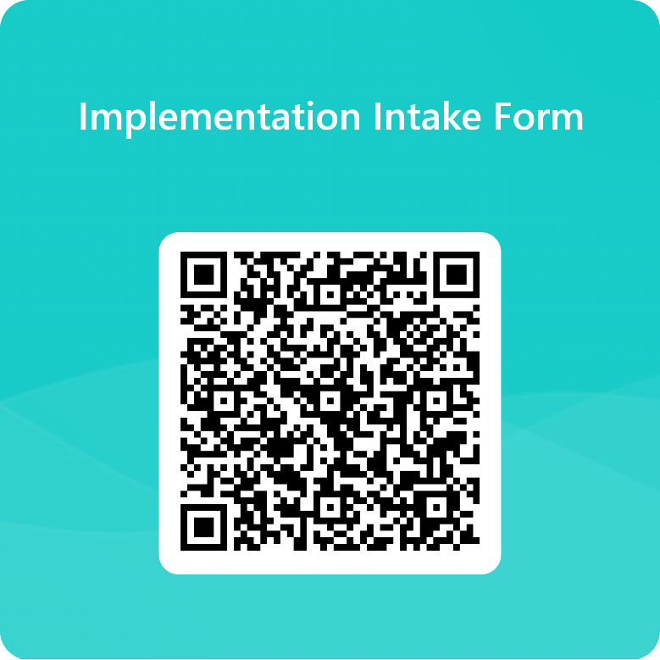
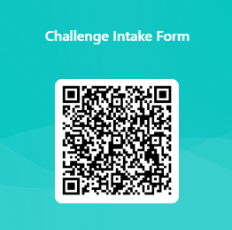

SCAN THE QR CODES & TAKE ACTION!
Download the Wellworks For You Mobile App Today!
Looking to customize your program or add an incentive?
Employer Registration for April Walking Challenge

