Slide 1
Nonqualified Plan
Plan Discussion 2023

Slide 2
ADMASTER-STAMP!20211208-1865081-6009087
Non-Qualified Plan Agenda
Secure Act 2.0 Impact on NQ plans
Administrative and Technology Updates
Statement Enhancement
2023 Web Enhancements

Slide 3
Secure Act 2.0 and Nonqualified Plans

Slide 4
Secure Act 2.0
The Secure Act 2.0 had little impact on 409A plans
However, the increase in the age (72 to 73-75) for RMD’s has made the staging of NQ payments more important
In an effort to help support the cost of the Secure Act 2.0 the act requires 401(k) participants 50+ making $145,000+ to make their catch up in a Roth instead of a pre-tax contribution
Plan Sponsors may consider adding distribution workshops in 2023/2024to help plan participants integrate their NQ plan with other retirement programs
Notes:
Tax Preferred savings plans are nothing new, however there are significant restrictions placed on traditional plans.
These restrictions make it hard for high income earners to save the same proportional amount of their income.
NQDC plans are a way to bridge the savings gap between what you can put away in a qualified plan and what you will need when you retire.

Slide 6
Administration and Technology

Slide 7
Web Enhancements

Slide 8
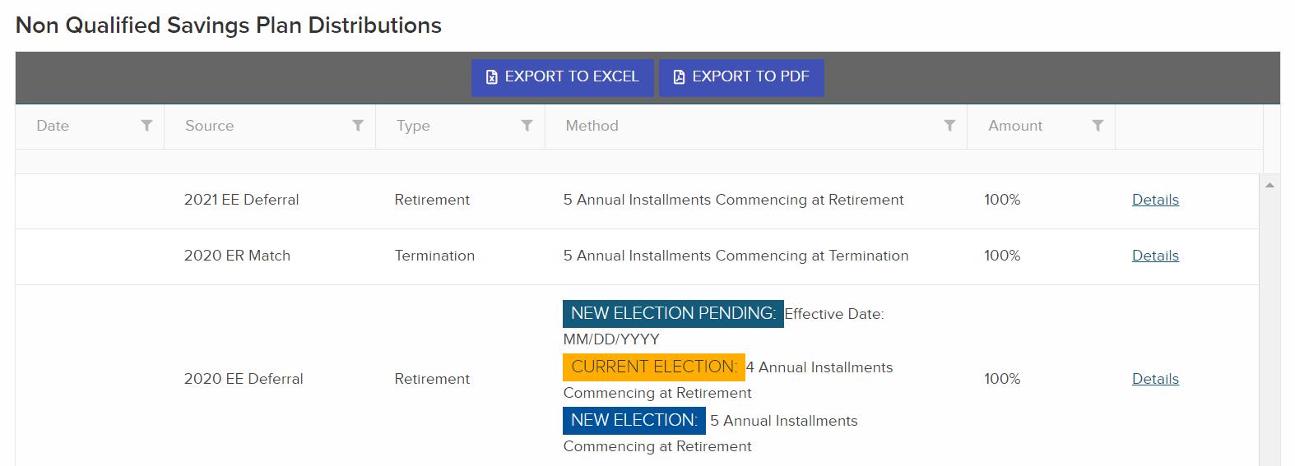
Before

Slide 9
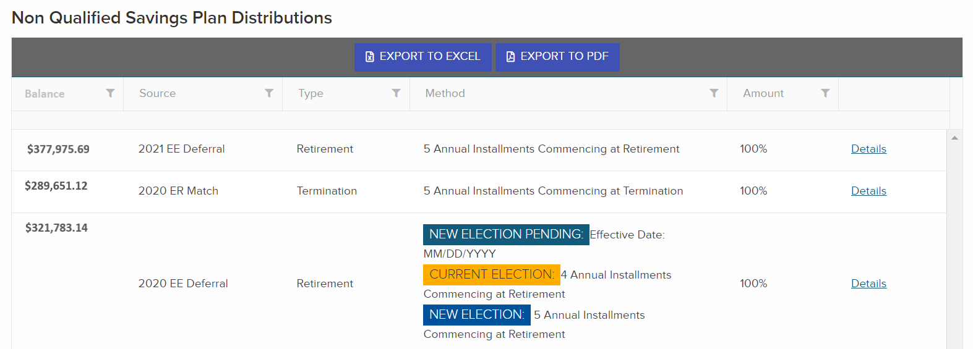
After

Slide 10
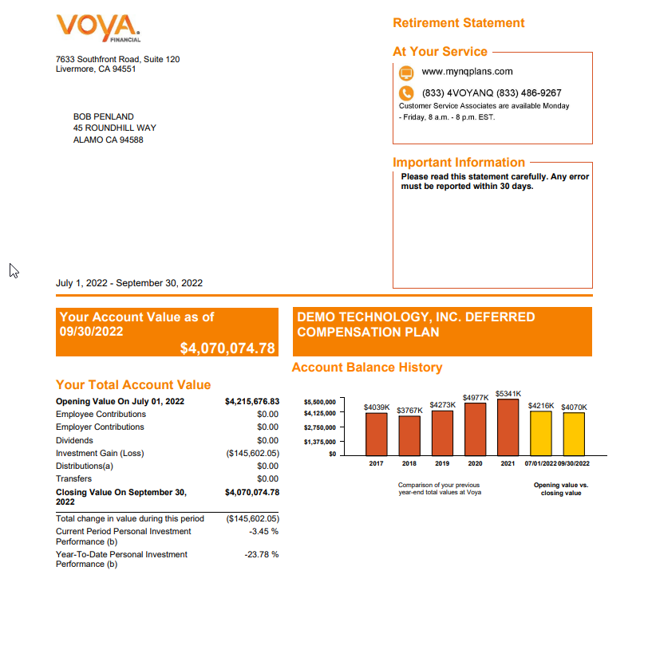
NQ Statement Enhancements
Participant’s current contribution elections
Beneficiary Designations
Distribution Elections

Slide 11
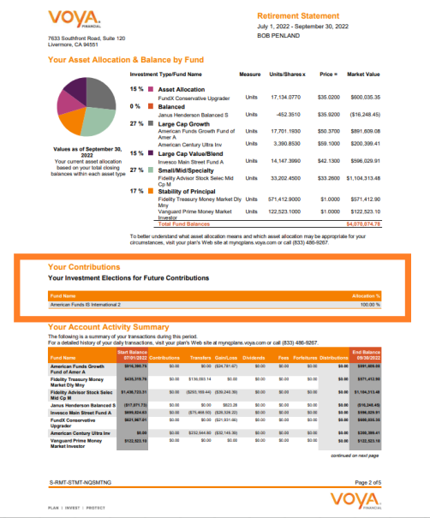
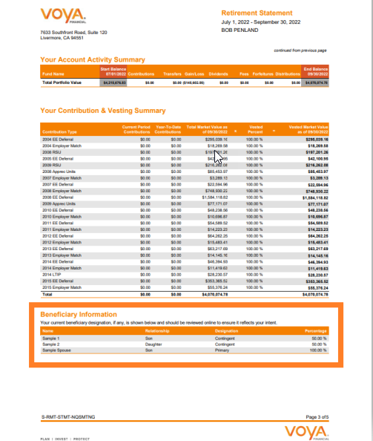
NQ Statement Enhancements

Slide 12
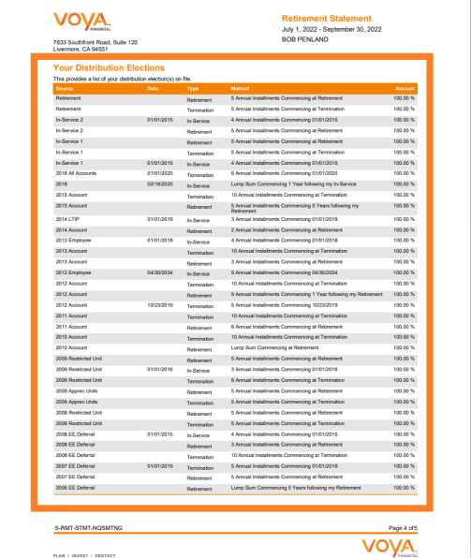
NQ Statement Enhancements

Slide 13
Not FDIC/NCUA/NCUSIF Insured I Not a Deposit of a Bank/Credit Union I May Lose Value I Not Bank/Credit Union Guaranteed I Not Insured by Any Federal Government Agency
Any insurance products, annuities and funding agreements that you may have purchased are sold as securities and are issued by Voya Retirement Insurance and Annuity Company (“VRIAC”). VRIAC is solely responsible for meeting its obligations. Plan administrative services provided by VRIAC or Voya Institutional Plan Services, LLC (“VIPS”). Neither VRIAC nor VIPS engage in the sale or solicitation of securities. If custodial or trust agreements are part of this arrangement, they may be provided by Voya Institutional Trust Company.
All companies are members of the Voya® family of companies. Securities distributed by Voya Financial Partners, LLC (member SIPC) or other broker-dealers with which it has a selling agreement. All products or services may not be available in all states.
Disclosures
Principal Risks. An investment in the Fund involves a considerable amount of risk. A Shareholder may lose money. Before making an investment decision, a prospective investor should (i) consider the suitability of this investment with respect to the investor’s investment objectives and personal situation and (ii) consider factors such as the investor’s personal net worth, income, age, risk tolerance, and liquidity needs. The Fund is an illiquid investment. Shareholders have no right to require the Fund to redeem their Shares in the Fund.
Therefore, before investing investors should carefully read the Fund’s prospectus and consider carefully the risks that they assume when they invest in the Fund’s common shares.
Investment Risk. An investment in the Fund involves a high degree of risk, including the risk that the Shareholder’s entire investment may be lost. The Fund’s performance depends upon the Adviser’s selection of Investment Funds and direct investments in operating companies, the allocation of offering proceeds thereto, and the performance of the Investment Funds, direct investments, and other assets. The Investment Funds’ investment activities and investments in operating companies involve the risks associated with private equity investments generally. Unexpected volatility or lack of liquidity, such as the general market conditions that prevailed in 2008, could impair the Fund’s performance and result in its suffering losses. The value of the Fund’s total net assets is expected to fluctuate. To the extent that the Fund’s portfolio is concentrated in securities of a single issuer or issuers in a single sector, the investment risk may be increased. The Fund’s or an Investment Fund’s use of leverage is likely to cause the Fund’s average net assets to appreciate or depreciate at a greater rate than if leverage were not used.
Closed-End Fund; Liquidity Risks. The Fund is a non-diversified closed-end management investment company designed principally for long-term investors and is not intended to be a trading vehicle. An investor should not invest in the Fund if the investor needs a liquid investment. General Private Equity Risks. The Fund is subject to those risks that are inherent in private equity investments. These risks are generally related to: (i) the ability of each Investment Fund to select and manage successful investment opportunities; (ii) the quality of the management of each company in which an Investment Fund invests; (iii) the ability of an Investment Fund to liquidate its investments; and (iv) general economic conditions. Securities of private equity funds, as well as the portfolio companies these funds invest in, tend to be more illiquid, and highly speculative.
General Risks of Secondary Investments. There is no established market for secondaries and the Adviser does not currently expect a liquid market to develop. Moreover, the market for secondaries has been evolving and is likely to continue to evolve. It is possible that competition for appropriate investment opportunities may increase, thus reducing the number and attractiveness of investment opportunities available to the Fund and adversely affecting the terms upon which investments can be made. Accordingly, there can be no assurance that the Fund will be able to identify sufficient investment opportunities or that it will be able to acquire sufficient secondaries on attractive terms.
The Fund may also be subject to the following risks: Limited Operating History Risk, Nature of Portfolio Companies Risk, Co-Investment Risk, Leverage Utilized by the Fund Risk, Leverage Utilized by Investment Funds Risk, Investments in Non-Voting Stock/Inability to Vote Risk, Valuation of Fund’s Interests in Investment Funds Risk, Valuations Subject to Adjustment Risk, Illiquidity of Investment Fund Interests Risk, Repurchase Risk, Expedited Decision-Making Risk, Availability of Investment Opportunities Risk, Special Situations and Distressed Investments Risk, Mezzanine Investments Risk, Small- and Medium-Capitalization Companies Risk, Utilities Sector Risk, Infrastructure Sector Risk, Technology Sector Risk, Financial Sector Risk, Geographic Concentration Risk, Sector Concentration Risk, Currency Risk, Venture Capital Risk, Real Estate Investments Risk, Substantial Fees and Expenses Risk, Foreign Portfolio Companies Risk, Non-U.S. Securities Risk, Structured Finance Securities Risk, Capital Calls / Commitment Strategy Risk, ETF Risk, Unspecified Investments Dependence on the Adviser Risk, Indemnification of Investment Funds / Investment Managers and Others Risk, Termination of the Fund’s Interest in an Investment Fund Risk,
Other Registered Investment Companies Risk, High Yield Securities and Distressed Securities Risk, Reverse Repurchase Agreements Risk, Other Instruments and Future Developments Risk, Dilution Risk, Incentive Allocation Arrangements Risk, Control Positions Risk, Inadequate Return Risk, Inside Information Risk, Possible Exclusion of a Shareholder Based on Certain Detrimental Effects Risk, Limitation on Transfer / Shares Not Listed / No Market for Shares Risk, Recourse to the Fund’s Assets Risk, Non-Diversified Status Risk, Special
Tax Risk, Additional Tax Considerations / Distributions to Shareholders and Payment of Tax Liability Risk, Current Interest Rate Environment Risk and Regulatory Change Risk. For a complete listing of all the Fund’s risks, with their descriptions, please refer to the “Types of Investments and Related Risks” section of the Fund’s prospectus. The Fund’s shares do not represent a deposit or obligation of, and are not guaranteed or endorsed by, any bank or other insured depository institution, and are not insured by the FDIC, the Federal Reserve Board or any other government agency. You may lose money by investing in common shares of the Fund.
Past performance is no guarantee of future results.
An investor should consider the investment objectives, risks, charges and expenses of the Fund(s) carefully before investing. For a free copy of the Fund’s prospectus, which contains this and other information, visit us at www.voyainvestments.com or call (855) 211-3220. Please read prospectus carefully before investing.
This is neither an offer to sell nor a solicitation of an offer to buy the securities described herein, and must be read in conjunction with the prospectus in order to understand fully all of the implications and risks of the offering to which this sales and advertising literature relates.
For plan sponsor and financial professional use only. Not for use with participants.
216200 1613333_0922 © 2022 Voya Investments Distributor, LLC, 230 Park Avenue, New York, NY 10169 CID: 2239193

