Slide 1

August 2022
Virginia Bankers
Introduction to ALCO/Balance Sheet Management
Scott Hildenbrand
Managing Director
HEAD of Piper sandler financial strategies
Head of piper sandler hedging services, llc
Tel: +1 212 466-7865
Email: scott.hildenbrand@psc.com
STRICTLY PRIVATE & CONFIDENTIAL

Slide 2
ALCO Overview
Asset Liability Committee (ALCO) is charged with overseeing an institution’s interest rate, liquidity, and market risk management
Primary Risks Managed by ALCO:
Interest Rate Risk: Exposure of a bank’s earnings and capital to changes in market interest rates
Liquidity: capacity to meet cash needs and collateral obligations in a timely manner and at a reasonable cost
Market Risk: Exposure of a bank’s earnings and capital to changes in market conditions

Slide 3
A/L Profile Measurement
Measurement: We measure interest rate risk in two primary ways:
  Short-term risk: Net Interest Income simulation for each of the next two years under different rate scenarios
  Captures impact to near-term earnings from changes in interest rates
  Long-term risk: Economic Value of Equity (EVE): Market Value of Assets less Market Value of Liabilities under different rate scenarios
  Captures interest rate risk from all future periods

Slide 4
Net Interest Income Volatility

Slide 5
Economic Value of Equity – Summary

Slide 6
Historical Beta Discussion
… roughly 50% average beta in last 3 hiking cycles… will this time be different?
Sources: Statista, S&P Global, Bloomberg
Note: Fed Funds on graph reflects quarterly average
* Beta calculated to cycle trough cost of interest-bearing deposit metric
Notes:
Next topic is historical beta data
On top of this peer information regarding modeling assumptions, we can now look at how our specific deposit base behaved recently in both a rising rate and declining rate environment. We went nearly a decade without a full cycle data point, and now we have 2 in 2 years. And regulators expect historical data specific to your customer base to be incorporated into the assumption development process
2 Key observations (at least at the industry-wide leve):
First: 39% beta in both rising and declining rate cycles, which is greater than the projections dictated in the OCC data – we under estimated both the increase and decrease to funding costs, as a whole
Secondly: While it took 7 years for cost of funds to bottom out in the last cycle, it has taken just 2 quarters to revisit those levels in this crisis. And I think that brings up an interesting question, and one I don’t have an answer to: while the last cycle was unprecedented in how slow the recovery is… should we expect the same this time? Or if/when a health solution is found, should we be thinking more about an unprecedentedly fast recovery?

Slide 7
Approach to Balance Sheet Management
Holistic: we take a holistic view on balance sheet management; franchise-building objectives and risk tolerance should dictate strategy
          Asset Liability Management (ALM) modeling is core to our strategic development process to optimize earnings, interest rate risk, capital, and liquidity profiles
Strategic: overall balance sheet strategy drives decision making, while tactics optimize current market opportunities balanced against risk profile of the portfolio
          Active management does not equate to an actively traded portfolio
Targeted: customized solutions based on deep understanding of institution’s priorities, policies, and the changing regulatory landscape
Collaborative Partnership: open dialogue with management teams to combine our broad reach and expertise in the industry and markets, with Client’s intimate knowledge of customer base and business model

Slide 8
Our view: role of the investment portfolio
Overall balance sheet objectives and risk tolerance should dictate investment portfolio strategy
Provide Liquidity for the Institution:
  Generate cash via bond sales or pledge for funds
  Cash flows serve as a liquidity source over time
Balanced Risk:
  Overall balance sheet interest rate risk profile drives the composition of the portfolio, combined with diligent monitoring of credit and market risk
Generate Additional Income:
  Fill earnings void during weak lending environments
  Tax-efficient income
Manage Capital Levels:
  Can help serve as a buffer for excess funds when loan balances are low
  Manage risk-adjusted capital levels
Risk/Reward trade-off between the investment portfolio objectives is dynamic and subject to change as overall balance sheet initiatives evolve.
Maintaining a nimble and flexible investment portfolio is a key priority.

Slide 9
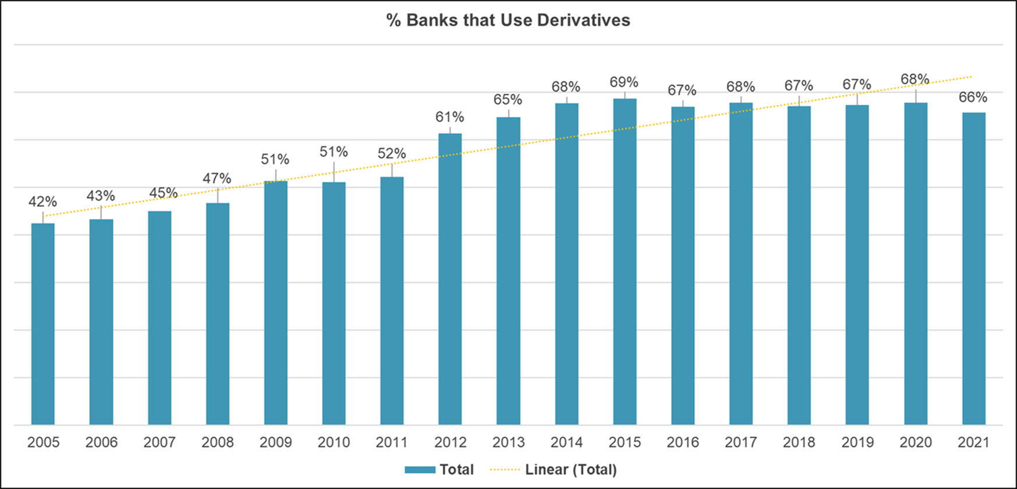
Community Banks’ Use of Interest Rate Derivatives Steadily Increased Post-Crisis. . .
    Banks $1 billion - $20 billion in assets with interest rate derivatives through the end of 2021
Source: S&P Global Market Intelligence

Slide 10
Establishing a Disciplined Approach to Balance Sheet Hedging
      Act, don’t react
        Build the infrastructure
        Incorporate hedge strategy evaluation into ALCO
      Keep it simple
        Identify the most plain vanilla strategy and hedge accounting application to meet your IRR goals
        Consider the availability of assets and liabilities to hedge
      Don’t bet on rates
        Don’t root for your hedge
      Quantify your opportunity cost
        Doing nothing is a decision, understand the cost

Slide 11
Commercially-Oriented Banks Can Benefit From a Customer Loan Swap Program
      Why now?
        Offer customers the long tenor, fixed rate loan they desire at a lower synthetic fixed rate
        Many commercial borrowers now expect a derivative offering
        Differentiate your product offering with custom structures such as cancelable features and longer tenor deals
      A client derivative hedging program can help enforce loan pricing discipline:
        Front-end: discourages bankers from pre-committing/promising fixed rates before loan closing date
        Back-end: helps with breakage termination enforcement/not waiving prepay penalties or setting low/no penalties on fixed rate loans that ignore bank funding losses
      Generate meaningful income, even on a small subset of loans
        Non-interest fee income opportunity / diversifies revenue streams
        Enhance investor/analyst perceptions of the Bank with increased fee income

Slide 12
Appendix

Slide 13

Scott Hildenbrand
Tel: +1 212-466-7865
Email: scott.hildenbrand@psc.com
Scott Hildenbrand is a Managing Director and Head of Piper Sandler Financial Strategies, working with financial institutions on balance sheet strategy development, which includes interest rate risk management, investment portfolio strategy, retail and wholesale funding management, capital planning, budgeting, and stress testing.
Hildenbrand also runs Piper Sandler Hedging Services, LLC, which is registered as a swap introducing broker with the Commodity Futures Trading Commission and is a member of the National Futures Association. In these capacities, Hildenbrand works closely with the firm’s Investment Banking Group to identify and develop strategic opportunities for clients involved in mergers and acquisitions.
Previously, he was a Principal and Chief Balance Sheet Strategist of Sandler O’Neill + Partners, L.P. Prior thereto, Hildenbrand worked in Sandler O’Neill’s Interest Rate Products Group, focusing on developing and implementing structured wholesale funding strategies for financial institutions. He spent his first four years at the firm in the Asset/Liability Management Group. Prior to joining Sandler O’Neill in 2004, Hildenbrand worked as a financial analyst in asset/liability management at Tower Federal Credit Union in Maryland.
In 2021 Hildenbrand was elected to the Financial Managers Society board of directors. Additionally, he serves as Treasurer on the Board of Directors for Liam’s Room, a not-for-profit organization that focuses on pediatric palliative care, a specialized approach to medical care for children with serious illnesses. He is a frequent speaker at industry conferences and seminars. He holds an M.B.A. in finance from Loyola College in Maryland and a bachelor’s degree with a concentration in accounting and finance from Gettysburg College.

Slide 14
Risk Considerations of Hedging with Derivatives
      While derivative transactions hedging future liabilities have many benefits, they also require the Bank’s Management and Board of Directors to carefully review the associated risks and considerations.
    Some of the risk factors management and the board should consider include:
      Market risk
        Risk that market moves in the opposite direction of the hedge leading to “buyer’s remorse” and a net cost to the hedge over its life
      Counterparty risk
        Risk that counterparty defaults and derivative’s value must be written off
        Risk that counterparty margin posted does not cover market value
        Chance of counterparty default may put hedge accounting treatment in jeopardy
      Accounting risk
        If hedge accounting is jeopardized through some misalignment between the hedge and the hedged item, the derivative market value of the hedge may be forced to flow through earnings and regulatory capital
        Regulatory risk
        Policies and procedures for monitoring initial and ongoing risk most scrutinized
        Minimal risk when derivative strategy is used for hedging and not speculative use
      Liquidity Risk
        Management must evaluate the effect an interest rate derivative strategy may have on liquidity calculations when collateral calls and periodic hedge payments are considered

Slide 15
© 2022 Piper Sandler & Co., 800 Nicollet Mall, Suite 900, Minneapolis, MN 55402-7036

