Slide 1
5 Buckets Principle™ The Science of Work-Life Balance

Slide 2
Learning Points
Participants will:
Consider the impacts and influences on our work-life balance
Explore the Five Buckets Principle of work-life balance
Discuss the elements necessary to fill the five buckets
Determine action steps to improve your work-life balance
Notes:
Explain that America ranks very low on work life balance and we need to acknowledge that and make some changes…
Take a step back and ask yourself ok what is not working for you that prohibits you from having work life balance
2.3 hours a day is the avg. amount that an American wastes on unnecessary interruptions.

Slide 3
Work-Life Balance
Pre-pandemic, we were already being stretched thin
We regularly worked “overtime”, including nights and weekends
26% of our work was being done outside of our regular hours
We spent about 43% of our day on our primary job duties
We averaged just under three hours of productive time per workday
28% of US workers reported feeling burned out at work ‘very often’ or ‘always’
Notes:
https://elitecontentmarketer.com/work-life-balance-stats/
American Time Use Survey 2019
State of Work Report done by Workfront 2020
Microsoft Work Trend Index Report 2020
State of Remote Report 2020
43% on primary job duties: ‘wasteful meetings’ take up a chunk of the remainder of our time
Top causes of burnout = unfair treatment and unmanageable workload

Slide 4
Work-Life Balance (continued)
Post pandemic our work-life balance has been tested and re-defined
We are doing our work differently and we have been dealing with clients, patients, customers and coworkers who were more stressed because of the uncertainty that we were all dealing with
Some of us worked in our existing jobs, in our usual location but with very different operating rules and procedures
Others worked from home while also caring for kids, pets and handling interruptions; The lines between work and home became even more blurred
Still others lost their jobs during the pandemic
However, the majority of people surveyed said they would like to the option to work from home / remotely at least some of the time, going forward
54% of people surveyed said that their mental health has increased in importance in 2020
According a Gallup poll, one of the best things that companies and employees can do is to prioritize ‘wellbeing’, which includes: career, social, financial, community and physical heath
Notes:
https://elitecontentmarketer.com/work-life-balance-stats/

Slide 5
Five Buckets
Family & Friends
Financial
Work
Health
Community
Giving Back
Notes:
These need to be full at least 80% of the time – 100% would be nice, but is not reality. We are also looking to nip perfectionism in the bud!
Each of these areas have to get your attention.
Give a personal example of when you spent more time or energy on one bucket than another and how you can put more into the others.
How do you get it all done?
How do you feel when you have put more energy an effort into all parts of your life vs. what you feel when one area is lacking.
Remind and empower participants that they have a chance and make their own choices…. Evaluate every single day! Think about your choices, decisions and how you manage your time.
What bucket do you need the most work on?

Slide 6
Family and Friends
Family
Friends
Quality time vs. quantity time
When to listen and when not to listen
Set boundaries
It is ok to say “no” to family
People who are happy for you during the good times but will coach you through the bad times
Be selective
Notes:
Not looking for quantity - you can’t get more than 168 hours a week.
What do : toxic, negative, drainers – want to bring you down.
Be very selective aboupeople who aret who you allow to take up your time.
Even if you do not spend physical time with them – people who cause you anxiety – time that you “think about” that make you angry or agitated are also using up your valuable energy.
Take back that time- don’t let them take up space in your thoughts!
There are people who are addicted to negativity – they are actually happy when they are miserable! They create drama if life is going too well!
This is not to say you should not make an effort to save a relationship that really matters, but if there is more take than give, if they always bring you down, move on. Create a move on mantra you say to yourself.
You have to accept that family members – you keep always – and you can listen – but limit the time they can vent.
After 7 minutes – whining stops being therapeutic and starts being physically detrimental to your body.
Create a “darn I’m good list” at the end of the day to help focus on the things you did well, not the things that did not go well.

Slide 7
Work
Remember. Remember you are “at work” more than anywhere else in life
Reframe. Reframe your attitude
List. Make a list of everything you like about your work
"D.I.G." Make a “Darn, I'm Good” file
Growing. Continue growing and learning
Manage. Manage interruptions and time wasters
Work. Work harder than you ever thought you could
7
Notes:
D.I.G. = Darn I’m Good notes kudos anything that anyone has sent to tell you how good you are.
Create a file that reminds you about how awesome you are at work??? Do you focus on the good or the bad?
Ask yourself- how and why do you love your job?
Positive people – are 80% more productive than negative people
Before you go home, give yourself a transition – drive around the block an extra minute – have some tea – put the troubles behind you so you don’t take negative energy into your house.
Give an example of someone who see’s their job as a “calling” not just their job!

Slide 8
Community and Giving Back
Outreach
Volunteering
Making connections
The beauty of giving, caring and mattering
Teaching your family members to get involved
The world we live in really is small – even more important to care
Notes:
It is so interesting that unless we give back we can’t feel satisfied. Being a “good, caring person” – taking time out of your day to give to others!
This is one of the most overlooked buckets!
Think about people who you can help… think about making stronger relationships with the people in your every day life. Make it a priority!!!
Make participants feel appropriately guilty– push them to do more!!
Good suggested resource here: Mans Search for Meaning by Viktor E. Frankl
Get people discussing organizations – locally or globally to volunteer with!

Slide 9
Financial
Goal setting
Nickel and dime spending
Retirement planning
Start now
Meat vs. gravy
Be prepared for the unexpected
Debt management
Family values
Inherited spending habits
Notes:
Finances – number 1 stress in America.
Ask – do you think that money makes you happy?
Reality is we do need a certain amount of money to live – meat…. But it should not be what makes us happy… that’s the gravy!
What are you working for?
Of course we are not going into detail here … we have hundreds of financial classes but financial stress is a major reason our lives go out of whack. We overspend because we mistakenly think it will make us happy! How many of us have ever gone out to dinner and wasted money because we had a bad day.. Hard day.. Long day!
Using money to make us feel more balanced doesn’t work! Even massages and manicures are really a waste of money!
Also mention that it is critically important to have a living will, power of attorney, and be prepared for retirement.

Slide 10
Health
Taking care of you
Exercise
Preventative screenings
Health journal
Nutrition
Sleep
Stress management
Notes:
Discuss the importance of all forms of medicine– medical and alternative and why its so important to be open to new and different things.
EX- ginger for digestion/stomach issues, rather than a pill
Know your numbers!!!!! BP, Cholesterol, BMI – be sure to have your checkups! Its all about being preventative! If you don’t know your numbers, find them out… make an appt with your physician

Slide 11
Invest in Yourself
The “oxygen mask” theory – all starts with you
Your “D.H.A.” – Dreams Hopes Aspirations
Get excited
Go into your “discomfort” zone
Motivation, willpower and determination
11
Notes:
What are your priorities? Work, family then you? How many roles do you play?
Worker, Parent, Spouse, Pet Owner, Brother/Sister, Uncle/Aunt, Neighbor, Peacemaker ,Daughter/Son, Community activist, Volunteer
Are you ready to commit time to yourself? How much time (out of 168 hours) can you find just for YOU!
Write your eulogy? Why – it gets you to think about what you are doing and what you should be doing.
The oxygen mask theory means that you take care of yourself first. If you are travelling on a plane the flight attendant says to place the mask on you first then your infant because you are no help to anyone if you are dead!
D, H, A.. Dreams, hopes and aspirations means that some of us are so jaded that we have forgotten how to get excited again and to dream. A balanced life means to set your goals higher than you ever thought you could. Get excited about possibilities..
Which means pushing yourself forward… if your life feels dull and maybe you have gotten complacent then this seminar is about pushing yourself harder than you ever have before. That is where motivation, willpower and determination comes in!

Slide 12
Happiness and Humor
This is about enjoying life
Embrace change and fear
Laugh, laugh, laugh – learn about humor therapy
Ethics and honesty
Appreciation
Tragedies
Moving on and upward
Example: lottery winners one year later - many say they are less happy
Creativity
Mindful living
Giving
Character: Who you are when no one is looking
Never give up
Don’t dwell on the past
Notes:
People who feel balanced are fun, happy people!!
Learning how to be happy and laugh more is critically important – especially so that we can get through the challenges in life.
Have a list for your pick me ups:
Funny movies
Songs that make you smile
Pictures
Dance
Don’t show this video but use this story as an example:
http://www.foxnews.com/health/2013/11/07/woman-about-to-undergo-mastectomy-hosts-dancing-party-before-surgery/
Do a visualization

Slide 13
“Three Rules of Life ...”
Your time is limited, so don't waste it living someone else's life.
Don't be trapped by dogma - which is living with the results of other people's thinking. Don't let the noise of others' opinions drown out your own inner voice.
Have the courage to follow your heart and intuition – they somehow already know what you truly want to become. - Steve Jobs
Notes:
Discuss Key Ingredients in context of this quote
Allow yourself to get excited again and set goals for yourself!!! Get motivated to do what you love and have a passion for!

Slide 14
“Three Rules of Life ...”
Your time is limited, so don't waste it living someone else's life.
Don't be trapped by dogma - which is living with the results of other people's thinking. Don't let the noise of others' opinions drown out your own inner voice.
Have the courage to follow your heart and intuition – they somehow already know what you truly want to become. - Steve Jobs

Slide 15
Take a slow, deep breath in through your nose lasting 5 seconds
Hold for a few seconds
Breath out slowly through your mouth
Repeat 10 times
Notes:
This quote relates to the Family & Friends Bucket

Slide 16
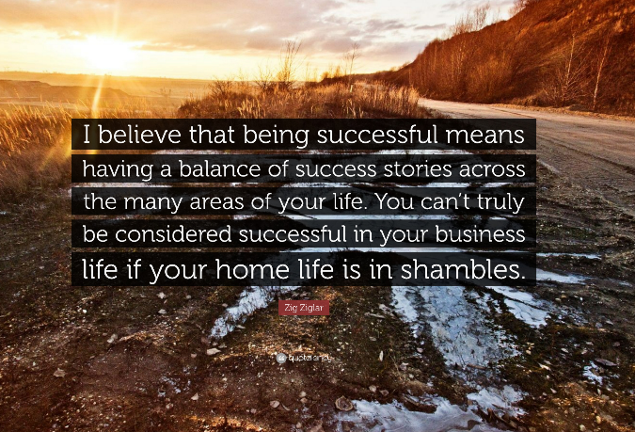
Notes:
Look at who said this -- Zig Ziglar.. One of the first motivational speakers.. Talked about work/life balance!

Slide 17
What Three Action Steps Will You Commit to Working On?
___________________________________________________________________.
___________________________________________________________________.
___________________________________________________________________.
Notes:
Before you leave take a minute and write down on a piece of paper or your smart phone. What is the first step to filling in your five buckets? Asking which bucket is your strongest? And which is your weakest can help?
Refer participants to the appendix; review and discuss, if there’s time.

Slide 18
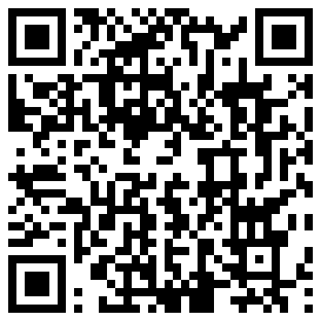
Evaluation
Survey QR Code:

Slide 19
Anthem EAP is here for you.
Visit the website: anthemeap.com
And enter company code: VBA
Call us: 800-346-5484
Notes:
Add in client info so employees know where to go for help.

Slide 20
THANK YOU FOR PARTICIPATING!
5 Buckets Principle™
The Science of Work-Life Balance
EAP products are offered by Anthem Life Insurance Company. In New York, Anthem EAP products are offered by Anthem Life & Disability Insurance Company. In California, Anthem EAP products are offered by Blue Cross of California using the trade name Anthem Blue Cross. ANTHEM is a registered trademark. Use of the Anthem EAP website constitutes your agreement with our Terms of Use.

