Slide 1
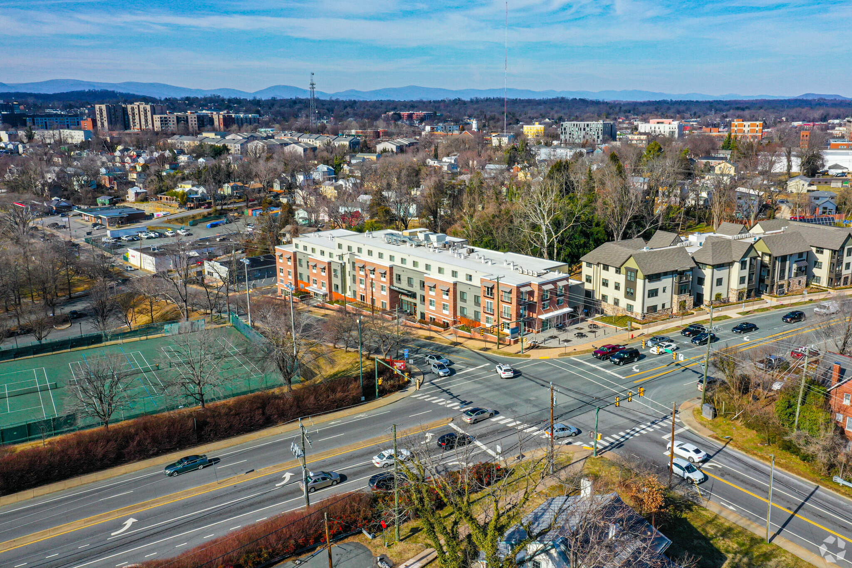
State of the Mid-Atlantic
Market
October 2022

Slide 2
Agenda
Office Update
Industrial Update
Retail Update
Questions?

Slide 3
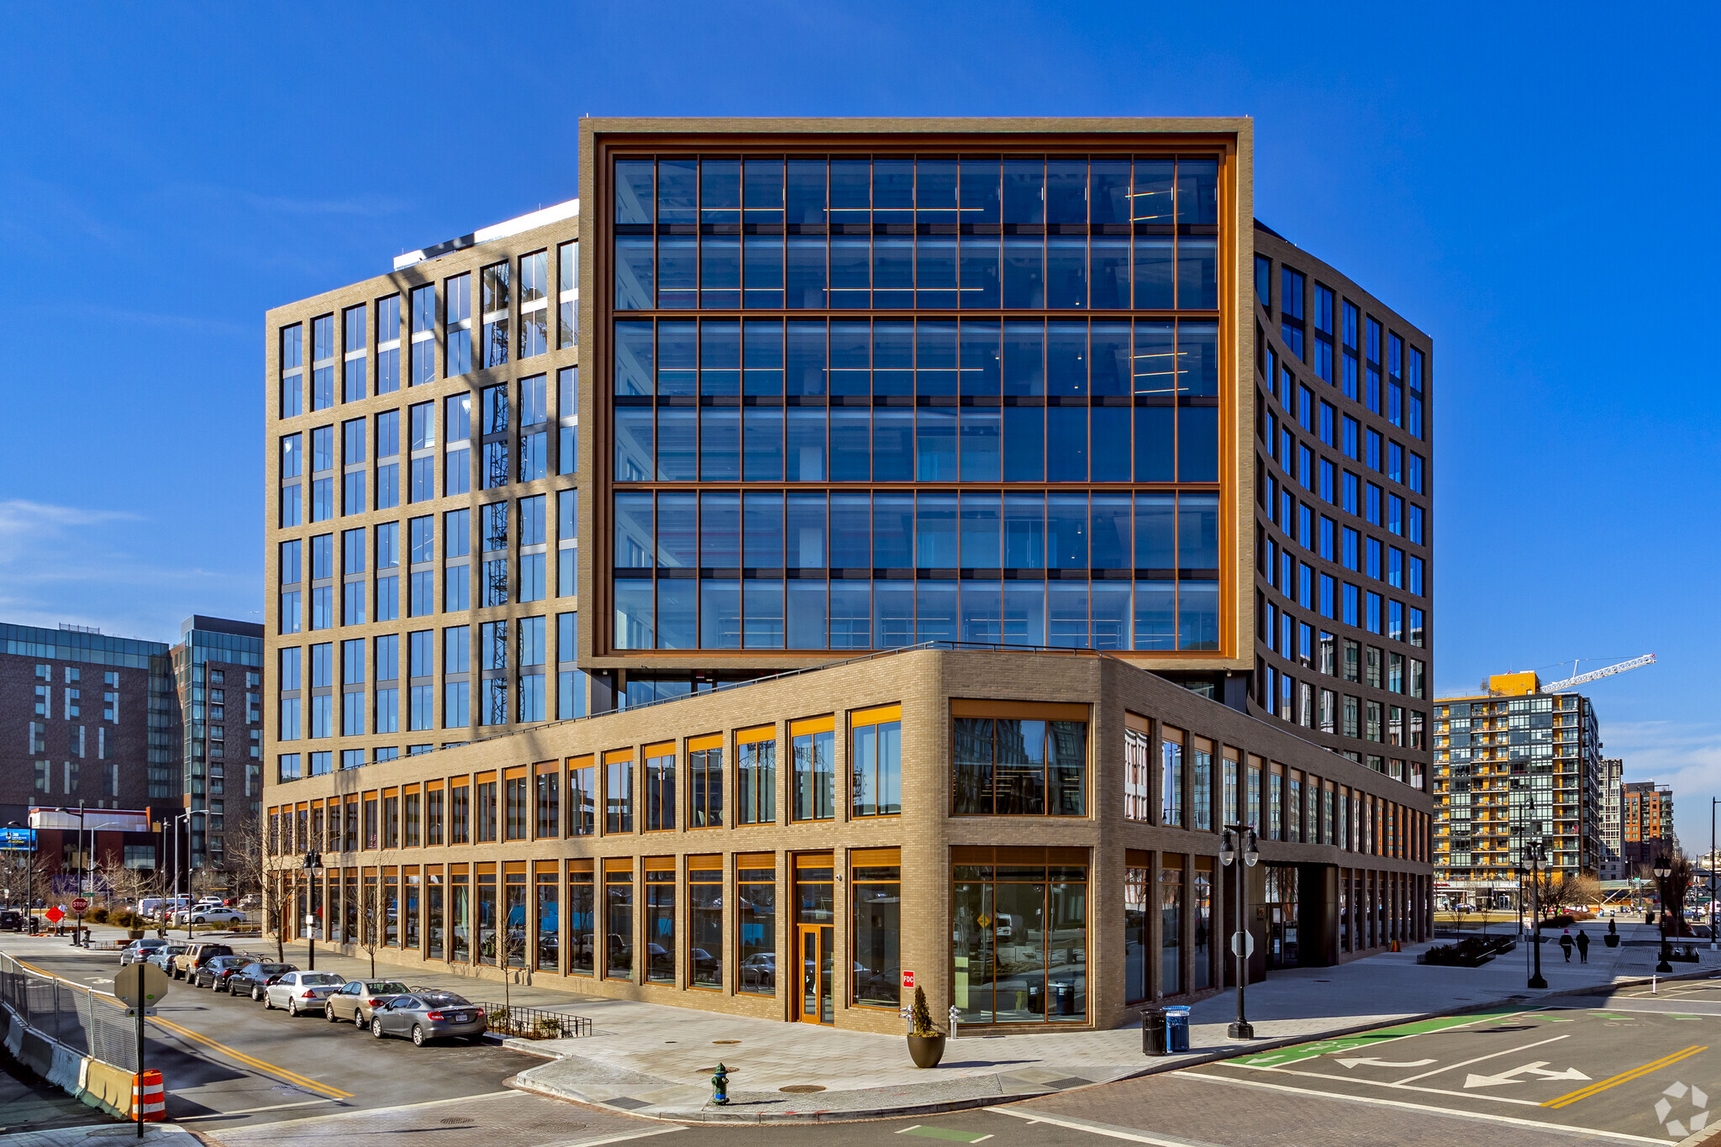
Office
Market

Slide 4
United States Office Fundamentals
Vacancy Rate
Quarterly Change in Supply & Demand
Source: CoStar, October 2022

Slide 5
Office Supply & Demand Balance Improving
Supply/Demand SF (Trailing 12-Month)
Source: CoStar, October 2022

Slide 6
Cumulative Net Absorption by Star Rating
Source: CoStar, October 2022

Slide 7
Vacancy Rate by Cohort
*YTD
Source: CoStar, October 2022

Slide 8
Mid-Atlantic Office Fundamentals
Vacancy Rate
Quarterly Change in Supply & Demand
Source: CoStar, October 2022
Includes MD, DC, WV, VA, NC

Slide 9
Office Vacancy Rate by Mid-Atlantic Market
Source: CoStar, October 2022
Includes MD, DC, WV, VA, NC

Slide 10
Office Vacancy Change Since 20Q1, Mid-Atlantic
Source: CoStar, October 2022
Includes MD, DC, WV, VA, NC

Slide 11
The Under-Construction Pipeline Remains Active, But Cooling
Source: CoStar, October 2022
Includes MD, DC, WV, VA, NC

Slide 12
Under Construction As Share of Inventory
Source: CoStar, October 2022
Includes MD, DC, WV, VA, NC

Slide 13
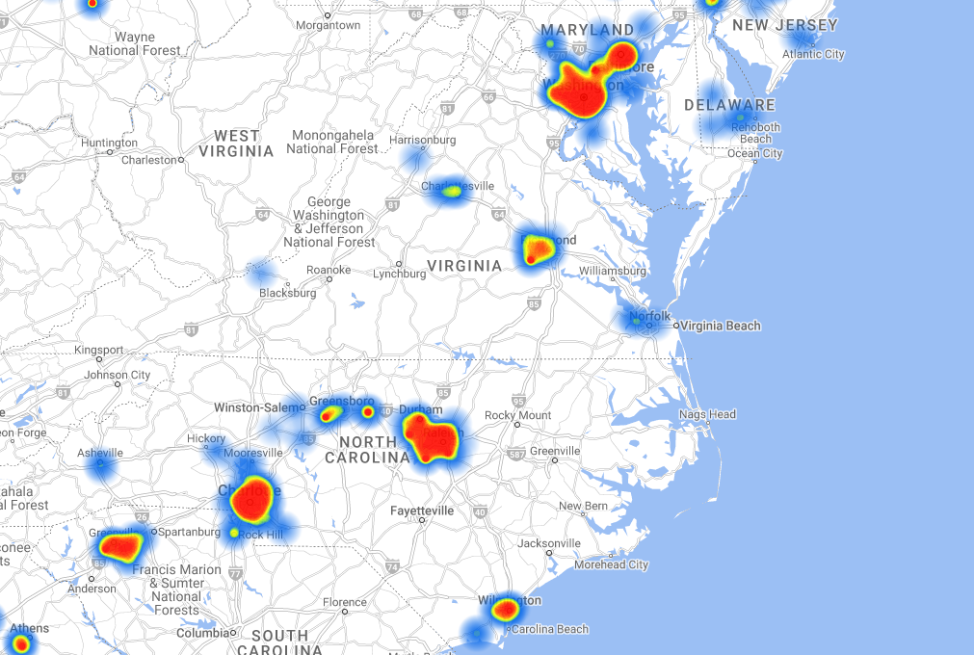
Office Development Concentrated In Large Metros
Source: CoStar, October 2022
Includes MD, DC, WV, VA, NC

Slide 14
Mid-Atlantic Office Rent Growth
Same-Store Asking Rent/SF
YOY Change
*YTD
Source: CoStar, October 2022
Includes MD, DC, WV, VA, NC

Slide 15
Mid-Atlantic Office Forecast
Forecast
Vacancy Rate
Quarterly Change in Supply & Demand
Source: CoStar, October 2022
Includes MD, DC, WV, VA, NC

Slide 16
Mid-Atlantic Office Rent Growth Forecast
Forecast
Same-Store Asking Rent/SF
YOY Change
Source: CoStar, October 2022
Includes MD, DC, WV, VA, NC

Slide 17
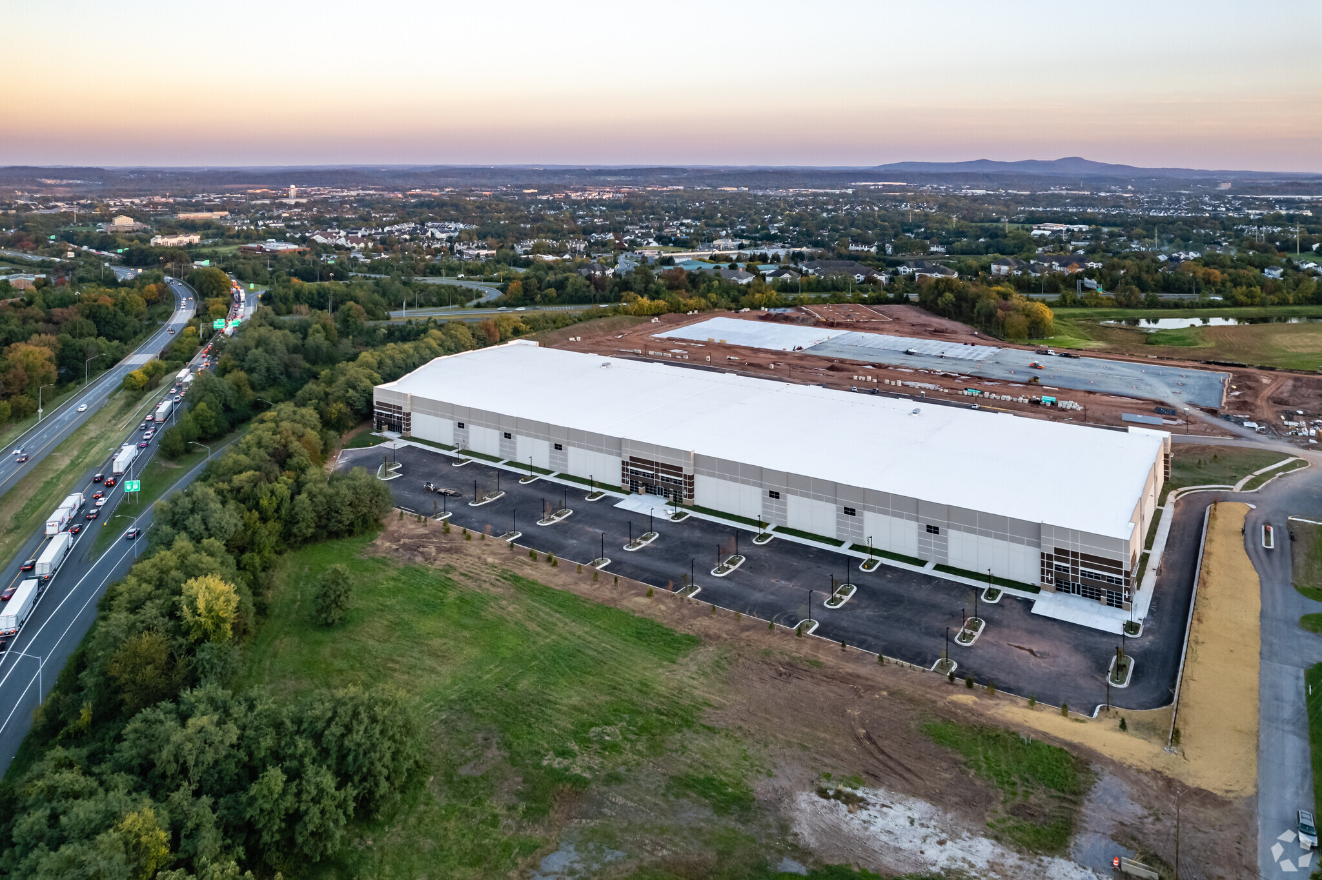
Industrial
Market

Slide 18
United States Industrial Fundamentals
Vacancy Rate
Quarterly Change in Supply & Demand
Source: CoStar, October 2022

Slide 19
Industrial Supply & Demand Balance Cooling
Supply/Demand SF (Trailing 12-Month)
Source: CoStar, October 2022

Slide 20
Vacancy Rate by Cohort
*YTD
Source: CoStar, October 2022

Slide 21
Availability Declining Across All Vintages Nationally
Source: CoStar, October 2022

Slide 22
Availability Declining Across All Vintages Nationally
Source: CoStar, October 2022
Portion of U.S. RBA Listed As Available for Lease

Slide 23
Years Supply of Modern Industrial Space Available For Lease
*Years of supply is calculated by dividing available space within existing properties built within the past 15 years or under construction properties, by average annual leasing within these same properties, plus proposed properties over the previous three years.
Source: CoStar, October 2022

Slide 24
Mid-Atlantic Industrial Fundamentals
Vacancy Rate
Quarterly Change in Supply & Demand
Source: CoStar, October 2022
Includes MD, DC, WV, VA, NC

Slide 25
Industrial Vacancy Rate by Mid-Atlantic Market
Source: CoStar, October 2022
Includes MD, DC, WV, VA, NC

Slide 26
Industrial Vacancy Change Since 20Q1, Mid-Atlantic
Source: CoStar, October 2022
Includes MD, DC, WV, VA, NC

Slide 27
The Under-Construction Pipeline Is Soaring
Source: CoStar, October 2022
Includes MD, DC, WV, VA, NC

Slide 28
Space Under Construction by Cohort
Source: CoStar, October 2022
Includes MD, DC, WV, VA, NC

Slide 29
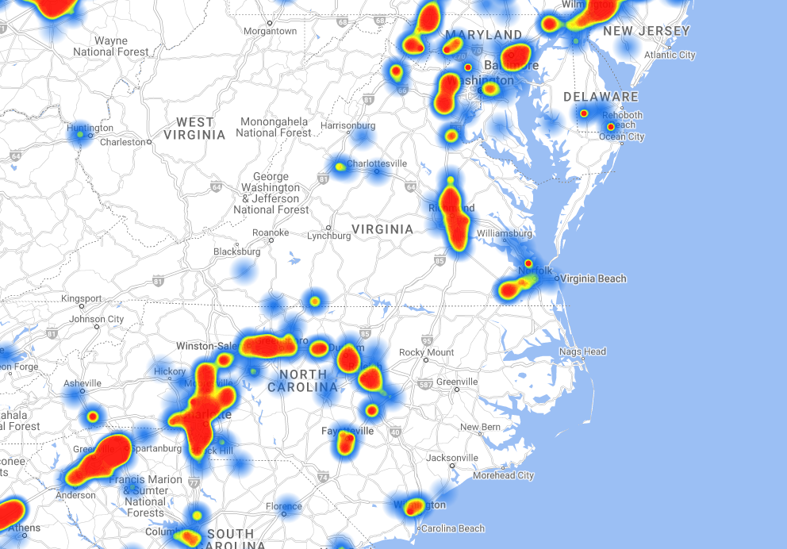
Industrial Development Concentrated Along Major Arteries
Source: CoStar, October 2022
Includes MD, DC, WV, VA, NC

Slide 30
Under Construction As Share of Inventory
Source: CoStar, October 2022
Includes MD, DC, WV, VA, NC

Slide 31
Mid-Atlantic Industrial Rent Growth
Same-Store Asking Rent/SF
YOY Change
Source: CoStar, October 2022
Includes MD, DC, WV, VA, NC

Slide 32
Mid-Atlantic Industrial Forecast
Forecast
Vacancy Rate
Quarterly Change in Supply & Demand
Source: CoStar, October 2022
Includes MD, DC, WV, VA, NC

Slide 33
Mid-Atlantic Industrial Rent Growth Forecast
Forecast
Same-Store Asking Rent/SF
YOY Change
Source: CoStar, October 2022
Includes MD, DC, WV, VA, NC

Slide 34
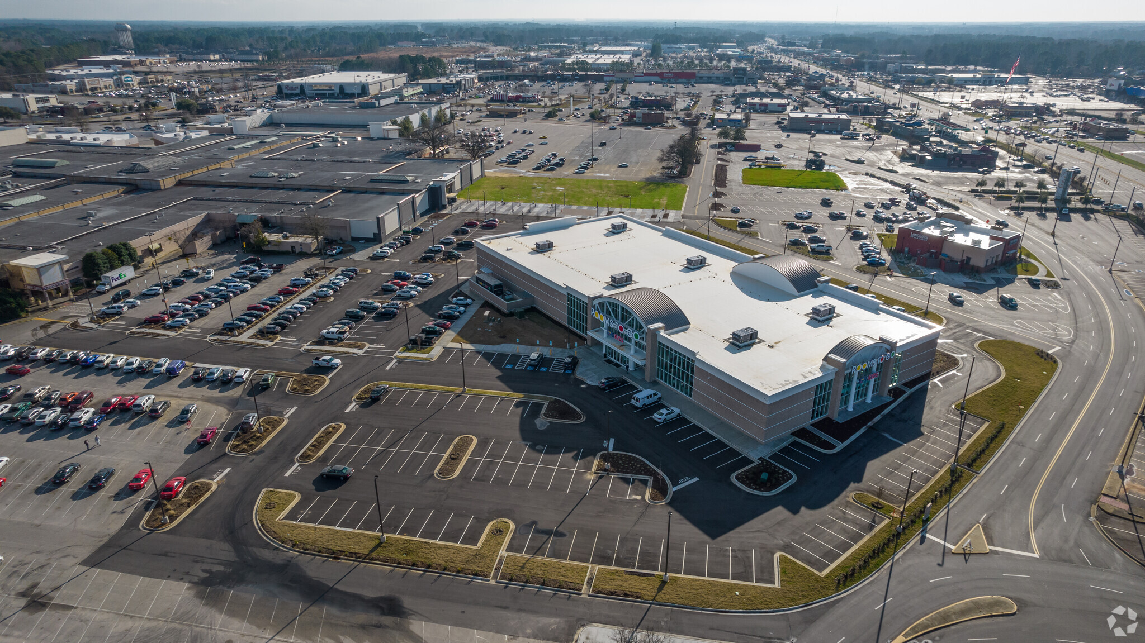
Retail
Market

Slide 35
United States Retail Fundamentals
Vacancy Rate
Quarterly Change in Supply & Demand
Source: CoStar, October 2022

Slide 36
Vacancy Rate by Shopping Center Type
Source: CoStar, September 2022

Slide 37
Quarterly Retail Leasing Volume
Source: CoStar, October 2022

Slide 38
Under Construction, by Center Type
Source: CoStar, October 2022

Slide 39
Mid-Atlantic Retail Fundamentals
Vacancy Rate
Quarterly Change in Supply & Demand
Source: CoStar, October 2022
Includes MD, DC, WV, VA, NC

Slide 40
Retail Vacancy Rate by Mid-Atlantic Market
Source: CoStar, October 2022
Includes MD, DC, WV, VA, NC

Slide 41
Retail Development Is Slimming
Source: CoStar, October 2022
Includes MD, DC, WV, VA, NC

Slide 42
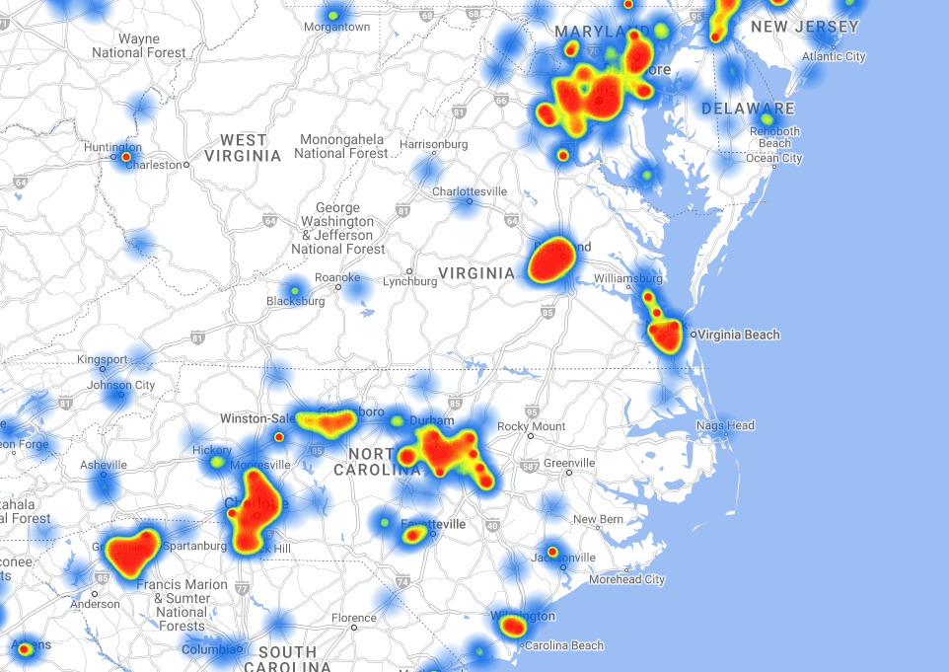
Retail Development Concentrated In Major Metros
Source: CoStar, October 2022
Includes MD, DC, WV, VA, NC

Slide 43
Mid-Atlantic Retail Rent Growth
Same-Store Asking Rent/SF
YOY Change
Source: CoStar, October 2022
Includes MD, DC, WV, VA, NC

Slide 44
Mid-Atlantic Retail Forecast
Forecast
Vacancy Rate
Quarterly Change in Supply & Demand
Source: CoStar, October 2022
Includes MD, DC, WV, VA, NC

Slide 45
Mid-Atlantic Retail Rent Growth Forecast
Forecast
Same-Store Asking Rent/SF
YOY Change
Source: CoStar, October 2022
Includes MD, DC, WV, VA, NC

Slide 46

Thank you!
Mike Cobb, Director of Market Analytics
mcobb@costar.com
410-319-2620

