Slide 1
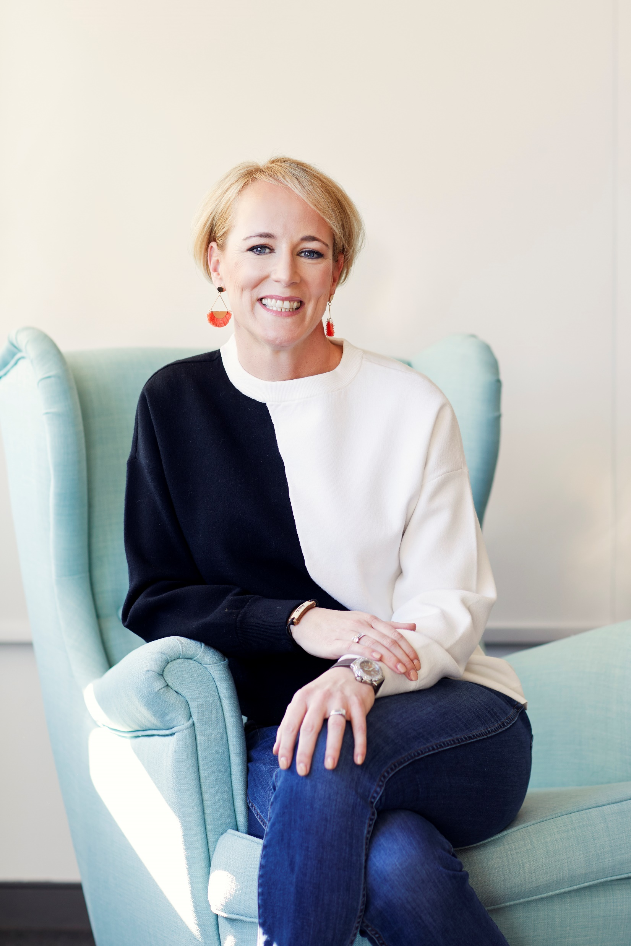
Chesapeake Bank Book Club
Check In Meeting: September 2021

Slide 2
Part 3, Getting Rid of Your Dragon For Good; Part 4, It’s Bigger than You
Suggested Questions
Katherine references three positive and proactive measures to instill a deep sense of inner peace and contentment: Gratitude, self-compassion and honesty. Does this resonate with you and how will you start practicing thinking more positively about yourself?
What do you look forward to the most regarding living a life free from a dragon of self-doubt? How different do you think your life will look?
What changes in culture would help us move through the world with more confidence and self-compassion?
What can you do to help another woman slay her dragon of self-doubt?
What can start doing today to teach your children to be dragon slayers?

Slide 3
Part 3, Getting Rid of Your Dragon For Good; Part 4, It’s Bigger than You
Suggested Exercises – See workbook
Dear Dragon: Write a message of gratitude to your dragon. Page 226.
Your Intuition: Do you know the difference between the voice of your intuition and your dragon’s echo? Complete the exercise to help you see the difference. Page 241.
Defining Success: Now that you’re no longer under your dragon’s influence, how will you define success for yourself? Page 271.

Slide 4
Questions and Open Forum

