Slide 1

Professional Maturity

Slide 2

PROFESSIONAL
MATURITY
Professional maturity relates specifically to how one ACTS and REACTS on the job.
It is acquired through the development of a rich combination of:
Self-awareness
Self-evaluation
Personal insight
Notes:
As the elements of the tasks/job duties are very important to master such as – balancing, using the right accounts, following policy and procedures – all important but professional maturity training is a MUST – how we handle ourselves and interactions with our customers and our CO-WORKERS – can set you up for success or struggles….. Having guidance in this area is absolutely OK – we are just going to see some things through a different perspective!

Slide 3
PROFESSIONAL
MATURITY
How do Others Perceive Professional Maturity?
Professional maturity communicates that you are focused and trustworthy and can manage your emotions.
Notes:
Important in our line of business – we are in charge of a customer’s money, their finances, their accounts

Slide 4
PROFESSIONAL
MATURITY
How do Others Perceive Professional Maturity?
If you demonstrate professional maturity you will be perceived as:
Business savvy
Approachable
Level-headed
Dependable
Notes:
Very personal and private – confidentiality – see everything through the LENS OF THE customer!

Slide 5
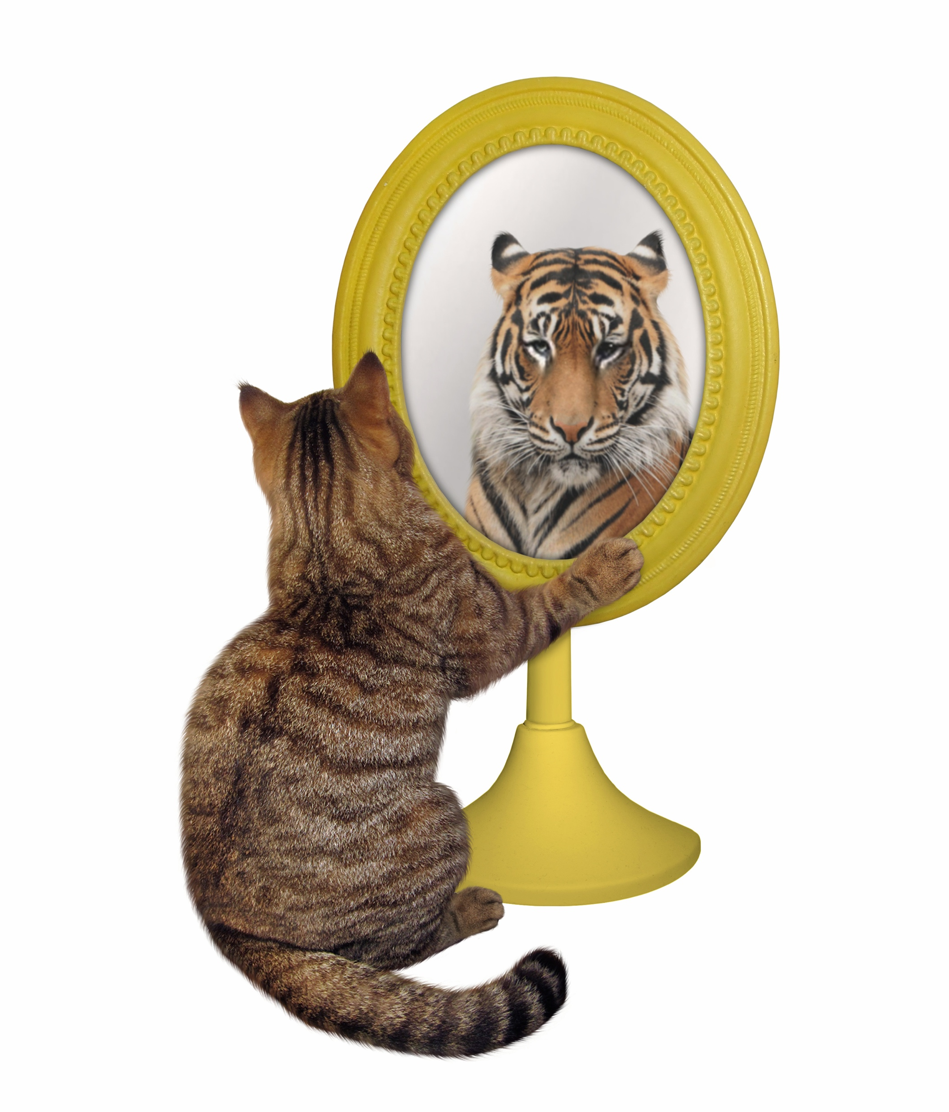
PROFESSIONAL MATURITY
Self-Awareness & Self-Evaluation
Why is this important?
YOU are the FACE of the Bank!
YOU are a person of Influence!
Notes:
Is MY behavior appropriate thru the lens of who I’m serving -

Slide 6




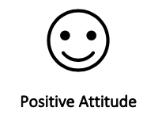
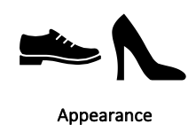
THE COMPONENTS
TO BE SEEN AS PROFESSIONAL:
Notes:
Professional maturity is above and beyond “dress code” Would you agree?

Slide 7

PROFESSIONAL MATURITY
Managing Your Image
What you wear sends a powerful message to others. Dress the way you want to be perceived.
Your body language, especially your posture and attention to grooming details, will convey confidence.
How you communicate verbally and in writing can either reinforce or erode your professional maturity.
Notes:
First impressions….. Take a guess????
Use of Chat….

Slide 8
PROFESSIONAL MATURITY
Let’s look at ”our” appearance through the
lens of our customer…
Do we look professional?
Do we feel confident?
Can we be trusted to take care of their money?
What are some advantages to looking and dressing professionally for the people we serve?

Slide 9
PROFESSIONAL MATURITY
Let’s look at ”our” appearance through the lens of our customer…
Clothing
Hair
Hands and nails
Face, make-up, and perfume
Notes:
Good rule of thumb: When in doubt, go back to the closet…

Slide 10
PROFESSIONAL MATURITY
Guaranteed to Detract from a Professional Image
Too much skin
Tattoos
Undergarments
Wrinkled, unclean or unkept clothing
Notes:
Who are we dressing for? – this is not discrimatory in nature – its how we are perceived from the customers we are serving

Slide 11
PROFESSIONAL MATURITY
Guaranteed to Detract from a Professional Image
Behaving or Acting
• Inappropriate
• Sharing confidential information
• Arguing
• Blaming
• Shouting
Notes:
Again – perception is reality to our customer we are serving – over sensitive about information being shared or seen by others…

Slide 12
PROFESSIONAL MATURITY
Guaranteed to Detract from a Professional Image
Behaving or Acting (continued)
• Demeaning or demanding
• Unconcerned
• Gossiping
• Sharing too much personal information
• Flirting
Notes:
Expand it – treat EVERYONE with respect – including your team customers you work with
ALWAYS…take the high road
AVOID the blame game – he said, she said
Focus on what is best for our customers – ABOVE all!

Slide 13
PROFESSIONAL MATURITY
Guaranteed to Detract from a Professional Image
Thinking
• “I’m better than…”
• “They expect too much from me.”
• “I’m not paid enough to put up with this.”
• “I have too much to do to help you.”
Notes:
If you think this way – customers and co-workers will see this
WE are all on the same team – front-line team – should have the same common goal…

Slide 14
PROFESSIONAL MATURITY
Verbal and Non-Verbal Communication
Words are powerful
Non-verbals can send an even stronger message

Slide 15
PROFESSIONAL MATURITY
Verbal Communication
Situations that call for the teller to act with the
highest degree of professional maturity include:
Requesting ID
Turning down a customer request
Explaining policy or regulations to a customer
Answering questions pertaining to pricing or fees
Interacting with an upset, angry customer
Working with others
Notes:
Defining Moments

Slide 16
PROFESSIONAL MATURITY
What You Say and How You Say It
Make sure you choose a positive way of conveying a message, especially in a sticky situation.
Notes:
How do we get good at this?
Observe an expert, work with scripts, practice conversations – yes – if we want to improve – we need to practice…

Slide 17
Avoid Try
Contract Agreement/paperwork
Salesperson Account expert
Cost Investment
Problem Challenge, concern, issue
Objections Areas of concern
Cheaper More economical
Service charge Processing fee
Complaint Experience
Fault Lapse
Mistake Oversight
Reject Decline
Cannot Can
Blame Accountable

Slide 18
WORDS TO USE/ WORDS TO AVOID
Trigger Phrases
“Our policy…”
“I’m sorry, we can’t”
“No, I don’t know…”
“But…”
“You should have…”
“Why didn’t you …”
“The only thing we can do…”
“You need to …”
“No problem”
Calming Phrases
“Here’s what we can do”
“I can…”
“I can find out …”
“And ….”
“I understand why you …”
“I can see why…”
“The best option would be”
“Might I suggest …”
”It would be my pleasure”
Notes:
Internal Lingo we use – ACH – balance – NSF fee, dormant account
Type into CHAT others that come to mind

Slide 19

Poor habits and their appropriate alternatives
 | 
Excessive talking or chatting | Be friendly and engaging but don’t overdo it
Name calling or labeling (lazy, impatient, …) | Don’t place judgment on the person, describe the behavior
Making ‘you’ statements | Talking in ‘I’ statements
Soft, hesitant voice | Clear voice and proper volume
Belittling use of ‘boy’ or ‘girl’ | Use adult gender or no gender
Slang (yep, you betcha, …) | Use words that affirm your willingness (certainly, gladly, …)
Endearments (dear, sweetie, …) | Use the person’s name, never hesitate to ask how they prefer you call them.
Notes:
Highlight or use smiley or frown face – which ones do I do really well – which ones if I asked those who work with me – or self-reflection – could I use some work on – Be honest!!

Slide 20
PROFESSIONAL MATURITY
Apologies
Situations in which you want to avoid “I’m Sorry!”
 | 
I’m sorry I can’t cash your check. | I’m unable to cash your check because…
I’m sorry I need to see your photo ID. | I will need to see two forms of ID please.
I’m sorry for the wait. | Thank you for your patience this morning.
I’m sorry you are upset. | I can see/hear you are upset and I want to help you.
Notes:
Let them vent – share – don’t be too quick to jump and fix – listen attentively
What does that look like? Listen attentively?

Slide 21
PROFESSIONAL MATURITY
Non-Verbal Communication
Body Language
You are the FACE of the bank!
You are in a fishbowl
Perception is reality
See EVERYTHING through the lens of your customer.
Notes:
Your own retail experience when you walk in as a customer (just like your customers) where you noticed they are not genuinely interested in helping you?? Distracted with other co-workers, on their phones?
Let’s chat about phones for a moment…

Slide 22
PROFESSIONAL MATURITY
Attitude
It’s the difference between seeing the glass as half full vs. half empty.
“Life is 10% what happens to
me and 90% how I react to it”
- Excerpt from Chuck Swindoll

Slide 23
CONFIDENCE
Without confidence in yourself and your abilities, you will be inclined to avoid challenges and struggle with decision making.
Notes:
It’s OK to be a work in process……
Mentor, someone you can shadow or observe

Slide 24
BUILDING CONFIDENCE
Set personal and professional goals
Be a sponge – always willing to learn
Seek out additional responsibilities to help others
Take charge of a work project or volunteer
List – What strengths do I bring to the team?

Slide 25
REPUTATION
A good reputation will serve you well all through life.
Social networking sites – build or destroy?
Trustworthiness
Nothing can tarnish a person’s reputation more than being perceived as untrustworthy or dishonest.
Notes:
Trustworthiness – in communities where everyone knows everyone…
Fishbowl
Instagram
FB
Snap Chat

Slide 26
PROFESSIONAL
MATURITY
Choose Courtesy and Kindness
Customers often deal with just one person. In many cases that would be you, the teller. How that interaction goes between you and the customer will determine what the customer feels about the company.
• Interaction with customers
• How you treat and interact with your co-workers
“I may not remember what you said or did but I will always remember how you made me feel.” - Maya Angelou

Slide 27
Notes:
Breakout rooms – what were some take-aways – from this session – Professional maturity? – 4 groups…
What are you wanting to do differently – or suggest moving forward?
What can you do in your teams ….

Slide 28
Compliments of
Interaction-training.com
402.984.9297
Vicki@interaction-training.com

