Slide 1



PET BENEFITS
YOU AND YOUR PETS WILL LOVE
TOTAL PET PLAN
brought to you by Pet Benefit Solutions

Slide 2

YOUR PET BENEFIT OFFERING
Pet care bundle offering discounts on
services and everyday pet care products
Pet Benefit Solutions | www.petbenefits.com

Slide 3


WHY PET BENEFITS

Slide 4
PETS ARE FAMILY
Your pets are part of your family, and you’ll do anything to keep them happy and healthy.
45% of pet parents spend as much or more money for their pets' health expenses as their own
65% of pet owners spoil their pets daily, with over half spoiling their pets "24/7"
44% of pet owners celebrate their pet's birthday with a birthday bash
BPM
Zesty Paws
Zesty Paws
Pet Benefit Solutions | www.petbenefits.com

Slide 5


PET CARE COSTS GREW ~70% IN TWO YEARS
$800-$1500
average emergency vet bill
$2000
average spent per pet per year
(not including emergencies)
It's harder than ever to afford quality veterinary care –
with 63% of pet parents not prepared for a
$500 emergency expense
Global market insights from 2020-2022, CNBC
Pet Benefit Solutions | www.petbenefits.com

Slide 6
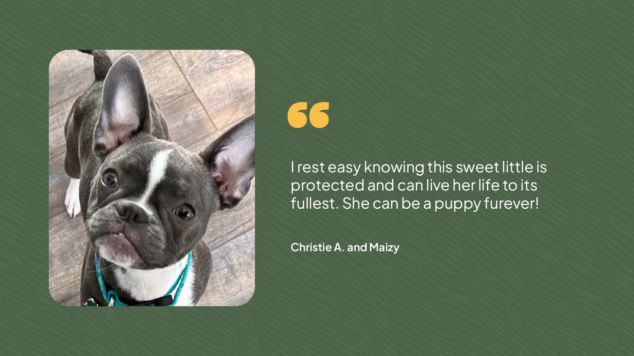
Pet Benefit Solutions | www.petbenefits.com

Slide 7

TOTAL PET PLAN
Get your paws on real pet care savings

Slide 8


TOTAL PET PLAN
PET CARE BUNDLE
Comprehensive package offers savings on everything your pet needs
No exclusions based on breed, age, or pre-existing health conditions
Low cost, even if you have multiple pets
Flat rates regardless of age, breed or zip code – a family plan covers all the pets in your home
Can be used alongside pet insurance
Pet Benefit Solutions | www.petbenefits.com

Slide 9
TOTAL PET PLAN
COVERAGE DETAILS
Our pet care bundle includes coverage on everything pets need:
DISCOUNTS ON PRODUCTS & PRESCRIPTIONS
DISCOUNTS ON VETERINARY CARE
24/7 PET TELEHEALTH
LOST PET RECOVERY SERVICE
DISCOUNTS AT PET RETAILERS & SERVICE PROVIDERS
Pet Benefit Solutions | www.petbenefits.com

Slide 10

TOTAL PET PLAN
DISCOUNTS ON
PRODUCTS & PRESCRIPTIONS
Receive members-only pricing (up to 40% off) on your pet’s prescriptions, preventatives, food, treats, and more
Shipping is always free
Most prescriptions can be picked up at participating pharmacies, including CVS, Walmart, and other independent CVS Caremark® pharmacies
All dogs and cats are eligible, regardless of age, breed or health
Pet Benefit Solutions | www.petbenefits.com

Slide 11
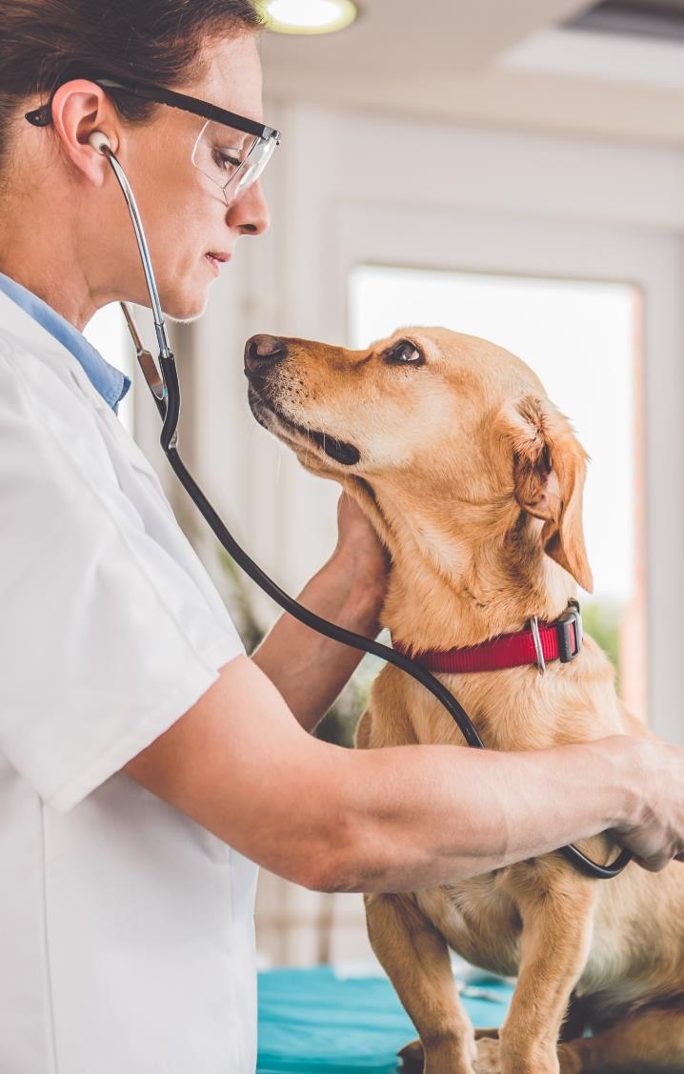
DISCOUNTS ON
VETERINARY CARE
TOTAL PET PLAN
25% savings on all in-house medical services at network veterinarians
Show your ID card at the time of service and receive an instant discount
All pets are eligible, even elderly pets and pets with pre-existing conditions
Participating veterinarians in all 50 states and Puerto Rico

Slide 12

24/7 PET
TELEHEALTH
TOTAL PET PLAN
Connect with a vet 24 hours a day
Staffed exclusively by licensed veterinarians
Receive answers to urgent questions about your pet’s health, wellness, behavior and more
Reduces unnecessary vet visits
No out-of-pocket costs or extra fees
Pet Benefit Solutions | www.petbenefits.com

Slide 13

LOST PET
RECOVERY SERVICE
TOTAL PET PLAN
All pets with a collar are eligible to receive an ID tag
If your pet goes missing, the finder scans the tag to access the information you provide in your online profile
No special scanners necessary, just a smartphone
Instantly update contact information online, even after your pet goes missing

Slide 14

DISCOUNTS AT PET RETAILERS AND SERVICE PROVIDERS
TOTAL PET PLAN
Exclusive discounts on subscription boxes, high-end pet products, pet sitting, and more
Easy to access from the Pet Benefit Solutions member portal
Complements other discounts and services provided through Pet Benefit Solutions
Pet Benefit Solutions | www.petbenefits.com

Slide 15
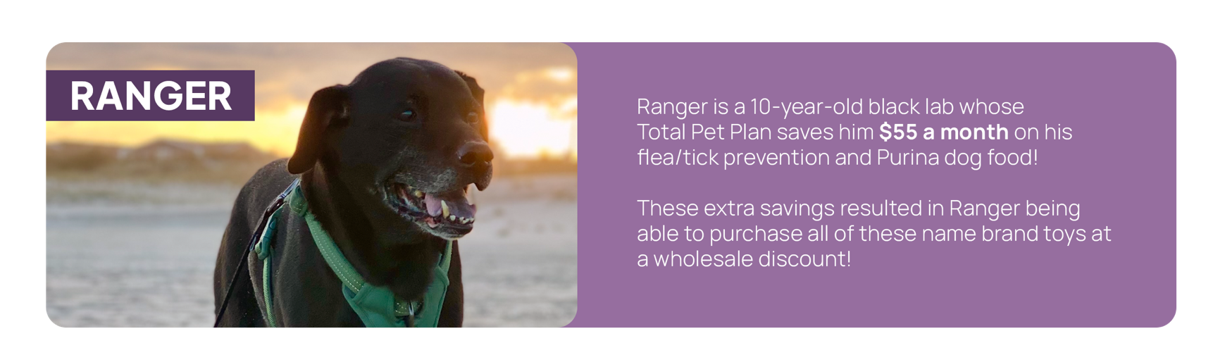
TOTAL PET PLAN
SAVES THE DAY
Pet Benefit Solutions | www.petbenefits.com

Slide 16

ENROLL IN
PET BENEFITS TODAY!
Comprehensive pet care bundle
Up to 40% off on pet food, prescriptions, toys, treats, and more
Instant 25% discount at network veterinarians
24/7 pet telehealth
Pet tag and lost pet recovery service
Questions? Contact Us
customercare@petbenefits.com | (800) 891-2565

