Slide 1
Management Development Program Session One: VBA Overview
Bruce T. Whitehurst
bruce@vabankers.org
804-241-3223
@BruceTW

Slide 2
History of Your Bank
New Peoples Bank
Sonabank
Southern Bank & Trust Co.
The Farmers Bank of Appomattox The Fauquier Bank
TowneBank
Virginia Commonwealth Bank
Bank of Botetourt
Bank of Fincastle
Benchmark Community Bank
Carter Bank & Trust
Chain Bridge Bank
Chesapeake Bank
F&M Bank
Farmers Bank
MainStreet Bank

Slide 3
Virginia bankers association

Slide 4
Virginia Bankers Association
127 Years Strong – established in 1893
Unified industry voice
High Banker Engagement; Outstanding Professional Staff
Key Focus Areas:
Advocacy & Communications
Education & Training
Employee Benefits
Member Services
Committees, Boards & Working Groups

Slide 5
Virginia Bankers Association - WEBSITE

Slide 6
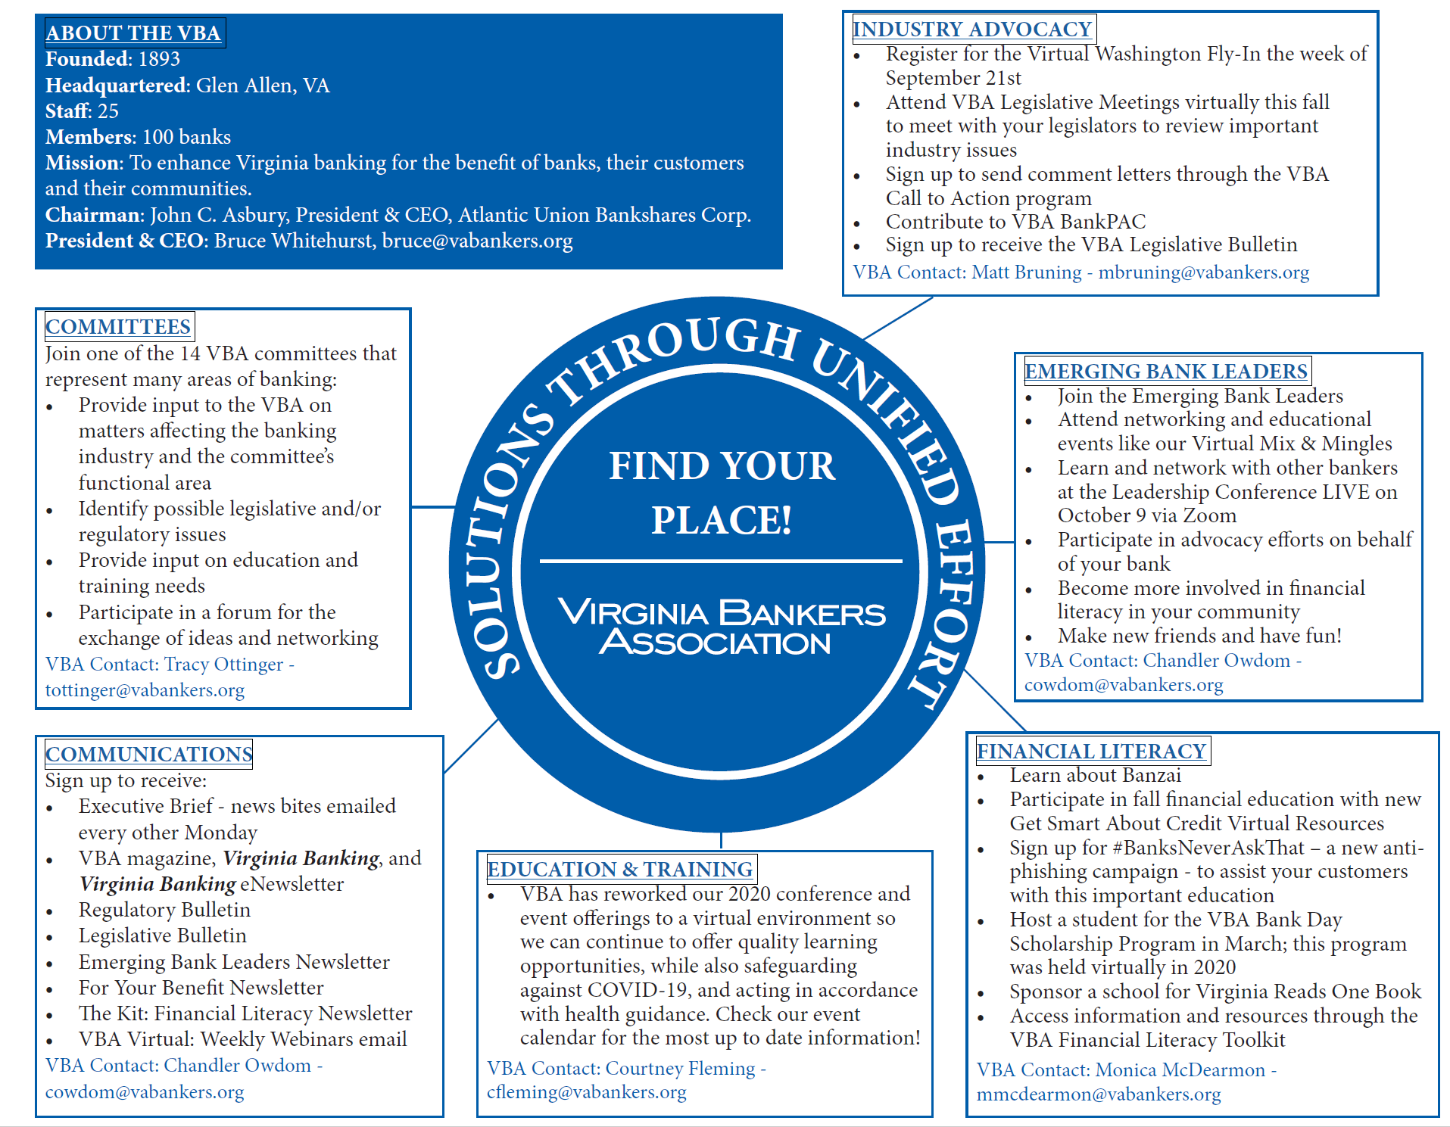
Find your place at the Virginia Bankers association

Slide 7
Virginia Bankers Association
Q&A with Bruce

