Slide 1



Slide 2

BY THE END OF THIS SESSION, YOU WILL KNOW:
LEARNING OBJECTIVE 1
LEARNING OBJECTIVE 2
LEARNING OBJECTIVE 3
Why Time-Management strategies don’t solve busy and busy is hurting your productivity & career.
Strategies that create more opportunity for you as a leader and increase the X Factor of executive presence.
Mindset shifts to keep your stress levels down and create more ease as you make changes to your workday and workload.

Slide 3
WOMEN IN THE WORKPLACE 2022
Women are overworked (at home and at work) and under-recognized.
Two-thirds of women under 30 say they would be more interested in advancing if they saw senior leaders with the work-life balance they want.
17% of women reported switching jobs due to an unmanageable workload.
*Lean In/McKinsey & Co. 2022

Slide 4
THE COSTS OF BEING TOO BUSY
Depression
Cardiovascular events
Incompetence
Sadness
Guilt
Anger
Anxiety
Accelerated Aging
Loneliness
Frustration
Addictions
Hopelessness
Inadequacy

Slide 5
THE COSTS OF BEING TOO BUSY
True Connection
Opportunity

Slide 6
CHANGING YOUR RELATIONSHIP WITH TIME
Experience being calmer, confident and competent.
Exude executive presence without effort.
Consciously choose where to invest your time.
Own your destiny and have agency in your work.
Be satisfied with the time you have.

Slide 7
WHERE ARE YOU RIGHT NOW?
On a scale of 1-10, what is your current state of busyness?
1 = You’re so busy you’re barely keeping your head above water.
10 = You’re not only on top of everything you’re ahead of the game and have more than enough time for your hobbies, for rest, and to absorb when things don’t go according to plan.

Slide 8
BY THE END OF THIS SESSION, YOU WILL KNOW:
LEARNING OBJECTIVE 1
LEARNING OBJECTIVE 3
Why Time-Management strategies don’t solve busy and busy is hurting your productivity & career.
Strategies that create more opportunity for you as a leader and increase the X Factor of executive presence.
Mindset shifts to keep your stress levels down and create more ease as you make changes to your workday and workload.

Slide 9
TIME-MANAGEMENT STRATEGIES WORK BUT YOU'LL STILL BE BUSY
Time-management creates capacity. What you do with that capacity determines your state of busyness: more tasks, more decisions, more distractions.
As a high-performing, busy person you become know as the person who can take on more work. You are the path of least resistance.
“If you want anything done, ask a busy [person] to do it.” ~ Elbert Hubbard

Slide 10
BUSY IS NOT THE SAME AS PRODUCTIVE OR EFFICIENT
A study published in the Harvard Business Review showed that at many companies, employees were spending about 80% of their time on mundane tasks.
  Email
  Meetings
  Phone calls
Busy creates the phenomenon of Tunneling.
  Survival mode (tunnel vision) and a default into old patterns.
The counterintuitive inversion of levels of leadership to busywork.

Slide 11
BUSYWORK WILL HURT YOUR CAREER ADVANCEMENT
Research confirms that strategic thinking is one of the few traits or behaviors that separates senior executives from those in the middle or lower levels.
Busywork prevents you from displaying your abilities to think strategically and do strategic planning.
Age is a factor in the performance gap.

Slide 12

LOOK INTO THE FUTURE

Slide 13
TIME WELL SPENT
LEARNING OBJECTIVE 1
LEARNING OBJECTIVE 2
LEARNING OBJECTIVE 3
Strategies that create more opportunity for you as a leader and increase the X Factor of executive presence.
Mindset shifts to keep your stress levels down and create more ease as you make changes to your workday and workload.

Slide 14



STRATEGIES TO LEVERAGE YOUR TIME
1. Make more progress by going slow.
Breaks
Reflection
Strategy

Slide 15
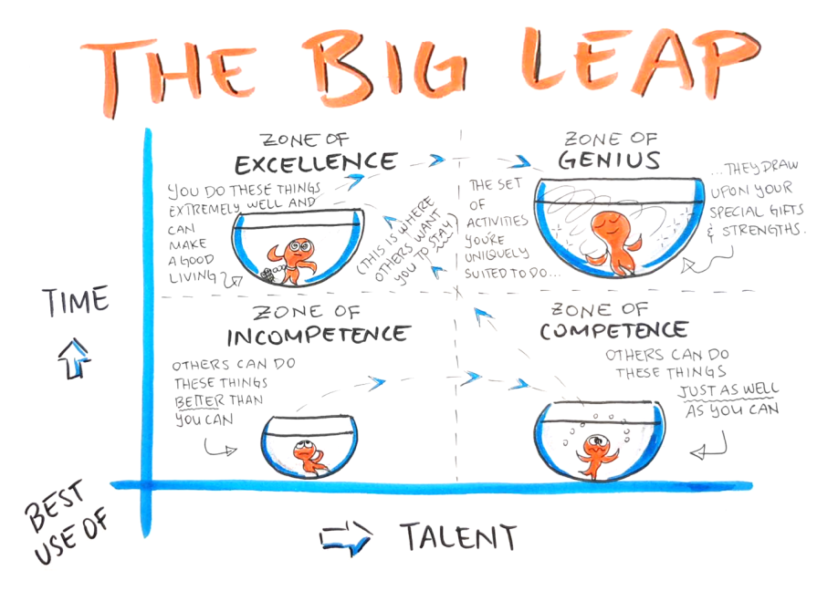
STRATEGIES TO LEVERAGE YOUR TIME
2. Work in your Zone of Genius.

Slide 16
SOUNDS REASONABLE. COULD IT BE A TRAP?
“If I don’t do it nobody else will.”
“We’ve always done it this way.”
“I don’t want to bother anyone.”
“If I just work hard, I’ll be recognized and appreciated.”
“I shouldn’t have to manage my boss.”
“I can do that work, it’s easy enough, so I guess I will.”

Slide 17
IT’S OKAY TO SAY NO TO MORE WORK…
When your primary job responsibilities will suffer.
When it’s someone else’s work.
When the
ask is unreasonable.
When there’s no clear exit strategy.

Slide 18
STRATEGIES TO LEVERAGE YOUR TIME
3. Network for Knowledge and Insight
Compared to women who have not attended a women’s conference…
Your likelihood of receiving a promotion the year after attending a women's conference doubles.
Your likelihood of getting a pay increase of 10% or more the year after attending a women's conference triples.
Women who attend women's conferences report being more optimistic about the future and more connected to others.

Slide 19
STRATEGIES TO LEVERAGE YOUR TIME
If you want to go fast, go alone.
If you want to go far, go together.
~ African Proverb

Slide 20
WHERE ARE YOU RIGHT NOW?
On a scale of 1-10, what is your current state of busyness?
1 = You’re so busy you’re barely keeping your head above water.
10 = You’re not only on top of everything you’re ahead of the game and have more than enough time for your hobbies, for rest, and to absorb when things don’t go according to plan.

Slide 21
BY THE END OF THIS SESSION, YOU WILL KNOW:
LEARNING OBJECTIVE 3
Why Time-Management strategies don’t solve busy and busy is hurting your productivity & career.
Strategies that create more opportunity for you as a leader and increase the X Factor of executive presence.
Mindset shifts to keep your stress levels down and create more ease as you make changes to your workday and workload.

Slide 22
MINDSET SHIFT
I’m so under water right now there’s no way I can get to a place where I’m not everywhere all at once.

Slide 23
MINDSET SHIFT
I don’t have say over the work I do; other people are impacting my time.

Slide 24
MINDSET SHIFT
I can’t pull back on what I do for others. They need me.
I would lose them.

Slide 25
WHAT YOU LEARNED IN THIS TRAINING SESSION
LEARNING OBJECTIVE 1
LEARNING OBJECTIVE 2
LEARNING OBJECTIVE 3
Why Time-Management strategies don’t solve busy and busy is hurting your productivity & career.
Strategies that create more opportunity for you as a leader and increase the X Factor of executive presence.
Mindset shifts to keep your stress levels down and create more ease as you make changes to your workday and workload.

Slide 26
THE 5 GREATEST REGRETS OF THE DYING
I wish I'd had the courage to live a life true to myself, not the life others expected of me.
I wish I hadn't worked so hard.
I wish I had the courage to express my feelings.
I wish I had stayed in touch with my friends.
I wish that I had let myself be happier.

Slide 27




HOW WAS THIS PRESENTATION?
Take 2 mins to share your feedback and get a digital copy of the workbook.
Scan this QR Code or go to talk.ac/jodi
Enter code when prompted:
TIME
Let’s Stay In Touch!
jodiflynn
WomenTakingTheLead.com/podcast
jodi@womentakingthelead.com

Slide 28
THANK YOU!
“Yesterday is gone. Tomorrow has not yet come. We have only today. Let us begin.”
~ Mother Teresa

