Slide 1
Creating a Caring Culture for ABC Bank
Removing the Stigma of Mental Health
Date

Slide 2
Behavioral/Mental Health Statistical Data
Before COVID-19

Slide 3
Mental Health Trends
Depression alone has economic cost of $200 billion and represents the leading cause of disability in the workforce.
Suicide rates in the United States up 25% from 1999 to 2014.
The opioid epidemic has led to overdose being the leading cause of accidental death in the U.S. (4x death rate in 1999).
Growing evidence that loneliness and social isolation are health risk factor on a par with smoking 15 cigarettes a day.
“The economic costs of mental illness will be more than cancer, diabetes, and respiratory ailments put together.”
Thomas Insel
Director National Institute of Mental Health USA

Slide 4

Mental Health by the Numbers
225.8B
1 in 5 adults in the US experience mental illness in a given year.
Employer impact
Because most employees are not seeking treatment or are unable to access care, employers are losing an estimated $225.8B annually due to stress, anxiety, depression and substance use disorder.
only 41% received mental health services.
Source: National Alliance of Healthcare Purchaser Coalitions, 2019

Slide 5




State of Mental Health in the U.S.
1 in 5
63%
Americans experience symptoms of depression, anxiety and stress. Those who have both a chronic and behavioral health condition(s) can cost up to 3 times more to treat.
Of employees reported that workplace stress had significant impact on their mental and behavioral health. This can have a direct impact on work productivity and employee retention.
80%
31%
Of workers with a mental health condition attribute their non-treatment to shame and stigma. Relatedly, the average person waits 8 to 10 years after the onset of initial symptoms before seeking treatment.
Of employees would be afraid of being labeled as weak, and 22% fear it would impact their promotion opportunities.
Catalyst: State of Mental Health Report Marketplace
*Common Reasons Members Don’t Seek Treatment
“Thought I could handle on my own”, “Could not afford treatment”, “Did not know where to go”
Notes:
In a given year, 1 in 5 Americans experience symptoms of these mental health conditions and almost half of us will over the course of our lifetimes. They impact direct medical costs, particularly for those who have both a chronic condition and a behavioral health condition, who can cost up to 3 times more to treat than someone without the comorbidity.
Stress in the workplace is also a costly proposition. Based on findings from Mental Health America, 63 percent of employees reported that workplace stress had significant impact on their mental and behavioral health. Employees experiencing stress in the workplace are much more likely be distracted at work, miss days, or quit their jobs.
Stigma: According to the National Alliance on Mental Health (NAMH), 80 percent of workers with a mental health condition attribute their nontreatment to shame and stigma. Relatedly, the average person waits 8 to 10 years after the onset of initial symptoms before seeking treatment.
A 2017 survey shows that 31% of employees would be afraid of being labeled as weak, and 22% fear it would impact their promotion opportunities.
Compounding the problem, many providers have stopped taking insurance, leaving Americans with few affordable options. In fact, only 50% of mental health or substance use specialists are in commercial networks compared with 96% of primary care physicians
Willis Towers Watson study-70% of employers opted to carve in behavioral health services in 2017. Potential advantages of this model include enhanced coordination between primary care and behavioral health providers, integrated benefit design and clinical management for MHPAEA compliance purposes, and more robust data sharing capabilities. Some feel the carved in model lends itself to less siloed care, citing how there can be confusion

Slide 6
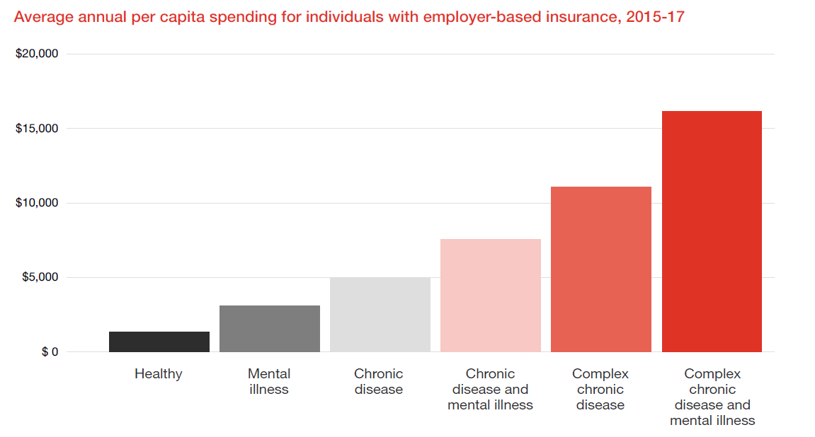
Employers spend 12X more per year on individuals with a complex chronic illness and mental illness than on healthy individuals.
*NIH Defines A Complex Chronic Disease (CCD) is a condition involving multiple morbidities, that requires the attention of multiple health care providers or facilities and possibly community (home)-based care.
Source; Medical Cost Trend: Behind the numbers 2021, Health Research Institute, June 2020

Slide 7
Behavioral/Mental Health Statistical Data
COVID-19 Impact

Slide 8
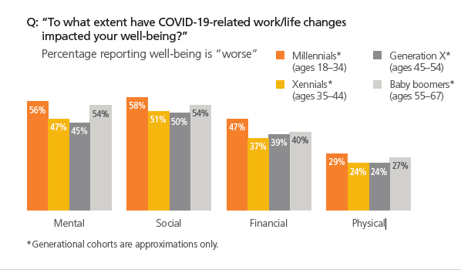
Source: Optum 2020

Slide 9
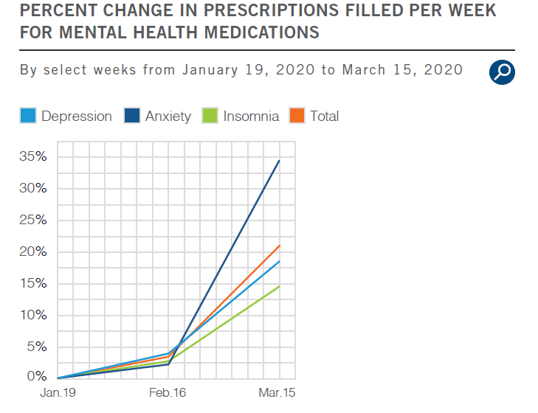
Source: ESI America’s State of Mind report 2020

Slide 10
Behavioral/Mental Health Solutions for ABC Bank

Slide 11
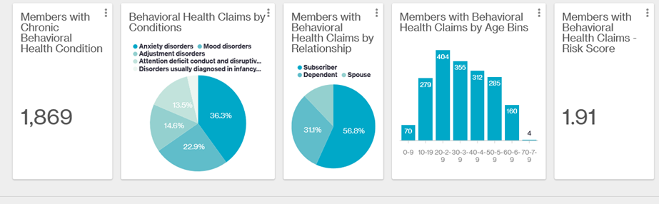
2016 – 2019 Mental Health Utilization for the VBA Population
Population health management data results based on 13,000 members (employees and dependents): Behavioral health major cost drivers for medical and prescription drug claims utilization

Slide 12
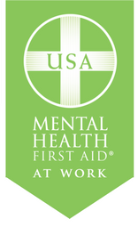

Mental Health First Aid Training Options
MHFA Training
Community
Based
At Work
4 hr private training provided by MHFA @ Work national team
Cost: $4500 for 5-30 participants
8 hr private training + certification provided by MHFA @ Work national team
Cost: $6000 for 5-30 participants
8 hr community-based training + certification
Cost: free-$35 per participant
8 hr private training + certification provided by MMA-MN team
*Cost: $4500 for 5-30 participants
8 hr private training + certification provided by community-based trainer
Cost: negotiated locally
Leverage VA grant
funding
for private training
*Contact Jill O’Brien for more details
Direct 763-746-8510 or jill.obrien@marshmma.com

Slide 13

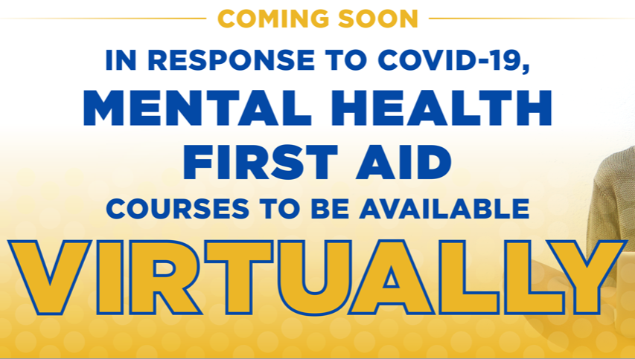
NEW: Virtual Mental Health First Aid
First Aiders will complete a 2-hour, self-paced class, and then participate in a 4-hour, Instructor-led class using videoconferencing technology.
The virtual training will be based on new curricula that has been in development for more than a year. It includes expanded content on trauma, addiction and self-care. A second addition of the MHFA Guide will be released at same time.
Youth MHFA will include new content applicable for adults working with elementary-age children, including content on the impact of social media. The content is gender neutral and culturally relevant.

Slide 14

People Want Their Employers to
Talk About Mental Health
Source Harvard Business Review – November 2019
“Mental health awareness has reached an inflection point. The good news is that change is possible and employers can help. It starts with:
  Acknowledging the equal prevalence of mental health conditions from the C-suite to the front lines
  Changing organizational culture
  Introducing proper training and support
  Addressing mental health as a standalone issue.
CEOs must lead by example as both the priority and culture setters of their companies. That said, every employee has a role to play as well. Culture change of any kind requires top-down and bottom-up support. Mental health is no different.”

Slide 15
How does it start?
Build a caring culture
1. Remove the Stigma of Mental Health within the Organization
2. Make Time for Listening
3. Give Employees Ways to De-Stress
4. Be Transparent With Employees
5. Establish Quiet Spaces
6. Offer Benefits That Support Mental Health
7. Implement a Mental Health Company Policy

Slide 16
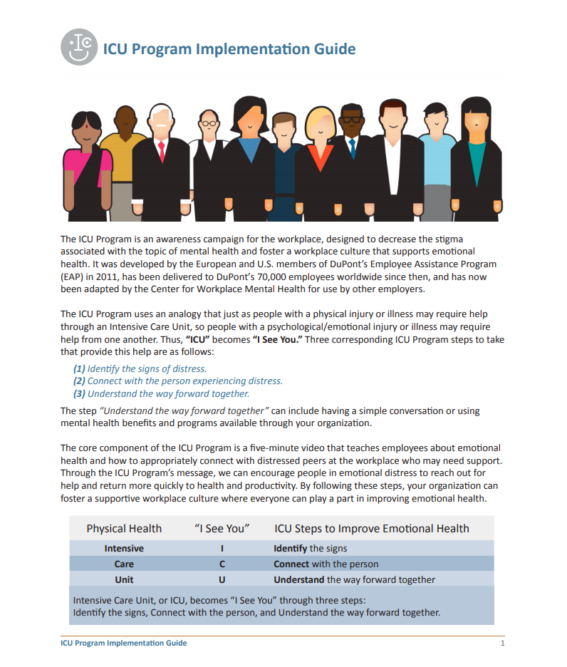

Remove Stigma of MH: ICU Program

Slide 17

Your Logo Here
(Not to exceed size of orange box)
ICU Program - Leadership Presentation
Improving Emotional Health
Notes:
Please refer to the ICU Program Implementation Guide for ideas on how to use this presentation.
Depending on the structure of your organization and level of understanding, you may not need to use all the slides.
You can tailor the slides to match your resources and might reorder the slides to best seek buy-in for the program and plan for your organization’s implementation.

Slide 18
Your Logo Here
(Not to exceed size of orange box)
WHAT IS THE ICU PROGRAM?
The ICU Program is an awareness campaign to improve emotional health.
A five-minute ICU video is used to convey an analogy that just as people with a physical injury or illness may require help through an Intensive Care Unit, so people in distress or with a psychological/emotional injury or illness may require help from one another through the three steps of Identify, Connect, and Understand.
ICU thus becomes “I See You.”
Physical Health | “I See You” | ICU Steps to Improve Emotional Health
Intensive | I | Identify the signs
Care | C | Connect with the person
Unit | U | Understand the way forward together
Notes:
ICU thus becomes “I See You” through three steps:
Identify the signs of distress.
Connect with the person.
Understand the way forward together.

Slide 19
Your Logo Here
(Not to exceed size of orange box)
WHAT IS THE ICU PROGRAM?
The ICU concept was developed in 2011 at DuPont by European and U.S. members of their Integrated Health Services (Employee Assistance Program and Occupational Medicine) team in support of two of their core values: Respect for People and Safety and Health.
The ICU video has been delivered to DuPont’s 70,000 employees worldwide to support an emotionally safe workplace.
DuPont generously donated the ICU concept to the Partnership for Workplace Mental Health to create a universal version that we can adopt.

Slide 20
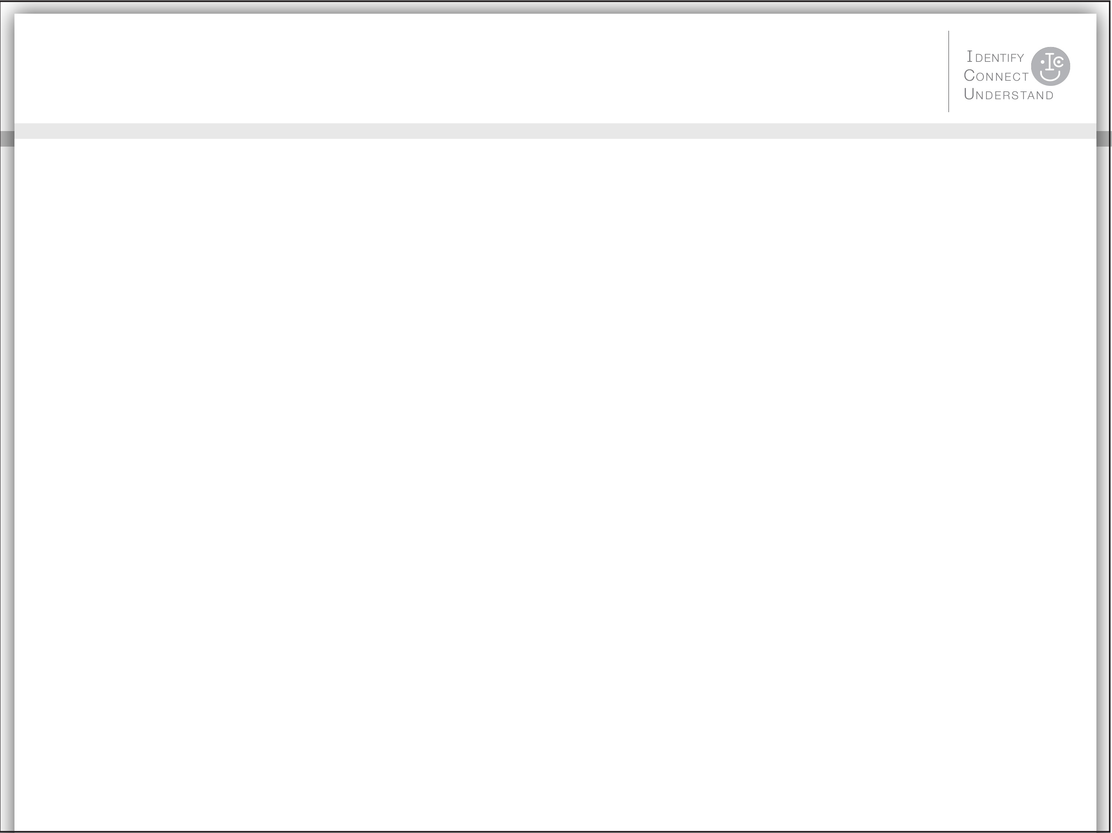
Your Logo Here
(Not to exceed size of orange box)
BUSINESS CASE FOR THE ICU PROGRAM
Emotional distress affects business through the connection between mental and emotional health and productivity.
Emotional distress does not mean a mental illness exists, but distress can still negatively affect performance; left unaddressed, performance can worsen.
Excessive demands resulting in stress may contribute to difficulty managing emotions, focusing attention, making decisions, and thinking clearly or objectively.¹
Reduced distress can lead to enhanced resilience, strengths in employee satisfaction, recruitment and retention, absence reduction, work engagement, productivity, and financial performance.²

Slide 21
Your Logo Here
(Not to exceed size of orange box)
BUSINESS CASE FOR THE ICU PROGRAM
A total of 25% of the adults in the United States experience mental illness in a given year.³
Mental illnesses cause more days of work loss and impairment than physical ailments such as arthritis, asthma, back pain, diabetes, hypertension, and heart disease.⁴
Mental illness short-term disability claims are growing by 10% annually.⁵
Discrimination charges against employers show the greatest increase in nonvisible disabilities such as anxiety, bipolar disorder, manic depression, PTSD, and depression.⁶

Slide 22
Your Logo Here
(Not to exceed size of orange box)
BUSINESS CASE FOR THE ICU PROGRAM
What untreated—or poorly treated—emotional distress or mental illness can look like in work performance and productivity.
Symptoms of distress | = | Signs that affect work productivity
Sleep problems | = | Lower quality work, lateness to work
Lack of concentration | = | Procrastination, more accidents on the job
Slowed thoughts | = | Indecision or trouble making decisions
Aches and pains | = | Trips to the doctor, increased healthcare costs
Forgetfulness | = | Poor quality work
Self-medication | = | Missed deadlines, absenteeism
Irritability or tearfulness | = | Poor relationships with coworkers, boss, or clients
Low motivation or morale | = | Presenteeism
Notes:
While the ICU video gives general information on what distress may look like in colleagues, here are a few other descriptions of what distress or mental illness may look like in the workplace.

Slide 23
Your Logo Here
(Not to exceed size of orange box)
BUSINESS CASE FOR THE ICU PROGRAM
Why don’t people speak up when they see others in distress?
Fear of invading privacy
A perception that it is not allowed or not businesslike to reach out
A lack of comfort and not knowing how
Why don’t people seek help on their own?
They don’t want to admit that they are unwell.
They are afraid that it will adversely affect their work status.
They are embarrassed due to stigma about emotional distress and mental illness.
They feel alone.
Notes:
ICU encourages employees to create an environment where it is safe to connect and offer support.

Slide 24
Your Logo Here
(Not to exceed size of orange box)
EMBRACE THE ICU CONCEPT
We have programs and resources that can help employees; the challenge is getting people to access them.
The ICU Program will help us promote our resources and encourage people to use them.
We can make our workplace a supportive community by allowing employees to reduce distress by simply talking with someone.⁷
We can implement an internal awareness program quickly with resources we already provide.

Slide 25
Your Logo Here
(Not to exceed size of orange box)
EMBRACE THE ICU CONCEPT
Through the ICU Program, we can create an environment where we equip our employees to recognize the signs of distress and refer each other to the resources already available.
Our employee assistance program
Our mental health and substance use disorder benefits
Interventions can help. The majority (65–80%) of those suffering from emotional distress or mental illnesses will get better with proper treatment—a success rate that exceeds many nonpsychiatric illnesses.⁸
Notes:
This slide is intended to be adapted to your specific needs and plans.
Reference the Implementation Guide when planning and presenting.
Pay close attention to these sections:
Tailor the implementation guide
Use of the ICU peripheral materials
Reinforce the message
Track your success

Slide 26
Your Logo Here
(Not to exceed size of orange box)
EXPECTED OUTCOMES
Through the ICU Program and improving emotional health, we will:
Foster an emotionally safe environment
Create awareness of the programs we provide for employees
Encourage people to reach out for help—early
Encourage colleagues to connect and support one another

