Slide 1
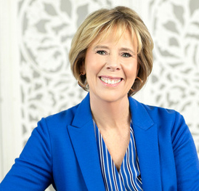
VBA WOMEN IN BANKING
HOW TO DEAL WITH DIFFICULT SITUATIONS
December 1, 2022
GAIL LETTS, CEO & FOUNDER
LETTS CONSULT
www.letts-consult.com

Slide 2
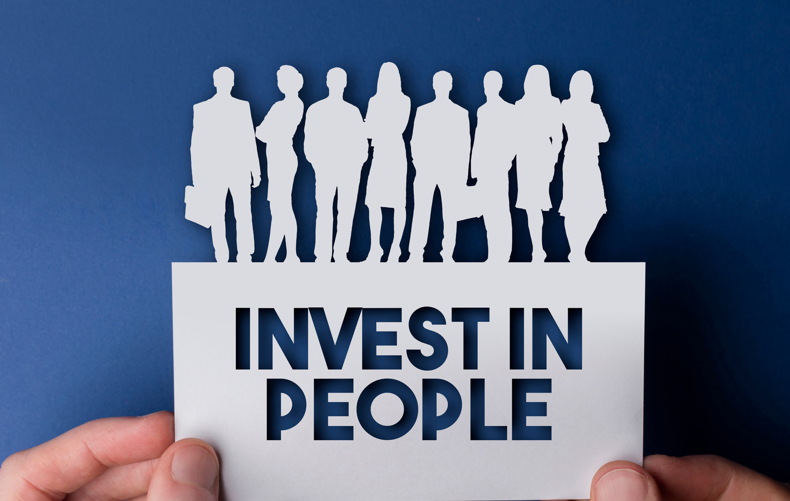
VBA WOMEN IN BANKING
LETTS CONSULT
BUILDING TOMORROW'S WORKFORCE TODAY
FOCUS ON TALENT

Slide 3
VBA WOMEN IN BANKING
LETTS
CONSULT
LC
LC
Talent Solutions
Helping businesses attract and retain the talent needed to deliver today and to develop the talent needed to deliver in the future.
Corner Office
Helping individuals to build/develop skills and develop relationships
necessary to achieve their full potential.

Slide 4
VBA WOMEN IN BANKING
EQ - Emotional Quotient also referred to as
Emotional Intelligence
An individual's capacity to observe, comprehend, abstract, reason and deduce conclusions from the emotions of people around oneself.
The ability to understand your emotions and those of other people and to behave in an appropriate way in different situations.
graphics by pch.vector on freepik

Slide 5
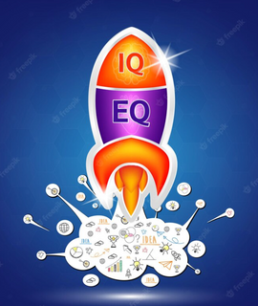
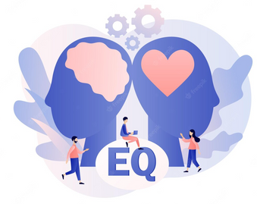
VBA WOMEN IN BANKING
EQ vs AQ and IQ
It is generally agreed that a high IQ Is generally workless if you have a low EQ. A genius, or someone with an extraordinarily high IQ who can’t relate well to others, can’t make the most of his/her intelligence.
Research shows that people who have higher emotional and social intelligence, tend to go further in life than those with a high IQ but low EQ.

Slide 6
VBA WOMEN IN BANKING
Emotional Intelligence impacts effectiveness
as a leader
It is the foundational piece to improving other leadership competencies
It influences the culture and work environment……and the engagement of your team

Slide 7
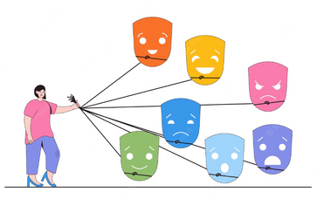
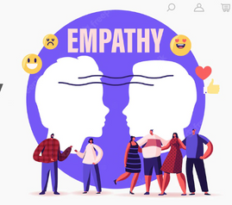
VBA WOMEN IN BANKING
Emotional Intelligence Theory
Five Key Components
Self-Awareness
Self-Regulation
Motivation
Empathy
Social Skills

Slide 8
VBA WOMEN IN BANKING
Emotional Triggers
An emotional trigger is anything –including memories, experiences or events – that sparks an intense emotional reaction, regardless of your current mood.
- What are examples of emotional triggers?
- What are possible reasons for their impact?
-What is the best way to control and respond?

Slide 9
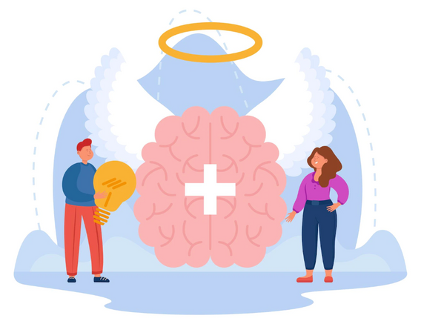
VBA WOMEN IN BANKING
ARE MEN AND WOMEN EQUALLY
EMOTIONALLY INTELLIGENT?

Slide 10
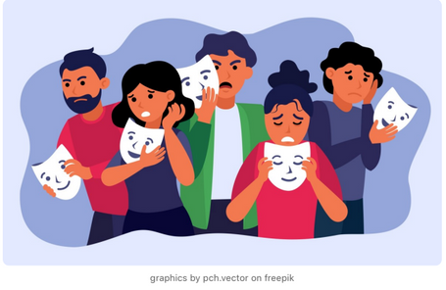
VBA WOMEN IN BANKING
Why There’s No Room for Women’s
Emotions in the Workplace
- Would women be more successful if they learned to
use logic instead of emotion?
- Are our emotions and logical thinking opposites?
- Why do angry emotions dominate the workplace?
-
- Lack of emotions creates a toxic workplace.
- Women never had a problem with logical thinking.
- We need to reclaim emotions.
- Diversity and the rise of a new corporate world
(Linkedin - January 16, 2022)

Slide 11
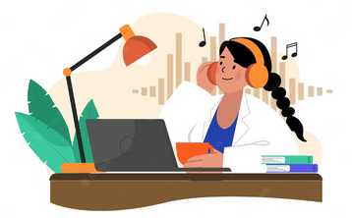
VBA WOMEN IN BANKING
Dealing with Challenging Situations
in the Workplace
- Bring yourself back to the present
- Practice your self-awareness
- Focus
- Take a breath
- Surround yourself with positive people
- Take a walk
- Listen to music
- Check in with yourself
- Body language

Slide 12
VBA WOMEN IN BANKING
Steps to Effectively Deal with Confrontation
- Don’t Wait
- Seek guidance and plan
- Feel, then Deal
- Speak about it in person
- Express empathy
- Identify your goals
- Remember it’s part of your job
- Make friends with adversity
- Remember bad news travels fast
- Smile
- Take one day at a time

Slide 13
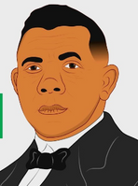
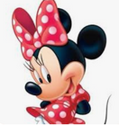
VBA WOMEN IN BANKING
When one door of happiness closes, another opens; but often we look so long at the closed door that we do not see the one which has opened for us.
(Helen Keller)
Success is to be measured not so much by they position that one has reached in life as by the obstacles which he(she) has overcome.
(Booker T. Washington)
All the adversity I’ve had in my life, all my troubles and obstacles, have strengthened me. You may not realize it when it happens, but a kick in the teeth may be the best thing in the world for you.
(Walt Disney)

Slide 14
VBA WOMEN IN BANKING
You may encounter many defeats, but you must not be defeated. In fact, it may be necessary to encounter the defeats so you can know who you are, what you can rise from, how you can still come out of it.
(Maya Angelou)
I always did something I was a little not ready to do. I think that’s how you grow. When there’s that moment of “Wow, I’m not really sure I can do this,” and you push through those moments, that’s when you have a breakthrough.”
(Marissa Mayer)

