Slide 1
Purpose
Strategic Marketing & Communication
VBA School of Bank MANGAGEMENT 2022

Slide 2
WELCOME

Slide 3
MY WHY

Slide 4
PURPOSE

Slide 5
THIS WEEk
BRAND
STRATEGY
CRISIS
Action

Slide 6
Points We Won’t Discuss
I’m not here to teach you HOW to be a marketer, but rather how to CONTRIBUTE fully to your bank’s marketing effort.

Slide 7
TODAY
PURPOSE
OVERVIEW
Corporate Brand
PERSONAL BRAND

Slide 8
OUR Purpose
CORPORATE BRAND

Slide 9
https://youtu.be/sQLlPC_alT8

Slide 10
Thoughts on Brand
“I used to think this and now I think that.”
Bob GofF
Love DoeS
PURPOSE

Slide 11
HOW EFFECTIVE IS YOUR BRAND?

Slide 12
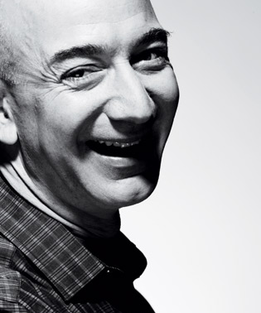
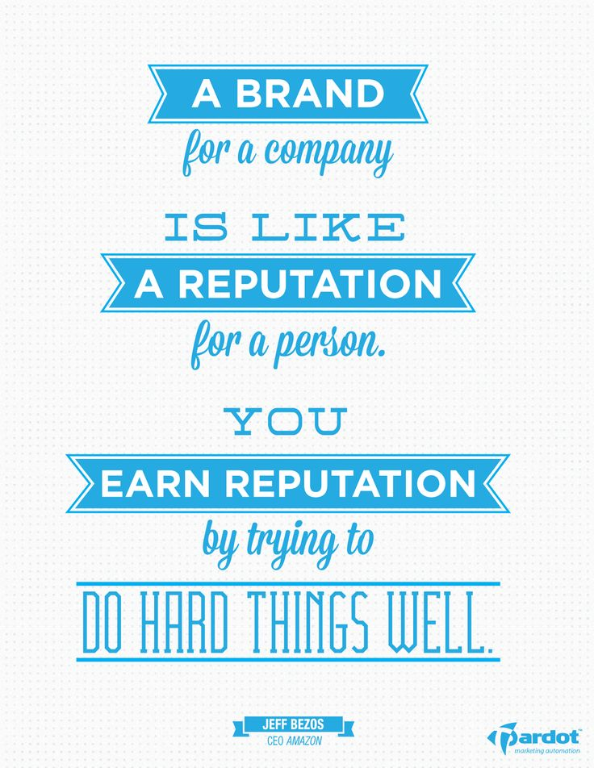

Slide 13
BRAND BREAKDOWN
Personal
Corporate

Slide 14
CORPORATE BRAND

Slide 15
How do you contribute to your corporate brand?

Slide 16
YOUR Purpose
PERSONAL BRAND

Slide 17
How would you describe your personal brand?

Slide 18
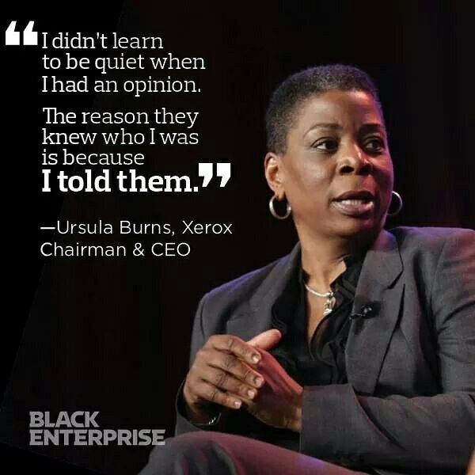

Slide 19
WHAT’s ON YOUR DESK?

Slide 20
WHAT ARE YOU POSTING ON FACEBOOK?

Slide 21
ARE YOU PARTICIPATING ON LINKEDIN?

Slide 22
AT WHAT LEVEL?

Slide 23
How are you interacting with the world?

Slide 24
How would you reshape your personal brand?

Slide 25
CASE STUDY

Slide 26
PURPOSE

Slide 27
Questions
Erin Black, PHD, APR
erinblack17@gmAIl.com
Linkedin: https://www.linkedin.com/in/erin-black-phd-apr-85b80120/

Slide 28
ON Purpose
STRATEGY

Slide 29
TODAY
Definitions
ZEROING IN
HAVING A PLAN
CASE STUDY

Slide 30
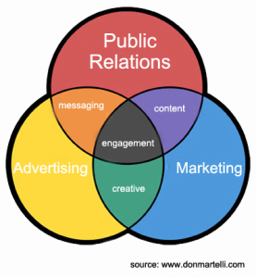
Differentiating the Components of Marketing
Marketing - The activity, set of institutions, and processes for creating, communicating, delivering, and exchanging offerings that have value for customers, clients, partners, and society at large.
Public Relations - Public relations helps an organization and its publics adapt mutually to each other. Public Relations broadly applies to organizations as a collective group, not just a business; and publics encompass the variety of different stakeholders.
Advertising - Advertising is the attempt to influence the buying behavior of customers or clients with a persuasive selling message about products and/or services.
Strategic Communication - Strategic communication is oriented towards orchestration and synchronization of actions, words and images in order to achieve the desired effects.
How Does Brand Fit In?

Slide 31
DEFINING MODERN DAY MARKETING
Modern marketing takes traditional marketing's principles and frameworks and reshapes the process so we can more quickly adapt to change. It's an approach that must be user-centered, interactive and built for continuous learning.

Slide 32
THE CENTER of Modern Day Marketing

Slide 33
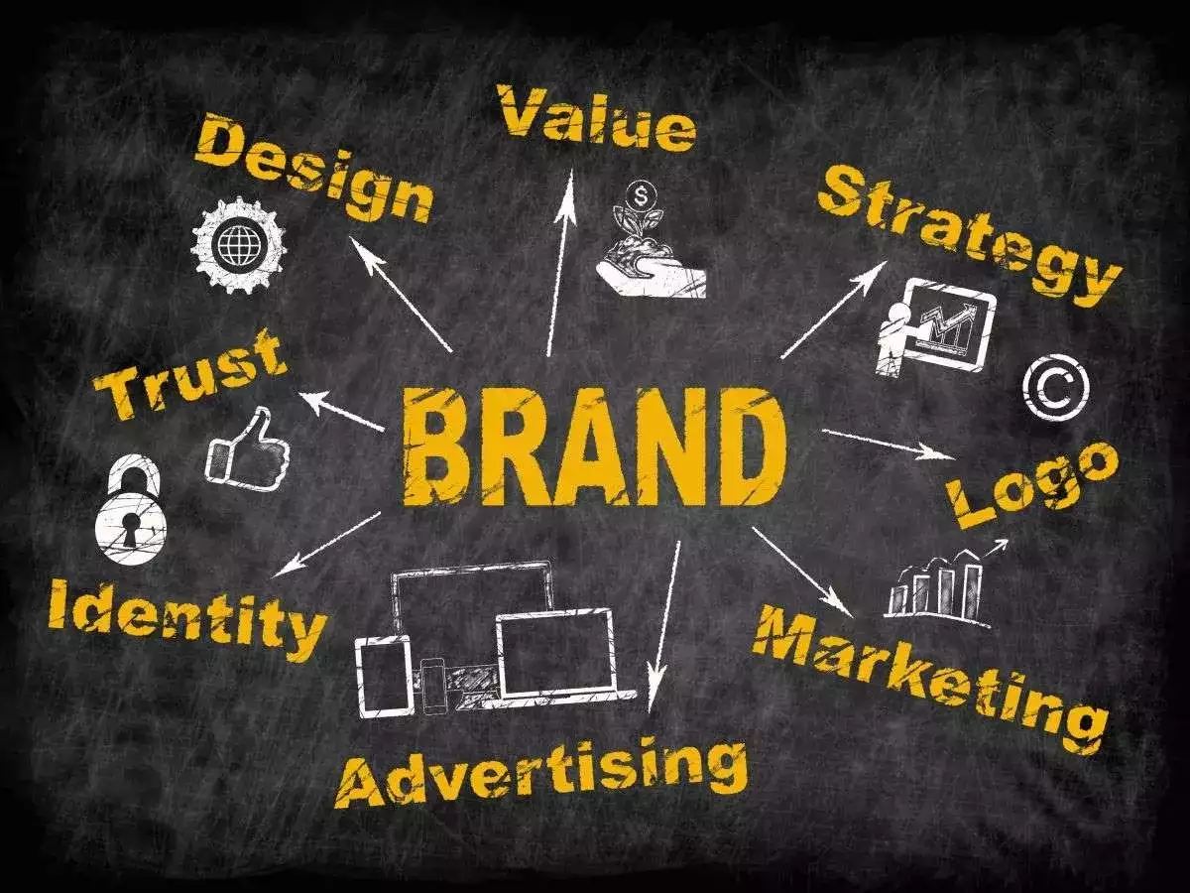
ELEMENTS of Modern Day Marketing

Slide 34
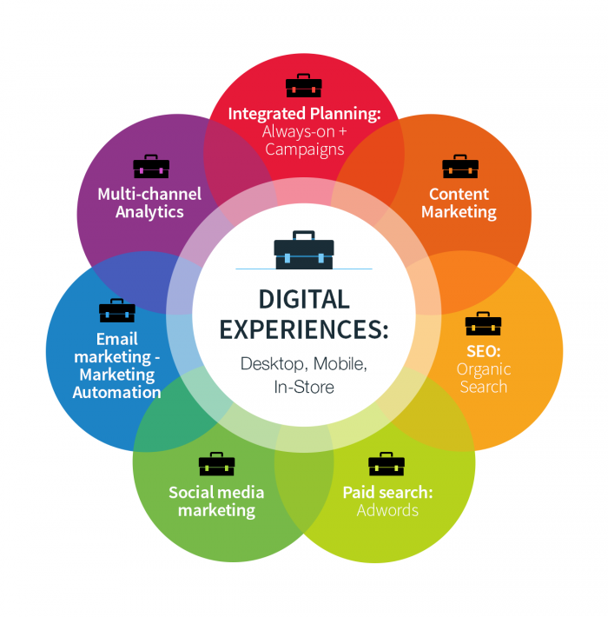
Types of Marketing
Content Marketing
Affinity Marketing
Event Marketing
Email Marketing
Digital Marketing
Social Media Marketing
In-Brand Marketing
And The List Goes On…

Slide 35
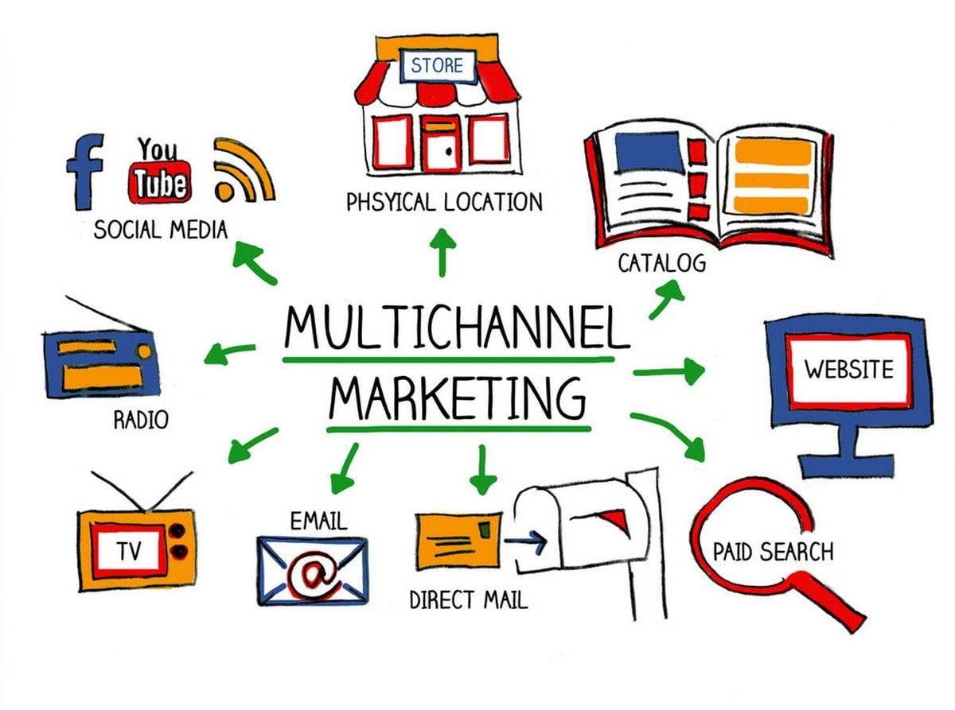

Slide 37
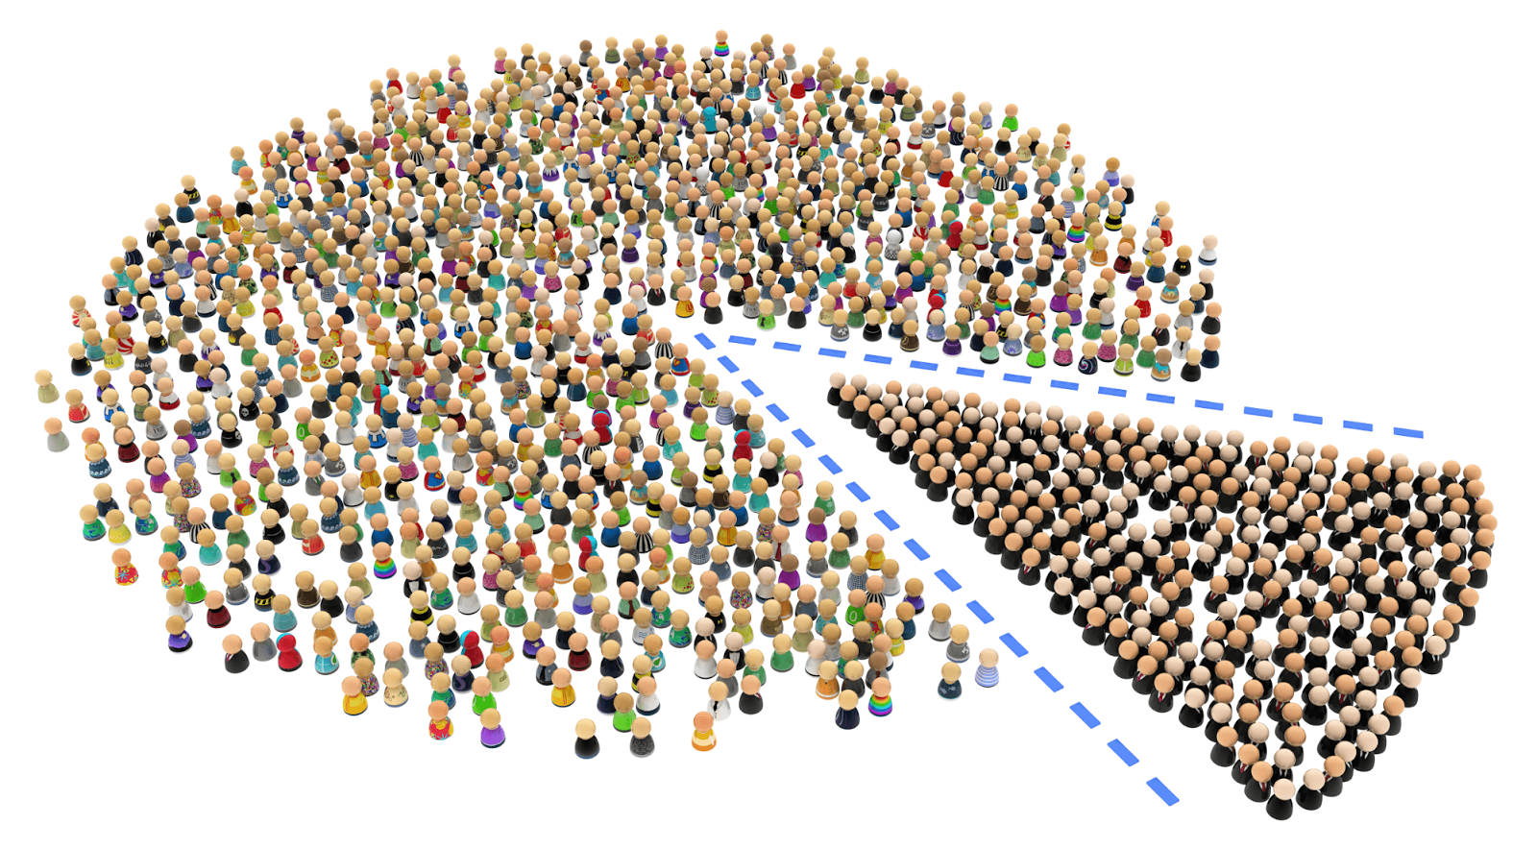

Slide 38
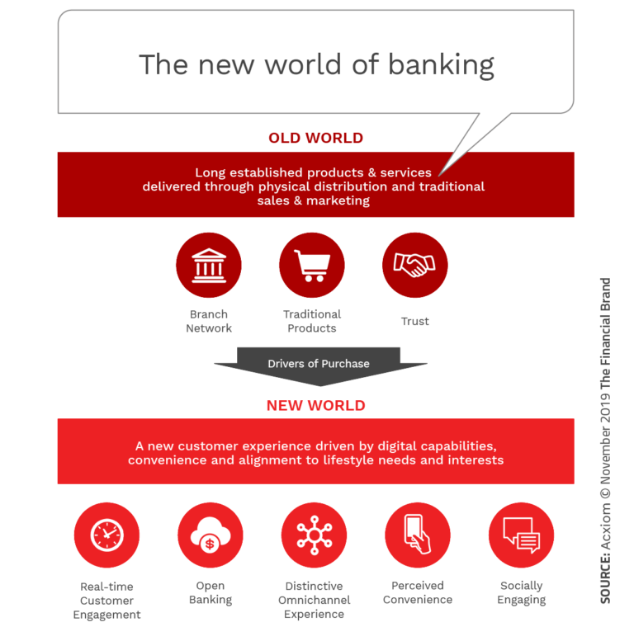

Slide 40
Strategic Questions We Ask
What is the goal?
What is the purpose?
With whom will we connect? (Who are the people like us?)
What message will we share?
What action will the audience take?
What impact will this have?

Slide 41
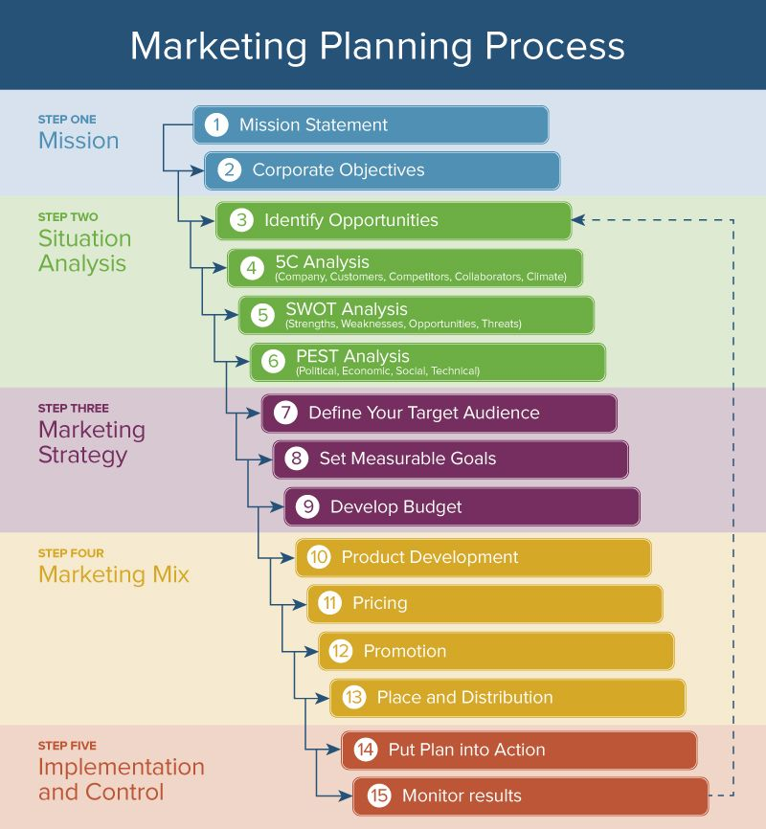
ESSENTIAL ELEMENTS

Slide 42
RPIE

Slide 43
RPIE
RPIE
Goals – Long Term, Broad, Global
Publics - WHO
Objectives – SMART!
Strategies – A Roadmap to Achieve Obj.
Tactics – Tools to accomplish strategies
Smart, Measurable, Achievable, Realistic, & Time-Specific

Slide 44
BUT THAT’S NOT ALL ….
Public Relations Strategy
Crisis Communication Strategy
Employee Communication Strategy
Customer Communication Strategy
Social Media Strategy
Marketing Risk Strategy
And the list goes on….

Slide 45
CASE STUDY

Slide 46
MAKE IT HAPPEN Goals Publics Objectives Strategies Tactics
Enhance employee engagement within the organization.

Slide 47
MAKE IT HAPPEN Goals Publics Objectives Strategies Tactics
The Managers

Slide 48
MAKE IT HAPPEN Goals Publics Objectives Strategies Tactics
Educate the management team about the value of employee engagement and opportunities for engagement before the end of 2022.

Slide 49
MAKE IT HAPPEN Goals Publics Objectives Strategies Tactics
Promote the employee engagement initiative with the leadership team.
Promote the initiative with the management team.
Create an open conversation about engagement between leadership and the management team.

Slide 50
MAKE IT HAPPEN Goals Publics Objectives Strategies Tactics
Develop an employee engagement curriculum designed for the management team.
Develop an employee engagement presentation designed for leadership.

Slide 51
PURPOSE

Slide 52
Questions
Erin Black, PHD, APR
erinblack17@gmAIl.com
Linkedin: https://www.linkedin.com/in/erin-black-phd-apr-85b80120/

Slide 53
WITH Purpose
WHEN CRISIS COMES

Slide 54
TODAY
COOMBS
THE IMPACT
COMMUNICATING
CASE STUDY

Slide 55
The longer it takes to address a crisis, the longer it will take to end it.

Slide 56
Coombs’ Crisis Lifecycle
PRE-CRISIS
CRISIS
POST-CRISIS
PREPARE
LEARN

Slide 60
Coombs’ Crisis Lifecycle
PRE-CRISIS
CRISIS
POST-CRISIS
PREPARE
LEARN

Slide 62
Evaluate

Slide 63
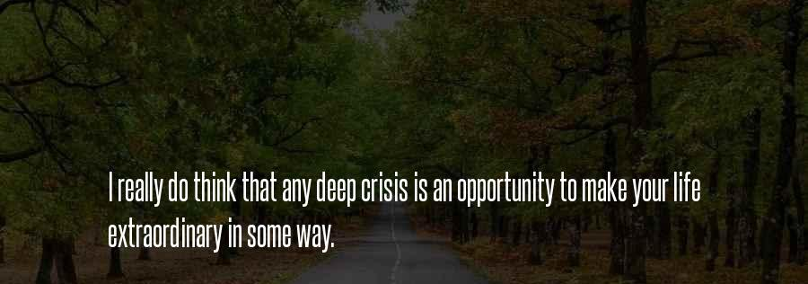

Slide 64
With Your Personal Life In Mind….
What crises have you faced
in the past 5 years?

Slide 65
With Your Bank In Mind….
What corporate crises have you faced
in the past 5 years?

Slide 66
THE IMPACT

Slide 67
THE PLAN

Slide 68
Elements of a Crisis Communication Plan
Detailed Plan (Who, What, When, Where, How)
Crisis Communication Team + Essential
Key Messages
Internal Communication Procedures
Contacts & Regulatory Considerations
Policies, Templates, & Other Existing Supplemental Materials

Slide 69
CASE STUDY

Slide 71
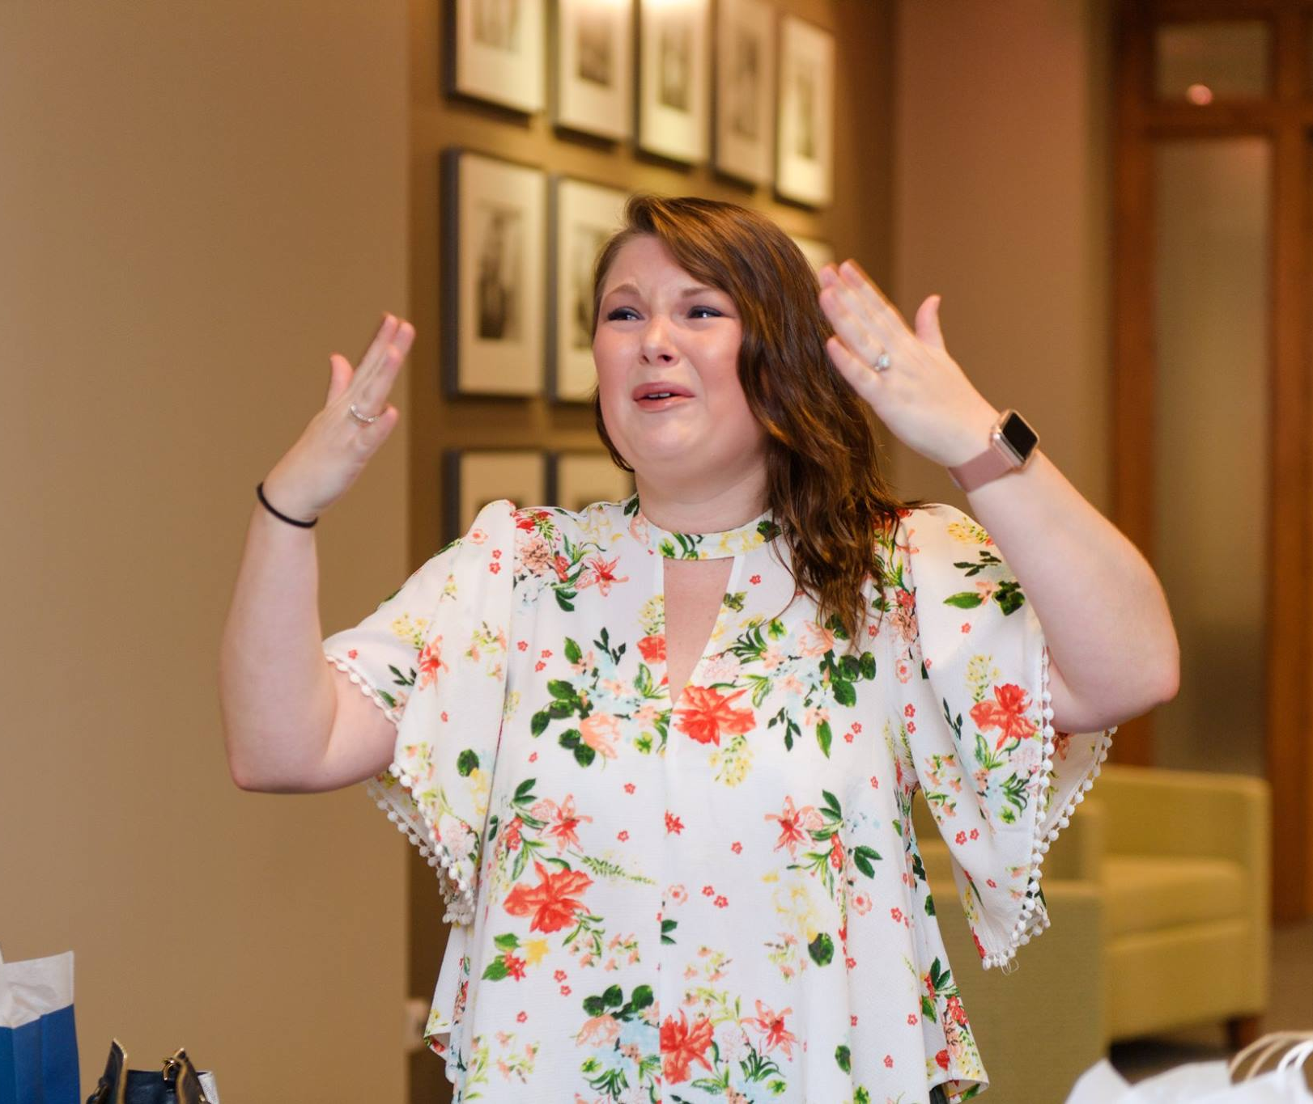

Slide 72
PURPOSE

Slide 73
Questions
Erin Black, PHD, APR
erinblack17@gmAIl.com
Linkedin: https://www.linkedin.com/in/erin-black-phd-apr-85b80120/

Slide 74
Purposeful
ACTION

Slide 75
TODAY
CASE STUDY
BANKEXEC
HOME STUDY
Final THOUGHTS

Slide 76
CASE STUDY

Slide 77
BRAND
STRATEGY
CRISIS
ACTION

Slide 78
KEY POINTS
MARKETING BUDGET
Set Your Business Development Salaries Budget
Direct (mktg staff) & Indirect Support
Set Your Advertising & Promotion Budget
BUSINESS DEVELOPMENT
Decisions in Loans are affected by decisions in Deposits.
You will prioritize how much you need Business Development in your Loan and Deposit decisions.
So let’s talk …..
BANK EXEC

Slide 79
WHY INVEST IN ADVERTISING & PROMOTION?
Imagine a Zero Budget.
Why go High?
What type of products need more advertising?
Why types of customers buy that product?
Are those customers swayed by advertising?
Example: Checking Accounts
Why go Low?
What type of products need more advertising?
Why types of customers buy that product?
Are those customers swayed by advertising?
Time Deposits
BANK EXEC

Slide 80
WHY INVEST IN BUSINESS DEVELOPEMENT?
Imagine a Zero Budget.
Shut down new account sales by employees
No marketing personnel
Complete focus on existing customer base
A great way to shrink a bank’s size quickly
Why go High?
Why go Low?
BANK EXEC

Slide 81
BANK EXEC
You Can Always Go Right Down the Middle.

Slide 82
BANK EXEC
Or Not.

Slide 83
HOME STUDY

Slide 84
What are YOUR biggest challenges?

Slide 85
Be a Problem Solver.

Slide 86
ASK QUESTIONS
Ask Your Financial Institution
Ask Your Customers
Ask Your Co-Workers
Ask Your Supervisors
Ask Other Financial Institutions
Ask Me.

Slide 87
PURPOSE

Slide 88
Questions
Erin Black, PHD, APR
erinblack17@gmAIl.com
Linkedin: https://www.linkedin.com/in/erin-black-phd-apr-85b80120/

