Slide 1


Lifestyle Spending Accounts

Slide 2

Lifestyle Interest & Uptake

Slide 3
Employer Challenges
Leading To An Increase In Lifestyle Spending Accounts
Competitive labor market & rising labor costs
Pandemic & post-pandemic environment
Demand for more personalized benefits
Focus on diversity, equity & inclusion
Employer desire for flexibility & efficiency
68%
45%
93%
65%
25%
of employed workers say they plan to leave their current job within 12 months; 79% believe they can make more money elsewhere
of employees now expect more flexibility for day-to-day work, better work/life balance, increased focus on employee wellbeing
of employees say the ability to customize their benefits is a “must-have” or “nice-to-have”
of business leaders say diversity, equity, and inclusion (DEI) is a high strategic priority
of HR teams can save an estimated 15%-25% through program & vendor consolidation, leveraged buying power, favorable contracts & automation

Slide 4

Percent of firms offering | All ERs | >5K ERs
Health & wellness | 41% | 75%
Food (grocery, in-office, stipend) | TBD | TBD
Fitness center subsidy/reimbursement | 22% | 38%
Tuition assistance | 48% | 76%
Student loan repayment | 7% | 15%
Professional skills development | 78% | 75%
Work from home (home office supply/equip) | 62% | 66%
Cell phone | TBD | TBD
Dependent care | 59% | 80%
Pet insurance | 14% | 35%
Employee gift cards | 31% | TBD
78% of employers offer post-tax benefit programs that can categorized as lifestyle benefits

Slide 5

Our FBA Lifestyle Solution

Slide 6
Choosing Your Plan Design
Mental
Physical
Financial

Slide 7
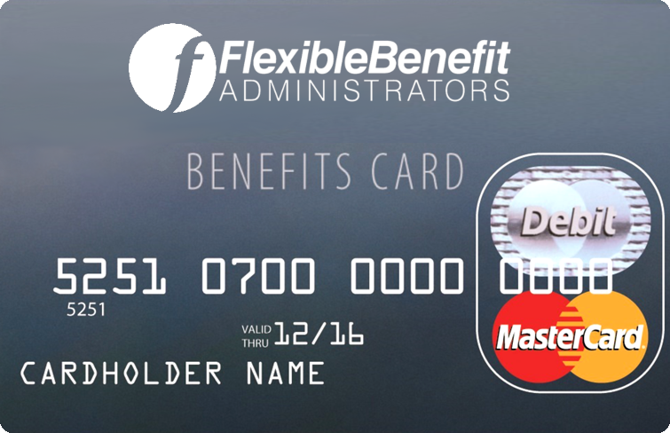
Pre-tax or post-tax Lifestyle account
Employers provide to employees via a debit card or claim reimbursement
Member Bank defines cash amount, fund availability & eligible expenses

Slide 8

Discovery

Slide 9
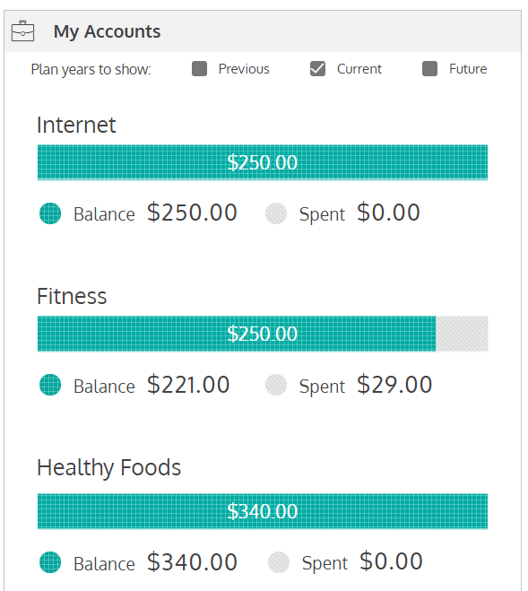
How Do Lifestyle Spending Accounts Work?
1
Member Bank decides to offer a lifestyle spending account as a benefit
Professional development
2
Member Bank determines total program budget, fund duration availability, and policy for unused funds
Member Bank allocates dollars to allowed spending categories and per-category limits
3
Professional development
Work-from home
4
Member Bank & FBA communicate LSA availability to employees via customized materials
Leisure & hobbies
Employees receive cards & spend funds (while employers get full insight into utilization & spending)
5

Slide 10
Insights & Trends to Consider in Plan Design
Program design
Adoption trends
Value alignment
Overall dollars spent
Biggest ticket items
50% of spend lies in four categories:
Health/wellness
Food
Family
Personal travel
Categories with highest funding:
Family
Travel
Professional development
Category considerations:
Food: high utilization, fastest growing segment, but lower spend
Health & wellness: decreasing utilization, but still top category
Trending in program adoption:
Employer: most prevalent in large employers
Employee: ranges widely based on program design
Strong relevance to partner value props:
Focus on wellbeing
1/3 of LSA spend in our book rooted in health & wellness

Slide 11
Key Points of Value
Un-used funds remain with the employer
Ability to target spending
Option for a single “stacked” card
Fund utilization reporting
Simplicity & savings through consolidation

Slide 12
Designing Your Own Program
Food
Professional development
Provide opportunities for food purchases which may be limited due to inflation
Retain existing talent and open talent pool
Family care
Work from home
Support a diverse workforce that increasingly identifies as caregivers
Support a positive work environment and engage with remote workforce
Healthy living
Leisure & hobbies
Increase engagement and boost employee wellbeing
Promote work/ life balance

Slide 13




Thank you!
(800) 437-3539
(757) 431-1155
www.flex-admin.com

