Slide 1

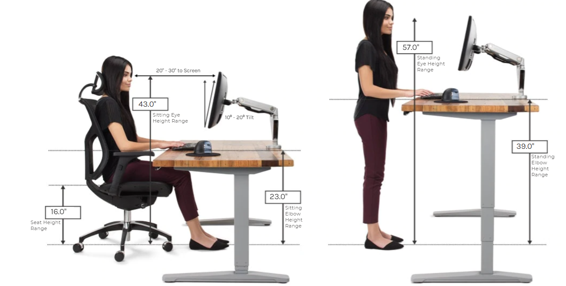
Uplift Desk
Office furniture that benefits you
CONTACT:
upliftdesk.com | 800-349-3839 | 2139 W Anderson Ln Austin, TX
PURCHASES:
Order direct from website - $$$
Website offers ergonomic calculator feature.
30 day trial
10 year warranty
Products:
Standing Desks
Desk Converters
Chairs & Stools
Monitor Arms / Mounts
Keyboard Tray
Accessories & More
Catalog: https://www.upliftdesk.com/content/pdfs/other/uplift-desk-product-brochure.pdf

Slide 2

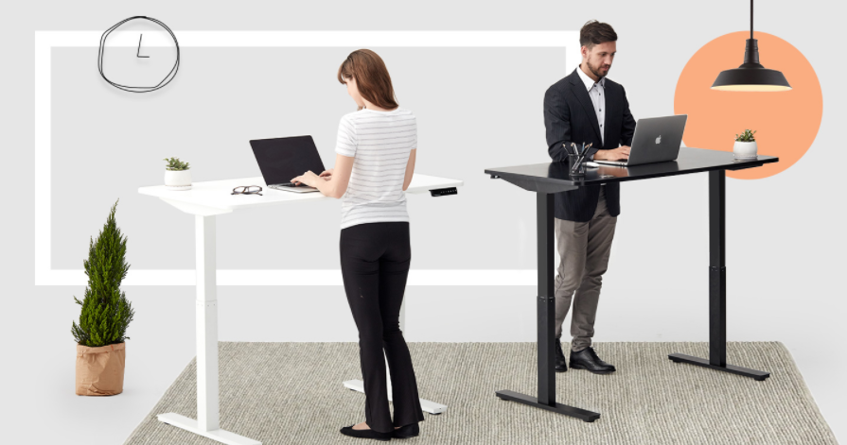
Autonomous
Smart Home Office
CONTACT:
https://www.autonomous.ai/
Email support w/ no phone number listed on website.
PURCHASES:
Order direct from website - $$
Design philosophy is simplicity
30 day trial
5 year warranty (less than Uplift Desk brand)
Free shipping
Slow customer service (personal opinion)
Products:
Standing Desks
Desk Converters
Chairs & Stools
Monitor Arms / Mounts
Keyboard Tray
Accessories & More
Offers designer desk setup guides based on industry i.e. designers, developers, digital artists, YouTubers, Gamers, etc.

Slide 3

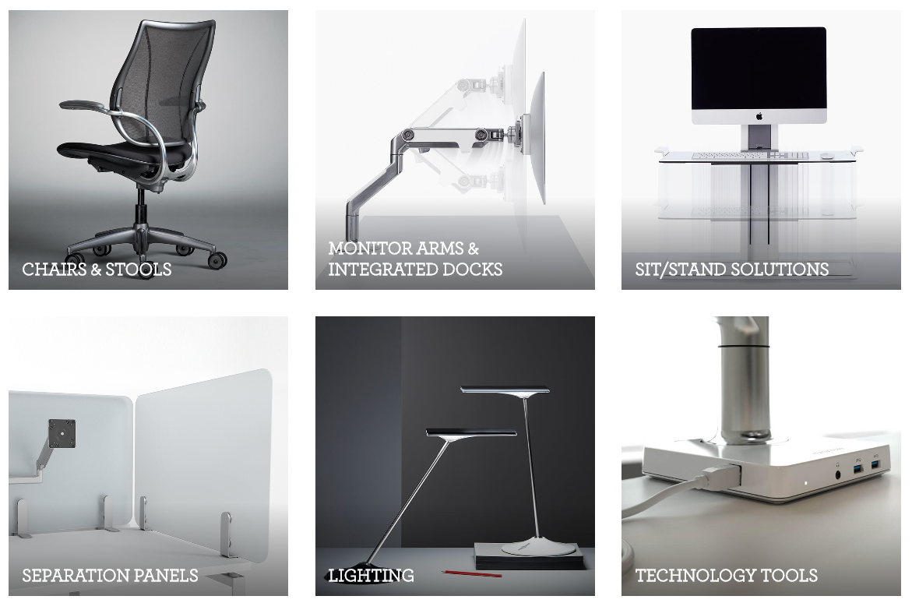
HumanScale Ergonomic Solutions
Leading designer & manufacturer of ergonomic products that improve the health and comfort of work life
CONTACT:
Email: Online Form
www.humanscale.com/about/company-overview/contact-us.cfm
Phone:
1 800-400-0625
Website:
www.humanscale.com/
PRICING:
See website for products and pricings

