Slide 1
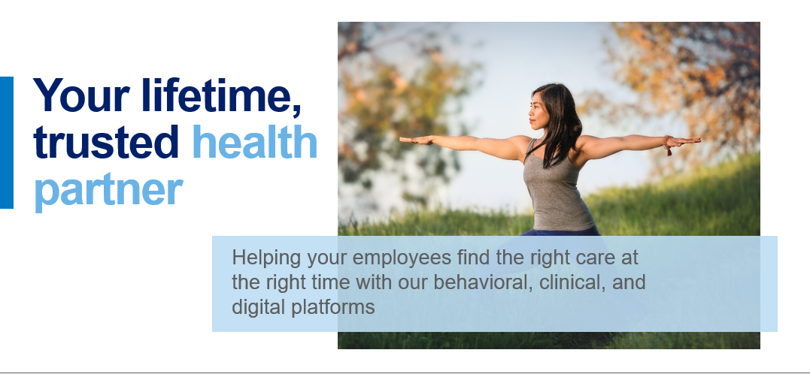


Slide 2
Our Employee Assistance Program delivers meaningful connections to you and your employees
Our enhanced solution offers support to help individuals manage life's challenges.
Member Support | 24/7 phone assistance for personal and organizational crisis events
 | Counseling visits – in person, by phone, or virtually
 | Work/life services to meet employees’ everyday needs like legal, financial, child/elder care support
 | Digital tools, including Emotional Well-being Resources
 | Guidance on engaging with behavioral health services
Employer Services | Trainings for managers, Human Resources (HR) staff, and employees
 | Critical incident response (CIR) services
 | Management consultations for supervisor and manager referrals
The results:
Our EAP model improves employee engagement, productivity, and satisfaction, with 86% of participants saying their work performance and productivity has improved.*
* Anthem EAP Satisfaction Survey, 2020.

Slide 3


Comprehensive solutions to serve complex needs
Connecting individuals to customized programs and personalized treatment to meet their unique needs before, during, and after physical and mental health events.
Self-paced support
Employee Assistance Program
Digital resources
Emotional Well-being Resources
Chat support
Virtual counseling
Behavioral Health
Case Management
In-person care
Notes:
Our comprehensive approach to care connects individuals to the right care when it’s needed, to meet individuals where and how they need it, for every level of unique mental health need.
BH: All levels of care, both long and short term BH and SUD issues
EAP: short term care, work/life balance, overall well-being. A solution for life's challenges – legal, financial, child/elder care.
EWR: Self service CBT
Our solutions meet the needs of your employees through a variety of care delivery methods:
Self-paced Support: Digital/mobile tools and resources utilizing cognitive behavior therapy techniques to address stress, depression, substance/opioid abuse, chronic pain, insomnia, anxiety, and other issues related to emotional well-being
Digital Resources: Sydney, Knowledge Hub (BHA specific)
Chat: Sydney chat support with a live agent, Talkspace asynchronous chat therapy (pending 2023 network)
Virtual Counseling: LiveHealth Online. Pending implementation: Talkspace, Vita, Equip, Array, Valera
In-person Care: Anthem has one of the largest networks

Slide 4
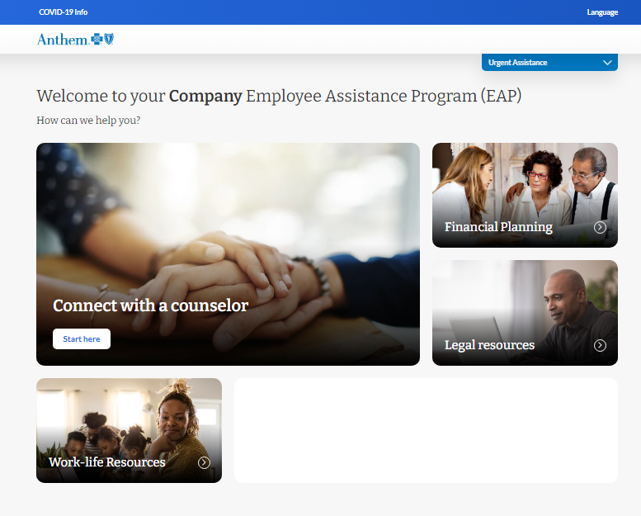
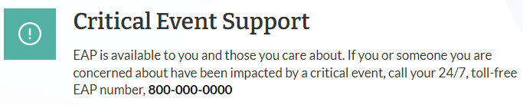
Digital Experience
Deliver truly comprehensive experiences
Access to high quality care and support
Spanish language capabilities

Slide 5

Deeply committed to behavioral health
We are expanding our capabilities, clinical expertise, and access to quality behavioral healthcare to help members feel confident in care.

