Slide 1
Highlights
Healthentic Report
Importance of Preventive Care
Reminders:
  Right Start 4 Kids®
  Healthy Smile, Healthy You®
  Virtual dental visits available through TeleDentristry.com
  Discounts on hearing aids available through Amplifon

Slide 2

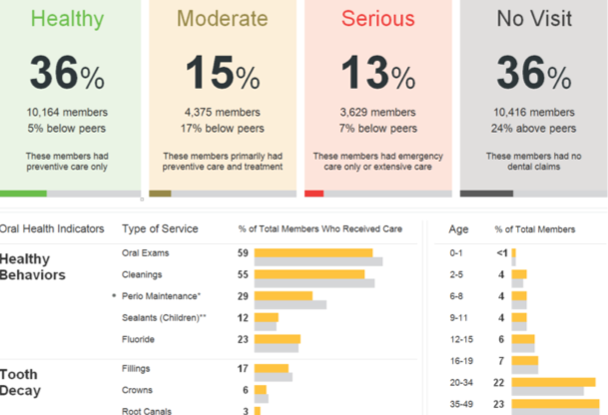
Healthentic
Dental Action Report
Benchmarks against peers of same industry and size both nationally
and locally
Tied utilization to health categories
See historical trends and measure results
Provides opportunity to respond
to behavior

Slide 3
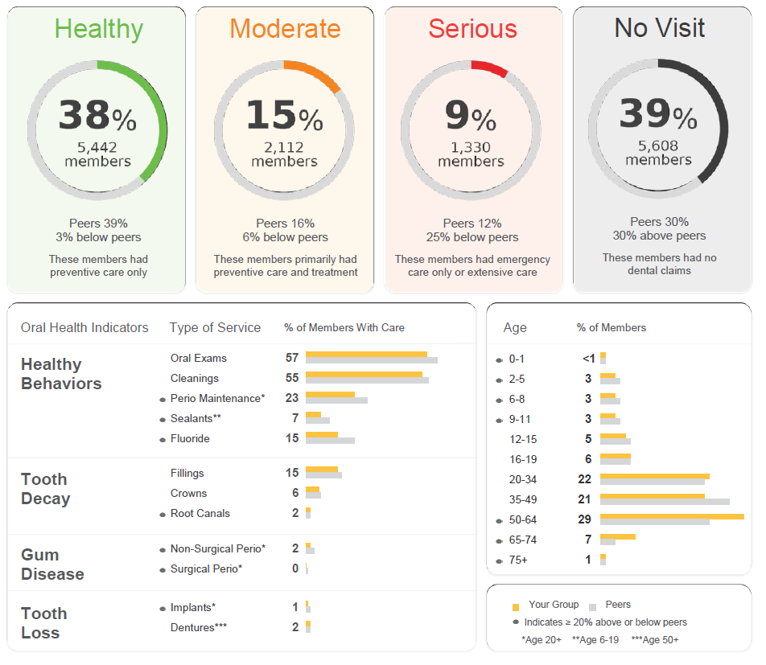
Categories
38% of members are considered “Healthy”
  DDVA Book of Business: 33%
39% of members didn’t see at dentist in the last plan year compared to 28% in 2021
  17% of members have not seen a dentist in two years
  DDVA Book of Business: 43% and 23%
The majority of No Visit members are age 20 and older
  20 to 49 is typically the highest concentration

Slide 4
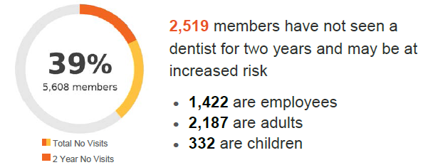
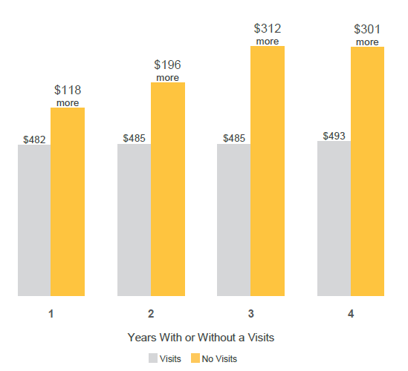
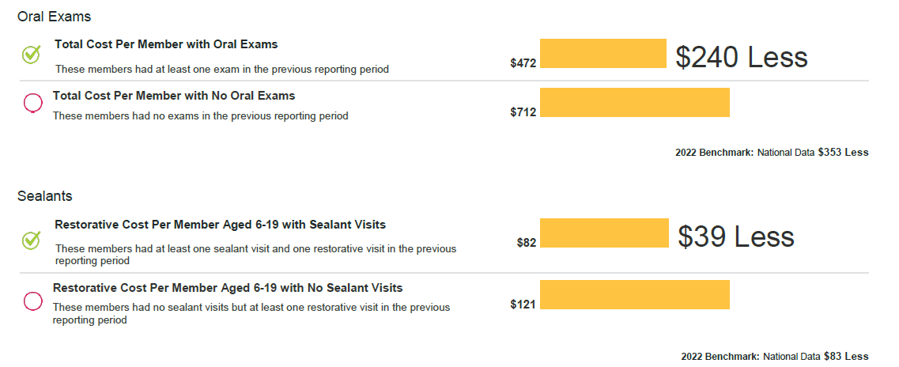
The Cost of No Visits

Slide 5
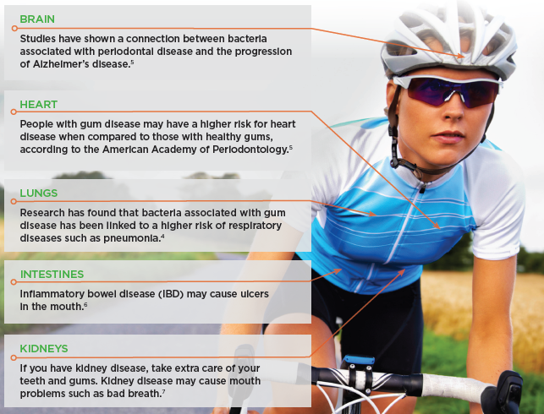
Oral Health & Overall Health
120+ diseases may be first detected by dental exam
Early detection can make treatment easier, less costly, and possibly lifesaving

Slide 6
Prevention First
Diagnostic and Preventive services such as cleanings, exams, and x-rays do not count towards the annual maximum
This means, even if you use your full annual maximum during the year for other services, your preventive services will still be covered at 100%
Included in Comprehensive, Indemnity, and Basic plans
*The example shown is for illustrative purposes only.
WITHOUT PREVENTION FIRST
Diagnostic and Preventive treatment
(twice annually)
Delta Dental Member Max
Pays Pays Remaining
$190 $0 $1,310
_______________________________________________________
WITH PREVENTION FIRST
Diagnostic and Preventive treatment
(twice annually)
Delta Dental Member Max
Pays Pays Remaining
$190 $0 $1,500

Slide 7


Right Start 4 Kids®
Removes cost barriers
Preventive and Diagnostic services are already covered at 100% with no deductible
RS4K provides 100% coverage with no deductible for:
  Basic services
  Major services
Available to children up to age 13
Must see an in-network provider
*Applicable plan limitations, exclusions, and annual maximums still apply
*Orthodontic services are not eligible for the 100% coverage level
Included
Benefit

Slide 8
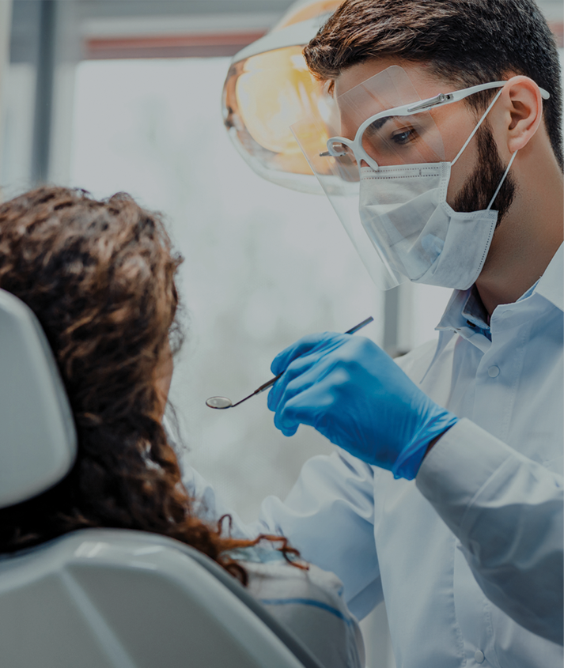

Healthy Smile, Healthy You®
Healthy Smile, Healthy You® provides additional dental benefits beyond your plan limit, per benefit period for the following health conditions that are connected to oral health:
  Pregnancy
  Diabetes
  High risk cardiac conditions
  Cancer treatment
  Weakened immune systems
  Kidney failure or dialysis
You must enroll before taking advantage of this benefit. You can download the enrollment form at DeltaDentalVA.com.
Included
Benefit

Slide 9


Delta Dental – Virtual Visits
Delta Dental – Virtual Visits provides access to dentists 24/7, 365
online DeltaDentalVA.com
over the phone 866-256-2101
Members may use service when they:
Have a dental emergency, but do not have a dentist,
Need access to a dentist after hours,
Would like to consult a dentist while traveling.
*A teledentistry visit counts as a problem-focused exam.
Included
Benefits

Slide 10
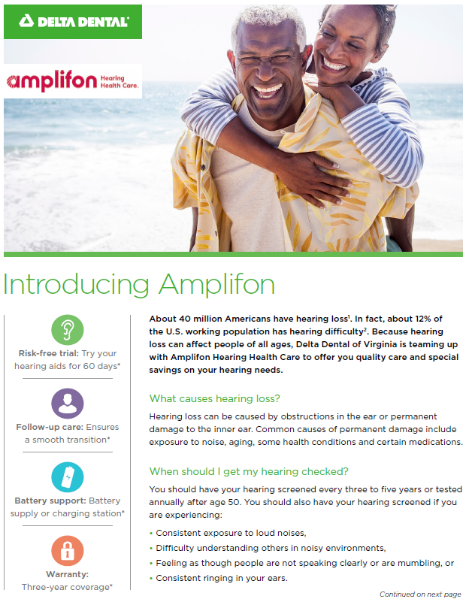
How to Access Your Hearing Program
Call Amplifon at 877.593.0051
Amplifon will explain the program details and help you take a virtual hearing assessment to confirm the presence of hearing loss
If loss is detected, Amplifon will help you schedule an appointment with a provider near you
Amplifon will send information to you and the provider, ensuring your program is activated
For more information, call 877.593.0051 or visit www.amplifonusa.com/lp/deltadentalva

Slide 11
Pre-Determination of Benefits
Recommended – but not required
For services of $250+
Process:
  Dentist submits to Delta Dental to include proposed treatment plan
  Delta Dental processes like a claim form (turnaround time 5-7 business days )
  Statement mailed to dentist and subscriber – indicating reimbursement amount
Allows members to make an informed decision prior to having services rendered!

