Slide 1
Embracing Meaningful Influence: The Building of Dynamic Leadership
Nikki Dixon-Foley, Master Coach – FSI International

Slide 2
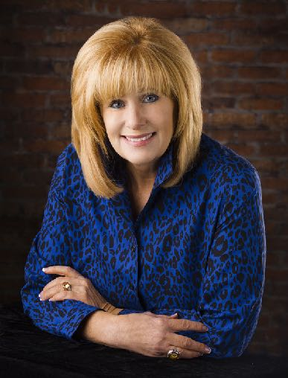
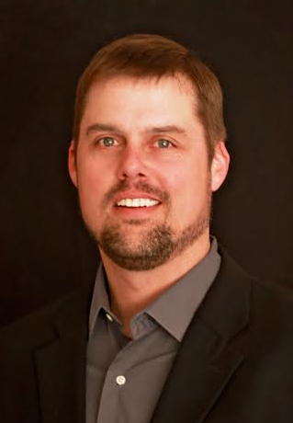
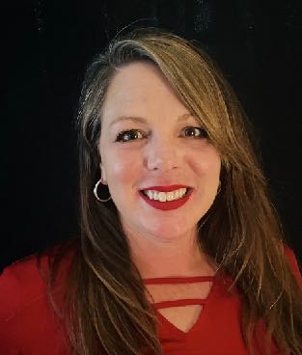
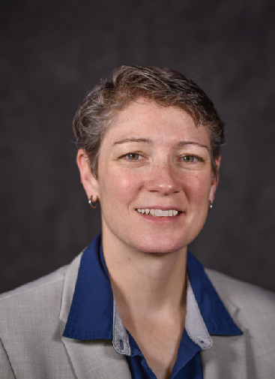
Wendy Samson
Founder
Master Facilitator
Curt Swenson
CEO/President
Master Facilitator
Ann Swenson
Vice President
Master Facilitator
Nikki Dixon-Foley
Partner
Master Facilitator

Slide 3
The Principles of Meaningful Influence
Meaningful Influence seeks to CREATE SPACE for CONSIDERATION.
Meaningful Influence targets BELIEFS in order to change behaviors.
More WORDS and more DATA do not change minds.
Notes:
Meaningful Influence seeks to CREATE SPACE for CONSIDERATION.
Meaningful Influence targets BELIEFS in order to change behaviors.
More WORDS and more DATA do not change minds.
Meaningful Influence listens to learn; it speaks far less in order to facilitate an understanding.
"A man convinced against his will, clings to the same opinion still

Slide 4
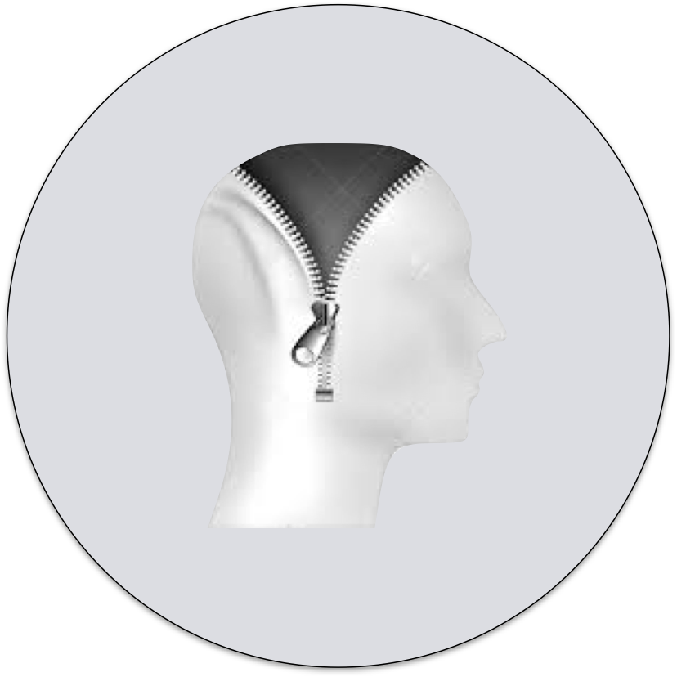
1. Follow Beyond Title.
What you believe
2. Follow into the
DIFFICULT.
How you think
3. They go to great
lengths to never
LET YOU DOWN!
How you act!

Slide 5
T
H
I
N
K
T
H
I
N
K
SELF
TALK
WEIRD
SELF
TALK
Behavior

Slide 6
Mosaic’s P.U.R.E. Influence Model
P = Powerful Purpose (The Great "Why" Factor)
U = Understanding (Listening and Messaging)
R = Relationships
E = Execute

Slide 7
Mosaic’s P.U.R.E. Influence Model
P = Powerful Purpose (The Great "Why" Factor)
Great purposes change the way we view the work.
Great purposes create the space for an amazing thing to happen.
Prepare the compelling “why”.

Slide 8
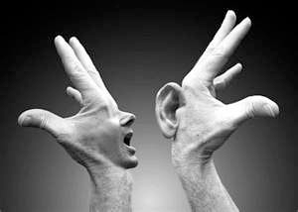
Mosaic’s P.U.R.E. Influence Model
U = The Power of Listening
Level 1: Listening to the WORDS
An exchange where the listening party utters agreements and aha, aha, ah…
You have competing thoughts and "mind popcorn”.

Slide 9
Mosaic’s P.U.R.E. Influence Model
U = The Power of Listening
Level 2: Listening to WHAT the WORDS MEAN to YOU
You take it personally.
You listen for the parts you agree with or understand.
You listen for what you must defend or protect.

Slide 10
Mosaic’s P.U.R.E. Influence Model
U = The Power of Listening
Level 3: Listening to WHAT the WORDS MEAN to THEM
You listen to learn.
You listen in a state of "appreciative inquiry”.
You listen and affirm, then invite more dialogue.

Slide 11
Mosaic’s P.U.R.E. Influence Model
U = The Power of Listening
Level 4: Listening to THE ENVIRONMENTAL FACTORS
You listen to understand the meaning behind their words.
You listen and adopt the "neutral observer position".
You listen to how they feel and what they are experiencing

Slide 12
Mosaic’s P.U.R.E. Influence Model

Slide 13
Mosaic’s P.U.R.E. Influence Model
R = Relationships (Think past the transaction)
Be Gracious with People…
…Be Relentless for Results

Slide 14
Mosaic’s P.U.R.E. Influence Model
E = Execute—Be known for getting things done!
Demonstrate action within 48 hours.
Under promise and over deliver.
Solve something unexpected for them.
If it's not in writing, it doesn't have to exist the want it want it to.

Slide 15
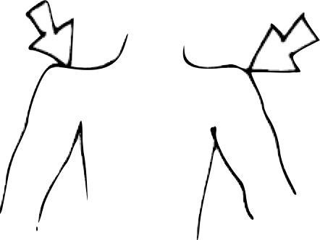
Clarifying Your Standards
Conduct
UNBECOMING
of a
professional
Conduct
SET-APART
from
others
Left
Shoulder:
Self-Preservation
Right
Shoulder:
Your Standards
Notes:
Your Secret Weapon

Slide 16
Your LEADERSHIP BRAND
Leading with INTENTION:
The Experience to be Anticipated
It returns you to YOU.
It is in meaningful service to others.
It makes your "tail wag”.
It gives you a great leadership story to enact.
It becomes instructive.
Notes:
Authenticity and Talents
Generosity
Purpose and Momentum
Self-concept
Clarifies Interactions

Slide 17
Closing Thoughts
Lead from within first. Shake off the labels, stories, and misguided beliefs. Those things will only get in your way.
Today is the day that you create space within so that you can embrace the power of meaningful influence.

