Slide 1
2023 Virginia Bankers School of Bank Management
Convocation

Slide 2
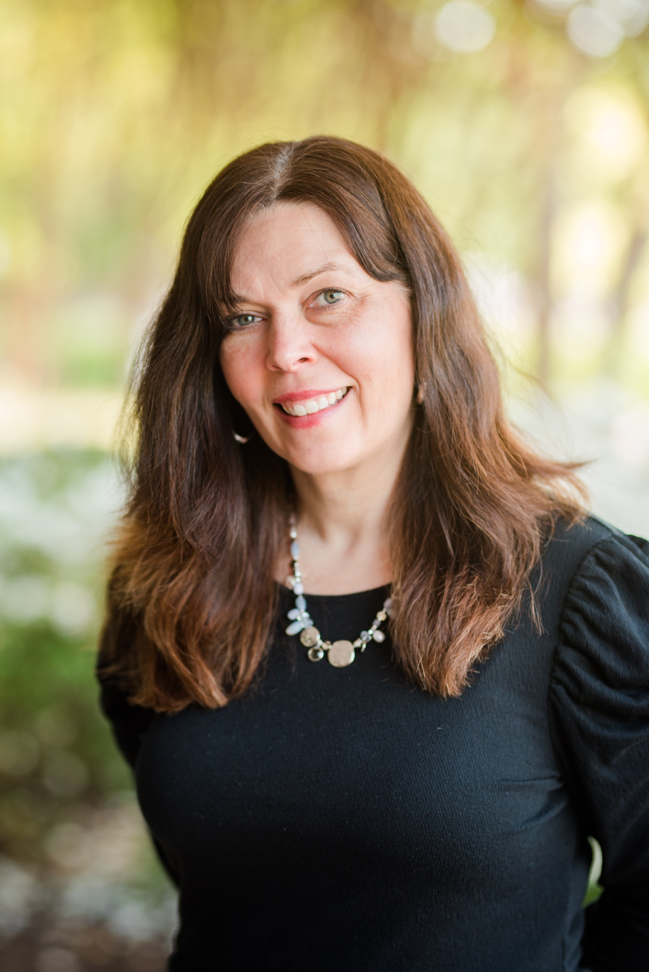
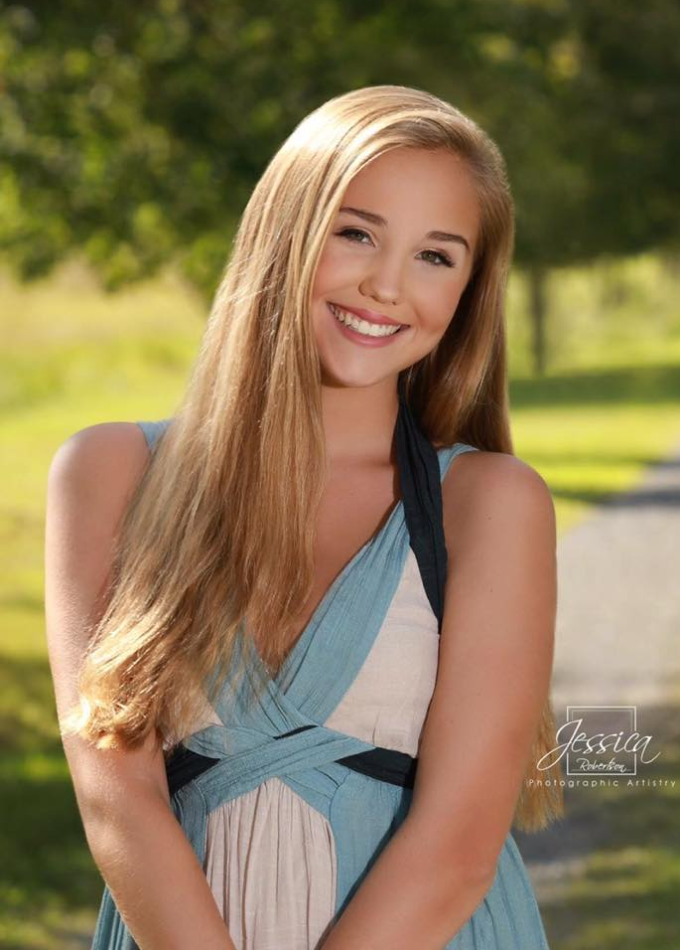
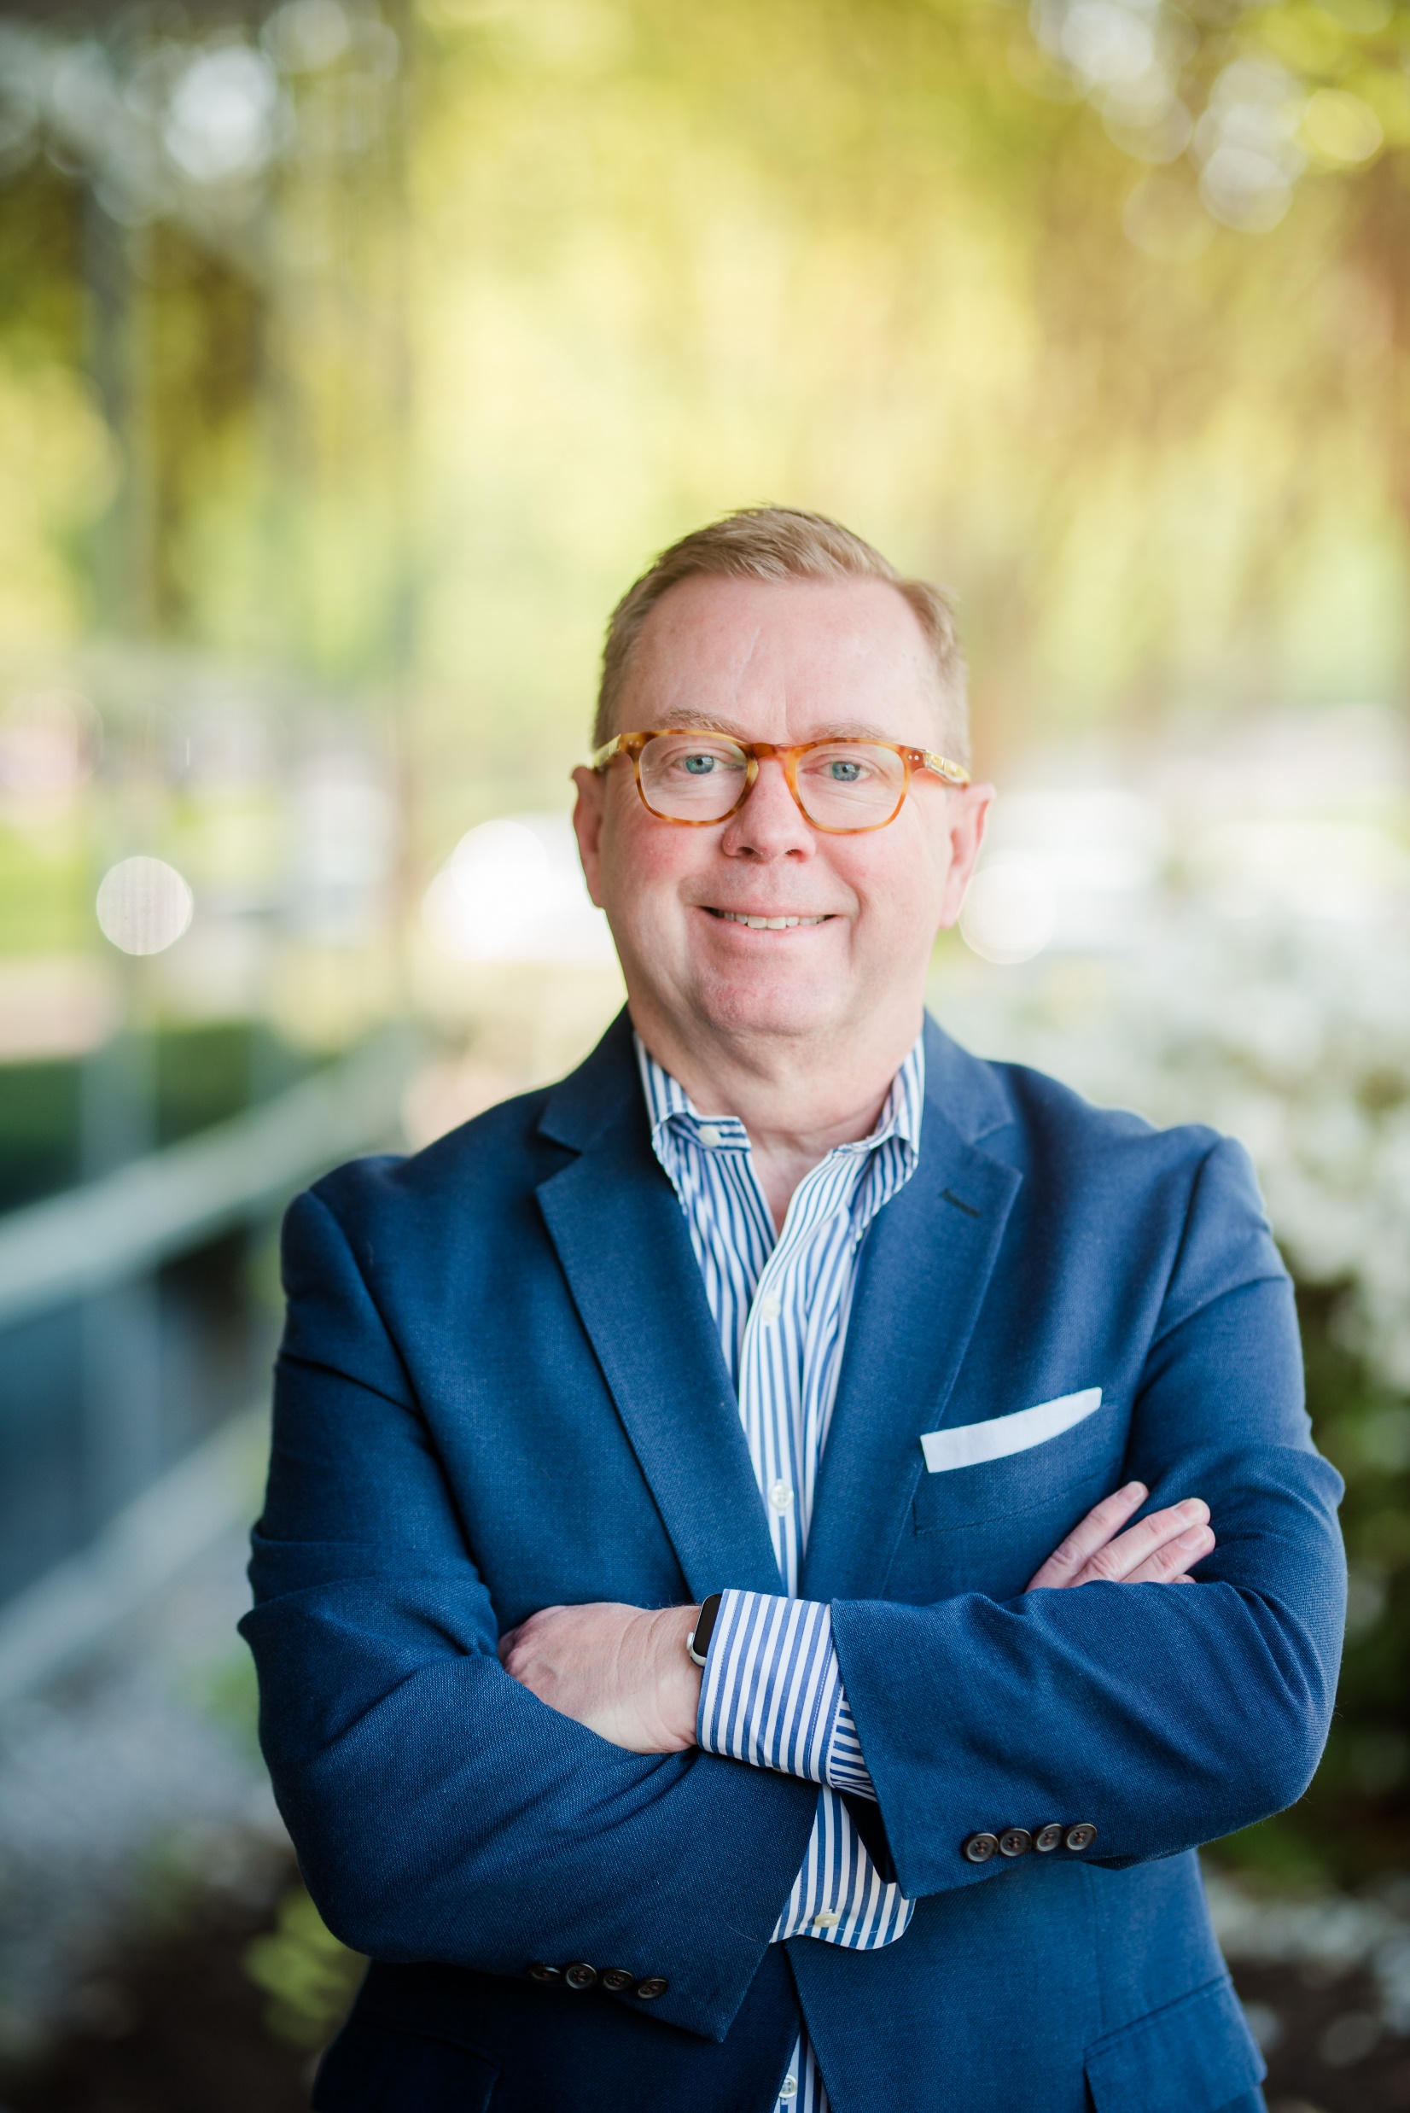
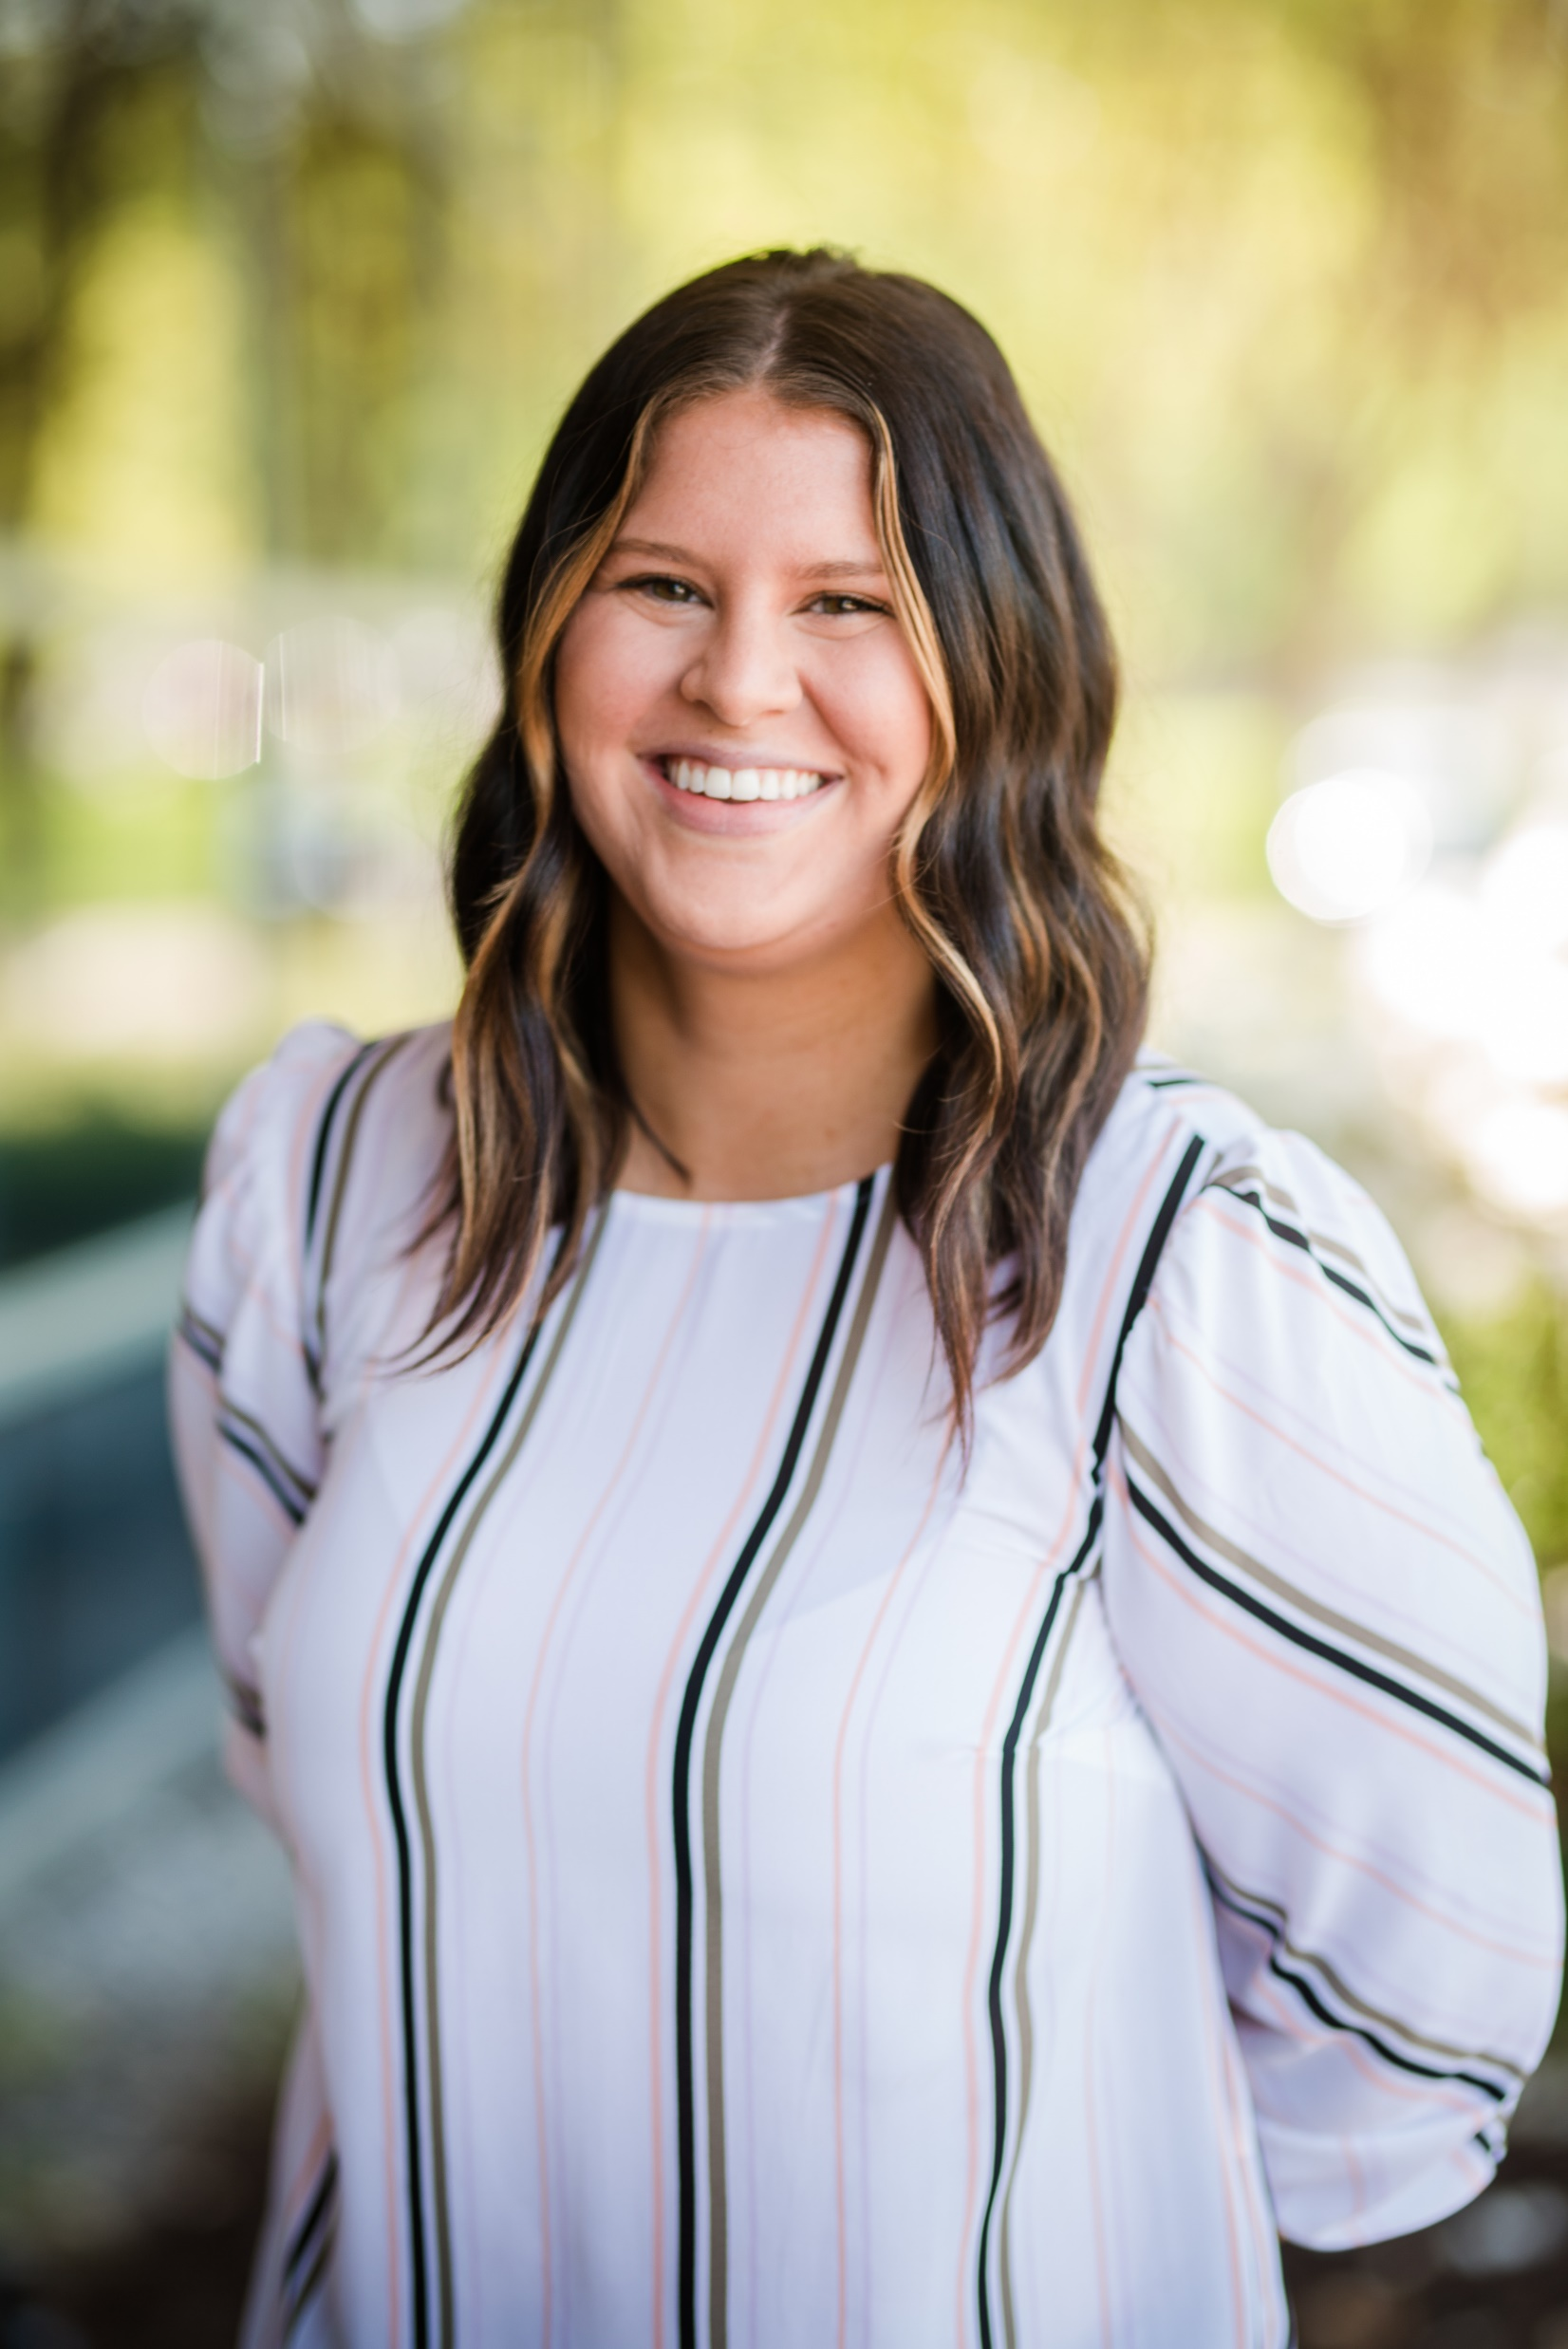
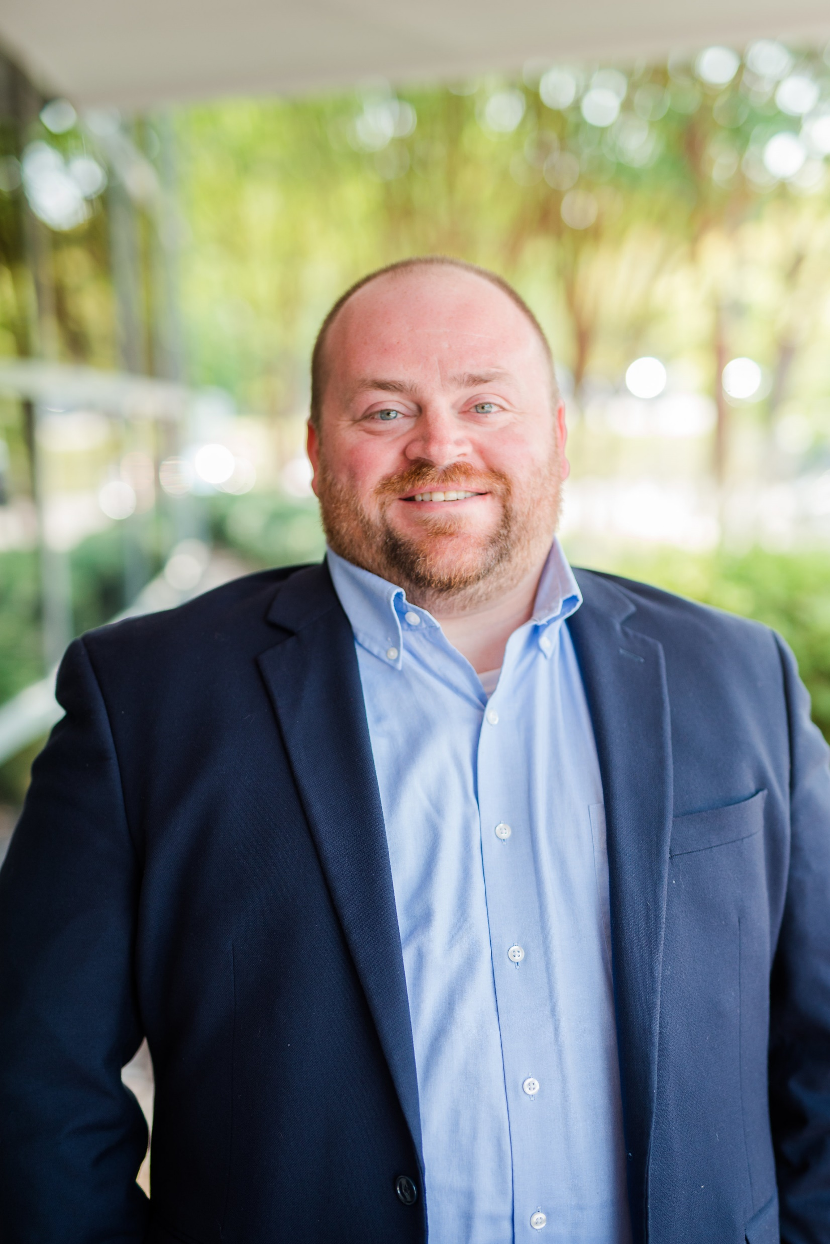
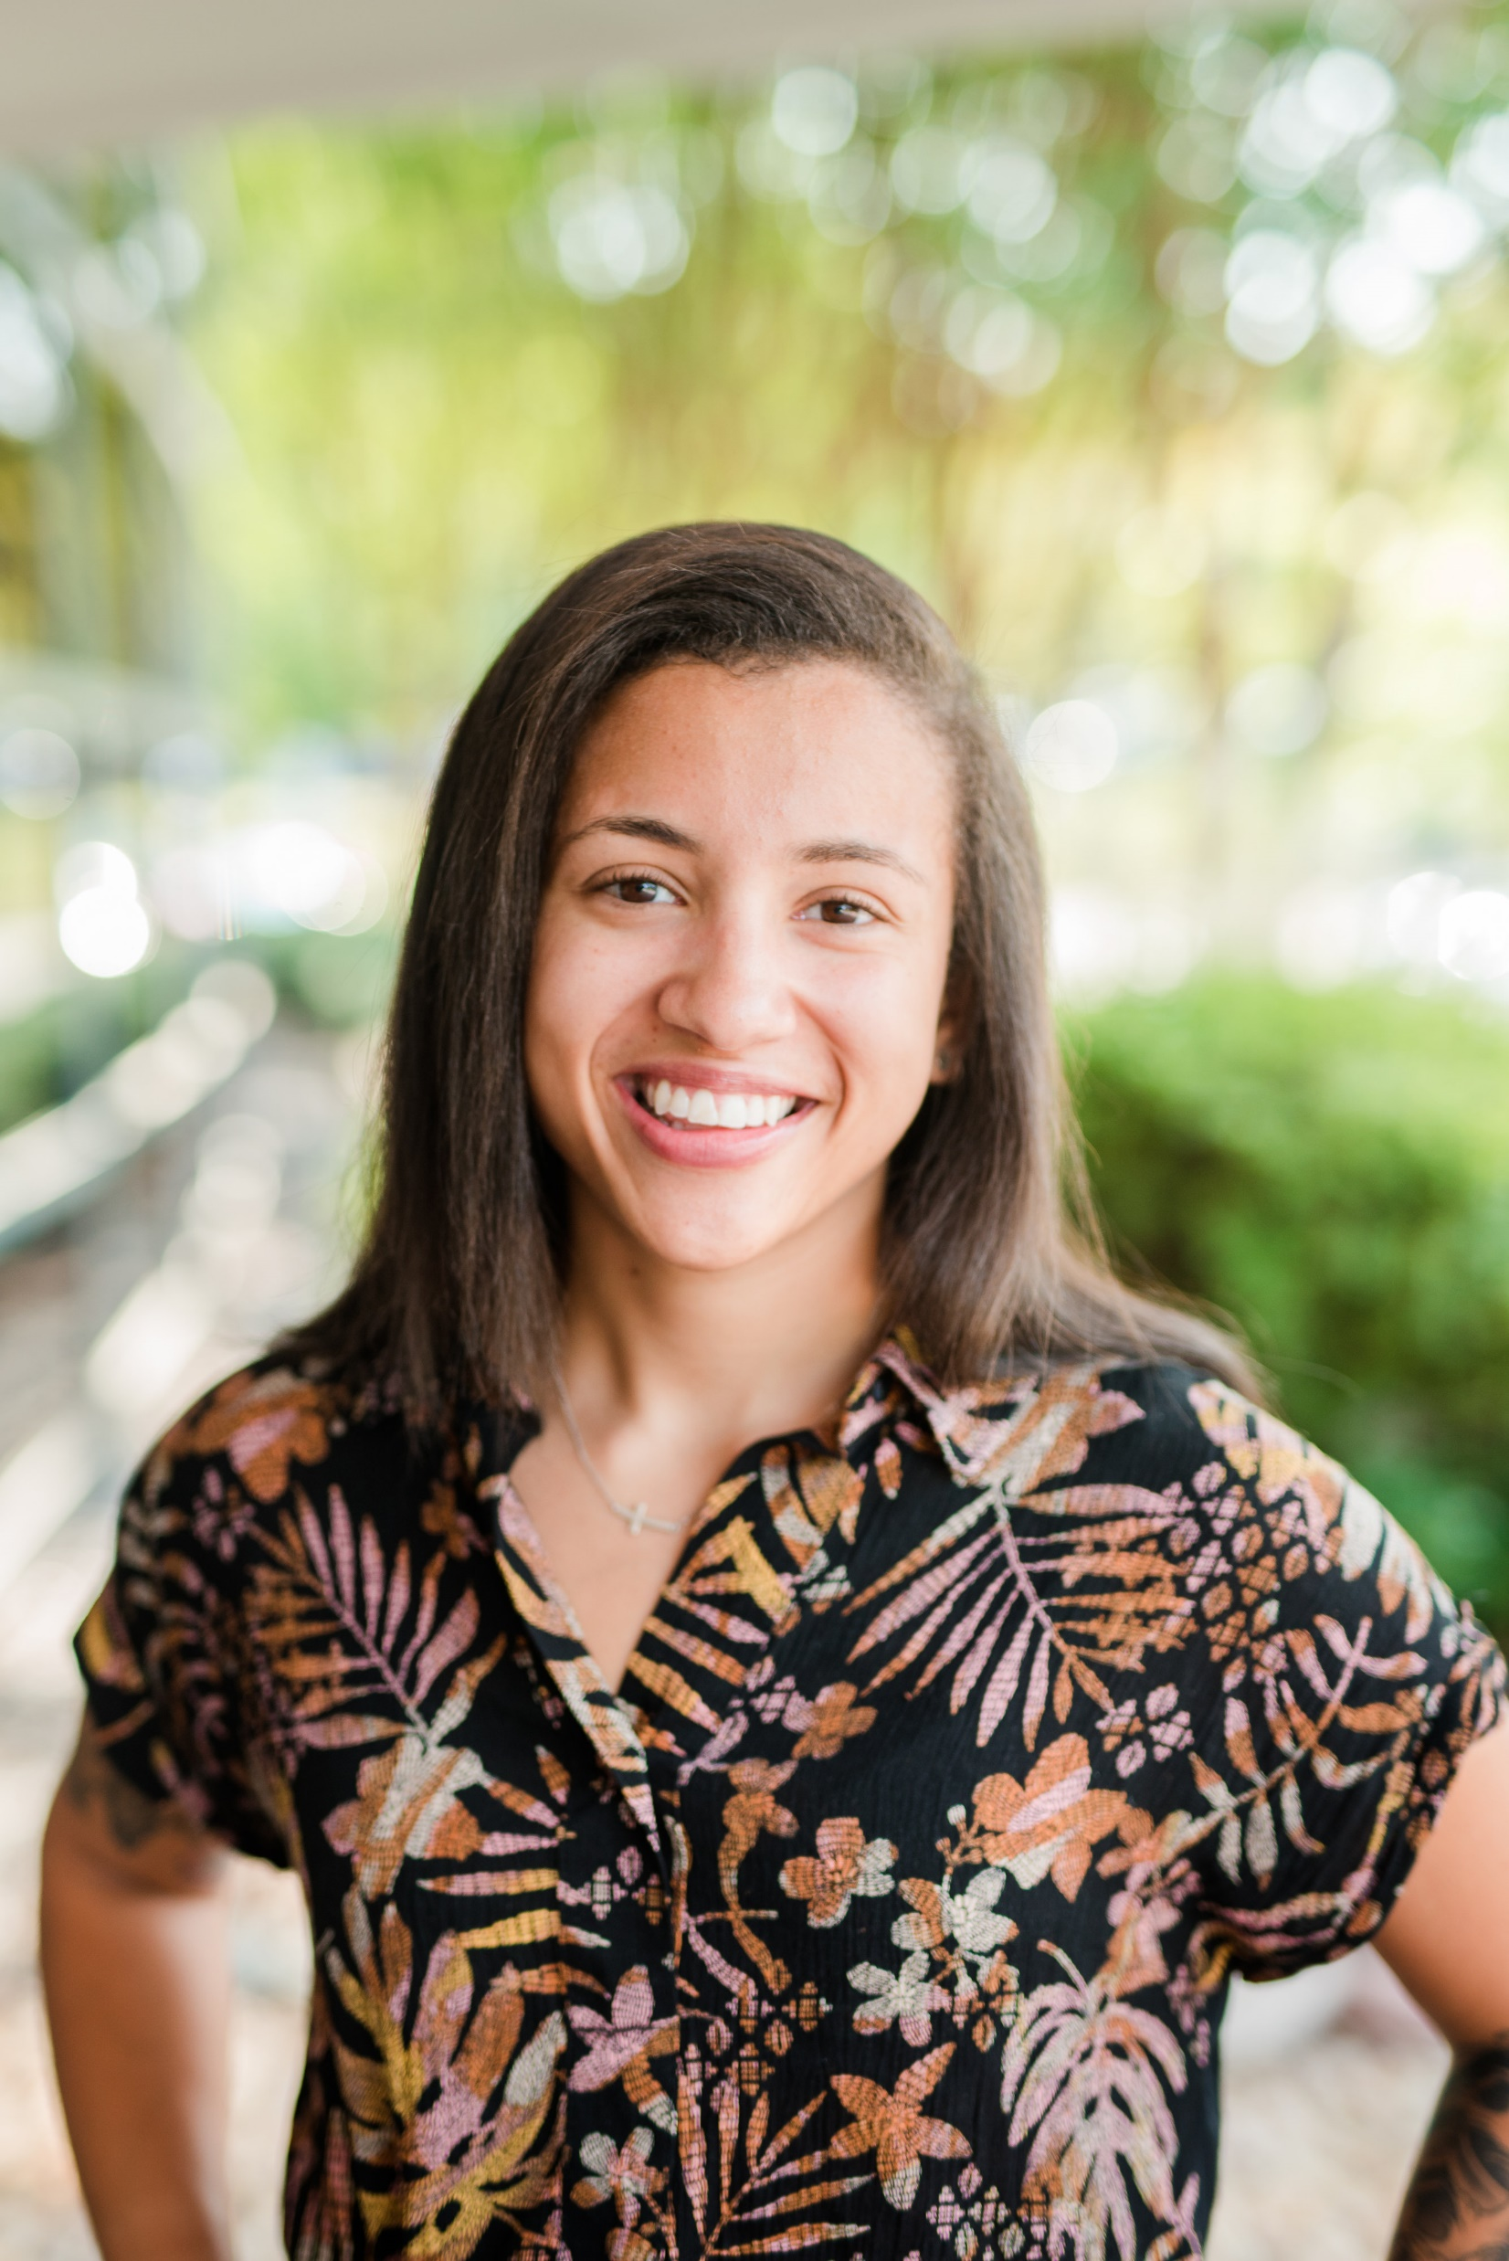
Meet the VBA Bank School Team
Bruce Whitehurst
President & CEO
Bank School Administration
Kristen Reid
Vice President,
Education & Training
Bank School Administration &
1st Year Class Support
Hannah Hedden
Education & Training Coordinator
1st Year Class Liaison
Megan Darmanin
Strategic Support Manager
2nd Year Class Liaison
Walt Lyons
Vice President, Education & Training & Executive Director, VMBA
2nd Year Class Liaison
Gabby Bond
Benefits Systems Manager
BankExec Administration & 3rd Year Class Liaison

Slide 3
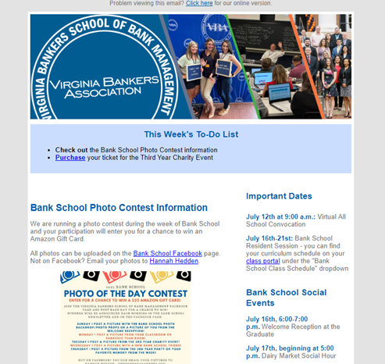
Bank School Newsletters

Slide 4
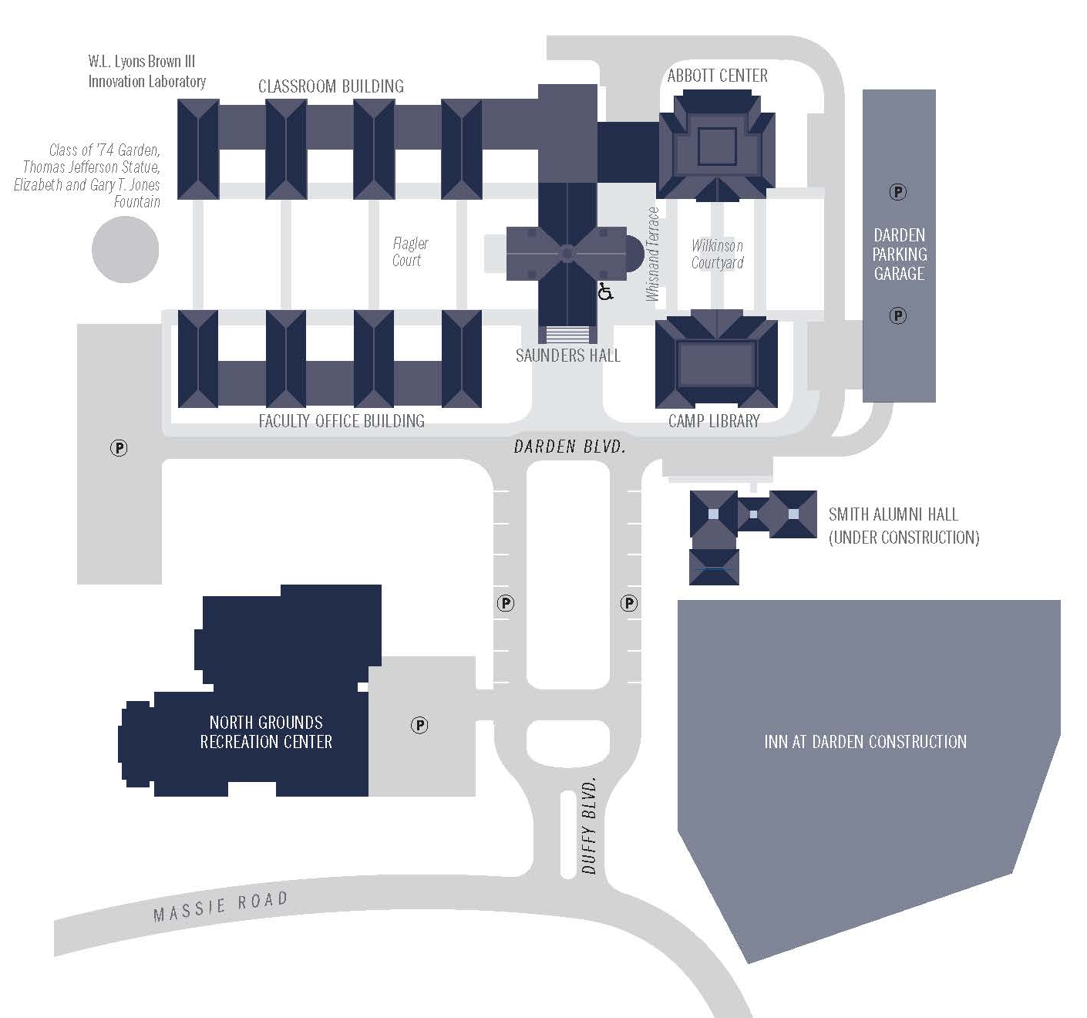
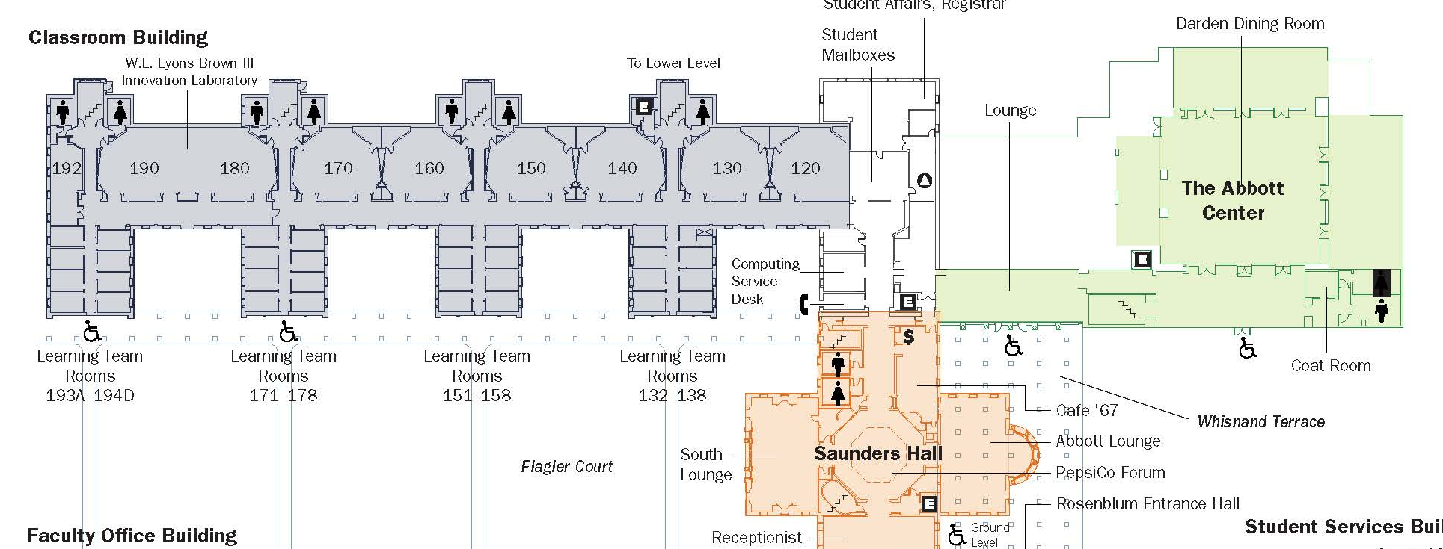
University of Virginia
Darden School of Business
Main Level
1st & 3rd Year Classrooms & BankExec Team Rooms
Shuttle Bus
Drop-off &
Pick-up
2nd Year Class &
General Sessions

Slide 5
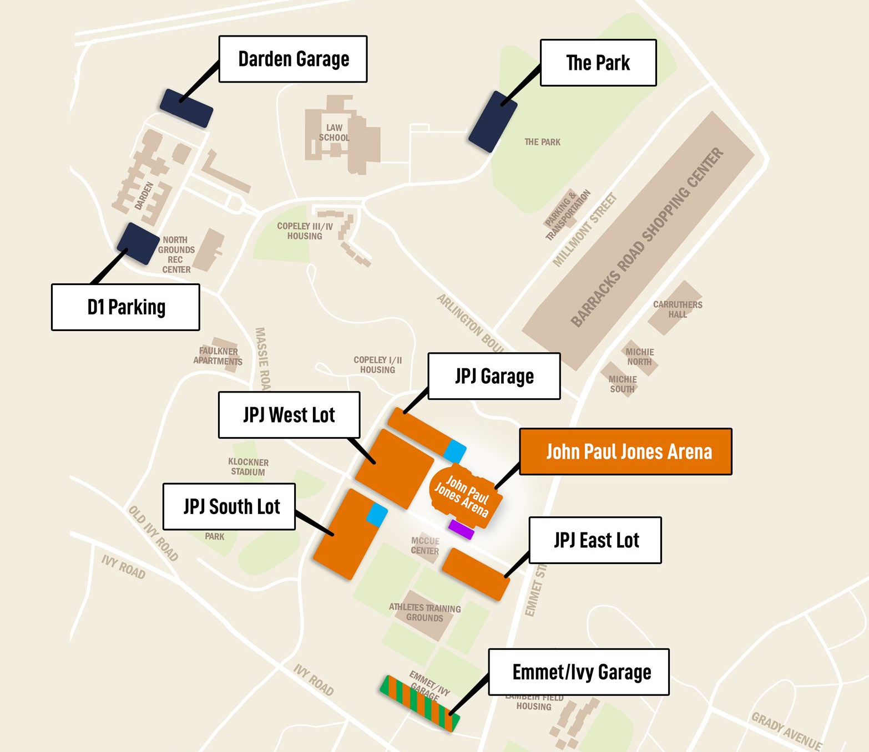
Parking
John Paul Jones Arena – West Lot
All students park at John Paul Jones Arena West Lot
Buses will provide transportation to and from Darden each day (times are noted on your curriculum schedule)

Slide 6
Parking
Darden (Sunday & Friday Only)
For Friday, July 21:
All students park at John Paul Jones Arena West Lot
Students carpool from JPJ to Darden
Parking passes will be distributed on Thursday in class to designated drivers and must be displayed in the Darden garage.

Slide 7
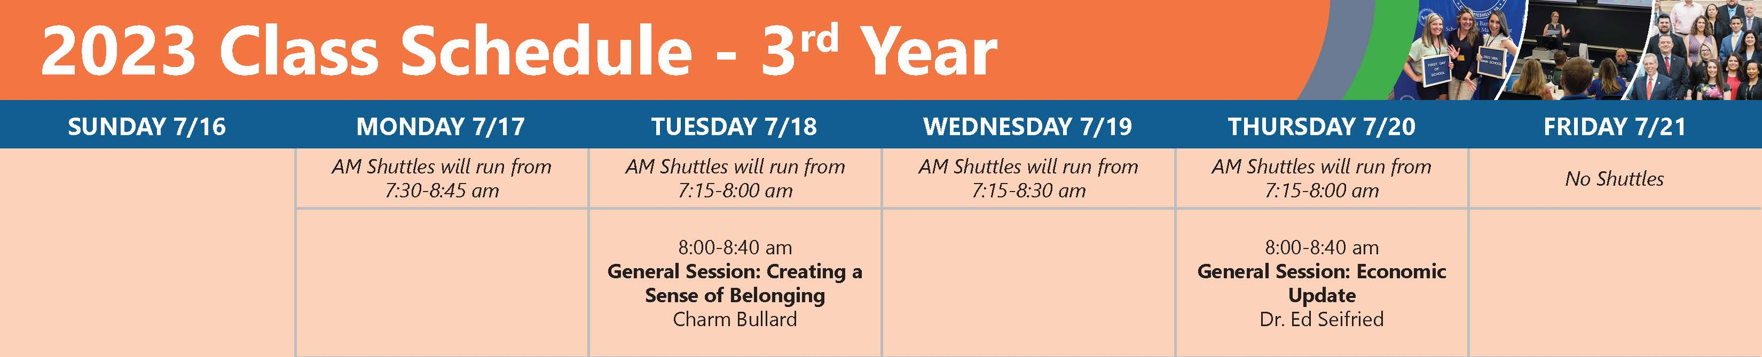
Bank School Schedule
General Sessions

Slide 8
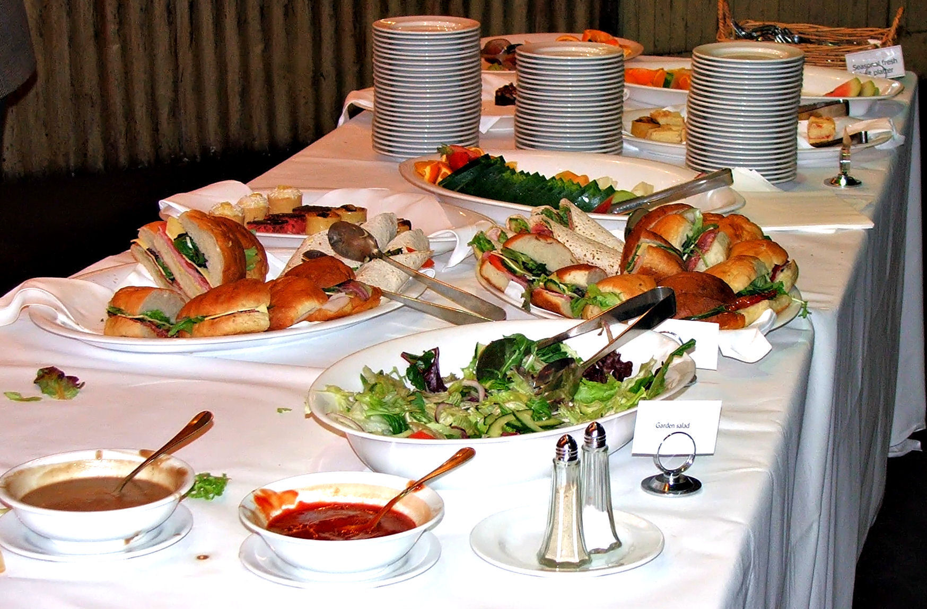
Bank School Schedule
Dining

Slide 9
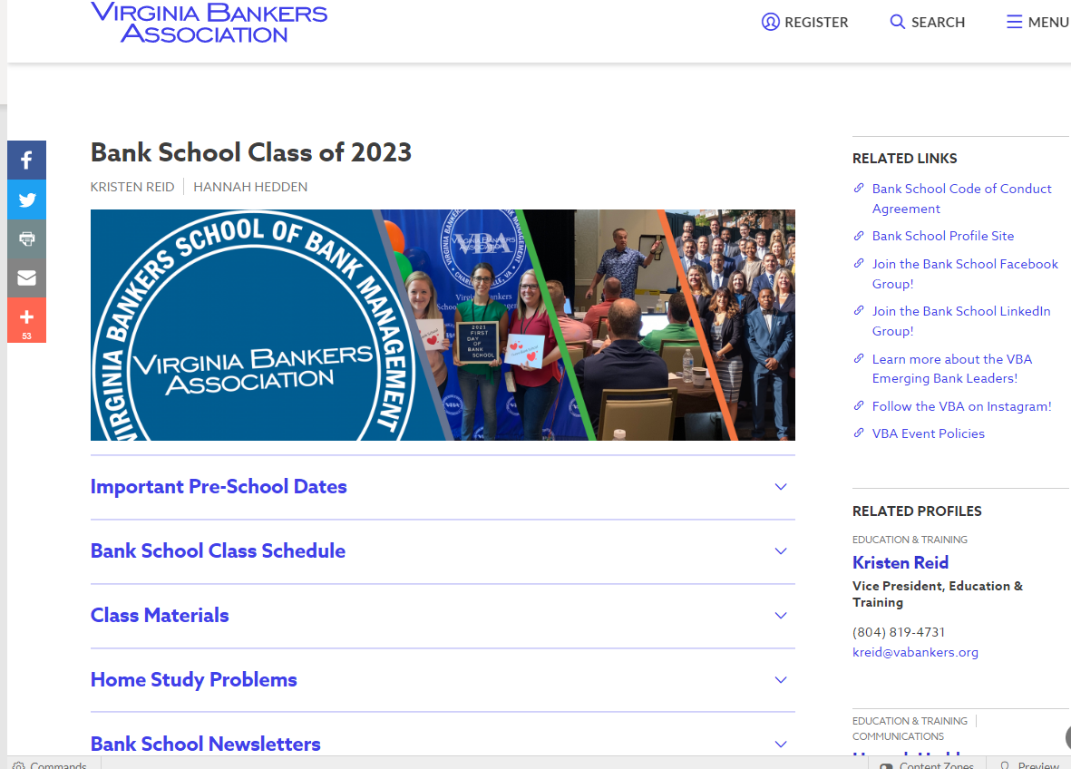
Class Portals

Slide 10

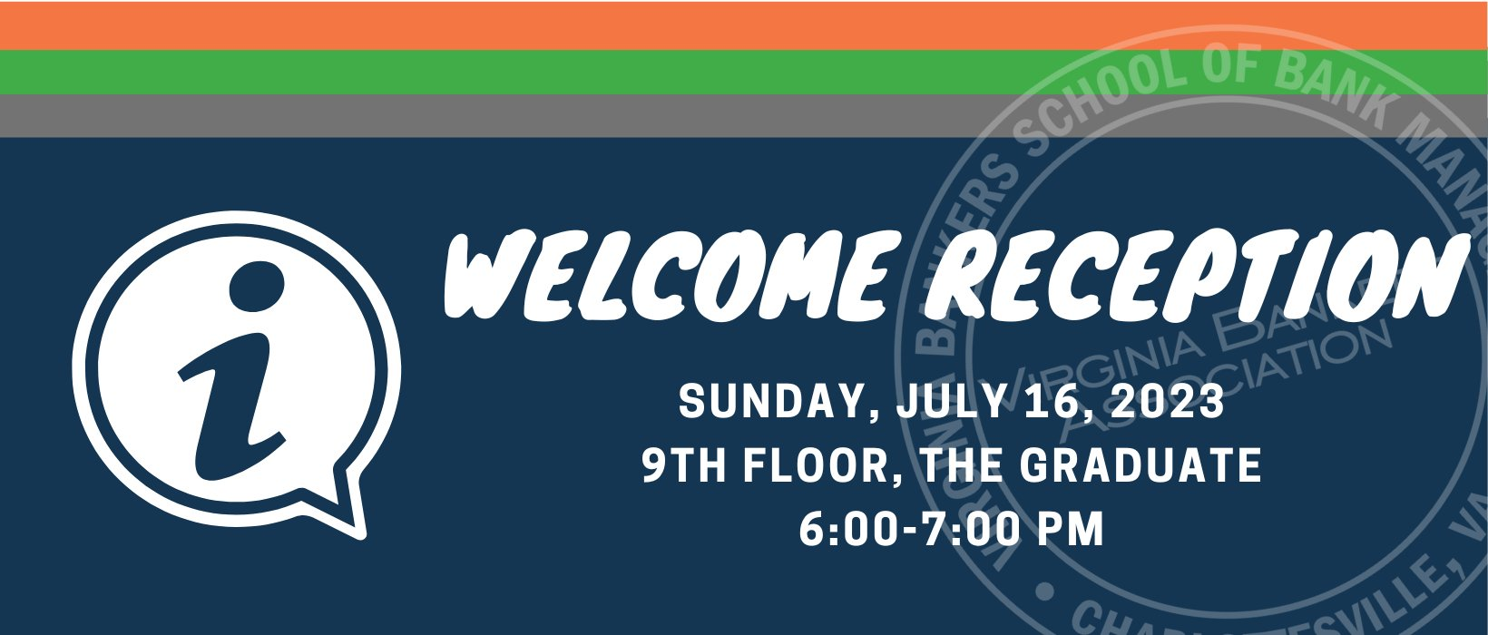


Evening Social Events

Slide 11
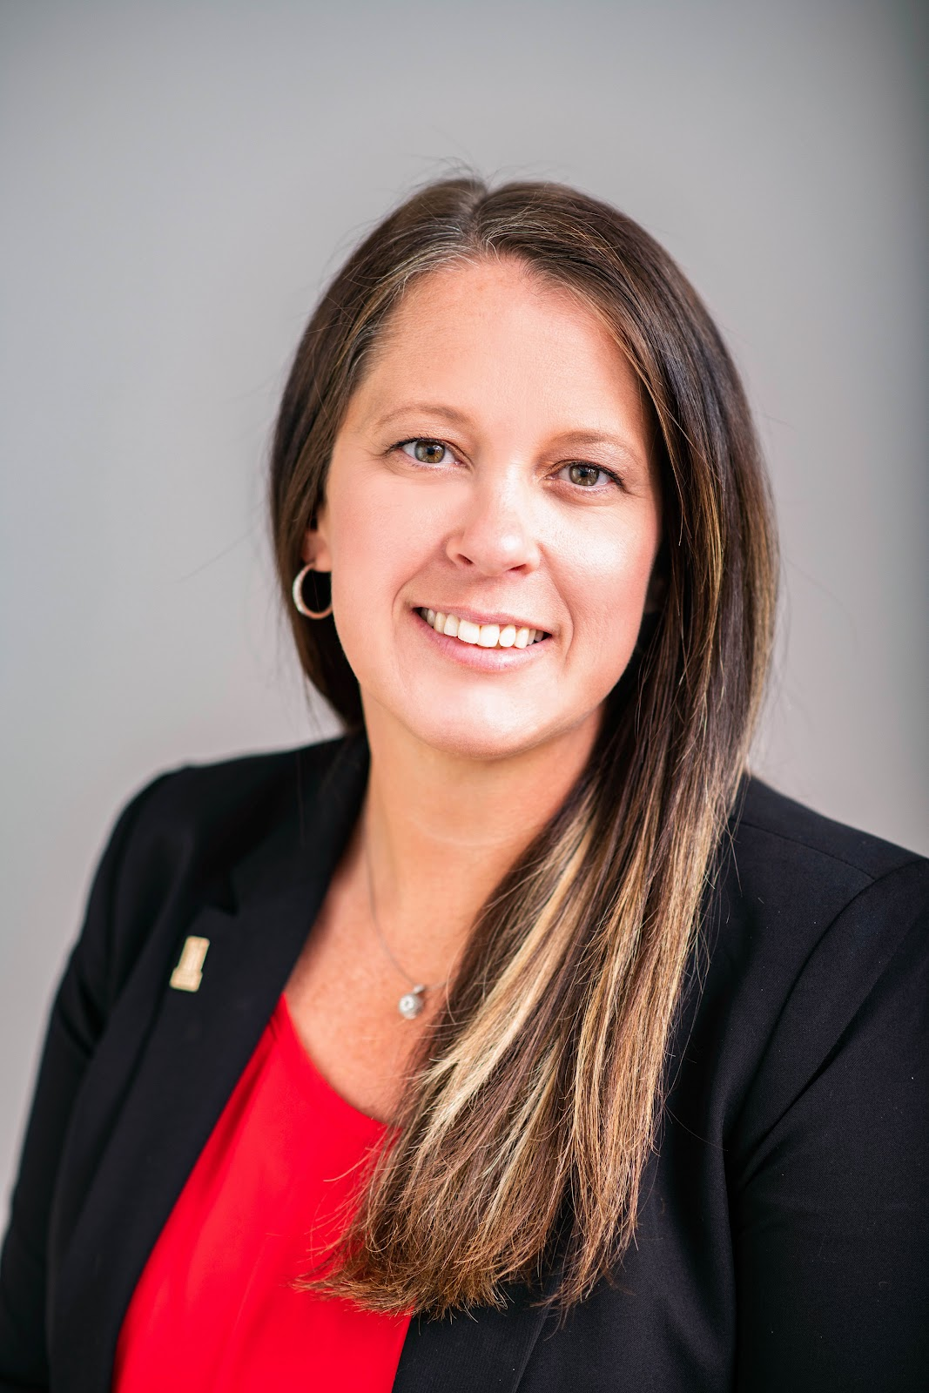
Vice President of the Class of 2023
Lynda Phillips

Slide 12
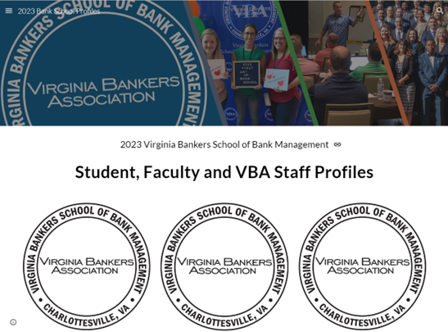
Student, Faculty, Staff
Profile Site

Slide 13
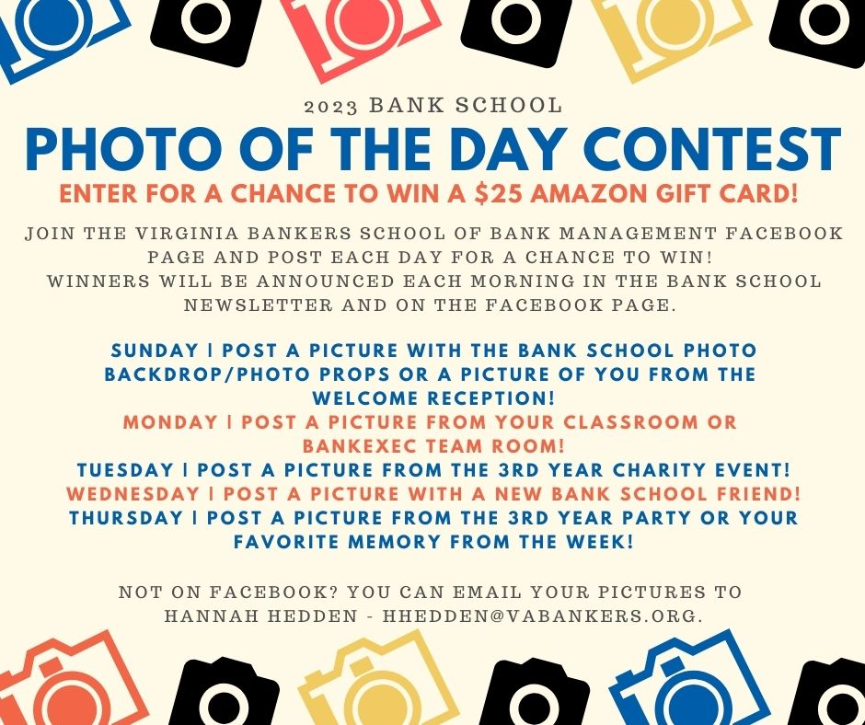

Slide 14
We’ll see you soon!

