Slide 1
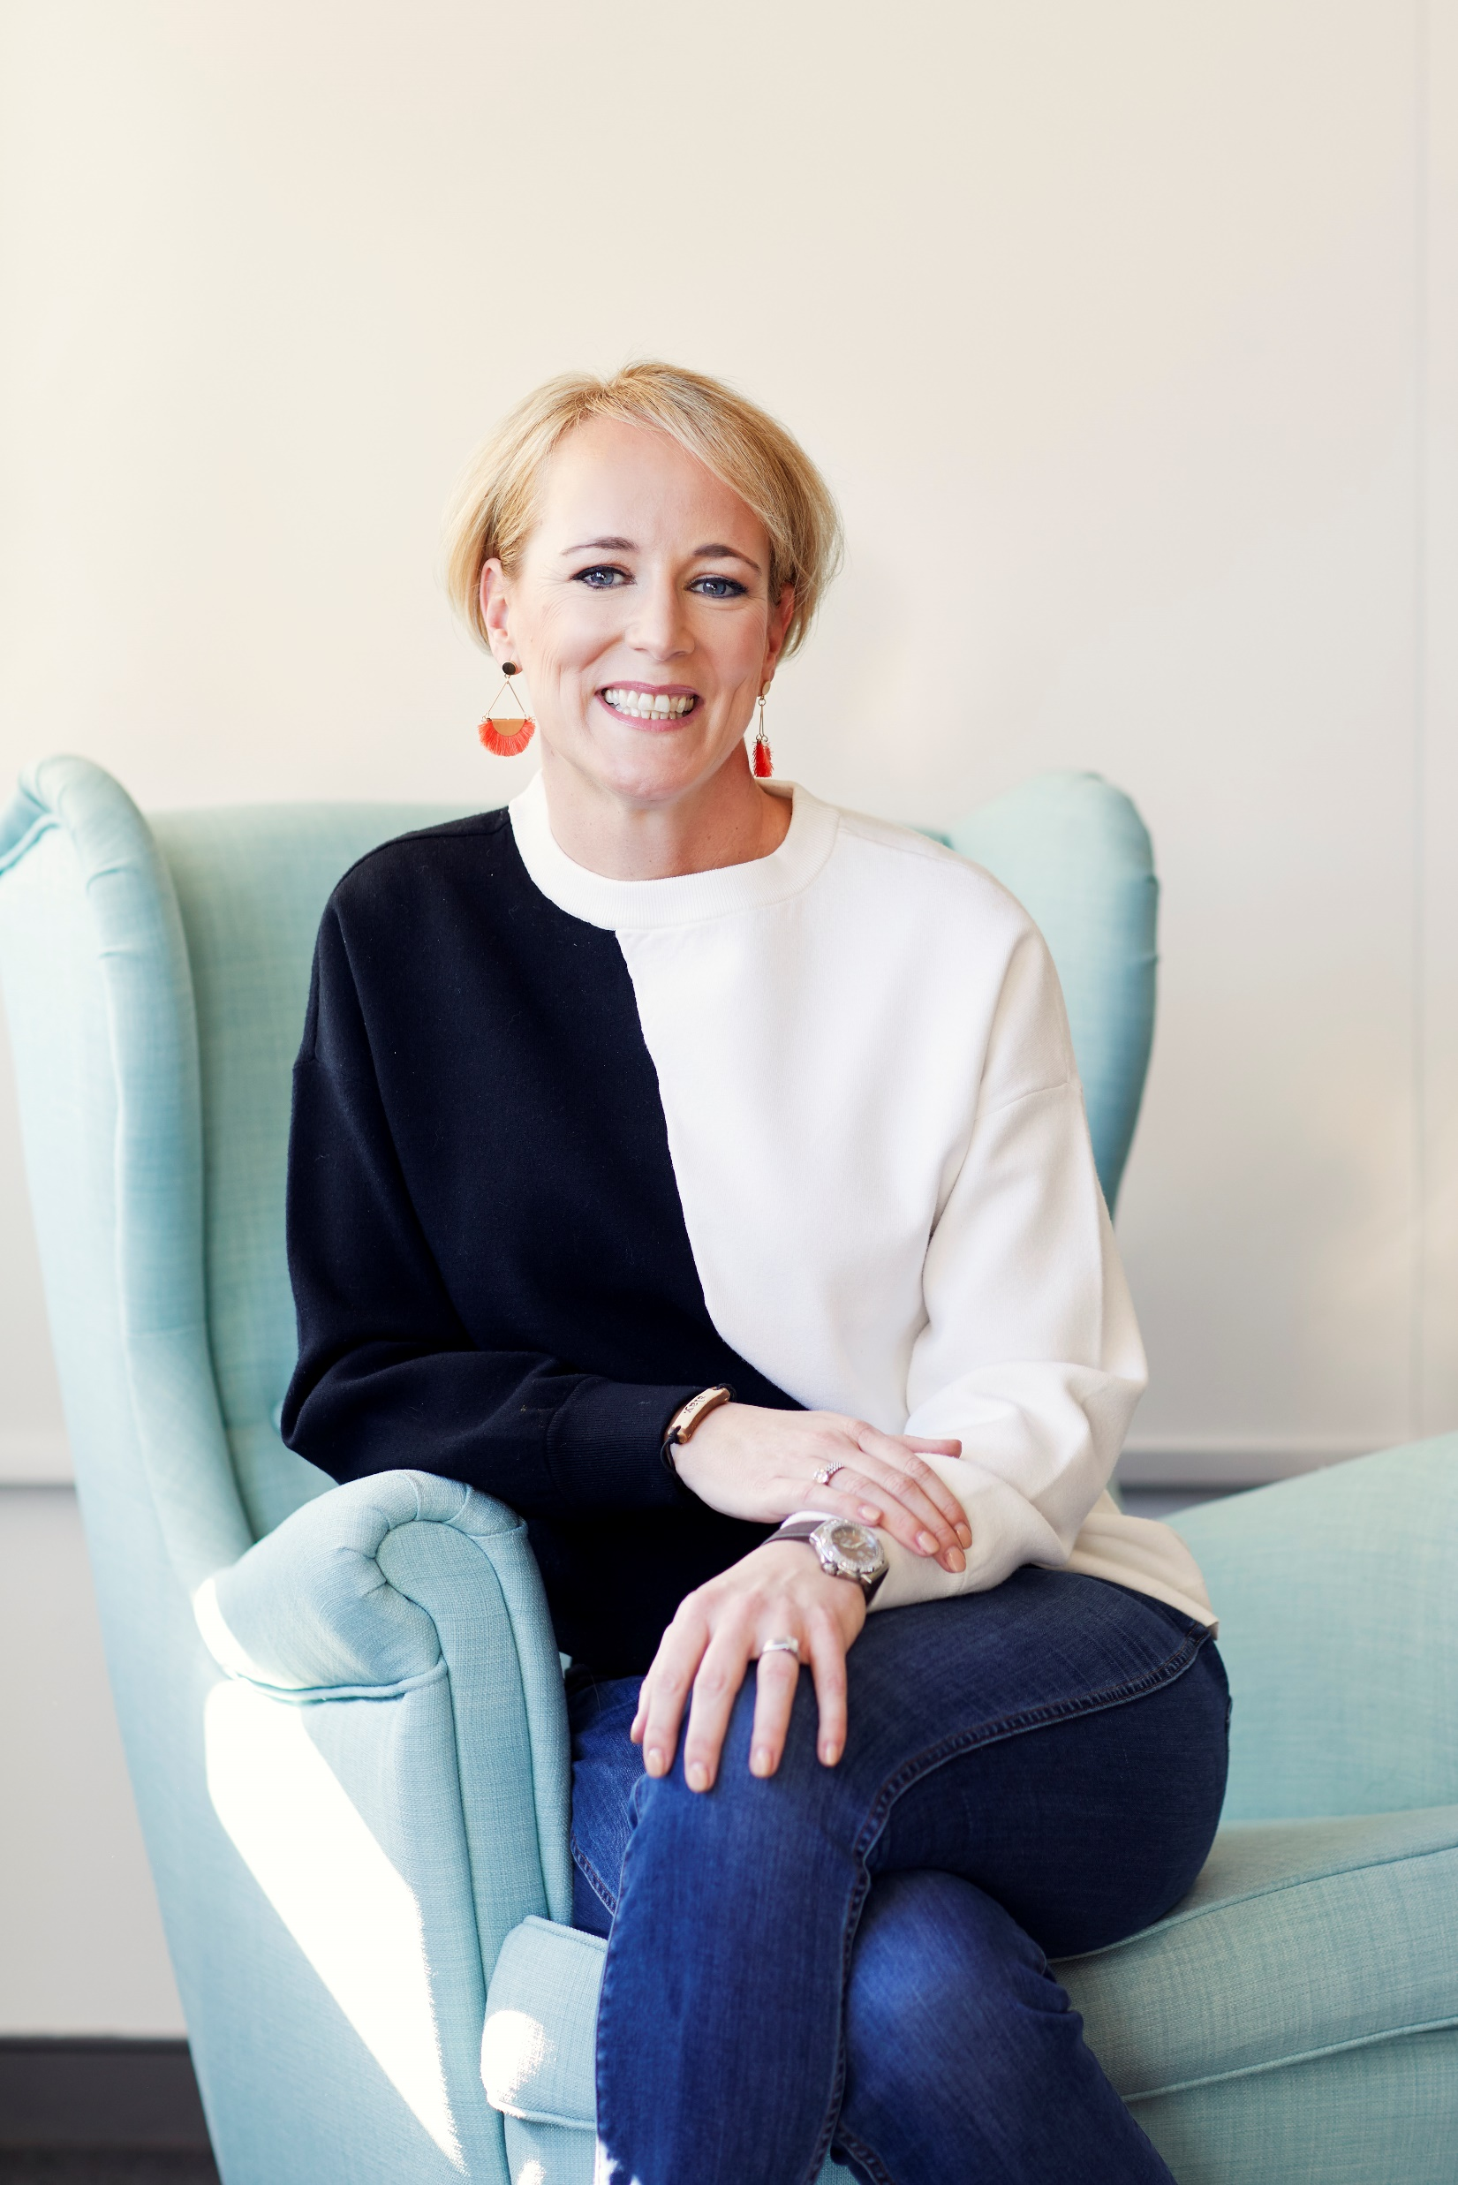
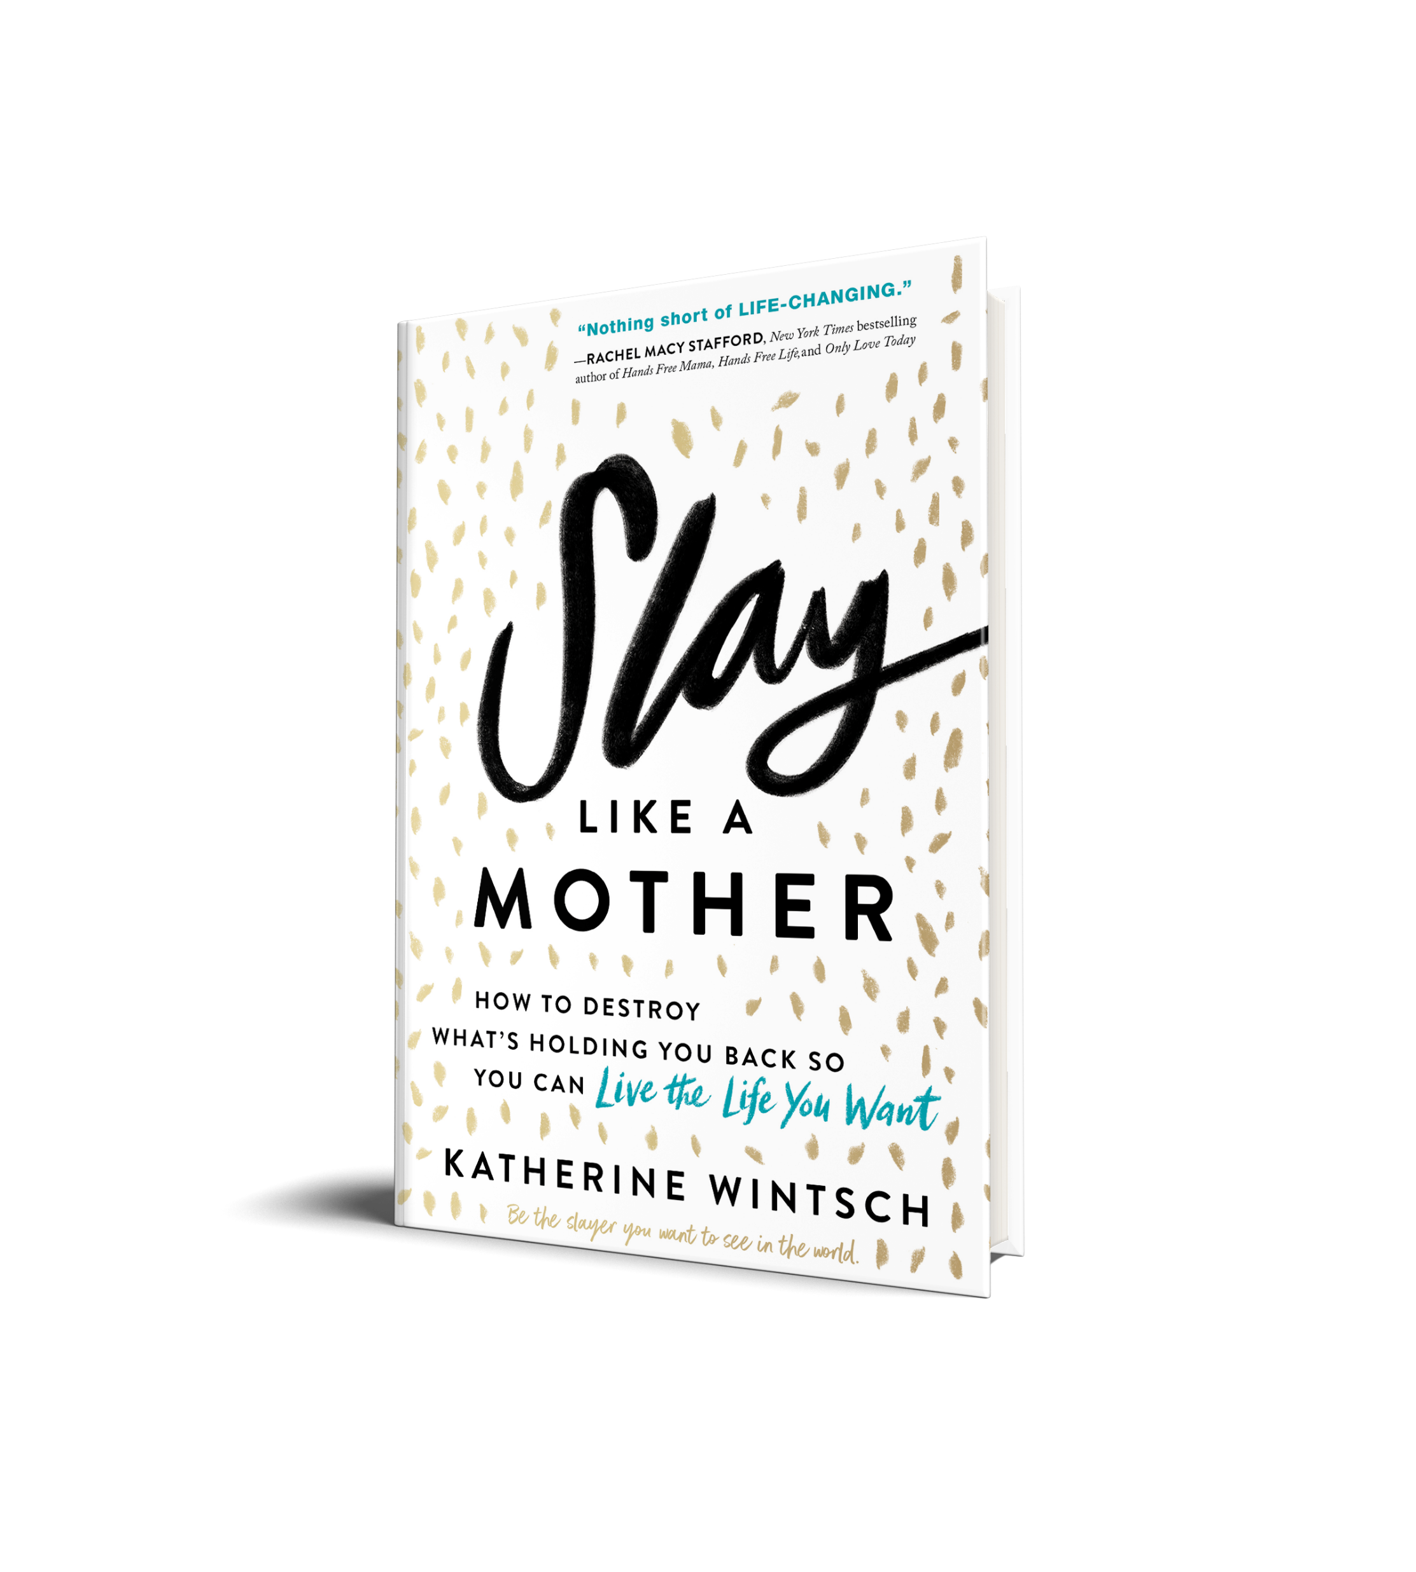
Chesapeake Bank Book Club
Kick off Meeting: June 2021

Slide 2
Today’s Agenda
Program Schedule & Timeline
Background on Slay Like a Mother concept
Recorded video by Katherine Wintsch

Slide 3
Program Schedule & Timeline
June
Book Club Kick-off event (regional groups)
Background information
Video viewing
Receive books
July
Monthly Check-in (regional groups)
Q&A discussion
60 minutes
August
Monthly Check-in (regional groups)
Q&A discussion
60 minutes
September
LIVE Closing Event (Training Center, Kilmarnock)
60-minute workshop with Katherine Wintsch
Book signing

Slide 4
Background on Slay Like a Mother (SLAM)
About the Book: Slay Like a Mother, a book that Parade magazine named one of the “Top 10 life-changing self-help books of the year,” is the kick you need to destroy what’s holding you back so you can live the life you want.
About the Author: Katherine Wintsch is an internationally recognized expert on modern motherhood. She is the founder and CEO of The Mom Complex, she and her team help develop innovative products and services for some of the world’s largest mom-focused brands. She has been featured by Today, the New York Times and The Wall Street Journal.
About the Book Club Pilot: Although this book has a focus on motherhood, it applies to anyone struggling with self-doubt. Particularly after 2020/COVID and the challenges it brought from a mental health perspective to many, reading this book may help those who need more confidence and self-compassion as the world opens back up to a new normal.

Slide 5
Kick-off video
Katherine provides background on the definition of “slaying your dragon” to help lay the groundwork prior to reading the book.
Keep pen and paper handy for exercises.

Slide 6
Questions?

