Slide 1
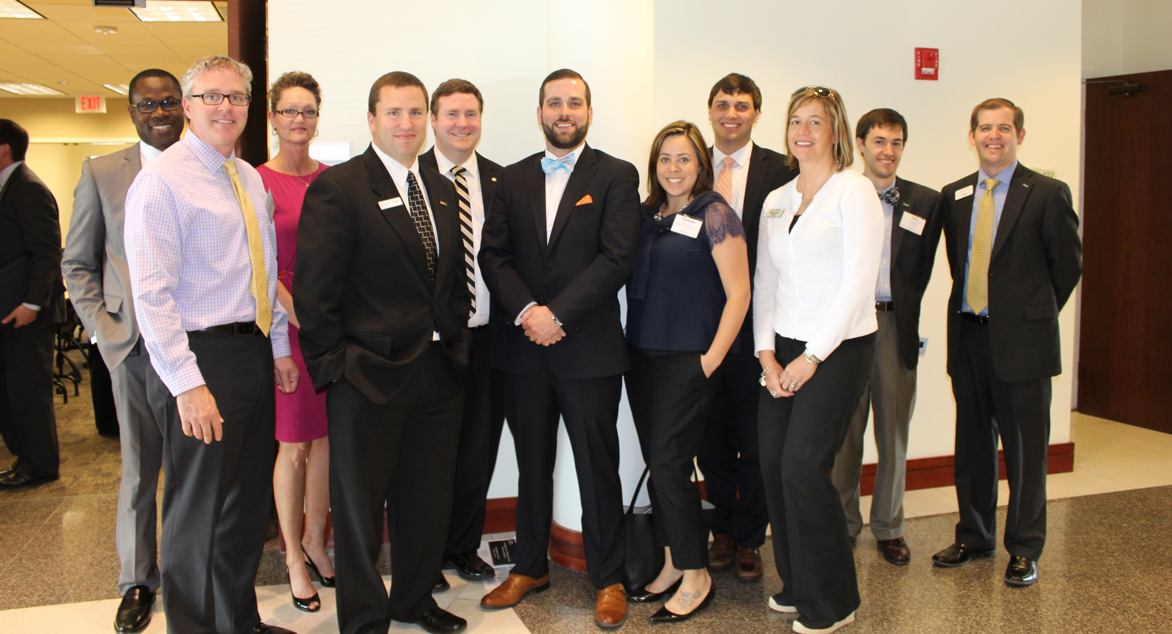
Careers banking
in

Slide 2
Today’s Agenda
[Insert specifics about the student’s time with your bank.]
[List departments/key members of the bank they will be meeting. Also, include your bank’s logo on this slide.]

Slide 3
VBA Bank Day Scholarship Program
The VBA Bank Day Scholarship Program is in its twelfth year.
In 2023, $26,000 in college scholarships will be awarded by the Virginia Bankers Association Education Foundation (VBAEF) to twelve students across the Commonwealth.
Six students will be named honorable mention winners, each winning a $1,000 scholarship.
Six students will be named regional winners, each winning a $2,500 scholarship.
One of the regional winners will also be named the statewide winner, earning an extra $5,000 scholarship for a total of $7,500 in college scholarships!

Slide 4
Bank Day Scholarship program - Essay guidelines
Using what you learned during your Bank Day visit, students will be asked to write an essay on the following topic:
What did you learn during Bank Day that will help you manage your financial future AND what did you learn about how banks support their communities?

Slide 5
Leadership
Plentiful Job Opportunities
Career Advancement
banking
Challenging Work
Community Service
Notes:
Banking Industry:
These are topics we’ll discuss today through this presentation and how our personal experiences and career paths have led to opportunities in these areas.

Slide 6
Find Your Future in Banking
Notes:
Link to video: https://www.youtube.com/watch?v=pNnv4g4HgEQ&feature=youtu.be

Slide 7
Banks Employ Two Million People
25%
Tellers
41%
Administrative and
Branch Operations
34%
Corporate and Management
Source: Bureau of Labor Statistics, 2013
Notes:
The banking industry employs more than 2 million people nationwide.
About two-thirds work in branches as tellers, loan officers and administrators. But as you can see, tellers—who as the public face of banks serve a very important role—make up one quarter of all banking jobs.

Slide 8
Snapshot of the Virginia Banking Industry
More than 45,000 employees
$11.9 billion in Paycheck Protection (PPP) Loans (more than 100,000 loans)
6.9 million banking customers
In 2020/2021, more than 284,000 volunteer hours and $77.1 million in community donations
Source: America’s Banks, https://americasbanks.aba.com/state-national-data/virginia
Notes:
Source OR resource to share with students: https://americasbanks.aba.com/state-national-data/virginia

Slide 9
Diverse Job Opportunities
customer sales representative
computer network technician
electronic banking officer
economist
human resources manager
attorney
agricultural lender
accountant
marketing manager
teller
Commercial loan officer
Compliance officer
Notes:
Possible talking points:
In addition to tellers, bank offer a variety of positions in such areas as compliance, business banking, public relations and marketing, accounting, human resources, IT and investment banking. A banker isn’t just a teller or a lender, he could be a computer network technician, an attorney or an economist.

Slide 10
About Our Bank
[Bank Name]
Headquartered in [city]
[#] branches throughout [location]
Employs [#] people
First office opened in [year]
[Name], [Chairman, President & CEO]
Insert picture of your bank headquarters
Insert bank logo

Slide 11
[Presenting Banker’s Name]
Background
[Information about banker]
[College attended]
[Degree]
[Previous work experience]
Pictures
Pictures

Slide 12
[Presenting Banker’s Name]
Banking Experience
[First job at a bank]
[Details on path to current position]
Pictures
Pictures

Slide 13
[Presenting Banker’s Name]
What I Looked for in an Employer
[Details about what was important to you when looking for a job/career]
Pictures
Pictures

Slide 14
[Presenting Banker’s Name]
Experiences as a Result of My
Career in Banking
[Details about unique experiences during your career - professional development, training, conferences, etc.]
Pictures
Pictures

Slide 15
[Additional Presenting Banker’s Name]
Background
[Information about banker]
[College attended]
[Degree]
[Previous work experience]
Pictures
Pictures

Slide 16
[Additional Presenting Banker’s Name]
Banking Experience
[First job at a bank]
[Detail on path to current position]
Pictures
Pictures

Slide 17
[Additional Presenting Banker’s Name]
What I Looked for in an Employer
[Details about what was important to you when looking for a job/career]
Pictures
Pictures

Slide 18
[Additional Presenting Banker’s Name]
Experiences as a Result of My
Career in Banking
[Details about unique experiences during your career - professional development, training, conferences, etc.]
Pictures
Pictures

Slide 19
Innovative
Educational
Perks of Being a banker
Service Business
Community Service
Notes:
Banking Industry:
■ Provides a wide range of job opportunities and experiences;
■ Encourages on-the-job training
■ Challenges you to solve problems and help others manage their finances; and
■ Offers opportunities for leadership and community service.
■ Competitive compensation and good benefits

Slide 20
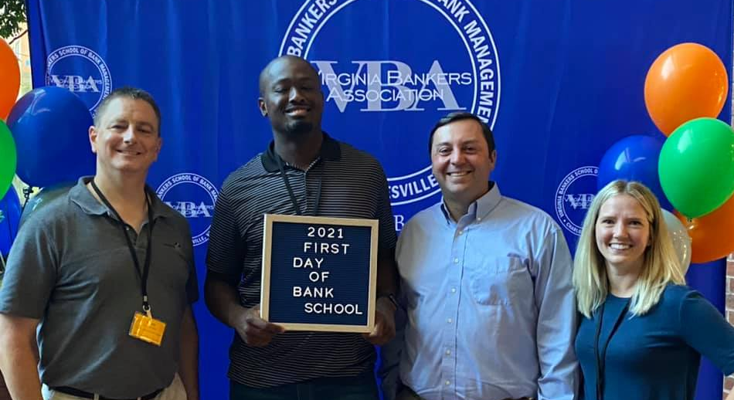
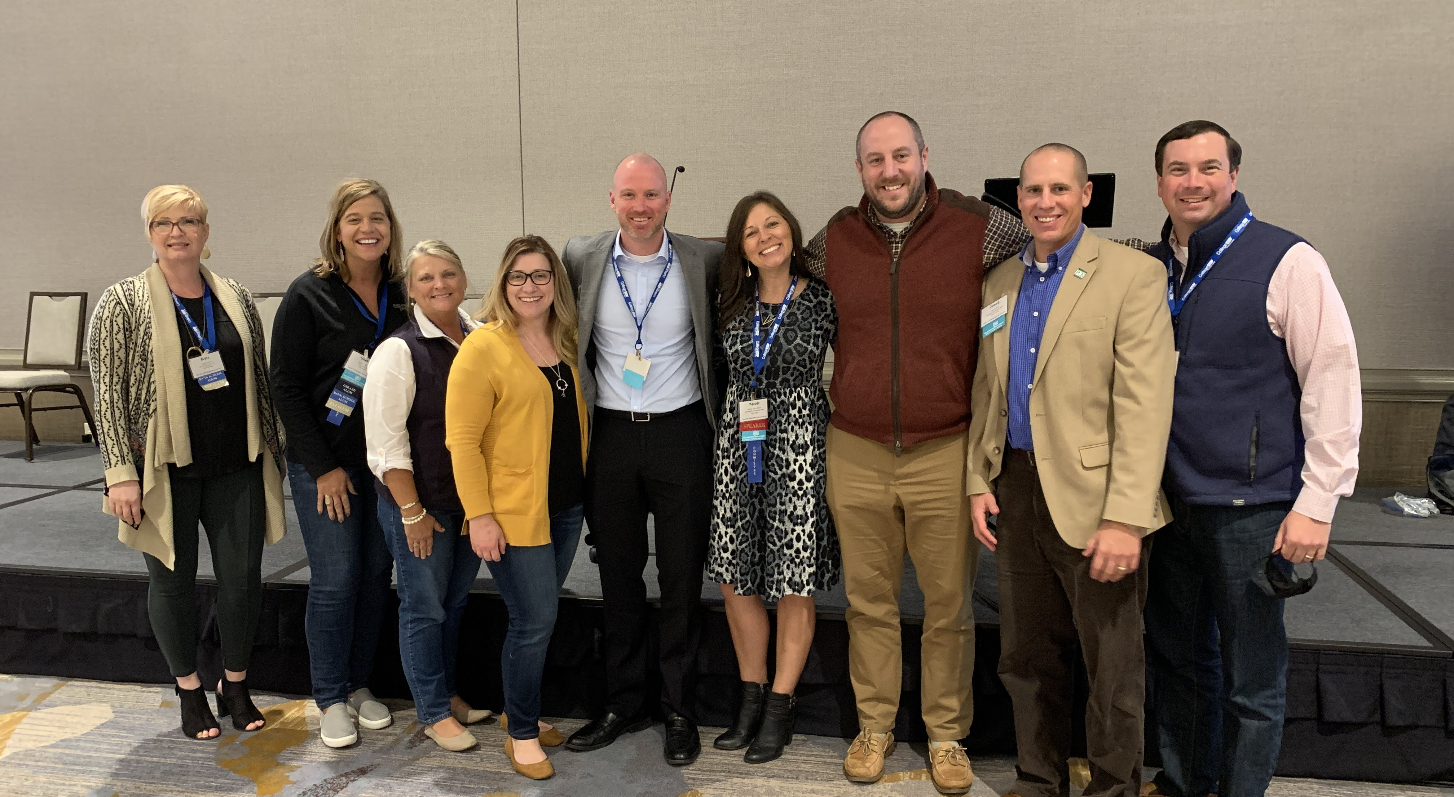
Banking is Educational
Continuing education
Professional certifications
Multiple career paths
Extensive trade association support and resources available to you
VBA Leadership Conference
VBA School of Bank Management
Notes:
Possible talking points:
Helping bankers develop their careers and enhance their profession is a long-established tradition. Banks offer training and encourage employees to further their educations.
Employees can advance their careers through trade associations like the American Bankers Association and the VBA. The VBA offers support in a variety of ways to the banks in Virginia.

Slide 21
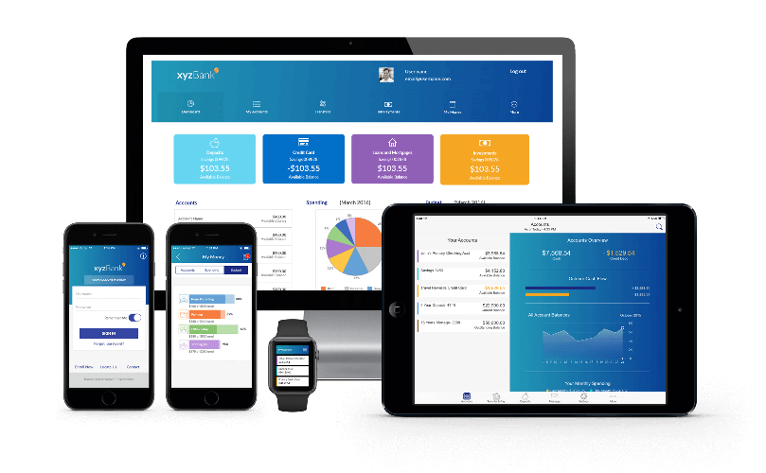
Banking is Innovative
Banking has a history of innovation – mobile banking, ATMs, online bill pay, credit and debit cards
These inventions have helped make consumers’ lives simpler and safer
New technology requires banks to add jobs to create and support mobile banking platforms, ATMs, and secure computer networks
Notes:
Banking is innovative.
Look at services such as mobile banking and online banking, which developed with the popularity of cell phones and the ubiquity of the Internet.
Discuss other fintech that your bank has embraced.
Bankers can make change and embrace change.

Slide 22
Banking is a Service Business
We help people and businesses manage their money and use credit carefully
We help people buy a home or start a business
We help our community grow
Notes:
What do bankers and banks do? We help people and businesses manage their money and to carefully use credit to achieve their dreams. That can include buying a home, saving for retirement or starting up a business. These activities and others help our community grow.

Slide 23
Best Perk of Being a Banker: Giving Back to Your Community
Pictures
Pictures
Description
Description
Notes:
In addition to helping our customers and community grow and prosper, like all banks do, we encourage our employees to give back through volunteer community service. Here are some examples…

Slide 24
Best Perk of Being a Banker: Giving Back to Your Community
Pictures
Pictures
Description
Description
Notes:
There are examples just like this at the banks where you are interning. Be sure to ask bankers you meet today to share the different ways your banks give back to their local community.

Slide 25
So What Does it Take to Become a Banker?
Desire to work with people
Good communication skills
Desire to learn and grow
Good credit history
College degree for a bank officer position or a specialized function
Notes:
Possible talking points:
What are the qualifications for a career in banking? Numerous opportunities exist for highly motivated individuals who are devoted to serving bank customers. You need to enjoy working with people, be able to communicate well, and be accurate, innovative, responsible, honest, sales-oriented and dedicated to community service. That says a lot about the profession. A good credit history is also important. And, while a college degree is helpful and often necessary for a bank officer’s position or a specialized function, it is not a requirement for working in a bank.

Slide 26
The Outlook: We’re Hiring
According to the Bureau of Labor Statistics, bank employment is projected to grow through the remainder of this decade.
One major growth area: compliance
Notes:
Possible talking points:
The outlook for bank employment remains promising. According to the Bureau of Labor Statistics, bank employment is projected to grow through the remainder of this decade.
Key drivers of this growth include increased regulatory compliance demands. Virtually every interaction we have with customers is guided by banking laws and their implementing regulations. These rules are enforced by regulators including the Federal Deposit Insurance Corp, the Office of the Comptroller of the Currency, the Federal Reserve, the Consumer Financial Protection Bureau and state regulatory agencies. That means banks must comply with thousands of pages of rules—many of which are new and affect entire segments of our lending business. Mortgage lending is one example. Bank compliance officers ensure that their institutions are following banking laws and regulations.

Slide 27
Explore the Opportunities
Careers banking
in
Picture
Notes:
Take a closer look at the many opportunities in banking. We’re glad we did. Let’s go to your questions now.

