Slide 1
Welcome to bank day!!

Slide 2
Let’s break the ice!............Networking 101
Write down three things about yourself on the notecard
Turn in your notecards
Draw a notecard
Speed chat! Find who your card belongs to by asking questions. (You have 23 seconds per person if you have to chat with everyone)…GO!

Slide 3
Today’s Agenda
Bank Trivia Kahoot with Jay Oakey-Essex Bank’s General Counsel
Essay / Scholarship Overview
Banking Basics
Careers in Banking
Community Involvement
Banker Meet and Greet
Lunch
Cash, Credit, & Consequences: Game of Financial Literacy

Slide 5
VBA Bank Day Scholarship Program
In 2020, $26,000 in college scholarships will be awarded by the Virginia Bankers Association Education Foundation (VBAEF) to twelve students across the Commonwealth.
Six students will be named honorable mention winners, each winning a $1,000 scholarship.
Six students will be named regional winners, each winning a $2,500 scholarship.
One of the regional winners will also be named the statewide winner, earning an extra $5,000 scholarship for a total of $7,500 in college scholarships!

Slide 6
Bank Day Scholarship program - Essay Topics
Using what you learned during your Bank Day visit, students will be asked to write an essay on the following topic:
What did you learn on Bank Day that will help you manage your financial future AND what did you learn about how banks support their communities?

Slide 7
Essay guidelines
Essay typed in English within one MICROSOFT WORD document (no google docs)
Typed in 12-point Times New Roman font
1.5 line spacing
1 inch margins
Include a title page:
Should contain all information listed on the ESSAY GUIDELINES provided in your packet
Your name should only go on the title page, not on any other page in your essay packet
Essay is limited to two pages (not including works cited or the title page)
Essay must address both parts of the essay topic.
All ideas must be your own. References should be cited.
Submit essays via email to the Virginia Bankers Association at bankday@vabankers.org
Essays due April 3rd by 5pm

Slide 8
Banking101

Slide 9
Basic Bank Function
Banks collect DEPOSITS that it then LENDS out to borrowers
Customers deposit $
Banks lend out $
Bank PAYS the customer INTEREST on deposits
Bank CHARGES the borrower INTEREST on loans
(Interest charged on Loans) – (Interest paid on deposits) =Profit

Slide 10
Sample Bank Structure:
Board of Directors-Chairman of the Board
President & CEO of Essex Bank
Chief Financial Officer
Legal & Governance

Slide 11
Sample Bank Structure
President & CEO
Accounting & Finance
Commercial & Industrial Lending
Commercial Real Estate Lending
Credit
Retail Banking
Digital Banking
Operations
Human Resources
Risk/Compliance
Mortgage & Consumer Lending
Small Business Lending
Essex Services: Investment
Retail Branch Banking
Deposit Operations
Retail Branch Operations
Training and Development
Bank Security
IT
Loan Collections and Special Assets
Appraisal & Evaluation Management
Payroll and Benefits Administration
Recruiting
General Counsel
Audit
Credit Analysis
Credit & Loan Operations
Marketing and Communications
Online & Mobile Banking
Call Center

Slide 12
Bank Deposit Products
An investment account where funds are deposited, earn interest, and can be accessed at an ATM or bank branch within certain limitations
An account where funds are deposited and can be withdrawn using checks, debit card, online transaction…funds are ‘on demand’
An investment account where funds are deposited, earn higher interest than saving accounts, and can be accessed at an ATM, bank branch, check writing, and debit card within certain limitations
Checking Account
Savings Account
Money Market Account

Slide 13
Bank Deposit Products
Certificate of Deposit (CD)
Health Savings Account
Individual Retirement Account
An account typically held as a certificate of deposit where funds are being saved specifically for retirement.
An investment account where funds are deposited for a specific length of time earning fixed interest rate during that time. Funds can not be withdrawn until the end of the specific term.
A checking account where funds are deposited and are used to pay for medical expenses, tax free.

Slide 14
Other vehicles to save and invest (non-deposit products)

Slide 15
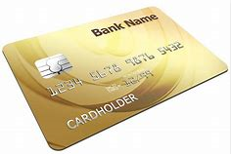
Bank Loan Products
Consumer Loan Products- Money needed for Life
Car Loans
Boat Loans
Mortgages
Home Equity Loans and Lines of Credit
Unsecured Loans

Slide 16
Bank Loan Products
Commercial and Small Business Loans
Equipment
Agricultural
Commercial Real Estate
Lines of Credit

Slide 17
Let’s Meet Some Bankers!!

Slide 18
Director of IT: Mike Dinelli

Slide 19
Consumer Credit Officer: Penny Dawkins
What Lenders Consider to Approve a Loan…
Credit Score = History of Repayment | Is the credit score in a fair to excellent range?
Debt to Income (DTI) = Ability to Repay | Calculated by your monthly payments (obligations) divided by your monthly income Should be around 43% or less for secured loans
Loan to Value (LTV) = Collateral Value | Is the collateral on the loan worth what we are lending? Mortgages may only allow 80% of the total home value

Slide 20
Chief Operations Officer : Jeff Cantrell

Slide 21
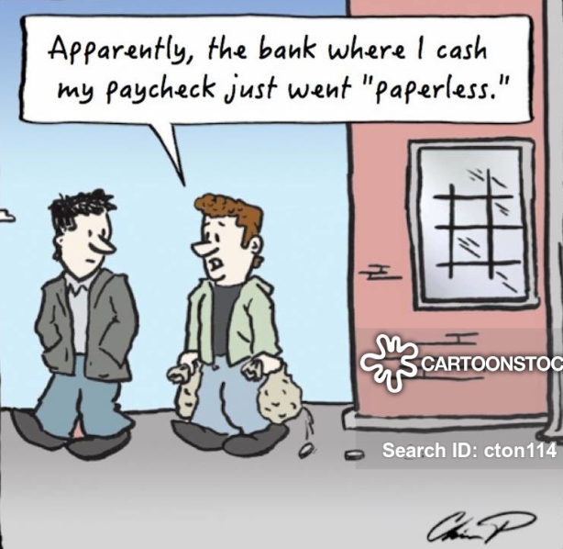
Digital Banking: Charles Driest

Slide 22
How banks contribute to their communities
Notes:
At our bank, we practice what we preach and do what we can to make our community a better place. Relationships are the foundation of our bank and investing in the future of the communities we serve is a core value at our bank.
[Give examples of customers you have helped and how that has benefited the community by doing so.]

Slide 23
Why Community Banks Matter
There are lots of types of banks: Commercial, Retail, Exchange, Industrial, Investment, Agricultural, Savings, Central, etc.
Community (Typically a blend of Commercial/Retail) banks constitute 99 percent of all U.S. banks
History – The word “Bank” is derived from the Italian for bench, banca, or counter; The term bankrupt is a corruption of the Italian banca rotta, or broken bench.²
Jobs: Employ nearly 750,000 Americans
Access: Only physical banking presence in one in three U.S. counties.
Economic Engine: More than $3.4 trillion in loans to consumers, small businesses and the agricultural community, community banks channel local deposits into the Main Streets and neighborhoods they serve, spurring job creation, fostering innovation.
*Data from Independent Community Bankers of America, https://www.icba.org/
²https://en.wikipedia.org/wiki/History_of_banking

Slide 24
Contributing to communities: Economic Engine
Notes:
[This slide could also list some of the specific types of customers your bank has made loans to that provide vital services to the local community, such as hospitals, small businesses, farms, non-profits, etc. In addition, it could discuss home loans made to low- to mid-income families or student loans.]

Slide 25
Contributing to our communities
Habitat for Humanity
VTO

Slide 26
Jobs
Essex Bank
Internships
100+ entry level jobs
Hire around 60 people annually
Since 2017, 116 new hires have been entry level
About 70 of our new hires since 2017 have been referred by an Essex Bank associate (top recruitment source)
Summer work for college students and teachers who have the opportunity to return
Exposure to banking
Shadow executives
Project work

Slide 27
Contributing to our communities
Supporting and facilitating financial literacy in local schools
Teach financial literacy students: Elementary, Middle, High, Young Adult, Seniors
Fund financial literacy curriculums used in schools
Teach teachers how to teach financial material to students
Provide school supplies
Notes:
[This slide could also list some of the specific types of customers your bank has made loans to that provide vital services to the local community, such as hospitals, small businesses, farms, non-profits, etc. In addition, it could discuss home loans made to low- to mid-income families or student loans.]

Slide 28
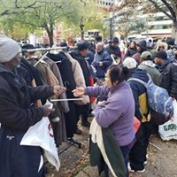
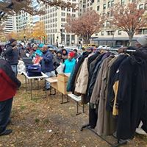
Contributing to our communities
We support local communities in times of need…

Slide 29
Let’s meet some more bankers!

Slide 31
Student Loans: How much will college cost!?
Average cost at private colleges: $34,740
Average cost for state residents at public colleges: $9,970
Average cost for out-of-state residents at public universities: $26,620

Slide 32
Can your Career pay for your education?
Be educated about getting your education.
Can you get the education you need at a lower cost?
If you know what you want to be, do you know the average salary for that job?
Do you know how much formal education you will need to be qualified for the job?
Does the salary of the job you want pay for the education you had to receive to get the job? If so, how long until you pay off the debt?

Slide 33
Start saving money now!!!
Pay yourself first!

Slide 34
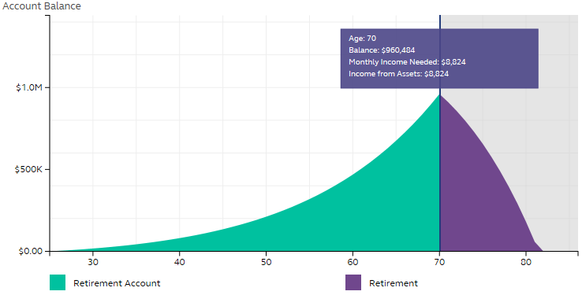
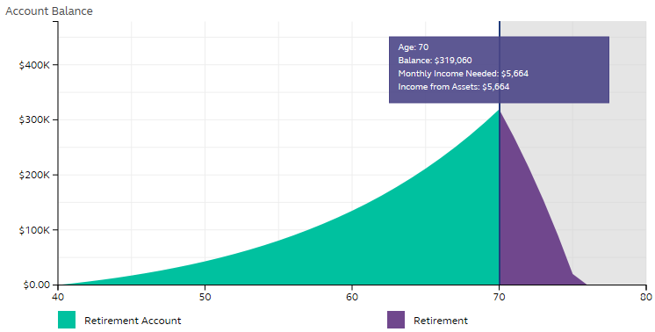
$960,484
$319,060
Beginning at age 25 / Retiring at age 70
Contributing 8%
Starting salary $35,000
Does not include other retirement benefits or savings (no Social Security)
www.principal.com
Beginning at age 40 / Retiring at age 70
Contributing 8%
Starting salary $35,000
Does not include other retirement benefits or savings (no Social Security)
www.principal.com

Slide 35
Smart use of Credit Cards
Credit cards can be beneficial if used wisely
Best Practice: if you can drink it, wear it, or eat it you shouldn’t be using credit to pay for it
You must be able to afford much more than the minimum payment in order to pay it off.
You should never use more than 30% of the credit card limit
$3,500 Balance
Monthly Payment | # of years to payoff balance | Total you will be paying:
Minimum | 17 years | $9,365
$135 | 3 years | $4800

Slide 36
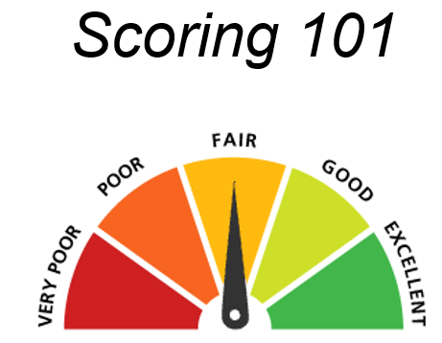
Understanding Credit and your Credit Score
Your credit score tells banks how likely you are to repay your loan
The higher the number, the more likely you are to repay, the more likely you are to be approved for a loan
450
650
850

Slide 37
Scoring Model Example

Slide 38
Consequences of a poor credit score
Difficult to qualify for loans, mortgages, credit cards
Will pay higher interest rates when borrowing
May be declined for a cell phone account
May not be able to open deposit accounts
May be declined for employment
May be declined to lease an apartment/house

Slide 39
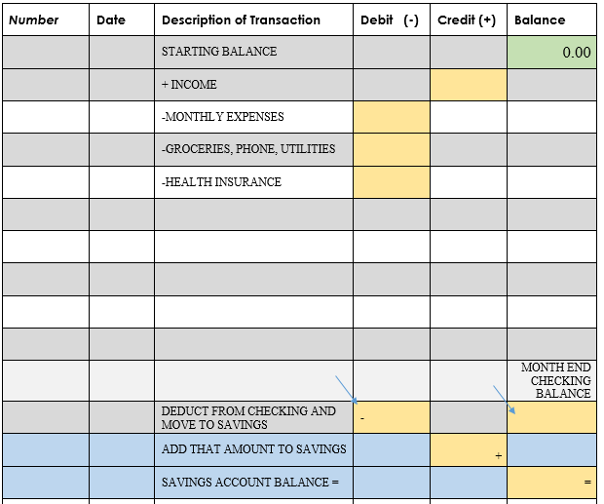
Track your expenses – insert check register here

Slide 41
Financial Tips for College Students
Create a BUDGET and stick to it. Don’t spend what you don’t make.
Use CREDIT wisely. Begin building your credit history responsibly.
Know what your BANK has to offer (online services, credit, savings, etc)
SAVE. Have a rainy day fund.
Don’t be afraid to ASK. Ask you parents/banker about financial questions.
Don’t TRUST just anyone with your money.
Pay bills ON TIME
Begin a RETIREMENT plan as soon as possible. Try to pay yourself first.
Beware of Social Media! What you post never goes away. Employers might search your profiles.

Slide 42
More Resources Provided…

Slide 43
Thank you for attending
Bank Day at Essex Bank!

