Slide 1
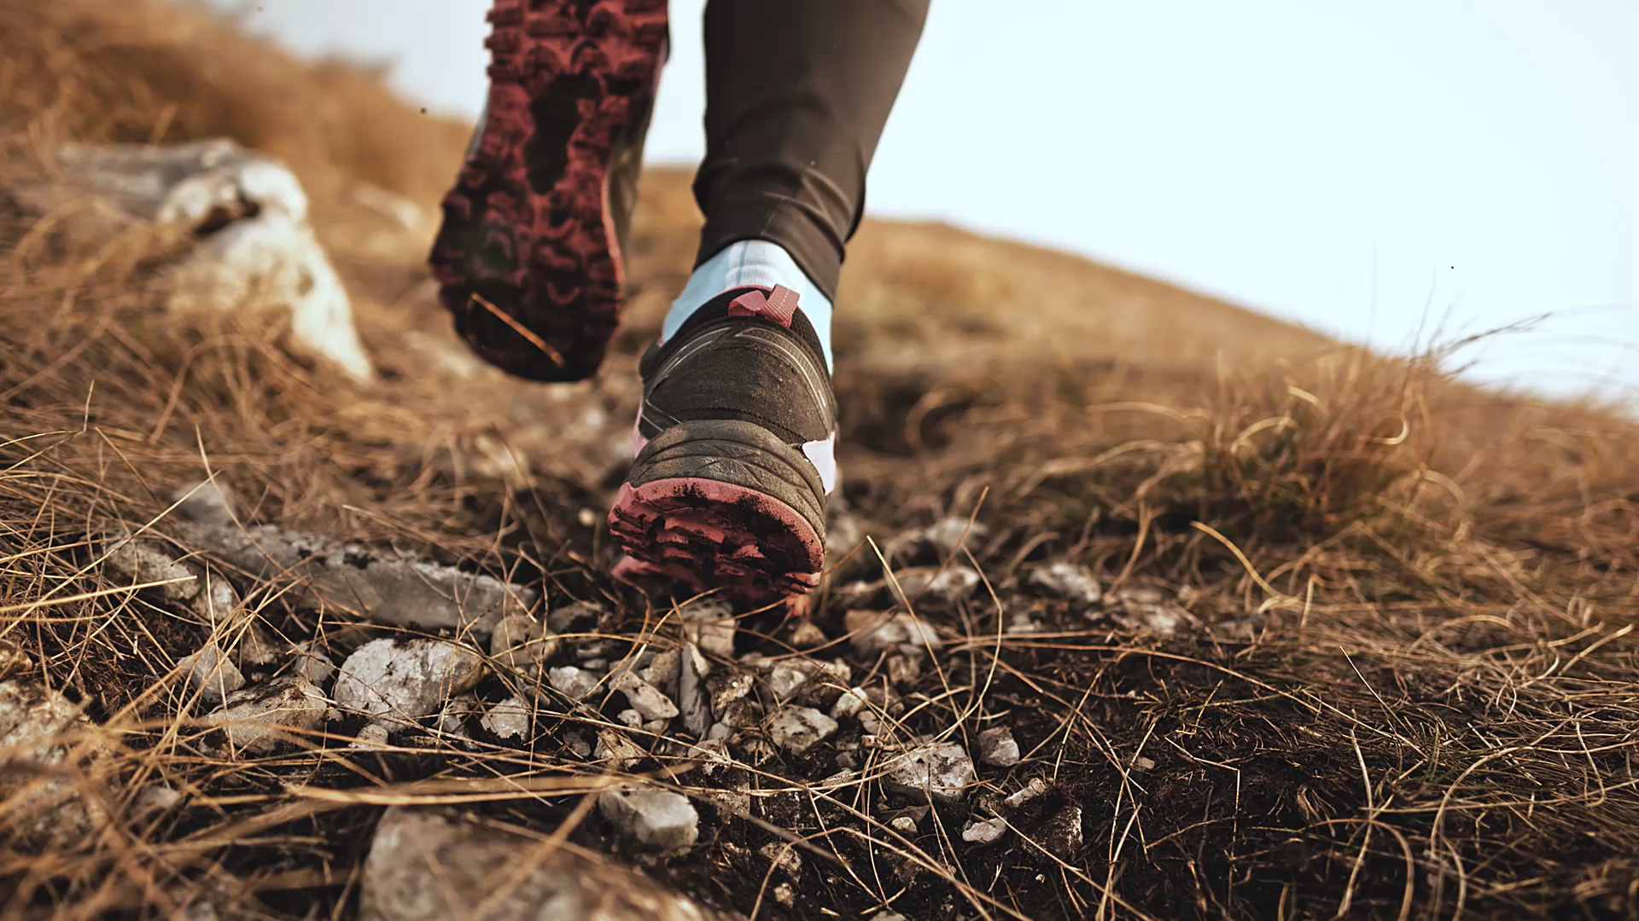
Grand Adventure Walking Challenge Details for HR Administrators
VBA Benefits Corp. & Wellworks for You
March 24, 2025

Slide 2

Challenge Details
What is it: Virtual Walking Challenge through Grand Canyon
When: April 7th through May 4th
Who: Employees with medical coverage through your bank/employer sponsored by VBA Benefits Corp.
How: Employees sign up through the Wellworks for You portal/app

Slide 3

How do employees sign up?
Employers that have medical coverage through VBA Benefits Corp. have own Wellworks for You portal already set up and ready for the challenge
The challenge is open March 24th for employees to sign up to participate for the April 7th launch
Send initial communications launch flyer to employees detailing the challenge and how to log into Wellworks for You - located on VBA Well-being microsite
Employee selects “SIGN IN” and use work email as username and birthdate (MMDDYYYY) as temporary password. System will prompt to change password immediately. Once in the site, “Challenges” icon will be located in bottom banner and sign up as well as connect activity tracker/device

Slide 4

Let’s view the Wellworks Portal and Challenge Dashboard!

Slide 5
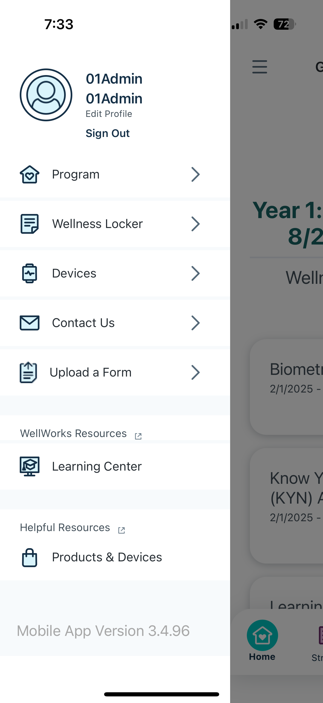
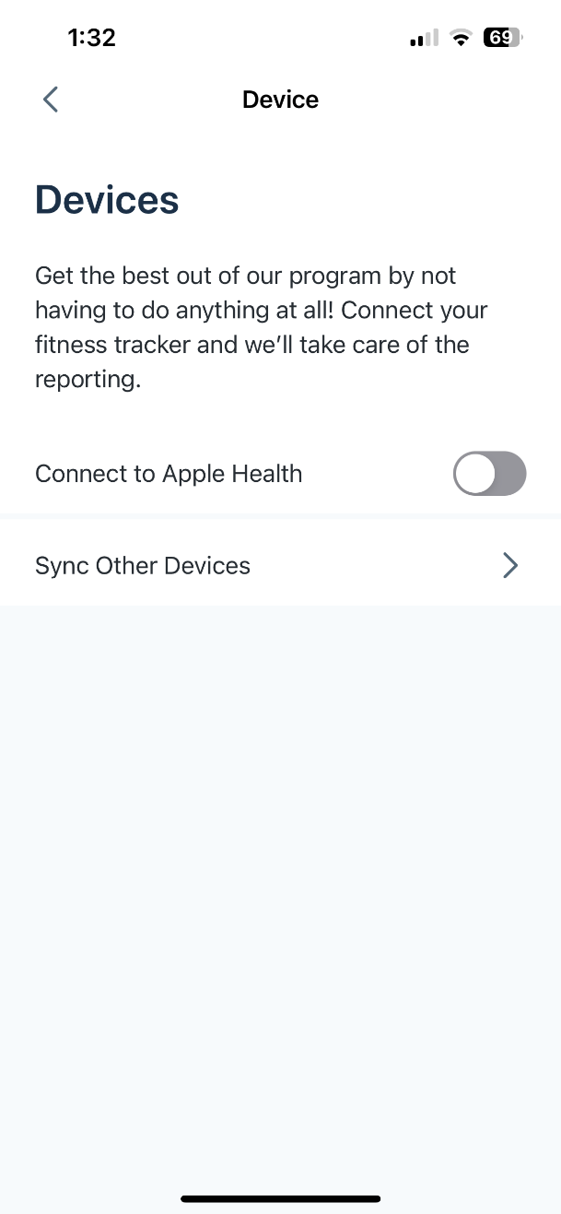
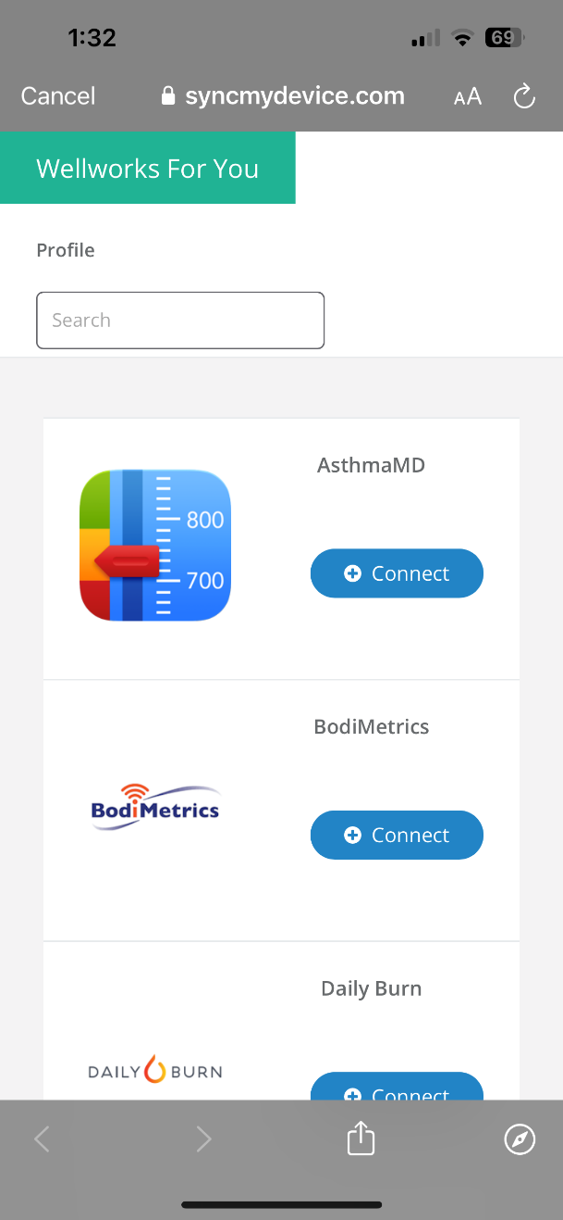
SYNC YOUR DEVICE!
Sync your device or everyday fitness app to the Wellness Portal or Mobile App. Click Device/App Connect from the portal homepage, locate your device and follow the prompts to sync with the Wellness Portal.
NOTE: Apple users must sync via the Wellworks For You mobile app to transfer data from the Apple Health App and Apple Watch.
For more information, view the Device/App Sync Guide & Troubleshooting Tips in the Wellness Locker!

Slide 6
What we need from HR
Promote the Challenge!
Offer incentives for participants to meet the challenge goal of 6,000 steps per day (participant reporting is available for HR administrators)
Raffled gift cards to all who completed the goal
PTO
Healthy lunch
Bragging rights for the winners
Communication throughout the Challenge:
Introductory email
Weekly emails encouraging participants
All materials located on microsite; Benefits Corp. will send weekly email as a reminder to distribute to employees

Slide 7


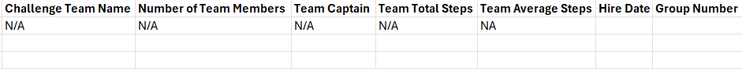
Reporting Sample – Challenge Incentive

Slide 8

Questions?
Grand Canyon Walking Challenge
April 7 – May 4

