Slide 1

2026 Benefits Open Enrollment
November X-X, 2025
Insert Employer Logo

Slide 2

Agenda
What’s changing for 2026?
Medical and Prescription Drug Benefits
Ancillary Benefits
  Dental Plan Options
  Vision Plan Options
  Flexible Spending Account Plans
  Disability Plan Options
  Life and AD&D Plan Options
  Voluntary Benefits
Open Enrollment Details

Slide 3
What’s Changing for 2026?

Slide 4

Noteworthy updates
  Medical plan design changes in 2026
    Updated medical plan names
    Prescription drug copay increases
    Virtual (telemedicine) primary care and behavior health coverage at 100%
    New medical plan – HealthKeepers 5000
  Dependent Care Flexible Spending Account maximum increasing from $5,000 to $7,500

Slide 5
Updated Medical Plan Names for 2026
Medical plan names updated to highlight Anthem network the plan utilizes and to be more consistent with how Anthem refers to networks on their website. ​
Each medical plan name will start with the network name (KeyCare or HealthKeepers) followed by the copay or deductible amount.
2025 Plan Name​ | 2026 Plan Name​
PPO 20​ | KeyCare 20​
PPO 25​ | KeyCare 25​
HMO 25​ | HealthKeepers 25​
PPO HRA​ | KeyCare HRA 2000​
PPO $2000 (HSA)​ | KeyCare 2000​
PPO $3500 (HSA)​ | KeyCare 3500​
HMO $3500 (HSA)​ | HealthKeepers 3500​
PPO $5000 (HSA)​ | KeyCare 5000​
NEW PLAN FOR 2026​ | HealthKeepers 5000​

Slide 6
Prescription Drug Copay Changes
  Increase copays by $5/$10/$15 for tier 1 through tier 3 medications; last indexed in 2016
  Drug copays same for all medical plans
 | Current Copays | 2026 Copays
Tier 1 | $15 | $20
Tier 2 | $40 | $50
Tier 3 | $75 | $90
Tier 4 – no change | 20% or $200

Slide 7

Telemedicine Coverage Expanded to 100%
One Big Beautiful Bill Act (OBBBA) permits telehealth and virtual care services to be provided at no cost to members before meeting their HDHP/HSA plan deductible. This waiver also applies to the copay and HRA plans.​
Covers visits for virtual primary care and behavioral health in-network providers and LiveHealth Online (LHO) (excludes LHO Dermatology)

Slide 8

LiveHealth Online Telehealth
Connect with care anywhere
Telehealth appointments on your mobile phone, tablet, or computer with a camera
Board-certified doctors available 24/7 for advice, treatment, and prescriptions
See a licensed therapist or psychiatrist. Appointments are available 7 days a week and usually cost the same as an in-person visit.
To make a LiveHealth Online virtual care appointment, in your Anthem account, choose Virtual Visit With A Provider under Care.

Slide 9
New Medical Plan HealthKeepers $5000
Plan Feature | KeyCare 5000 | NEW! HealthKeepers 5000
Annual Deductible
In-network (Employee only/Family) | $5,000/$10,000 | $5,000/$10,000
Out-of-network (Employee only/Family) | $5,000/$10,000 | $5,000/$10,000
Annual Out-of-pocket Maximum
In-network (Employee only/Family) | $6,000/$12,000 | $6,000/$12,000
Out-of-network (Employee only/Family) | $12,000/$24,000 | $12,000/$24,000
In-Network Benefits Illustrated Below
Preventive Care Services
Employee Only/Family | Covered at 100% | Covered at 100%
Doctor Visits & Medical Services
Primary Care Physician | After deductible, plan pays 100%, you pay 0% | After deductible, plan pays 100%, you pay 0%
Specialist
In-Patient Hospital
Most Other Services
Prescription drugs - Four-tier program
Retail (30 day supply) benefit illustrated by tier. Mail order (90 day supply) cost is retail copay multiplied by 2.5; specialty drugs only allow for 30 day supply. | Copay applies to preventive drugs before deductible; all drugs after deductible. 1st Tier: $20 2nd Tier: $50 3rd Tier: $90 4th Tier: 20%, $200 per prescription maximum | Copay applies to preventive drugs before deductible; all drugs after deductible. 1st Tier: $20 2nd Tier: $50 3rd Tier: $90 4th Tier: 20%, $200 per prescription maximum
Out-of-Network Member Coinsurance | 20% | 20%
Network | KeyCare PPO | HealthKeepers HMO
Same plan design as PPO 5000; only differentiator is the network (HealthKeepers)
Rate differential is approximately 3% decrement from the PPO 5000 plan

Slide 10
Medical Plan Options

Slide 11
HealthKeepers vs. KeyCare
HealthKeepers
  Need to live or work in state of Virginia
  Cheaper premium rates in comparison to KeyCare due to more limited network
  Higher negotiated discounts for medical services, thus less out of pocket expense
  Out of state care – utilize KeyCare network
KeyCare
  Higher premium rates in comparison to HealthKeepers due to more robust network
  National network
Anthem network provider – https://www.bcbs.com/
  Click “Find Doctor” under “Members” and use current address
  Enter “BVA” for KeyCare network or “XHY” for HealthKeepers network

Slide 12
12
KeyCare 20
$20 primary care/$40 specialist
100% for preventive care services, no member co-pay
80%/20% co-insurance in-network
  Inpatient (after $400 co-pay) and outpatient (after $200 co-pay) hospitalization
  Lab, tests, x-rays, and most other services
$4,000 individual/$8,000 family out of pocket maximum
Drug Co-pays:
    $20/$50/$90/20% up to $200
6
12

Slide 13
KeyCare 25
$25 primary care/$50 specialist
100% for preventive care services, no member co-pay
$500 individual/$1,000 family deductible
  Inpatient and outpatient hospitalization
  Lab, tests, x-rays, and most other services
80%/20% co-insurance in-network, after deductible
$4,500 individual/$9,000 family out of pocket maximum
Drug Co-pays:
    $20/$50/$90/20% up to $200
13

Slide 14
HealthKeepers 25
Anthem HealthKeepers network of providers
$25 primary care/$50 specialist
100% for preventive care services, no member co-pay
$500 individual/$1,000 family deductible
  Inpatient and outpatient hospitalization
  Lab, tests, x-rays, and most other services
80%/20% co-insurance in-network, after deductible
$4,500 individual/$9,000 family out of pocket maximum
Drug Co-pays:
    $20/$50/$90/20% up to $200
14

Slide 15
KeyCare HRA
Two components:
  High deductible health plan (HDHP)
  Health reimbursement account (HRA)
15

Slide 16
16
1st component of KeyCare HRA Plan – High Deductible Health Plan
Deductible (HRA)
  $2,000 ($500 HRA allocation) Individual
  $4,000 ($1,000 HRA allocation) Family
  One person can meet the $2,000 deductible and the plan will start paying for that person even if the $4,000 for family hasn’t been satisfied
Preventive care services covered at 100% outside of the deductible
80%/20% co-insurance in-network after deductible
Out-of-Pocket Maximum
  $3,500 Individual
  $7,000 Family
Drug co-pays:
  $20/$50/$90/20% up to $200
  Co-pays for approved preventive care drugs taken from HRA prior to deductible (please see CarelonRx’s list of approved preventive drugs); co-pays do not accumulate towards deductible, but do accumulate towards the out-of-pocket maximum
  Non-preventive drugs count towards deductible and out-of-pocket maximum
  Co-pays for all drugs after deductible is met
16
16

Slide 17
17
2nd component of KeyCare HRA Plan– Health Reimbursement Account
Built in HRA to offset deductible:
  $500 individual, $1,000 family
  HRA funds not spent roll over to next year, up to the annual deductible amount
  Pays first while meeting deductible
  Anthem processes claims and tracks HRA usage
Can participate in traditional flexible spending account; HRA pays first
17
17

Slide 18
KeyCare $2000
$2,000 individual/$4,000 family deductible
All members with family coverage must meet the $4,000 deductible before the plan will start paying
90%/10% co-insurance in-network for all medical costs after deductible
Preventive care services covered at 100% outside of the deductible
$3,500 individual/$7,000 family out of pocket maximum
Drug co-pays:
  $20/$50/$90/20% up to $200
  Co-pays for approved preventive care drugs before deductible (please see CarelonRx’s list of approved preventive drugs); co-pays do not accumulate towards deductible, but do accumulate towards the out-of-pocket maximum
  Non-preventive drugs count towards deductible and out-of-pocket maximum
  Co-pays for all drugs after deductible is met
18

Slide 19
Keycare $3500
$3,500 individual/$7,000 family deductible
  One person can meet the $3,500 deductible and the plan will start paying for that person even if $7,000 for family hasn’t been satisfied
100% co-insurance in-network for medical after deductible
Preventive care services covered at 100% outside of the deductible
$4,000 individual/$8,000 family out-of-pocket maximum
Drug copays:
  $20/$50/$90/20% up to $200
  Co-pays do not accumulate towards deductible, but do accumulate towards the out-of-pocket maximum
  Non-preventive drugs count towards deductible and out-of-pocket maximum
  Co-pays for approved preventive care drugs before deductible (please see CarelonRx’s list of approved preventive drugs)
  Co-pays for all drugs after deductible is met
19

Slide 20
Healthkeepers $3500
Anthem HealthKeepers network of providers
$3,500 individual/$7,000 family deductible
  One person can meet the $3,500 deductible and the plan will start paying for that person even if $7,000 for family hasn’t been satisfied
100% co-insurance in-network for medical after deductible
Preventive care services covered at 100% outside of the deductible
$4,000 individual/$8,000 family out-of-pocket maximum
Drug copays:
  $20/$50/$90/20% up to $200
  Co-pays for approved preventive care drugs before deductible (please see CarelonRx’s list of approved preventive drugs); co-pays do not accumulate towards deductible, but do accumulate towards the out-of-pocket maximum
  Non-preventive drugs count towards deductible and out-of-pocket maximum
  Co-pays for all drugs after deductible is met
20

Slide 21
Keycare $5000
$5,000 individual/$10,000 family deductible
  One person can meet the $5,000 deductible and the plan will start paying for that person even if $10,000 for family hasn’t been satisfied
100% co-insurance in-network for medical after deductible
Preventive care services covered at 100% outside of the deductible
$6,000 individual/$12,000 family out-of-pocket maximum
Drug copays:
  $20/$50/$90/20% up to $200
  Co-pays for approved preventive care drugs before deductible (please see CarelonRx’s list of approved preventive drugs); co-pays do not accumulate towards deductible, but do accumulate towards the out-of-pocket maximum
  Non-preventive drugs count towards deductible and out-of-pocket maximum
  Co-pays for all drugs after deductible is met
21

Slide 22
Healthkeepers $5000
Anthem HealthKeepers network of providers
$5,000 individual/$10,000 family deductible
  One person can meet the $5,000 deductible and the plan will start paying for that person even if $10,000 for family hasn’t been satisfied
100% co-insurance in-network for medical after deductible
Preventive care services covered at 100% outside of the deductible
$6,000 individual/$12,000 family out-of-pocket maximum
Drug copays:
  $20/$50/$90/20% up to $200
  Co-pays for approved preventive care drugs before deductible (please see CarelonRx’s list of approved preventive drugs); co-pays do not accumulate towards deductible, but do accumulate towards the out-of-pocket maximum
  Non-preventive drugs count towards deductible and out-of-pocket maximum
  Co-pays for all drugs after deductible is met
22

Slide 23
HEALTH SAVINGS ACCOUNT (HSA)
How Does a Health Savings Account (HSA) Work?
Establish a Health Savings Account (HSA) and make contributions into it
Pay out-of-pocket health plan costs (deductible and co-insurance)
Decide whether to reimburse yourself out of HSA for out-of-pocket costs
Unused funds in HSA remain and available to use for future costs
Can be used for spouse and tax dependents, even if they are not covered by the high deductible health plan
To contribute to an HSA, you:
Must be enrolled in qualified high deductible health plan (HDHP)
Cannot be enrolled in Medicare
Cannot be covered by another health insurance plan
Cannot be enrolled in a regular medical Flexible Spending Account
Cannot be claimed as a dependent on another’s tax return (doesn’t apply to joint filing)
HSA Triple Tax Advantage
All contributions are tax-free
All interest earned is tax-free
All funds used for qualified medical expenses are tax-free
HSAs can be used on certain insurance premiums
COBRA
Long Term Care
Medicare, parts B & D
23

Slide 24
Cost of living adjustments
2026 Health Savings Accounts (HSAs):
  Individual Limit: $4,400
  Family Limit: $8,750
  Catch-up Contribution (55+): $1,000
  2026 Healthcare Flexible Spending Account (FSAs) 2025 amounts
  Limit - $3,400
  Carryover maximum - $680

Slide 25
Low Claims Utilization Example – Employee Only
25
*For illustrative purposes only, costs could be overstated depending on dates of service.
- Annual wellness visit: $200
- Two PCP office visits: $75 each
- One specialist office visit: $150 each
- One generic prescription per month (level 1): $12
Service | KC 20 | KC 25 | HK 25 | KC HRA | KC 2000 | KC 3500 | HK 3500 | KC 5000 | HK 5000
Wellness | $0 | $0 | $0 | $0 | $0 | $0 | $0 | $0 | $0
PCP | $40 | $50 | $50 | $0 ($150 fund) | $150 | $150 | $150 | $150 | $150
Specialist | $40 | $50 | $50 | $0 ($150 fund) | $150 | $150 | $150 | $150 | $150
Rx | $144 | $144 | $144 | $0 ($144 fund) | $144 | $144 | $144 | $144 | $144
CLAIMS COSTS | $224 | $244 | $244 | $0 | $444 | $444 | $444 | $444 | $444
Annual EE Premium | $0 | $0 | $0 | $0 | $0 | $0 | $0 | $0 | $0
TOTAL ANNUAL COSTS | $0 | $0 | $0 | $0 | $0 | $0 | $0 | $0 | $0
25

Slide 26
High Claims Utilization Example – Employee Only
26
- Annual wellness visit: $200 - One MRI: $800
- Two-day hospital stay: $5,000 - One generic prescription (preventive – tier 1) per month (level 1): $20 each
- One PCP visit: $75 - One prescription (non-preventive – tier 2) per month (level 1): $80 each
- Four specialist office visits: $150 each
*For illustrative purposes only, costs could be overstated depending on dates of service.
Service | KC 20 | KC 25 | HK 25 | KC HRA | KC 2000 | KC 3500 | HK 3500 | KC 5000 | HK 5000
Wellness | $0 | $0 | $0 | $0 | $0 | $0 | $0 | $0 | $0
Hospital | $1,320 | $1,400 | $1,400 | $2,100 ($500 fund) | $2,300 | $3,500 | $3,500 | $5,000 | $5,000
PCP | $20 | $25 | $25 | $15 | $7.50 | $0 | $0 | $0 | $0
Specialist | $160 | $200 | $200 | $120 | $60 | $0 | $0 | $0 | $0
MRI | $160 | $160 | $160 | $160 | $80 | $0 | $0 | $0 | $0
Rx 1 | $240 | $240 | $240 | $240 | $240 | $145 | $145 | $240 | $240
Rx 2 | $600 | $600 | $600 | $600 | $600 | $355 | $355 | $600 | $600
CLAIMS COSTS | $2,500 | $2,625 | $2,625 | $3,235 | $3,287.50 | $4,000 | $4,000 | $5,840 | $5,840
Annual EE Premium | $0 | $0 | $0 | $0 | $0 | $0 | $0 | $0 | $0
TOTAL ANNUAL COSTS | $0 | $0 | $0 | $0 | $0 | $0 | $0 | $0 | $0
26

Slide 27
Additional Medical Tools & Resources

Slide 28



Sydney Health mobile app
Download Sydney Health and register on the app to take full advantage of your Anthem plan.
Use it to:
Find care and check costs.
See all medical benefits.
View medical claims and payment information.
View and use digital ID cards.
Get answers quickly with the interactive chat feature.
Access virtual care.
Access wellness resources and rewards.
Sync with your fitness tracker.
Reach Member Services for support.
Note: For 2026, new ID cards will be available in electronic version only; please make sure to download the Sydney app before the end of the year.

Slide 29
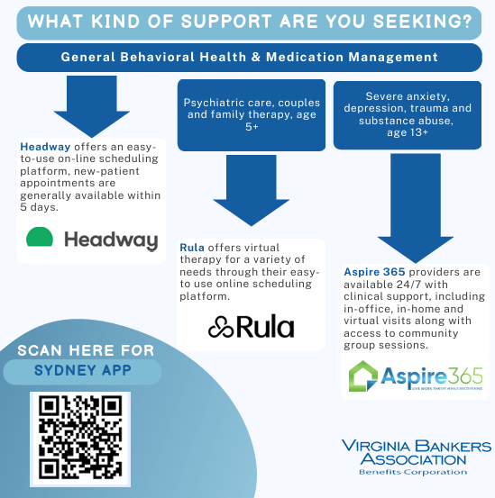
Anthem Mental Health Resources
Details available through Sydney App
In-network specialty provider groups
Marketing Communication available on website
29
Notes:
John

Slide 30

Total Health Connections
Members are paired with a family advocate who can assist with:
Locating providers and scheduling appointments
Stay on top of preventive care and manage chronic conditions
Suggest additional benefits and resources available from employer
Assist with getting pre-approvals for urgent medical needs, such as surgery
Connect with in-house clinical experts to create a personal care plan that supports the overall wellness and ongoing health needs of the member
Support whole health of member with non-medical needs such as food; childcare; transportation; and other social, financial and mental health concerns
Serviced through the Sydney Health app using the chat feature or dedicated 800# for phone calls

Slide 31
Employee Assistance Program (EAP)
A confidential service to help you:
Find support for various personal and work-related issues.
Connect with legal, financial, and crisis counselors.
Reach EAP at 800-346-5484 and online when you log in to anthem.com (Login – VBA). You can also reach them through the Sydney Health mobile app.

Slide 32

Lark - Diabetes Prevention Program
The 12-month weight loss program can help you lose weight and reduce your risk for diabetes.
Anthem and Lark have come together to offer this program at no extra cost. It is part of your health plan.
It’s customized to your lifestyle, so you receive 24/7 coaching to:
Lose weight
Manage stress
Eat healthier
Sleep better
Increase activity
Use the Sydney Health mobile app to complete the Lark prediabetes survey by going to My Health Dashboard and searching for Lark Diabetes Prevention Program under Programs.

Slide 33
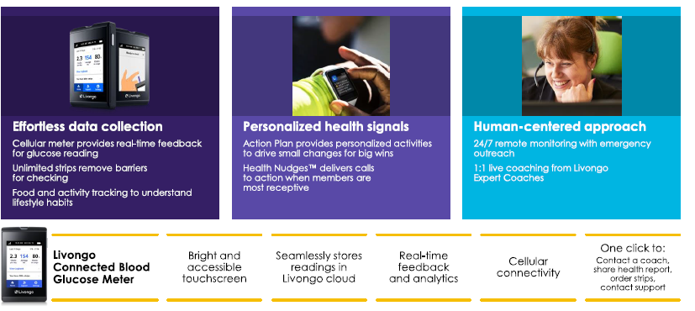
Teladoc Health– Diabetic Solution
Health Coaching included; diabetic supplies provided at no cost to member. Participants will receive letter if eligible, can reach out to Total Health Connections Team or available through the Sydney app to self-enroll.

Slide 34

Cancer Care Engagement
When members enroll in Cancer Care Engagement, a navigator serves as their partner to assist with the following:
Building a care team, including mental health and pharmacy support
Developing a personalized plan to manage all your health conditions
Connecting with community resources such as transportation and support groups
Program has an app featuring:
24/7 support through chat
Tools to help you check your symptoms and monitor health status
Resources to answer questions
Members access resource through anthem.com, Sydney Health app or Total Health Connections.

Slide 35







HINGE HEALTH
Digital Musculoskeletal Program (physical therapy program)
$0.00 cost to members – not subject to deductible and co-insurance
Anthem Medical participants and dependents (over age 18) are eligible
Complete assessment at hingehealth.com/vabankers or log into the Sydney app
Prevention
At-risk
Job-specific exercises & education
Acute
Recent injury
Virtual PT for all joint
& muscle groups
Chronic
High-risk
Exercise, education, and behavioral change
Surgery
Pre & Post rehab
Pre/post rehab & continuity of care

Slide 36
Maven for VBA Benefits Corp. Members
A comprehensive family planning and support program at no cost to members
**Employees and partners/spouses on the Anthem medical plan
Fertility & Family Building
Maternity & Newborn Care
Parenting & Pediatrics
Pediatric care Parent coaching Family medicine
Special needs support Childcare navigation
Menopause &
Ongoing Care
Preconception
Egg and sperm freezing IUI & IVF
Male fertility Adoption & surrogacy
Pregnancy Postpartum Newborn Care
Return-to-work coaching Miscarriage & loss
Perimenopause
Menopause Postmenopause
Early intervention
Symptom management

Slide 37
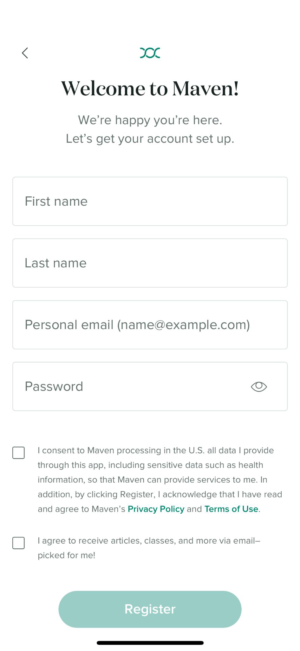
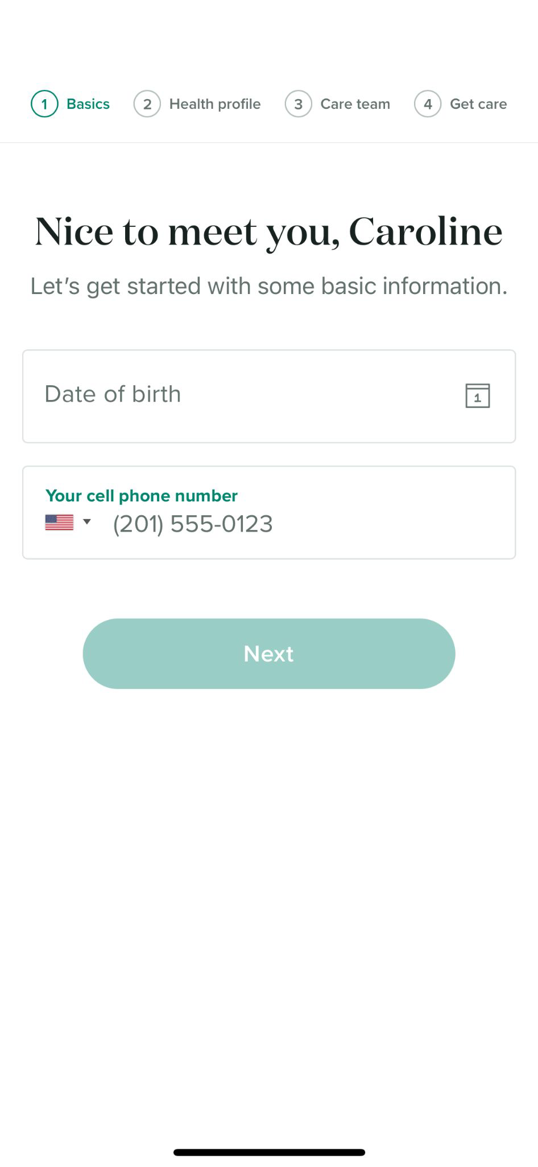


Create your Maven account and get verified
Go to mavenclinic.com/join/takecare, register by downloading the Maven Clinic app or Sydney app. Registering and choosing a pathway will charge the plan so do not enroll unless you are ready to utilize the benefit.
Maven
mavenclinic.com/join/takecare

Slide 38

Program provides resources for members with high blood pressure. Registered members receive a blood pressure cuff which links to the Hello Heart app to track blood pressure readings and provide customized digital coaching and reminders.
Eligibility for program:
Enrolled medical plan employees, spouses, and dependents over age 18 can participate at no cost
Has a blood pressure reading of 130/80mmHG or above
Those currently taking blood pressure medication
Women in pre and post menopausal stages
Participants will receive emails and direct mail with additional information to sign up or log into the Sydney app to enroll.

Slide 39



Noom takes a personalized, mind-first approach that combines technology and human support to create healthier daily habits. The program includes:
Educational support behind bad habits and how to change them
Daily lesson tailored to each user's goals
1:1 coaching and peer support
AI food logging
Move exercise tutorial library
Eligibility for program:
Enrolled medical plan employees and spouses can participate at no cost
Participants will receive emails with additional information to sign up or log into the Sydney app to enroll

Slide 40
Ancillary Benefits

Slide 41
DENTAL PLAN HIGHLIGHTS
No plan or rate changes
Plan Design Feature | Basic | Comprehensive | Enhanced Indemnity
Annual Deductible | $50 (3 per family) | $50 (3 per family) | $50 (3 per family)
Annual Benefit Max | $1,000 per person | $1,500 per person | $1,500 per person
Preventive & Diagnostic Services (cleanings, exams, x-rays) | 100% allowable charge (AC); 80% out-of-network | 100% AC: 80% out-of-network | 100%; no network required; can be balanced billed by dentist
Primary Services (fillings, oral surgery, endodontics & periodontics) | 80% AC after deductible; 60% out-of-network | 80% AC after deductible; 60% out-of-network. | 80% AC after deductible
Major Services (crowns, bridges, dentures, implants) | No coverage | 50% AC after deductible | 50% AC after deductible
Orthodontia (both dependent children & adults) | No coverage | 50% up to $1,000 lifetime maximum | 50% up to $1,000 lifetime maximum

Slide 42
DENTAL PLAN RATES
Employee Category | Basic | Comprehensive | Enhanced Indemnity
Employee | $25.50 | $41.20 | $49.50
Employee & Child(ren) | $48.80 | $77.50 | $93.90
Employee & Spouse | $51.70 | $83.30 | $99.80
Employee & Family | $82.40 | $131.20 | $159.10

Slide 43



Right Start 4 Kids®
Specifically for children up to age 13
When a member visits in-network provider:
  Provides 100% coverage for:
    Diagnostic/Preventive services
    Basic services
    Major services
No deductible
Included Benefits

Slide 44


Delta Dental – Virtual Visits
Delta Dental – Virtual Visits provides access to dentists 24/7, 365 online or over the phone.
Members may use service when they:
  Have a dental emergency, but do not have a dentist,
  Need access to a dentist after hours,
  Would like to consult a dentist while traveling.
Included Benefits
**A teledentistry visit counts as a problem- focused exam.

Slide 45


Healthy Smile, Healthy You®
Healthy Smile, Healthy You® provides additional dental benefits for the following health conditions:
Pregnancy
Diabetes
Cancer treatment
High-risk cardiac conditions
Available now:
Weakened immune systems
Kidney failure or dialysis
Included Benefits
Members can download the enrollment form at DeltaDentalVA.com

Slide 46
Vision Plan Highlights
No plan design changes
In-network Plan Design Features | Anthem Blue View Vision (Included with Anthem) | Basic Plan (VSP) | Enhanced Plan (VSP)
Comprehensive Eye Exam | $15 copay | $15 copay | $15 copay
Frames/Lenses – single vision, bifocal, trifocal and lenticular | 35% discount off retail | $30 copay ($150 allowance*); frame benefit available every 24 months | $15 copay ($150 allowance*); frame benefit available every 12 months
Covered Lens Options | Varying discounts | Standard scratch-resistant coating; polycarbonate lenses for children | Standard scratch-resistant coating, progressive lenses, photochromic, polycarbonate lenses (children and adults), ultraviolet coating and Pink Tints (1 & 2)
Contact Lenses (Contact lens benefit in lieu of frames benefit every 12 months) | 15% off retail | $30 copay; $150 allowance | $15 copay; $150 allowance
Contact lenses fitting fee | No discount | Copay not to exceed $60 | Copay not to exceed $60
*$80 allowance at Costco

Slide 47
Vision (VSP) Plan Rates
No rate changes
Employee Category | Basic Plan | Enhanced Plan
Employee only | $7.00 | $12.50
Employee + child(ren) | $11.70 | $19.00
Employee + spouse | $11.00 | $17.80
Employee + family | $18.70 | $30.40

Slide 48
Healthcare FLEXIBLE Spending Account (fsa)
Set aside pretax dollars to pay for qualified out-of-pocket healthcare expenses throughout the plan year
Maximum annual deferral is $3,400
Pre-funded annual account; payroll deductions made on per pay period basis
Examples of eligible expenses include co-payments, co-insurance, orthodontics, eyeglasses, contact lenses
Limited FSA is available for employees who have a health saving account (HSA) to use on dental and vision expenses
“Use it or lose it”
  2 ^{½} month grace period or $680 carryover
  For new HSA participants, automatic rollover into limited FSA with grace/carryover provision

Slide 49
Dependent Care Spending Account
Set aside pre-tax dollars to pay for qualified dependent care expenses throughout the plan year
Not a pre-funded annual account; payroll deductions made on per pay period basis
Maximum annual deferral is $5000 (new limit $7,500)
Examples of eligible expenses include licensed day care centers, babysitters/nannies, before and after school care, day care for elderly or disabled dependent
49

Slide 50
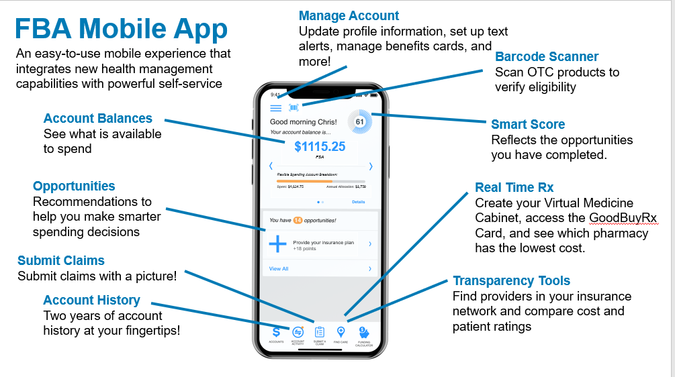

Slide 51

LONG TERM DISABILITY (ltd)
Pays monthly income replacement
60, 90, or 180 day elimination period
60% or 70% benefit
  $15,000 monthly benefit maximum
ABC Employer funds the cost of the 90 day/60% LTD plan
51

Slide 52
SHORT TERM DISABILITY (std)
Pays 60% weekly income replacement (after required 14-day elimination period)
7 weeks, 11 weeks, 24 weeks duration period
Maximum $2,500 weekly benefit
52

Slide 53

LIFE & ACCIDENTAL DEATH AND DISMEMBERMENT(AD&D)
Basic Life and AD&D: X base salary
Supplemental Life –
  1-8 times salary (combined with basic life)
  $1,500,000 maximum amount of coverage (combined with basic life)
  NOTE: Increasing life coverage will require evidence of insurance (EOI)
Spouse Life
  Increments of $10,000, up to $100,000 (not to exceed employee’s amount of insurance)
  Requires Evidence of Insurability when buying up in coverage
Child Life
  $5,000; $10,000; $15,000; $20,000 options
  All guaranteed issue

Slide 54
LIFE & ACCIDENTAL DEATH AND DISMEMBERMENT(AD&D)
Voluntary AD&D – All Guarantee Issue
Rate | Per Thousand of Coverage | $0.019 Employee Only Coverage $0.03 Family Coverage
Benefit Summary | $25,000 Increments | % reflect employee’s principal sum: Spouse (with children): 40% Spouse (no children): 50% Each child (with spouse): 10% Each child (no spouse): 15%
Plan Maximum | $1,000,000

Slide 55




Empathy – Bereavement Support
There during life’s most challenging moments
Dedicated Care Manager at the ready
Personalized care plan based on each family’s needs
Time-saving tools that simplify complicated tasks
Probate and estate settlement guidance
Emotional support for coping with grief
Available at no cost
Scan the QR code to learn more
How to access
Life insurance claims:
Website: join.empathy.com/securian
Access code: emp-securian
Terminal illness claims*:​
Website: join.empathy.com/securian-prep
Access code: emp-securianprep
*Empathy is offered to insured employees with life-threatening conditions and their family at the time of claim.

Slide 56


Supplemental health benefits
Accident Insurance:
Provides cash payments for injuries and treatments as a result of a covered accident
Critical Illness Insurance:
After diagnosis of a covered illness such as a stroke or heart attack, you receive cash payments
Hospital Indemnity Insurance:
If you are confined in a hospital, you receive cash payments. This includes confinement for labor and delivery.
Hospital indemnity insurance:
If you are confined in a hospital, you receive cash payments. This includes confinement for labor and delivery.

Slide 57

What is accident insurance?
Accident insurance provides a cash payment directly to you regardless of income, expenses incurred or other insurance coverage if you’re injured in a covered accident.
    Coverage available for spouses, child(ren) and dependent parents
    Dependent parents are paid at 25% of the employee benefit amount
    Multiple accidents are covered throughout the year
    Claims may be paid out under multiple products
    Benefits may be payable for initial care and treatment associated with an accident as well as follow up care (ie: follow up doctor visits, inpatient/outpatient therapy, transportation, etc.)
    $50 Health & Wellness Benefit available

Slide 58

What is critical illness insurance?
Critical illness insurance provides a lump-sum cash payment directly to you if you are diagnosed with a covered condition.
    Coverage available for spouses, child(ren) and dependent parents
    Dependent parents are paid at 25% of the employee benefit amount
    No pre-existing condition exclusion
You can use the money any way you want – for medical expenses and non-medical expenses, mowing/cleaning services, hotel stays, childcare
    Offers a recurrence benefit on certain conditions after a separation period of 6 months
    $100 Health & Wellness Benefit available
Notes:
​

Slide 59

What is hospital indemnity insurance?
Hospital indemnity insurance provides a lump-sum benefit if you
or a dependent requires hospitalization.
    Benefits can be used to help pay out-of-pocket costs, as well as
    additional living expenses
    Payout doesn’t depend on income or other insurance
    The time spent in the hospital for an existing pregnancy will be covered
    as long as coverage is effective before you enter the hospital
    Enhanced benefit for expectant mothers (BenefitBump)
    Covers hospitalization due to accident or sickness with no pre-existing condition exclusion.
    Get paid at 36 weeks of pregnancy by submitting your labor and delivery claim ahead of being in the hospital
    $50 Health & Wellness Benefit available

Slide 60


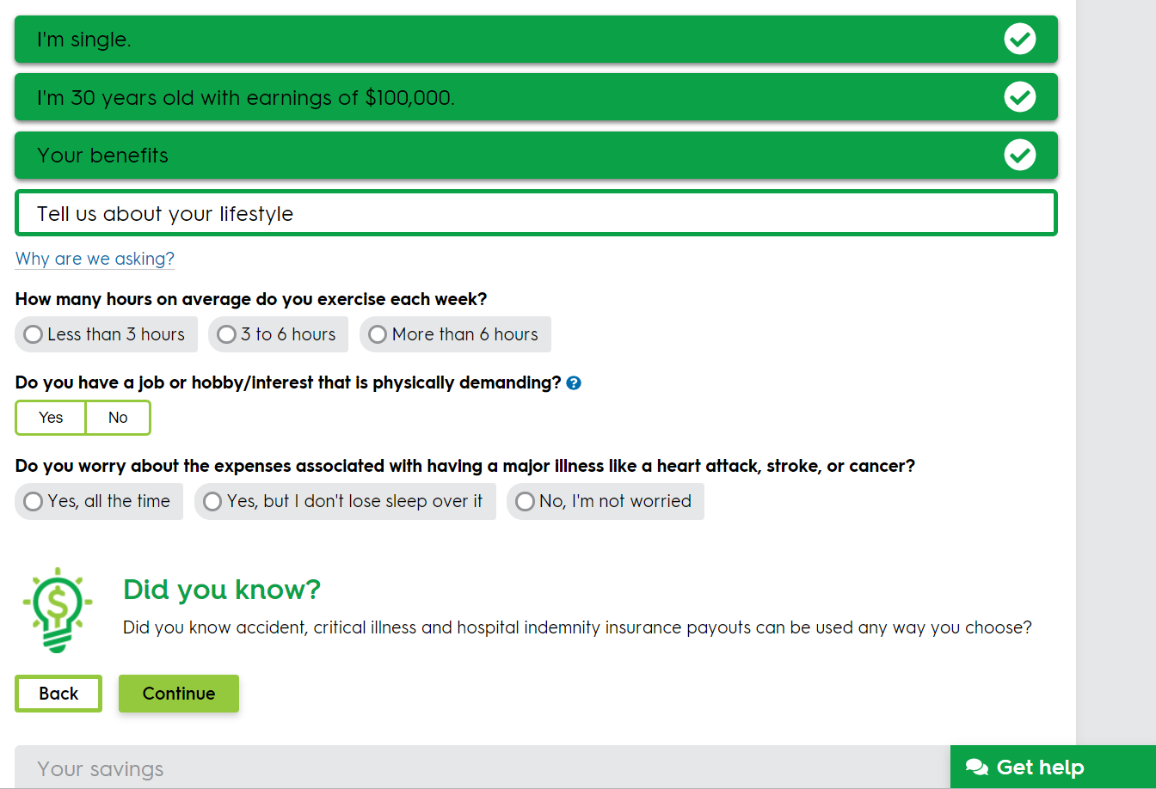


Supplemental health Resources available
VBA Securian Microsite
Benefit Scout ® through bswift enrollment site
Contact Securian Financial at 1-866-293-6047

Slide 61


Norton LifeLock Benefit Plan Overview
Benefit Premier Plus
$12.49 Employee Only
$21.48 Employee + Dependents
ALL PRODUCTS INCLUDE:
Identity Theft Protection
Financial Protection; Credit Monitoring, Reports, & Score
Dark Web Monitoring
Social Media Monitoring
$3 Million Dollar Protection Package
Identity Restoration Specialists
24/7 Live Member Support
Features Include:
3 Bureau Credit Monitoring
3 Bureau Report & Score
Alerts on Crimes Committed in
Your Name
Home Title Monitoring
Norton Device Protection (10 EE/
unlimited FF)
Cyber Crime Coverage
Norton AntiTrack
Online Privacy
PC SafeCam
Privacy Monitor
Secure VPN
Device Security
Anti-Spyware, Antivirus, Malware & Ransomware Protection
Parental Control
Password Manager
PC Cloud Backup
Benefit Plans are 60% less than the retail equivalent.

Slide 62
Legal Assistance (MetLife Legal Plan)
More than 13,000 attorneys, covering all 50 states
  Strong network of attorneys in VA
No deductible, claim forms, or usage limits
Plan is portable (12 months of premium payments required)
Spouse and dependent coverage included
Provides full coverage for most legal matters:
  Money matters, home and real estate, estate planning, living will preparation, family and personal, civil lawsuits, elder care issues, vehicles and driving, adoption assistance
Monthly rate - $16.50
  Paid on an after-tax basis
  Enrollment is locked in for one year
Enhancements:
ID management services
4 hours for non-covered attorney services

Slide 63

Nationwide Pet Insurance
Nationwide is our pet insurance vendor and Participants can sign up for coverage any time during the year at https://benefits.petinsurance.com/vabankers
  Group premium discount for VBA members
  Participants billed directly from Nationwide
Provides illness and injury coverage for cats, dogs and exotic pets (birds, lizards, turtles) at 50% and 70% reimbursement levels ($250 annual deductible, $7,500 annual benefit maximum)
Includes 24/7 vet helpline and ability to submit mobile claims
Multiple pet discount available

Slide 64





This specialized provider offers discounts on vet care, pet products, 24/7 pet telehealth and more!
Pet benefit solutions
Discounted Pet Products, Prescriptions and Preventatives
Discounts on
Veterinary Care
24/7 Pet
Telehealth
Lost Pet
Recovery Service
VOLUNTARY BENEFIT
$11.75/month for one pet
$18.50/month for the family plan (2+ pets)
Visit www.petbenefits.com/search to view participating vets in Pet Assure network.

Slide 65


PETPLUS SAMPLE SAVINGS
Pet benefit solutions
PRODUCT |  | MSRP | CHEWY | WALMART | AMAZON
Seresto Flea and Tick Collar For Cats – 8 months | $44.27 | $70.70 | $67.98 | $67.98 | $67.98
Royal Canin Veterinary Diet Gastrointestinal High Fiber Dry Dog Food – 8.8lb bag | $62.99 | $133.69 | $97.99 | N/A | N/A
Blue Buffalo Healthy Living Indoor Chicken & Brown Rice Recipe for Cats – 15lb | $42.99 | $62.65 | $46.98 | $64.69 | $46.98
Heartgard Plus Chewables (dogs up to 25lbs), 6 month supply | $39.84 | $64.82 | $48.59 | $48.59 | N/A
PetPlus also includes FREE SHIPPING with no minimum order size!
PetPlus and competitor pricing as of 7/5/2023 Visit www.petplusbenefit.com to view all available products and pricing.

Slide 66


Total Pet Plan - Easy To Offer
Pet benefit solutions
Preferred bswift partner
  Employees enroll in bswift system at open enrollment
  Payroll deduction on after-tax basis
Complements current Nationwide Pet Insurance Program
  Can enroll in the Pet Benefit Solutions plan and the Nationwide Pet Insurance Program
Easy for employees to use; no claim forms or waiting for reimbursements
Covers all types of pets and ages

Slide 67
Open Enrollment Details

Slide 68

Open Enrollment Details
Open Enrollment – November 3–21, 2025
Employees can enroll through multiple internet browsers, including Microsoft Edge, Google Chrome and Safari (Apple products)
Enrollment is also available on the Bswift Mobile App.
68

Slide 69


Learnyour benefits

Slide 70
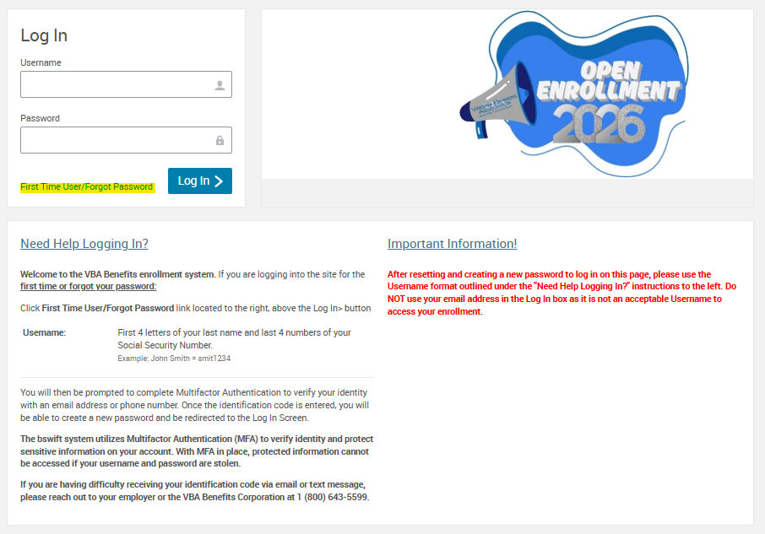
Open Enrollment Instructions – Step 1
Go to http://vbabenefits.bswift.com
Enter your login information
If you are a first-time user, or do not know your password, click on the First Time User/Forgot Password link.
NOTE: You will be required to complete multi-factor authentication to access system

Slide 71
Open Enrollment Instructions – Step 2
To begin open enrollment, click on “Visit Enrollment Center” on your Bswift home page.
Once you are on the Enrollment Center page, choose “Enroll Now”
On the next page make sure that all of your information is correct before proceeding. At the bottom of this page, select the “I agree” checkbox and continue.
On the Family Information page ensure all of your dependents are listed, if applicable. Select the “I agree” checkbox at the bottom to continue.
Please note that because of ACA requirements you must also include dependents you may not intend to cover.

Slide 72
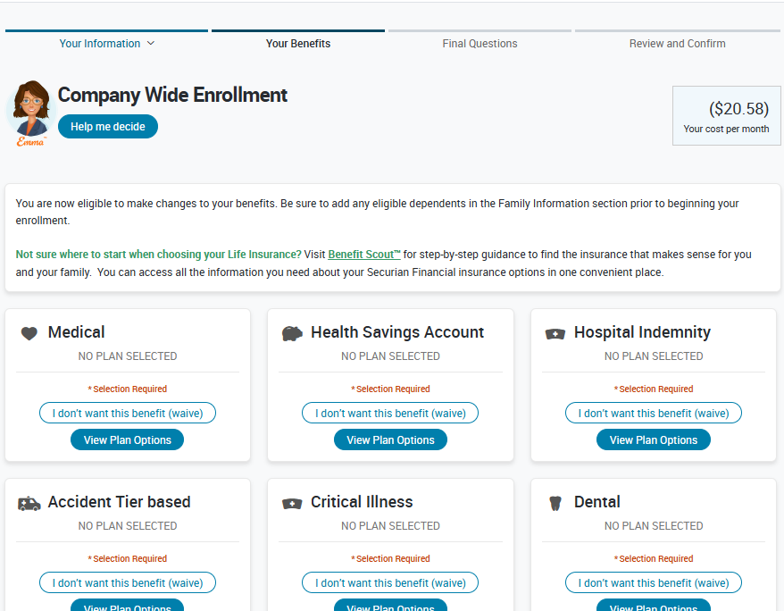

Open Enrollment Instructions – Step 3
You will now be brought to the Company Wide Enrollment screen and will be able to elect which plans you want for 2026.
Click on view plan options and confirm who will be covered by this plan and click continue.
Make election and click on “keep selection” or “select button” for each plan type. A checkmark next to the plan type will appear showing that you have selected a plan for that benefit type.
Ensure all plan icons are green and select Continue.

Slide 73
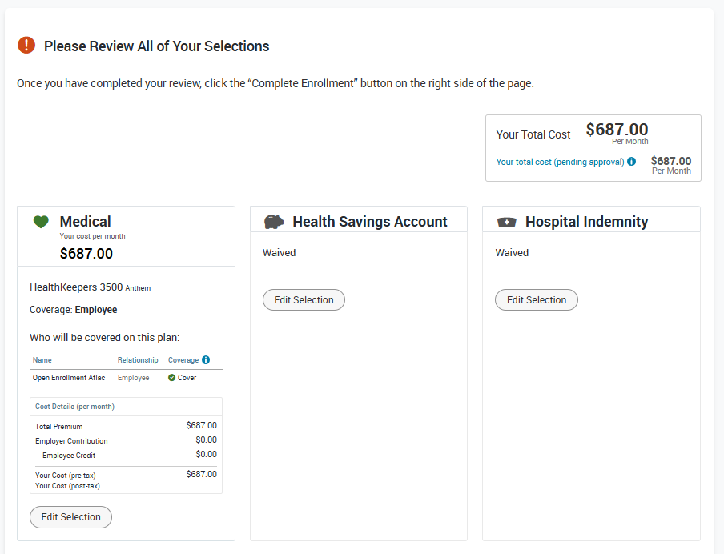
Open Enrollment Instructions – Step 4
Please make sure all your selections are correct. If not, you can click on Edit Selection at the bottom of desired plan description to make changes.
After making sure all your selections are correct, please read the participation statement at the bottom of the page and select the “I agree” and “Complete Enrollment” button to the right of the page.

Slide 74
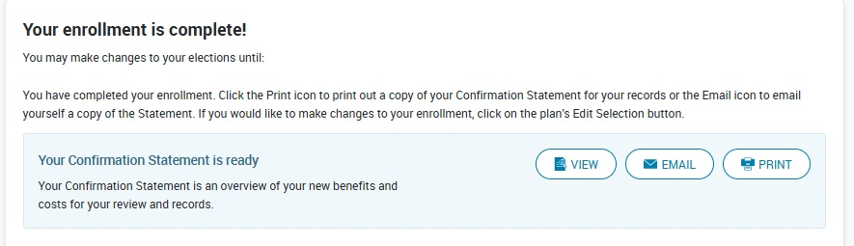
Open Enrollment Instructions – Step 5
Now your enrollment is complete! On the next page, you may view the confirmation statement, email it to your preferred email address on file, or print it.

Slide 75
Questions about benefits or open enrollment?
Contact:
HR Administrator
xxx-xxx-xxxx
hremail@bank.com
or
VBA Benefits Corporation
1-800-643-5599

