Slide 1





2023 Benefits Open Enrollment
November XX, 2022
Insert Employer Logo

Slide 2
Agenda
What’s changing for 2023?
Consumerism Tools
Medical Plan Options
Medical Programs
Ancillary Benefits
  Dental Plan Options
  Vision Plan Options
  Flexible Spending Account Plans
  Disability Plan Options
  Life and AD&D Plan Options
  Voluntary Benefits
Open Enrollment Details

Slide 3
What’s Changing for 2023?

Slide 4
2023 Benefit Plan Changes
Medical | Enhancements to HMO network New Talkspace (Anthem EAP) behavior health tool New Building Health Families (maternity resource) tool
Dental | No rate change; adding adult orthodontia and enhanced benefits for dependent children
Vision | No change
Life and AD&D | No rate change; increasing voluntary AD&D coverage limit to $1,000,000
Disability | No change
Accident, CI and HI | No change
MetLife Legal | No rate changes; ID management services and 4 hours for non-covered attorney services
Flexible Spending Accounts | Transitioning to Flexible Benefit Administrators (FBA)
Health Savings Accounts | No change

Slide 5
2023 Medical & Rx Changes
Anthem HMO (HealthKeepers) out of area benefits network changing in 2023
Members must either live or work in Virginia to be eligible for the HMO plans
HMO 25 & HMO $3000 Plans | 2022 benefit | 2023 benefit
HealthKeepers out-of-area access to benefits | Out of area benefits available through the Traditional/ Par Network Guest Membership available | Out of area benefits available through the BlueCard PPO network; benefits paid as though in-network Guest Membership not available
IMPORTANT: ALL HMO MEMBERS WILL RECEIVE NEW ID CARDS FOR 2023. THERE WILL BE A SUITCASE LOGO ADDED FOR ACCESS TO THE BC PPO NETWORK.

Slide 6
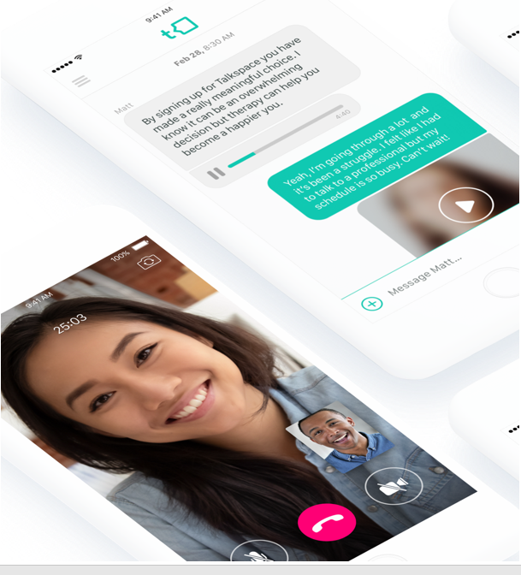
TalkSpace (Anthem EAP) Available Now!
  Talkspace is a digital platform that supports behavioral health and emotional wellness needs from a secure, HIPAA-compliant app
  EAP participants work with a dedicated, licensed provider for one-on-one counseling and therapy (13+)
    Talkspace’s network include thousands of licensed and verified counselors who specialize in topics like stress, anxiety, depression, eating disorders, substance use, sleep, trauma and more
  Talkspace offers participants unlimited texts in which the counselors will engage daily during their business hours (real-time video calls also available)
    One “session” generally equals one week of Talkspace access and the ability to send unlimited messages to your counselor (or one completed live video session)
  Talkspace access can be obtained through AnthemEAP.com, or by calling the EAP call center. You may also go to talkspace.com/associatecare (please enter the letters "EAP", a space, and your company code “EAP VBA" in the field to access services.)

Slide 7




Building Healthy Families (Formerly Future Moms)
Access to screenings, tools, and trackers for preconception/fertility, pregnancy, and children through age five (and beyond)
Digital program available 24/7 through our Sydney SM Health mobile app
Extensive content library covering topics to support diverse families on their path to parenthood including single parents and same-sex or multicultural couples
You can earn up to $400 as you complete the program.

Slide 8
Consumerism Tools

Slide 9

What is Consumerism?
Consumers of healthcare are aware of the costs for medical services and prescription drugs.
Consumers review treatment options and alternatives by using tools and resources available through the health insurer and employer before utilizing a specific service or filling a prescription drug.
Consumers share in the cost of healthcare services so there is incentive or “skin in the game” to find most cost-effective providers while maintaining high quality standards

Slide 10


Anthem Health Guides
Anthem Health Guides answer your questions and walk you through the healthcare system so you can:
Find the right benefits for your needs.
Save money on prescriptions.
Stay on top of appointments.
Compare costs for healthcare services.
Reach an Anthem Health Guide at 833-831-0085 which is on the back of your member ID card. You can also go to anthem.com to send a secure email or chat online.
*Call RxBenefits for Rx questions - 800-334-8134

Slide 11

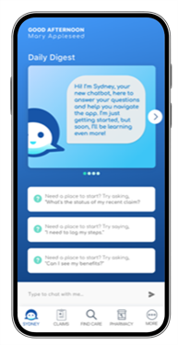

Sydney Health mobile app
Download Sydney Health and register on the app to take full advantage of your Anthem plan.
Use it to:
Find care and check costs.
See all medical benefits.
View medical claims and payment information.
View and use digital ID cards.
Get answers quickly with the interactive chat feature.
Access virtual care.
Access wellness resources and rewards.
Sync with your fitness tracker.
Reach Member Services for support.

Slide 12
Telehealth with virtual primary care
Access to routine care and chronic condition management
Services available through the Sydney Health app
Virtual primary care includes preventive care, wellness checks, lab work referrals, new prescriptions and refills, specialist referrals, and care management for conditions including:¹
Asthma ◦ Heartburn or GERD²
High blood pressure ◦ Migraines
Diabetes ◦ Irritable bowel syndrome
High cholesterol ◦ Musculoskeletal issues
Appointment hours
9 a.m. to 9 p.m. ET, Monday through Friday
9 a.m. to 5 p.m. ET, Saturday and Sunday
Available to members 18 to 64 years old.
GERD = gastroesophageal reflux disease.

Slide 13
Anthem Skill On Alexa
How to set up The Anthem Skill on Alexa
With The Anthem Skill, you can ask Alexa to:
Send your digital ID card.
Check how close you are to reaching your deductible or out-of-pocket limit.
Refill, renew, and check on your prescriptions.
Call Member Services.
Look up healthcare terms.
Download the Amazon Alexa app.
Go to Skills & Games in the Alexa app and search for “The Anthem Skill.” Tap Enable to use.
Enter your Anthem username and password to link your Anthem account.
Set up your Alexa voice profile and passcode.
Ask Alexa for help by saying, “Alexa, ask Anthem ...”

Slide 14


Special Offers
Visit anthem.com and choose Discounts to:
Save money on glasses, weight loss programs, gym memberships, and vitamins.

Slide 15




How to save time and money
Save emergency room (ER) visits for emergencies
Consider an urgent care center, retail clinic, or walk-in doctor’s office. Of course, if you have a life-threatening, serious emergency, go to the ER or call 911.
See doctors in your plan’s network
Pay less out of pocket when you see doctors in your plan’s network.
Preapprove hospital services (PPO plans)
Call to preapprove services to prevent unnecessary charges.
Use the Find Care tool to check costs and quality ratings
Save money on health products
Receive discounts on health-related products and services for you, your family, and your home.
Find doctors and hospitals in your plan’s network, review details and patient ratings, and compare costs for health services and tests.

Slide 16

Important Questions to Ask The Doctor
Why is this treatment necessary?
How much will my treatment cost?
Can I be treated another way that is equally effective but less costly?
What is the current procedural terminology (CPT) code of this treatment so I can price shop this procedure ?
What can I do to improve my condition?
Can you recommend a lower-cost generic or therapeutic drug as an alternative?

Slide 17
Medical Plan Options

Slide 18
2023 Medical Plan Options

Slide 19
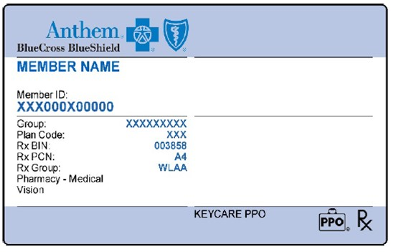
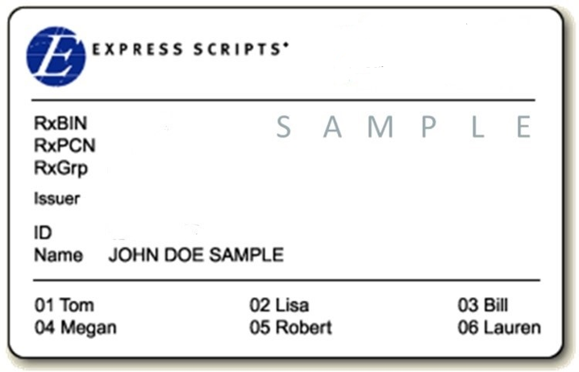
  Medical services will continue to be administered by Anthem and Rx services by Express Scripts and RxBenefits
  Participants who stay in same plan in 2023 will continue to use the same ID cards
    Anthem ID Card
    Participants who change medical plans OR are enrolled in an HMO plan will receive a new Anthem ID card
  Express Scripts ID Card
    Participants who change medical plans will not receive a new Express Scripts card (only receive new Express Scripts card if adding dependents)
Integrated Medical Plan (2 ID Cards)

Slide 20
HMO vs. PPO
HMO
  Cheaper premium rates in comparison to PPO due to limited network
  Higher negotiated discounts for medical services, thus less out of pocket expense
  Network limited to state of Virginia
PPO
  Higher premium rates in comparison to HMO due to more robust network
  National network that crosses state lines
Anthem network provider – https://www.bcbs.com/
  Click “Find Doctor” and use current address
  Enter “BVA” for PPO network or “XHY” for HMO network

Slide 21
21
PPO 20
$20 primary care/$40 specialist
100% for preventive care services, no member co-pay
80%/20% co-insurance in-network
  Inpatient (after $400 copay) and outpatient (after $200 co-pay) hospitalization
  Lab, tests, x-rays, and most other services
$4,000 individual/$8,000 family out of pocket maximum
Drug Co-pays:
    $15/$40/$75/20% up to $200
6
21

Slide 22
PPO 25
$25 primary care/$50 specialist
100% for preventive care services, no member copay
$500 individual/$1,000 family deductible
  Inpatient and outpatient hospitalization
  Lab, tests, x-rays, and most other services
80%/20% co-insurance in-network, after deductible
$4,500 individual/$9,000 family out of pocket maximum
Drug Copays:
    $15/$40/$75/20% up to $200
22

Slide 23
HMO 25
Anthem Healthkeepers HMO network of providers
$25 primary care/$50 specialist
100% for preventive care services, no member copay
$500 individual/$1,000 family deductible
  Inpatient and outpatient hospitalization
  Lab, tests, x-rays, and most other services
80%/20% co-insurance in-network, after deductible
$4,500 individual/$9,000 family out of pocket maximum
Drug Copays:
    $15/$40/$75/20% up to $200
23

Slide 24
HDHP Concept
Plan design is a high deductible health plan (HDHP), typically $2,000 or higher; an individual is responsible for healthcare expenses prior to meeting deductible. Once deductible is satisfied, applicable plan coinsurance applied.
In addition to the high deductible health plan, there are accounts set up to help “fund” or pay for healthcare services while meeting the deductible. The two most common types of plans are:
  Health Reimbursement Account (HRA)
  Health Savings Account (HSA)
24

Slide 25
PPO HRA
Two components:
  High deductible health plan (HDHP)
  Health reimbursement account (HRA)
25

Slide 26
26
1. PPO HRA Plan – High Deductible Health Plan
Deductible (HRA)
  $2,000 ($500 HRA allocation) Individual
  $4,000 ($1,000 HRA allocation) Family
  One person can meet the $2,000 deductible and the plan will start paying for that person even if the $4,000 for family hasn’t been satisfied
Preventive care services covered at 100% outside of the deductible
80%/20% coinsurance in-network after deductible
Out-of-Pocket Maximum
  $3,500 Individual
  $7,000 Family
Drug copays:
  $15/$40/$75/20% up to $200
  Copays for approved preventive care drugs taken from HRA prior to deductible (please see ESI’s list of approved preventive drugs); copays do not accumulate towards deductible, but do accumulate towards the out-of-pocket maximum
  Non-preventive drugs count towards deductible and out-of-pocket maximum
  Copays for all drugs after deductible is met
26
26

Slide 27
27
2. PPO HRA Plan – Health Reimbursement Account
Built in HRA to offset deductible:
  $500 individual, $1,000 family
  HRA funds not spent roll over to next year, up to the annual deductible amount
  Pays first while meeting deductible
  Anthem processes claims and tracks HRA usage
Can participate in traditional flexible spending account; HRA pays first
27
27

Slide 28
PPO HSA $2000
$2,000 individual/$4,000 family deductible
  Dependents under family coverage must meet the $4,000 deductible before the plan will start paying
90%/10% co-insurance in-network for all medical costs after deductible
Preventive care services covered at 100% outside of the deductible
$3,500 individual/$7,000 family out of pocket maximum
Drug copays:
  $15/$40/$75/20% up to $200
  Copays for approved preventive care drugs before deductible (please see ESI’s list of approved preventive drugs); copays do not accumulate towards deductible, but do accumulate towards the out-of-pocket maximum
  Non-preventive drugs count towards deductible and out-of-pocket maximum
  Copays for all drugs after deductible is met
28

Slide 29
PPO $3000
$3,000 individual/$6,000 family deductible
  One person can meet the $3,000 deductible and the plan will start paying for that person even if $6,000 for family hasn’t been satisfied
100% co-insurance in-network for medical after deductible
Preventive care services covered at 100% outside of the deductible
$4,000 individual/$8,000 family out of pocket maximum
Drug copays:
  $15/$40/$75/20% up to $200
  Copays for approved preventive care drugs before deductible (please see ESI’s list of approved preventive drugs); copays do not accumulate towards deductible, but do accumulate towards the out-of-pocket maximum
  Non-preventive drugs count towards deductible and out-of-pocket maximum
  Copays for all drugs after deductible is met
29

Slide 30
HMO $3000
Anthem Healthkeepers HMO network of providers
$3,000 individual/$6,000 family deductible
  One person can meet the $3,000 deductible and the plan will start paying for that person even if $6,000 for family hasn’t been satisfied
100% co-insurance in-network for medical after deductible
Preventive care services covered at 100% outside of the deductible
$4,000 individual/$8,000 family out of pocket maximum
Drug copays:
  $15/$40/$75/20% up to $200
  Copays for approved preventive care drugs before deductible (please see ESI’s list of approved preventive drugs); copays do not accumulate towards deductible, but do accumulate towards the out-of-pocket maximum
  Non-preventive drugs count towards deductible and out-of-pocket maximum
  Copays for all drugs after deductible is met
30

Slide 31
PPO $4000
$4,000 individual/$8,000 family deductible
  One person can meet the $4,000 deductible and the plan will start paying for that person even if $8,000 for family hasn’t been satisfied
70% co-insurance in-network for medical after deductible
Preventive care services covered at 100% outside of the deductible
$6,350 individual/$12,700 family out of pocket maximum
Drug copays:
  $15/$40/$75/20% up to $200
  Copays for approved preventive care drugs before deductible (please see ESI’s list of approved preventive drugs); copays do not accumulate towards deductible, but do accumulate towards the out-of-pocket maximum
  Non-preventive drugs count towards deductible and out-of-pocket maximum
  Copays for all drugs after deductible is met
Note: Plan is deemed non-creditable if considering Medicare Part D
31

Slide 32
PPO $5000
$5,000 individual/$10,000 family deductible
  One person can meet the $5,000 deductible and the plan will start paying for that person even if $10,000 for family hasn’t been satisfied
100% co-insurance in-network for medical after deductible
Preventive care services covered at 100% outside of the deductible
$6,000 individual/$12,000 family out of pocket maximum
Drug copays:
  $15/$40/$75/20% up to $200
  Copays for approved preventive care drugs before deductible (please see ESI’s list of approved preventive drugs); copays do not accumulate towards deductible, but do accumulate towards the out-of-pocket maximum
  Non-preventive drugs count towards deductible and out-of-pocket maximum
  Copays for all drugs after deductible is met
Note: Plan is deemed non-creditable if considering Medicare Part D
32

Slide 33
Low Claims Utilization Example – Employee Only
33
*For illustrative purposes only, costs could be overstated depending on dates of service.
- Annual wellness visit: $200
- Two PCP office visits: $75 each
- One specialist office visit: $150 each
- One generic prescription per month (level 1): $12
Service | PPO 20 | PPO 25 | HMO 25 | PPO HRA | PPO 2000 | HMO 3000 | PPO 3000 | PPO 4000 | PPO 5000
Wellness | $0 | $0 | $0 | $0 | $0 | $0 | $0 | $0 | $0
PCP | $40 | $50 | $50 | $0 ($150 fund) | $150 | $150 | $150 | $150 | $150
Specialist | $40 | $50 | $50 | $0 ($150 fund) | $150 | $150 | $150 | $150 | $150
Rx | $144 | $144 | $144 | $0 ($144 fund) | $144 | $144 | $144 | $144 | $144
CLAIMS COSTS | $224 | $244 | $244 | $0 | $444 | $444 | $444 | $444 | $444
Annual EE Premium | $0 | $0 | $0 | $0 | $0 | $0 | $0 | $0 | $0
TOTAL ANNUAL COSTS | $0 | $0 | $0 | $0 | $0 | $0 | $0 | $0 | $0
33

Slide 34
High Claims Utilization Example – Employee Only
34
- Annual wellness visit: $200 - One MRI: $800
- Two-day hospital stay: $5,000 - One generic prescription (preventive – tier 1) per month (level 1): $15 each
- One PCP visit: $75 - One prescription (non-preventive – tier 2) per month (level 1): $80 each
- Four specialist office visits: $150 each
*For illustrative purposes only, costs could be overstated depending on dates of service.
Service | PPO 20 | PPO 25 | HMO 25 | PPO HRA | PPO 2000 | HMO 3000 | PPO 3000 | PPO 4000 | PPO 5000
Wellness | $0 | $0 | $0 | $0 | $0 | $0 | $0 | $0 | $0
Hospital | $1,320 | $1,400 | $1,400 | $2,100 ($500 fund) | $2,300 | $3,000 | $3,000 | $4,300 | $5,000
PCP | $20 | $25 | $25 | $15 | $7.50 | $0 | $0 | $22.50 | $0
Specialist | $160 | $200 | $200 | $120 | $60 | $0 | $0 | $180 | $0
MRI | $160 | $160 | $160 | $160 | $80 | $0 | $0 | $240 | $0
Rx 1 | $180 | $180 | $180 | $180 | $180 | $180 | $180 | $180 | $180
Rx 2 | $480 | $480 | $480 | $480 | $480 | $480 | $480 | $480 | $480
CLAIMS COSTS | $2,320 | $2,445 | $2,445 | $3,055 | $3,107.50 | $3,660 | $3,660 | $5,402.50 | $5,660
Annual EE Premium | $0 | $0 | $0 | $0 | $0 | $0 | $0 | $0 | $0
TOTAL ANNUAL COSTS | $0 | $0 | $0 | $0 | $0 | $0 | $0 | $0 | $0
34

Slide 35
How Does a Health Savings Account (HSA) Work?
Health Savings Account (HSA)
HSA Triple Tax Advantage
All contributions are tax-free
All interest earned is tax-free
All funds used for qualified medical expenses are tax-free
Establish a Health Savings Account (HSA) and make contributions into it
Pay out-of-pocket health plan costs (deductible and coinsurance)
Decide whether or not to reimburse yourself out of HSA for out-of-pocket costs
Unused funds in HSA remain and available to use for future costs
Can be used for spouse and tax dependents, even if they are not covered by the high deductible health plan
In order to contribute to an HSA, you:
Must be enrolled in qualified high deductible health plan (HDHP)
Cannot be enrolled in Medicare
Cannot be covered by another health insurance plan
Cannot be enrolled in a regular medical Flexible Spending Account
Cannot be claimed as a dependent on another’s tax return (doesn’t apply to joint filing)
HSAs can be used on certain insurance premiums
COBRA
Long Term Care
Medicare, parts B & D
35

Slide 36

2023 HSA Maximum Contribution Limits
Self only: $3,850 ($200 increase)
Family: $7,750 ($450 increase)
Catch-up (age 55+): $1,000
36

Slide 37
Medical Programs

Slide 38
Employee Assistance Program (EAP)
A confidential service to help you:
Find support for various personal and work-related issues.
Connect with legal, financial, and crisis counselors.
Reach EAP at 800-346-5484 and online when you log in to anthem.com (Login – VBA). You can also reach them through the Sydney Health mobile app.

Slide 39

24/7 NurseLine
Registered nurses can:
Answer health questions.
Help you decide where to go for care.
Find doctors or other healthcare professionals near you.

Slide 40

LiveHealth Online Telehealth
Connect with care anywhere
Telehealth appointments on your mobile phone, tablet, or computer with a camera
Board-certified doctors available 24/7 for advice, treatment, and prescriptions
See a licensed therapist or psychiatrist. Appointments are available 7 days a week and usually cost the same as an in-person visit.
Cost is less than or equal to an in-person office visit
To make a LiveHealth Online virtual care appointment, in your Anthem account, choose Virtual Visit With A Provider under Care.

Slide 41

ConditionCare
A dedicated nurse team that offers support if you’re living with:
Asthma
Diabetes
Heart disease or heart failure
You also have additional support from dietitians, health educators, and pharmacists.
Chronic obstructive pulmonary disease (COPD)

Slide 42

Diabetes Prevention Program
The 12-month weight loss program can help you lose weight and reduce your risk for diabetes.
Anthem and Lark have come together to offer this program at no extra cost. It is part of your health plan.
It’s customized to your lifestyle, so you receive 24/7 coaching to:
Lose weight
Manage stress
Eat healthier
Sleep better
Increase activity
Use the Sydney Health mobile app to complete the Lark prediabetes survey by going to My Health Dashboard and searching for Lark Diabetes Prevention Program under Programs.

Slide 43

LivingConnected Diabetes Coaching Program
LivingConnected is a Diabetic Care Program that provides coaching and diabetic supplies at no cost to participants
Program benefits include:
  Bluetooth Glucose Meter
  Test strips, lancing device, lancets
  24-hour monitoring and coaching when readings out of range
  Live, personalized health coaching from Certified Diabetes Educators
Participant will automatically be enrolled (based on claims experience); if not interested in program please opt out and return kit
Call 1-800-966-2046 for additional information

Slide 44







Hinge Health
Digital Musculoskeletal Program (physical therapy program)
$0.00 cost to members – not subject to deductible and coinsurance
Anthem Medical participants and dependents (over age 18) are eligible
Complete assessment at hingehealth.com/vabankers (waitlist open now - program begins 1/1/22)
Prevention
At-risk
Job-specific exercises & education
Acute
Recent injury
Virtual PT for all joint
& muscle groups
Chronic
High-risk
Exercise, education, and behavioral change
Surgery
Pre & Post rehab
Pre/post rehab & continuity of care

Slide 45
Ancillary Benefits

Slide 46


Plan Enhancements
Dental
Available beginning in 2023
Adult orthodontia included with Comprehensive and Enhanced Indemnity Plans ($1,000 lifetime maximum)
Right Start 4 Kids when member visits in-network provider (Under age 13):
  Provides 100% coverage for (up to annual benefit maximum):
New Benefit Option
diagnostic/preventive services
basic services
major services
excludes orthodontia
No deductible

Slide 47


Healthy Smile, Healthy You®
Healthy Smile, Healthy You® provides additional dental benefits for the following health conditions:
Pregnancy
Diabetes
Cancer treatment
High-risk cardiac conditions
Available now:
Weakened immune systems
Kidney failure or dialysis
Included Benefits
Members can download the enrollment form at DeltaDentalVA.com

Slide 48


Delta Dental – Virtual Visits
Delta Dental – Virtual Visits provides access to dentists 24/7, 365 online or over the phone.
Members may use service when they:
Have a dental emergency, but do not have a dentist,
Need access to a dentist after hours,
Would like to consult a dentist while traveling.
Included Benefits
*A teledentistry visit counts as a problem- focused exam.

Slide 49
Dental Plan Highlights
No plan or rate changes
Plan Design Feature | Basic | Comprehensive | Enhanced Indemnity
Annual Deductible | $50 (3 per family) | $50 (3 per family) | $50 (3 per family)
Annual Benefit Max | $1,000 per person | $1,500 per person | $1,500 per person
Preventive & Diagnostic Services (cleanings, exams, x-rays) | 100% allowable charge (AC); 80% out-of-network | 100% AC: 80% out-of-network | 100%; no network required; can be balanced billed by dentist
Primary Services (fillings, oral surgery, endodontics & periodontics) | 80% AC after deductible; 60% out-of-network | 80% AC after deductible; 60% out-of-network. | 80% AC after deductible
Major Services (crowns, bridges, dentures, implants) | No coverage | 50% AC after deductible | 50% AC after deductible
Orthodontia (both dependent children & adults) | No coverage | 50% up to $1,000 lifetime maximum | 50% up to $1,000 lifetime maximum

Slide 50
Dental Plan Rates
Employee Category | Basic | Comprehensive | Enhanced Indemnity
Employee | $25.50 | $41.20 | $49.50
Employee & Child(ren) | $48.80 | $77.50 | $93.90
Employee & Spouse | $51.70 | $83.30 | $99.80
Employee & Family | $82.40 | $131.20 | $159.10

Slide 51
Vision Plan Highlights
Vision
No plan or rate changes
In-network Plan Design Features | Anthem Blue View Vision (Included with Anthem) | Basic Plan (VSP) | Enhanced Plan (VSP)
Comprehensive Eye Exam | $15 copay | $15 copay | $15 copay
Frames/Lenses – single vision, bifocal, trifocal and lenticular | 35% discount off retail | $30 copay ($150 allowance*); frame benefit available every 24 months | $15 copay ($150 allowance*); frame benefit available every 12 months
Covered Lens Options | Varying discounts | Standard scratch-resistant coating; polycarbonate lenses for children | Standard scratch-resistant coating, progressive lenses, photochromic, polycarbonate lenses (children and adults), ultraviolet coating and Pink Tints (1 & 2)
Contact Lenses (Contact lens benefit in lieu of frames benefit every 12 months) | 15% off retail | $30 copay; $150 allowance | $15 copay; $150 allowance
Contact lenses fitting fee | No discount | Copay not to exceed $60 | Copay not to exceed $60
*$80 allowance at Costco

Slide 52
Vision (VSP) Plan Rates
Employee Category | Basic Plan | Enhanced Plan
Employee only | $6.30 | $11.20
Employee + child(ren) | $10.60 | $17.10
Employee + spouse | $9.90 | $16.00
Employee + family | $16.90 | $27.40

Slide 53
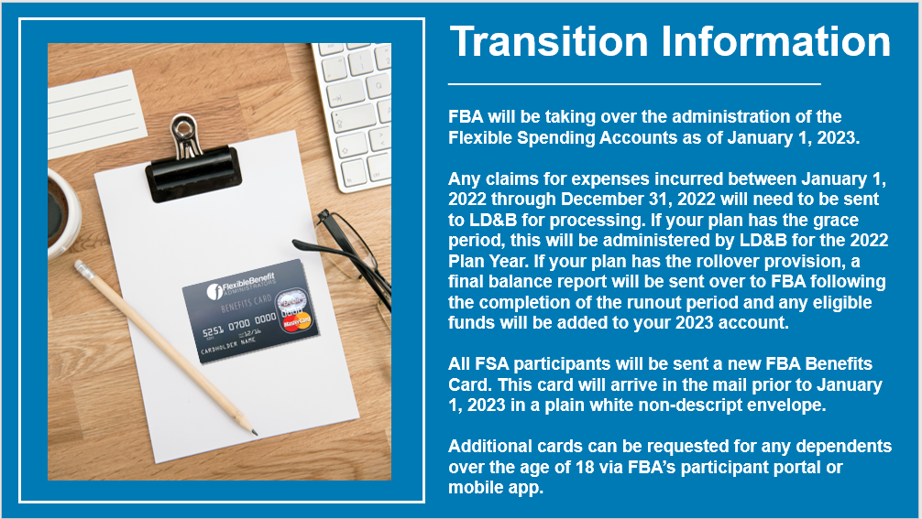
Flexible Spending Account (FSA)

Slide 54
Healthcare Spending Account
Set aside pretax dollars to pay for qualified out-of-pocket healthcare expenses throughout the plan year
Pre-funded annual account; payroll deductions made on per pay period basis
Maximum annual deferral is $3,050 **Can change**
Examples of eligible expenses include copayments, coinsurance, orthodontics, eyeglasses, contact lenses
Limited FSA is available for employees who have a health saving account (HSA) to use on dental and vision expenses
“Use it or lose it”
  2 ^{½} month grace period or $610 carryover
  For new HSA participants, automatic rollover into limited FSA with grace/carryover provision

Slide 55
Dependent Care Spending Account
Set aside pretax dollars to pay for qualified dependent care expenses throughout the plan year
Not a pre-funded annual account; payroll deductions made on per pay period basis
Maximum annual deferral is $5,000
Examples of eligible expenses include licensed day care centers, babysitters/nannies, before and after school care, day care for elderly or disabled dependent
55

Slide 56
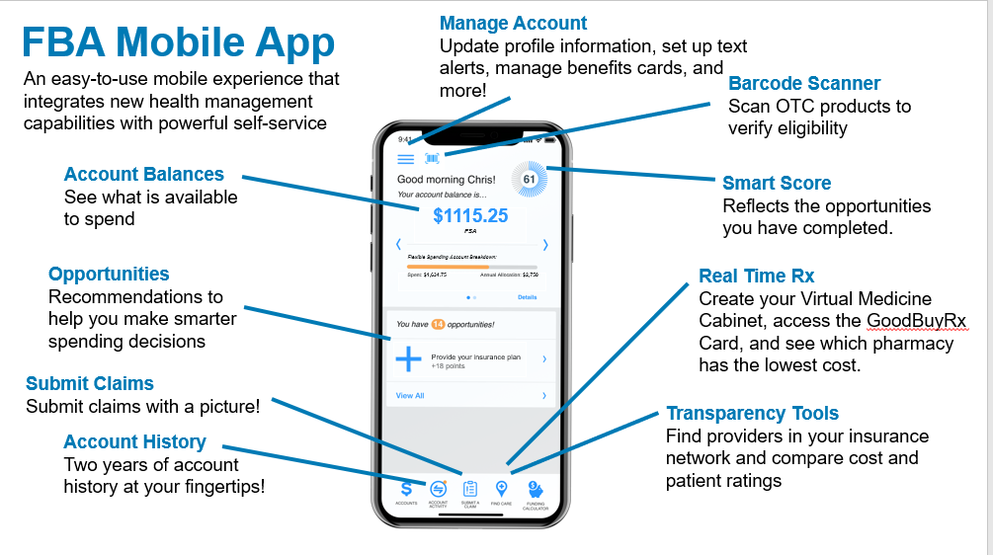

Slide 57
Long Term Disability (LTD)
Disability
Pays monthly income replacement
60, 90, or 180 day elimination period
60% or 70% benefit
  $15,000 monthly benefit maximum
ABC Employer funds the cost of the 90 day/60% LTD plan
57

Slide 58
Short Term Disability (STD)
Pays 60% weekly income replacement (after required 14-day elimination period)
7 weeks, 11 weeks, 24 weeks duration period
Maximum $2,500 weekly benefit
58

Slide 59
Life Insurance and AD&D
Life
Basic Life and AD&D: X base salary
Supplemental Life –
  1-8 times salary (combined with basic life)
  $1,500,000 maximum amount of coverage (combined with basic life)
  NOTE: Increasing life coverage will require evidence of insurance (EOI)
Voluntary AD&D – All Guarantee Issue
Rate | Per Thousand of Coverage | $0.019 Employee Only Coverage $0.03 Family Coverage
Benefit Summary | $25,000 Increments | % reflect employee’s principal sum: Spouse (with children): 40% Spouse (no children): 50% Each child (with spouse): 10% Each child (no spouse): 15%
Plan Maximum | $1,000,000 (increased from $500,000) | Spouse: $250,000 Child: $25,000

Slide 60
Life Insurance and AD&D Cont.
No changes to spouse or child life
Spouse Life
  Increments of $10,000, up to $100,000
  Requires EOI when buying up in coverage
Child Life
  $5,000; $10,000; $15,000; $20,000 options
  All guaranteed issue

Slide 61
How does Aflac work?
Voluntary Benefits
Your Medical Insurance will pay medical providers (doctor, hospital, pharmacy, lab) directly.
Aflac group coverage pays benefits directly to you!
These benefits can help you offset deductibles, coinsurance or copays. They are HSA compatible so you can use these benefits and continue to let your HSA grow.
Enrolling in Aflac does not require you to be enrolled in VBA Medical plans. For example, if your spouse is covered elsewhere for Medical you can still cover them through VBA’s Aflac plans.

Slide 62

I need financial support in the event of
a critical illness.
Critical Illness

Slide 63
Why Aflac group Critical Illness insurance may be right for you.
Coverage is offered Guaranteed Issue – no health questions for employee or spouse
Coverage options are $10,000 or $20,000 for Employee and Spouse (Spouse can elect 100% of employee coverage and Employee must enroll for Spouse to enroll)
Children are covered at 50% of employee amount and there is no additional premium charged
There is no pre-existing condition exclusion for diagnosis that happens after coverage effective date. For cancer, must be treatment free 12 months.
No benefit waiting period for health screening benefit
Coverage is portable if you leave employment, and you can keep the coverage at the same premium

Slide 64

Why Aflac group Critical Illness insurance may be right for you. In the event of any event below the lump sum benefit is paid directly to you:
Cancer
Heart Attack (Myocardial Infarction)
Stroke
Major Organ Transplant
End-Stage Renal Failure
Coronary Artery Bypass Surgery
Initial Diagnosis, Additional Diagnosis and Recurrence
Health Screening Benefit $100 Employee and Spouse
Notes:
Other conditions covered: MS, ALS, Parkinson’s (25%), Advanced Alzheimer (50%), skin cancer ($250)

Slide 65

I need financial support in the event of
an accident.
Accident

Slide 66
Why Aflac group Accident insurance may be right for you. Below are examples of the benefit amounts.
Hospital Admission Options: $2000 or $750
Transportation & Lodging $200 or $100/night for up to 30 nights
Ambulance $300 or $200 ground / $1000 or $750 air
Emergency Room Treatment $50
Concussion $200
Major Diagnostic Testing $200 or $100
Fractures & Dislocations $120 (toe) to $1,500 (hip) or $240 (toe) to $3,000 (hip)

Slide 67

I need financial support if an accident or illness requires hospitalization.
Hospital Indemnity

Slide 68
Why Aflac group Hospital Indemnity insurance may be right for you.
Hospital Admission Benefit $2,000 or $1,000 when admitted as inpatient
Hospital Confinement Benefit $200 or $100/day max 31 days per covered sickness or accident
Hospital Intensive Care Benefit $200 or $100/day, max 10 days per covered sickness or accident
Guaranteed Issue AND No Pre-Existing Conditions exclusion for Employee AND Spouse
*Must be enrolled in plan for full year

Slide 69
Legal Assistance (MetLife Legal Plan)
More than 13,000 attorneys, covering all 50 states
  Strong network of attorneys in VA
No deductible, claim forms, or usage limits
Plan is portable (changing from 30 months to 12 months of premium payments)
Spouse and dependent coverage included
Provides full coverage for most legal matters:
  Money matters, home and real estate, estate planning, living will preparation, family and personal, civil lawsuits, elder care issues, vehicles and driving, adoption assistance
Monthly rate - $16.50
  Paid on an after-tax basis
  Enrollment is locked in for one year
2023 Enhancements:
ID management services
4 hours for non-covered attorney services

Slide 70

Pet Insurance
Nationwide is our pet insurance vendor and Participants can sign up for coverage any time during the year at https://benefits.petinsurance.com/vabankers
  Group premium discount for VBA members
  Participants billed directly from Nationwide
Provides illness and injury coverage for cats, dogs and exotic pets (birds, lizards, turtles) at 50% and 70% reimbursement levels ($250 annual deductible, $7,500 annual benefit maximum)
Includes 24/7 vet helpline and ability to submit mobile claims
Multiple pet discount available

Slide 71
Open Enrollment Details

Slide 72
Open Enrollment Details
Open Enrollment – November 2 - 22
Employees can enroll through multiple internet browsers, including Internet Explorer and Safari (Apple products)
72

Slide 73


Web and mobile employee benefits education and engagement platform:
Customized videos to our plans
Stock educational videos
www.bankwebsite.com
73

Slide 74
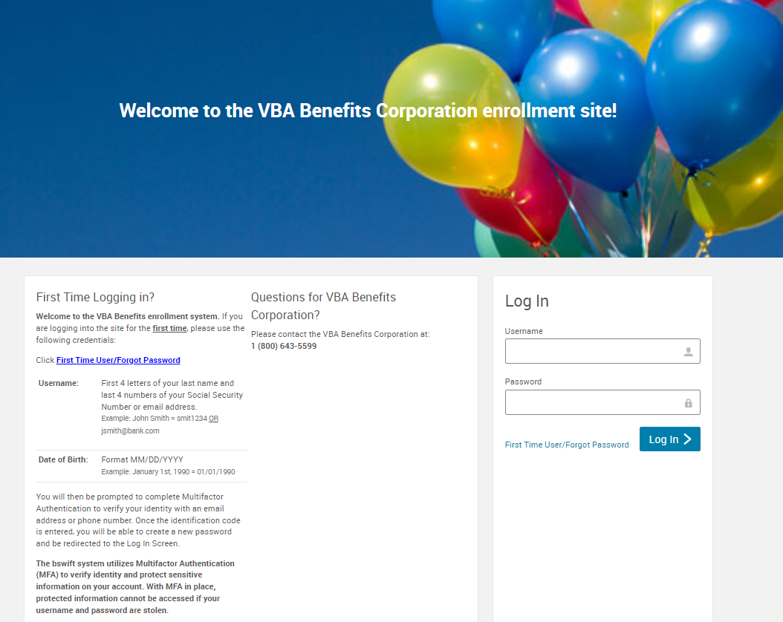
Open Enrollment Instructions – Step 1
Go to http://vbabenefits.bswift.com
Enter in your login information
If you are a first-time user, or do not know your password, click on the First Time User/Forgot Password link.
NOTE: You will be required to complete multi-factor authentication to access system

Slide 75

Open Enrollment Instructions – Step 2
To begin open enrollment, click on the “2023 Open Enrollment” button in the welcome box
After clicking on “2023 Open Enrollment,” it will bring you to an employee information page. Make sure that this information is correct before proceeding. At the bottom of this page, select the “I agree” checkbox and continue.
Family Information: You will then be prompted to enter in any dependents if necessary. Ensure ALL eligible dependents are listed. Once complete, select the “I agree” checkbox and continue.
  NOTE: Because of ACA reporting requirements, you must include even those dependents you do not intend to cover.

Slide 76
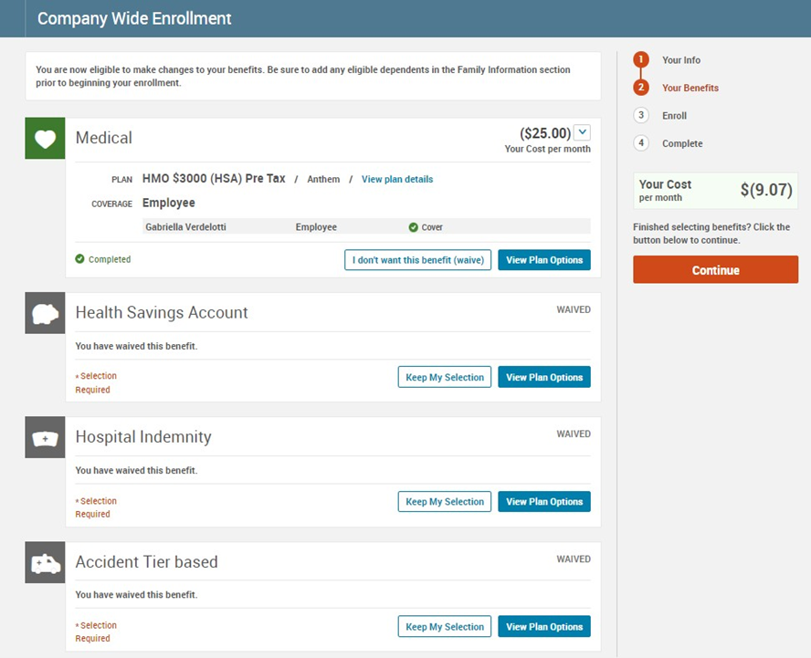

Open Enrollment Instructions – Step 3
You will now be brought to the Company Wide Enrollment screen and will be able to elect which plans you want for each benefit type (i.e. medical, dental, vision, etc.).
Click on view plan options and confirm who will be covered by this plan and click continue.
Make election and click on “keep selection” or “select button” for each plan type. A checkmark next to the plan type will appear showing that you have selected a plan for that benefit type.
Ensure all plan icons are green and select Continue.

Slide 77
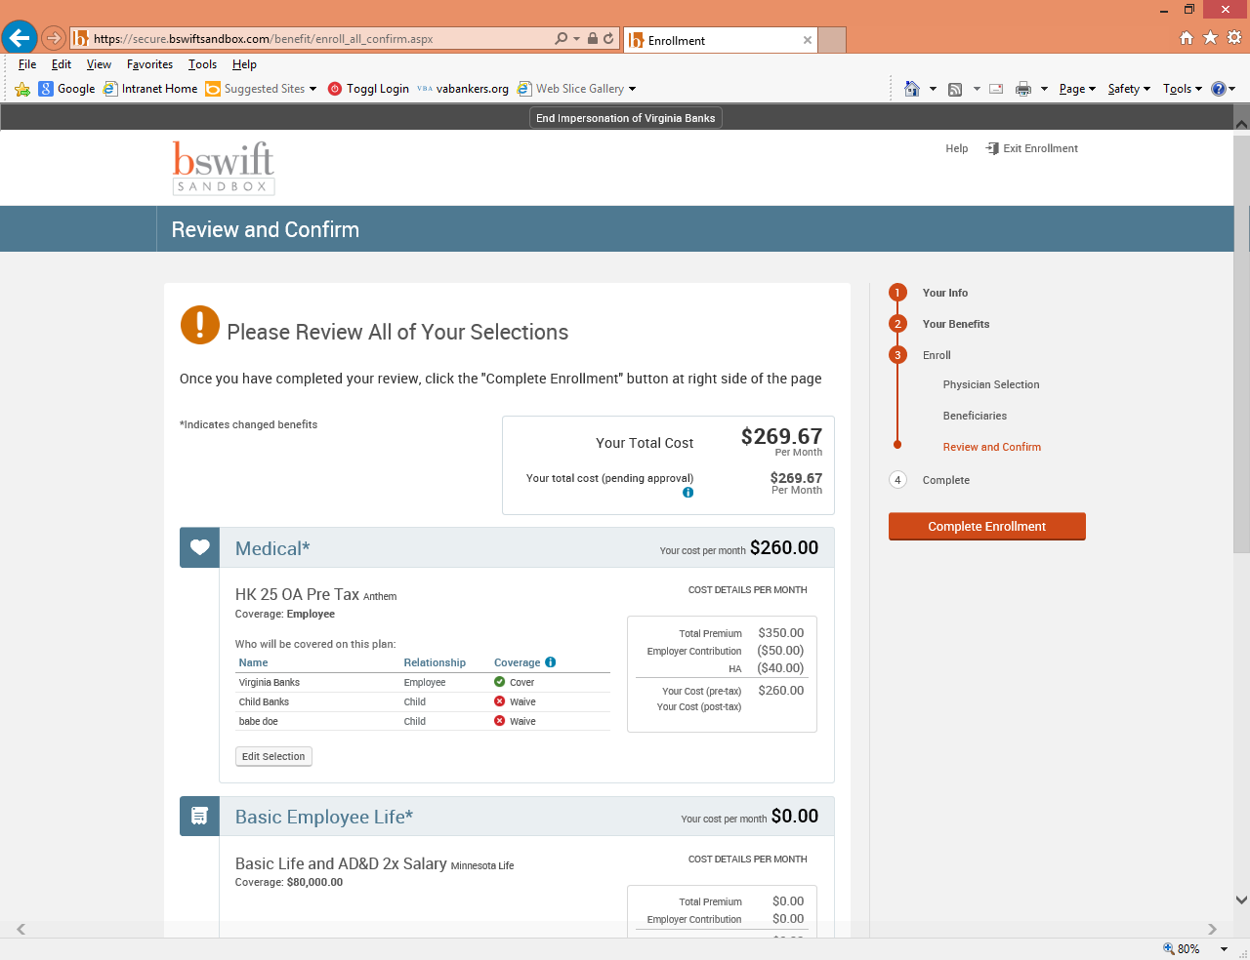
Open Enrollment Instructions – Step 4
Review and Confirm
Please make sure all your selections are correct. If not, you can click on Edit Selection at the bottom of desired plan description to make changes.
After making sure all your selections are correct, please read the participation statement at the bottom of the page and select the “I agree” and “Complete Enrollment” button to the right of the page.

Slide 78
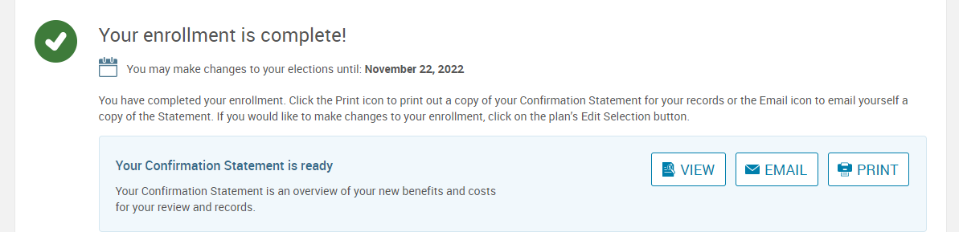
Open Enrollment Instructions – Step 5
Now your enrollment is complete! On the next page, you may view the confirmation statement, email it to your preferred email address on file, or print it. Enjoy your benefits!

Slide 79
Questions about benefits or open enrollment?
Contact:
VBA Benefits Corporation
1-800-643-5599

