Slide 1
2020 BENEFITS OPEN ENROLLMENT
ABC Employer

Slide 2
Medical & Prescription Drug Plans

Slide 3
2020 Medical Plan Options

Slide 4
Pharmacy Carve-out
  Effective January 1, 2020 prescription drug coverage will transition to RxBenefits and Express Scripts (ESI)
  Design changes:
    Modify current plan design (eliminate tiered pharmacy networks)
    Separate ID cards versus combined card
  Will identify disruption beforehand and communicate to impacted members
    ESI previous PBM before Ingenio Rx

Slide 5
Who is RxBenefits?
RxBenefits is your Pharmacy Benefit Administrator (PBA).
They partner with the country’s largest Pharmacy Benefit Managers (PBM) to bring greater discounts, enhanced access, and improved Member Services to clients and their employees.
Your pharmacy benefits coverage will be with Express Scripts.
What’s New?
You have access to their Member Services Team (800-334-8134), available Monday through Friday, 8:00 a.m. – 9:00 p.m. Eastern. Their knowledgeable representatives can assist you with questions such as:
Is my drug covered?
What will it cost?
Can you help transition my mail order scripts?
Can you assist me with my
benefits questions?
Is my pharmacy
in the network?
Are there lower cost alternatives?

Slide 6
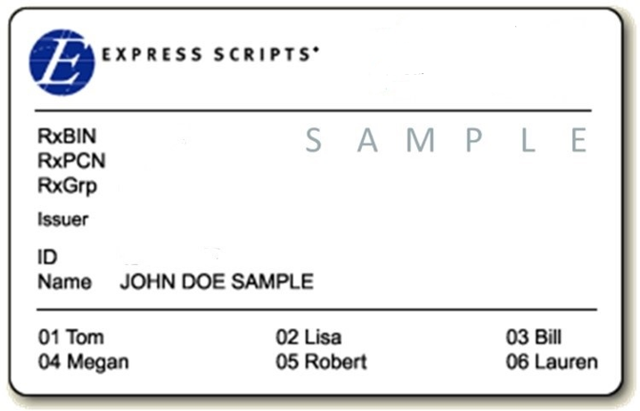
Your New Pharmacy ID Card
    New Pharmacy ID Card
Your new ID cards will be delivered to participants’ home address.
Please make sure you show this new ID card to your pharmacy on or after 1/1/2020
RxBenefits Member Services’ phone number
is printed on the back of the card
Please note: Participants will also receive a new Anthem ID card removing pharmacy information.

Slide 7

Specialty Medications
Specialty medications are covered when purchased though Express Scripts’ Specialty Pharmacy, known as Accredo
Members currently using a specialty medication should expect to have their information transfer, requiring no action on their part to have these filled by Accredo beginning 1/1/2020
Accredo can be contacted at 800.922.8279
Members can also contact RxBenefits Member Services for assistance.

Slide 8
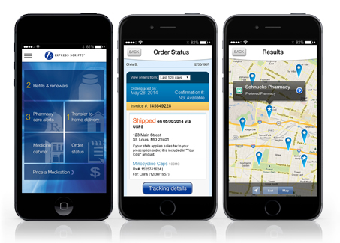
The Express Scripts App
    For Members on the Go
Register your account from your
mobile device
Transfer eligible maintenance medications
to Express Scripts Pharmacy
Select and schedule prescription refills and enroll eligible prescriptions in auto refills
Check Express Scripts Pharmacy order shipping information
Locate a nearby pharmacy using GPS
Access DrugDigest database for information, uses, possible side effects, etc.
Set a reminder for medication doses

Slide 9
Value Added Medical Services
Advance Medical
  Expert medical opinion and health advocacy services
CCS Diabetic Management
  Bluetooth glucometer, monitoring, coaching and supplies at no cost to diabetic member; if not interested in program please opt out and return kit
Airrosti (in select areas)
  Alternative orthopedic care solution for musculoskeletal injuries
Anthem Health Guide
  Concierge customer service team that assists members in navigating health care
  Note- will only use for medical services in 2020; Rx services will be directed to RxBenefits

Slide 10
HMO vs. PPO
HMO
  Cheaper premium rates in comparison to PPO due to limited network
  Higher negotiated discounts for medical services, thus less out of pocket expense
  Network limited to state of Virginia
PPO
  Higher premium rates in comparison to HMO due to more robust network
  National network that crosses state lines

Slide 11
11
PPO 20
$20 primary care/$40 specialist
100% for preventive care services, no member copay
80%/20% co-insurance in-network
  Inpatient (after $400 copay) and outpatient (after $200 copay) hospitalization
  Lab, tests, x-rays, and most other services
$4,000 individual/$8,000 family out of pocket maximum
Drug Copays:
    $15/$40/$75/20% up to $200
6

Slide 12
PPO 25
$25 primary care/$50 specialist
100% for preventive care services, no member copay
$500 individual/$1,000 family deductible
  Inpatient and outpatient hospitalization
  Lab, tests, x-rays, and most other services
80%/20% co-insurance in-network, after deductible
$4,500 individual/$9,000 family out of pocket maximum
Drug Copays:
    $15/$40/$75/20% up to $200
12

Slide 13
HMO 25
Anthem Healthkeepers HMO network of providers; out-of-network coverage is limited and must be pre-authorized.
$25 primary care/$50 specialist
100% for preventive care services, no member copay
$500 individual/$1,000 family deductible
  Inpatient and outpatient hospitalization
  Lab, tests, x-rays, and most other services
80%/20% co-insurance in-network, after deductible
$4,500 individual/$9,000 family out of pocket maximum
Drug Copays:
    $15/$40/$75/20% up to $200
13

Slide 14
HDHP Concept
Plan design is a high deductible health plan (HDHP), typically $2,000 or higher; an individual is responsible for healthcare expenses prior to meeting deductible. Once deductible is satisfied, applicable plan coinsurance applied.
In addition to the high deductible health plan, there are accounts set up to help “fund” or pay for healthcare services while meeting the deductible. The two most common types of plans are:
  Health Reimbursement Account (HRA)
  Health Savings Account (HSA)
14

Slide 15
PPO HRA
Two components:
  High deductible health plan (HDHP)
  Health reimbursement account (HRA)
15

Slide 16
1. PPO HRA Plan - High Deductible Health Plan
16
Deductible (HRA)
  $2,000 ($500 HRA allocation) Individual
  $4,000 ($1,000 HRA allocation) Family
  One person can meet the $2,000 deductible and the plan will start paying for that person even if the $4,000 for family hasn’t been satisfied
Preventive care services covered at 100% outside of the deductible
80%/20% coinsurance in-network after deductible
Out-of-Pocket Maximum
  $3,500 Individual
  $7,000 Family
Drug copays:
  $15/$40/$75/20% up to $200
  Copays for approved preventive care drugs taken from HRA prior to deductible (please see ESI’s list of approved preventive drugs); copays do not accumulate towards deductible, but do accumulate towards the out-of-pocket maximum
  Non-preventive drugs count towards deductible and out-of-pocket maximum
  Copays for all drugs after deductible is met
16

Slide 17
17
2. PPO HRA Plan – Health Reimbursement Account
Built in HRA to offset deductible:
  $500 individual, $1,000 family
  HRA funds not spent roll over to next year, up to the annual deductible amount
  Pays first while meeting deductible
  Anthem processes claims and tracks HRA usage
Can participate in traditional flexible spending account; HRA pays first
17

Slide 18
How Does a Health Savings Account (HSA) Work?
Enroll in qualified high deductible health plan (HDHP)
Establish a Health Savings Account (HSA) and make contributions into it
Pay out-of-pocket health plan costs (deductible and coinsurance)
Decide whether or not to reimburse yourself out of HSA for out-of-pocket costs
Unused funds in HSA remain and available to use for future costs
Can be used for spouse and tax dependents, even if they are not covered by the high deductible health plan
Note: In order to contribute to an HSA, you must be enrolled in a qualified HDHP and not enrolled in Medicare
HSA Triple Tax Advantage
All contributions are tax-free
All interest earned is tax-free
All funds used for qualified medical expenses are tax-free
18

Slide 19
PPO HSA $2000
$2,000 individual/$4,000 family deductible
  Dependents under family coverage must meet the $4,000 deductible before the plan will start paying
90%/10% co-insurance in-network for all medical costs after deductible
Preventive care services covered at 100% outside of the deductible
$3,500 individual/$7,000 family out of pocket maximum
Drug copays:
  $15/$40/$75/20% up to $200
  Copays for approved preventive care drugs before deductible (please see ESI’s list of approved preventive drugs); copays do not accumulate towards deductible, but do accumulate towards the out-of-pocket maximum
  Non-preventive drugs count towards deductible and out-of-pocket maximum
  Copays for all drugs after deductible is met
19

Slide 20
PPO $3000
$3,000 individual/$6,000 family deductible
  One person can meet the $3,000 deductible and the plan will start paying for that person even if $6,000 for family hasn’t been satisfied
100% co-insurance in-network for medical after deductible
Preventive care services covered at 100% outside of the deductible
$4,000 individual/$8,000 family out of pocket maximum
Drug copays:
  $15/$40/$75/20% up to $200
  Copays for approved preventive care drugs before deductible (please see ESI’s list of approved preventive drugs); copays do not accumulate towards deductible, but do accumulate towards the out-of-pocket maximum
  Non-preventive drugs count towards deductible and out-of-pocket maximum
  Copays for all drugs after deductible is met
20

Slide 21
HMO $3000
Anthem Healthkeepers HMO network of providers; out-of-network coverage is limited and must be pre-authorized.
$3,000 individual/$6,000 family deductible
  One person can meet the $3,000 deductible and the plan will start paying for that person even if $6,000 for family hasn’t been satisfied
100% co-insurance in-network for medical after deductible
Preventive care services covered at 100% outside of the deductible
$4,000 individual/$8,000 family out of pocket maximum
Drug copays:
  $15/$40/$75/20% up to $200
  Copays for approved preventive care drugs before deductible (please see ESI’s list of approved preventive drugs); copays do not accumulate towards deductible, but do accumulate towards the out-of-pocket maximum
  Non-preventive drugs count towards deductible and out-of-pocket maximum
  Copays for all drugs after deductible is met
21

Slide 22
PPO $4000
$4,000 individual/$8,000 family deductible
  One person can meet the $4,000 deductible and the plan will start paying for that person even if $8,000 for family hasn’t been satisfied
70% co-insurance in-network for medical after deductible
Preventive care services covered at 100% outside of the deductible
$6,350 individual/$12,700 family out of pocket maximum
Drug copays:
  $15/$40/$75/20% up to $200
  Copays for approved preventive care drugs before deductible (please see ESI’s list of approved preventive drugs); copays do not accumulate towards deductible, but do accumulate towards the out-of-pocket maximum
  Non-preventive drugs count towards deductible and out-of-pocket maximum
  Copays for all drugs after deductible is met
Note: Plan is deemed non-creditable if considering Medicare Part D
22

Slide 23
PPO $5000
$5,000 individual/$10,000 family deductible
  One person can meet the $5,000 deductible and the plan will start paying for that person even if $10,000 for family hasn’t been satisfied
100% co-insurance in-network for medical after deductible
Preventive care services covered at 100% outside of the deductible
$6,000 individual/$12,000 family out of pocket maximum
Drug copays:
  $15/$40/$75/20% up to $200
  Copays for approved preventive care drugs before deductible (please see ESI’s list of approved preventive drugs); copays do not accumulate towards deductible, but do accumulate towards the out-of-pocket maximum
  Non-preventive drugs count towards deductible and out-of-pocket maximum
  Copays for all drugs after deductible is met
Note: Plan is deemed non-creditable if considering Medicare Part D
23

Slide 24

2020 HSA Maximum Contribution Limits
Self only: $3,550
Family: $7,100
Catch-up (age 55+): $1,000
24

Slide 25

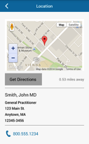
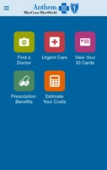
Utilize Anthem’s Tools and Resources
www.anthem.com has tools and resources to assist with making decisions about cost of medical care:
LiveHealth Online, allows you to have a virtual doctor visit for acute care conditions
Estimate Your Costs, allows you to price a procedure at different settings/facilities
Find an Urgent Care Center
Find a Doctor

Slide 26
Health Plan Decisions
26
Try to predict and estimate own healthcare costs for next year
  Anthem’s website
Review plan design choices and out-of-pocket maximums for each plan
Review employee premiums
Compare cost of premiums to expected medical plan utilization when making selection
26

Slide 27
Low Claims Utilization Example – Employee Only
27
- Annual wellness visit: $200
- Two PCP office visits: $75 each
- One specialist office visit: $150 each
- One generic prescription per month (level 1): $12
*For illustrative purposes only, costs could be overstated depending on dates of service.
Service | PPO 20 | PPO 25 | HMO 25 | PPO HRA | PPO 2000 | HMO 3000 | PPO 3000 | PPO 4000 | PPO 5000
Wellness | $0 | $0 | $0 | $0 | $0 | $0 | $0 | $0 | $0
PCP | $40 | $50 | $50 | $0 ($150 fund) | $150 | $150 | $150 | $150 | $150
Specialist | $40 | $50 | $50 | $0 ($150 fund) | $150 | $150 | $150 | $150 | $150
Rx | $144 | $144 | $144 | $0 ($144 fund) | $144 | $144 | $144 | $144 | $144
CLAIMS COSTS | $224 | $244 | $244 | $0 | $444 | $444 | $444 | $444 | $444
Annual EE Premium | $0 | $0 | $0 | $0 | $0 | $0 | $0 | $0 | $0
TOTAL ANNUAL COSTS | $0 | $0 | $0 | $0 | $0 | $0 | $0 | $0 | $0
27

Slide 28
High Claims Utilization Example – Employee Only
- Annual wellness visit: $200 - One MRI: $800
- Two-day hospital stay: $5,000 - One generic prescription (preventive – tier 1) per month (level 1): $15 each
- One PCP visit: $75 - One prescription (non-preventive – tier 2) per month (level 1): $80 each
- Four specialist office visits: $150 each
*For illustrative purposes only, costs could be overstated depending on dates of service.
Service | PPO 20 | PPO 25 | HMO 25 | PPO HRA | PPO 2000 | HMO 3000 | PPO 3000 | PPO 4000 | PPO 5000
Wellness | $0 | $0 | $0 | $0 | $0 | $0 | $0 | $0 | $0
Hospital | $1,320 | $1,400 | $1,400 | $2,100 ($500 fund) | $2,300 | $3,000 | $3,000 | $4,300 | $5,000
PCP | $20 | $25 | $25 | $15 | $7.50 | $0 | $0 | $22.50 | $0
Specialist | $160 | $200 | $200 | $120 | $60 | $0 | $0 | $180 | $0
MRI | $160 | $160 | $160 | $160 | $80 | $0 | $0 | $240 | $0
Rx 1 | $180 | $180 | $180 | $180 | $180 | $180 | $180 | $180 | $180
Rx 2 | $480 | $480 | $480 | $480 | $480 | $480 | $480 | $480 | $480
CLAIMS COSTS | $2,320 | $2,445 | $2,445 | $3,055 | $3,107.50 | $3,660 | $3,660 | $5,402.50 | $5,660
Annual EE Premium | $0 | $0 | $0 | $0 | $0 | $0 | $0 | $0 | $0
TOTAL ANNUAL COSTS | $0 | $0 | $0 | $0 | $0 | $0 | $0 | $0 | $0
28

Slide 29
Dental

Slide 30
Dental Plan Highlights
No plan or rate changes
Plan Design Feature | Basic | Comprehensive | Enhanced Indemnity
Annual Deductible | $50 (3 per family) | $50 (3 per family) | $50 (3 per family)
Annual Benefit Max | $1,000 per person | $1,500 per person | $1,500 per person
Preventive & Diagnostic Services (cleanings, exams, x-rays) | 100% allowable charge (AC); 80% out-of-network | 100% AC: 80% out-of-network | 100%; no network required; can be balanced billed by dentist
Primary Services (fillings, oral surgery, endodontics & periodontics) | 80% AC after deductible; 60% out-of-network | 80% AC after deductible; 60% out-of-network. | 80% AC after deductible
Major Services (crowns, bridges, dentures, implants) | No coverage | 50% AC after deductible | 50% AC after deductible
Orthodontia (dependent children to age 19) | No coverage | 50% up to $1,000 lifetime maximum | 50% up to $1,000 lifetime maximum

Slide 31
Dental Plan Rates
Employee Category | Basic | Comprehensive | Enhanced Indemnity
Employee | $25.50 | $41.20 | $49.50
Employee & Child(ren) | $48.80 | $77.50 | $93.90
Employee & Spouse | $51.70 | $83.30 | $99.80
Employee & Family | $82.40 | $131.20 | $159.10

Slide 32
Vision

Slide 33
Vision Plan Highlights
No plan or rate changes
In-network Plan Design Features | Anthem Blue View Vision (Included with Anthem) | Basic Plan (VSP) | Enhanced Plan (VSP)
Comprehensive Eye Exam | $15 copay | $15 copay | $15 copay
Frames/Lenses – single vision, bifocal, trifocal and lenticular | 35% discount off retail | $30 copay ($150 allowance*); frame benefit available every 24 months | $15 copay ($150 allowance*); frame benefit available every 12 months
Covered Lens Options | Varying discounts | Standard scratch-resistant coating; polycarbonate lenses for children | Standard scratch-resistant coating, progressive lenses, photochromic, polycarbonate lenses (children and adults), ultraviolet coating and Pink Tints (1 & 2)
Contact Lenses (Contact lens benefit in lieu of frames benefit every 12 months) | 15% off retail | $30 copay; $150 allowance | $15 copay; $150 allowance
Contact lenses fitting fee | No discount | Copay not to exceed $60 | Copay not to exceed $60
*$80 allowance at Costco

Slide 34
Vision (VSP) Plan Rates
Employee Category | Basic Plan | Enhanced Plan
Employee only | $5.80 | $10.20
Employee + child(ren) | $9.60 | $15.60
Employee + spouse | $9.00 | $14.60
Employee + family | $15.40 | $25.00

Slide 35
Disability

Slide 36
Long Term Disability (LTD)
Pays monthly income replacement
60, 90, or 180 day elimination period
60% or 70% benefit
  $15,000 monthly benefit maximum
ABC Employer funds the cost of the 90 day/60% LTD plan
36

Slide 37
Short Term Disability (STD)
Pays 60% weekly income replacement (after required 14 day elimination period)
7 weeks, 11 weeks, 24 weeks duration period
Maximum $2,500 weekly benefit
37

Slide 38
Life

Slide 39
Life Insurance and AD&D
Basic Life and AD&D: X base salary
Supplemental Life –
  1-8 times salary (combined with basic life)
  $1,500,000 maximum amount of coverage (combined with basic life); EOI required on any increase
Voluntary AD&D – All Guarantee Issue
Rate | Per Thousand of Coverage | $0.019 Employee Only Coverage $0.03 Family Coverage
Benefit Summary | $25,000 Increments | % reflect employee’s principal sum: Spouse (with children): 40% Spouse (no children): 50% Each child (with spouse): 10% Each child (no spouse): 15%
Plan Maximum | $500,000 | Spouse: $250,000 Child: $25,000

Slide 40
Life Insurance and AD&D Cont.
No changes to spouse or child life
Spouse Life
  Increments of $10,000, up to $100,000
Child Life
  $5,000; $10,000; $15,000; $20,000 options
  All guaranteed issue

Slide 41
Flexible Spending Accounts

Slide 42
Healthcare Spending Account
Set aside pretax dollars to pay for qualified out-of-pocket healthcare expenses throughout the plan year
Pre-funded annual account; payroll deductions made on per pay period basis
Maximum annual deferral is $2,700 (if chosen by employer) **Can change**
Examples of eligible expenses include copayments, coinsurance, orthodontics, eyeglasses, contact lenses
Limited FSA is available for employees who have a health saving account (HSA) to use on dental and vision expenses
“Use it or lose it”
  2 ^{½} month grace period or $500 carryover
  For new HSA participants, automatic rollover into limited FSA with grace/carryover provision

Slide 43
Dependent Care Spending Account
Set aside pretax dollars to pay for qualified dependent care expenses throughout the plan year
Not a pre-funded annual account; payroll deductions made on per pay period basis
Maximum annual deferral is $5,000
Examples of eligible expenses include licensed day care centers, babysitters/nannies, before and after school care, day care for elderly or disabled dependent
43

Slide 44
Voluntary Benefits

Slide 45
How does Aflac work?
Your Medical Insurance will pay medical providers (doctor, hospital, pharmacy, lab) directly.
Aflac group coverage pays benefits directly to you!
These benefits can help you offset deductibles, coinsurance or copays. They are HSA compatible so you can use these benefits and continue to let your HSA grow.
Enrolling in Aflac does not require you to be enrolled in VBA Medical plans. For example, if your spouse is covered elsewhere for Medical you can still cover them through VBA’s Aflac plans.

Slide 46

I need financial support in the event of
a critical illness.
Critical Illness

Slide 47
Why Aflac group Critical Illness insurance may be right for you.
Coverage is offered Guaranteed Issue – no health questions for employee or spouse
Coverage options are $10,000 or $20,000 for Employee and Spouse (Spouse can elect 100% of employee coverage and Employee must enroll for Spouse to enroll)
Children are covered at 50% of employee amount and there is no additional premium charged
There is no pre-existing condition exclusion for diagnosis that happens after coverage effective date. For cancer, must be treatment free 12 months.
No benefit waiting period for health screening benefit
Coverage is portable if you leave employment and you can keep the coverage at the same premium

Slide 48

Why Aflac group Critical Illness insurance may be right for you. In the event of any event below the lump sum benefit is paid directly to you:
Cancer
Heart Attack (Myocardial Infarction)
Stroke
Major Organ Transplant
End-Stage Renal Failure
Coronary Artery Bypass Surgery
Initial Diagnosis, Additional Diagnosis and Recurrence
Health Screening Benefit $100 Employee and Spouse
Notes:
Other conditions covered: MS, ALS, Parkinson’s (25%), Advanced Alzheimer (50%), skin cancer ($250)

Slide 49

I need financial support in the event of
an accident.
Accident

Slide 50
Why Aflac group Accident insurance may be right for you. Below are examples of the benefit amounts.
Hospital Admission Options: $2000 or $750
Transportation & Lodging $200 or $100/night for up to 30 nights
Ambulance $300 or $200 ground / $1000 or $750 air
Emergency Room Treatment $50
Concussion $200
Major Diagnostic Testing $200 or $100
Fractures & Dislocations $120 (toe) to $1,500 (hip) or $240 (toe) to $3,000 (hip)
Notes:
Disclaimer??

Slide 51

I need financial support if an accident or illness requires hospitalization.
Hospital Indemnity

Slide 52
Why Aflac group Hospital Indemnity insurance may be right for you.
Hospital Admission Benefit $2,000 or $1,000 when admitted as inpatient
Hospital Confinement Benefit $200 or $100/day max 31 days per covered sickness or accident
Hospital Intensive Care Benefit $200 or $100/day, max 10 days per covered sickness or accident
Guaranteed Issue AND No-Pre Existing Conditions exclusion for Employee AND Spouse
*New: must be enrolled in plan for full year

Slide 53
Legal Assistance (Hyatt Legal)
More than 13,000 attorneys, covering all 50 states
  Strong network of attorneys in VA
No deductible, claim forms, or usage limits
Plan is portable (changing from 30 months to 12 months of premium payments)
Spouse and dependent coverage included
Provides full coverage for most legal matters:
  Money matters, home and real estate, estate planning, living will preparation, family and personal, civil lawsuits, elder care issues, vehicles and driving, adoption assistance
Monthly rate - $16.50
  Paid on an after-tax basis
  Enrollment is locked in for one year

Slide 54

Pet Insurance
FIGO, a technology-based pet insurance vendor; policies are underwritten by Markel American Insurance Company (http://go.pardot.com/l/173192/2016-10-03/5y3qw)
  Group premium discount for VBA members
  Participants billed directly from FIGO
Provides illness and injury coverage for cats and dogs; no wellness
Flexible plan designs; deductible, coinsurance and benefit maximums can be customized on an individual basis during quoting process.
Technology resources
  Pet cloud: all records preserved, reminders, claims
  Mobile App for electronic claims submittal and payment
  Digital pet tags/lost pet service

Slide 55
Open Enrollment

Slide 56


Web and mobile employee benefits education and engagement platform:
Customized videos to our plans
Stock educational videos
www.bankwebsite

Slide 57
Open Enrollment Details
Open Enrollment – November X – XX
Employees can enroll through multiple internet browsers, including Internet Explorer and Safari (Apple products)
57

Slide 58
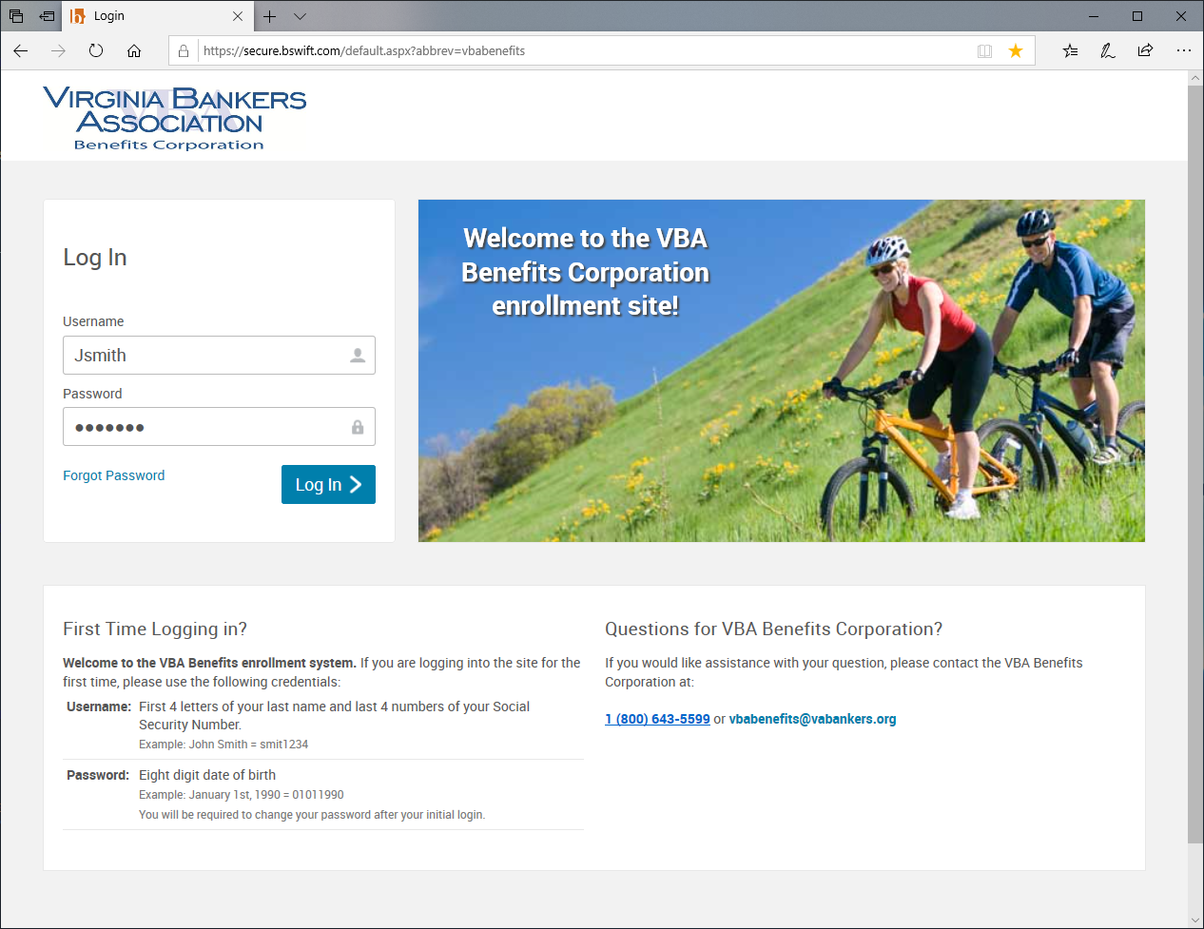
Open Enrollment Instructions – Step 1
Go to http://vbabenefits.bswift.com
Enter in your login information
Username and password information will be listed below if you are a first time user

Slide 59
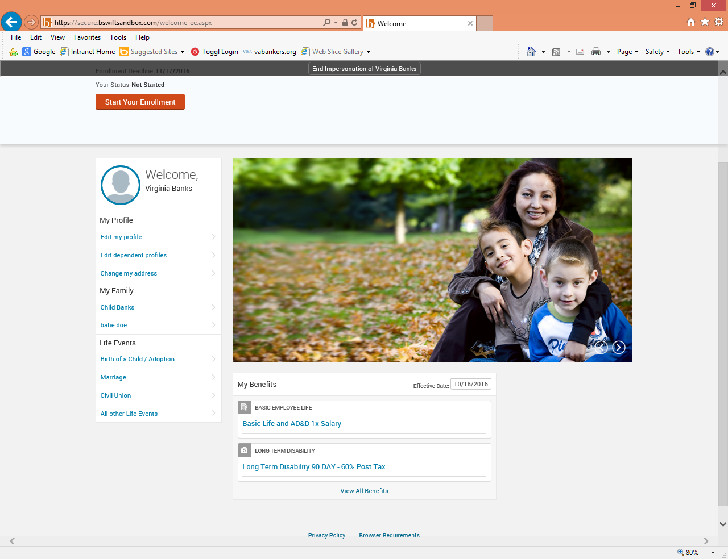
Open Enrollment Instructions – Step 2
To begin open enrollment, click on the “Start Your Enrollment” button in the welcome box
After clicking on “Start Your Enrollment,” it will bring you to an employee information page. Make sure that this information is correct before proceeding. At the bottom of this page, select the “I agree” checkbox and continue. It will then prompt you to enter in any dependents if necessary. Again, after this is complete, select the “I agree” checkbox and continue.

Slide 60
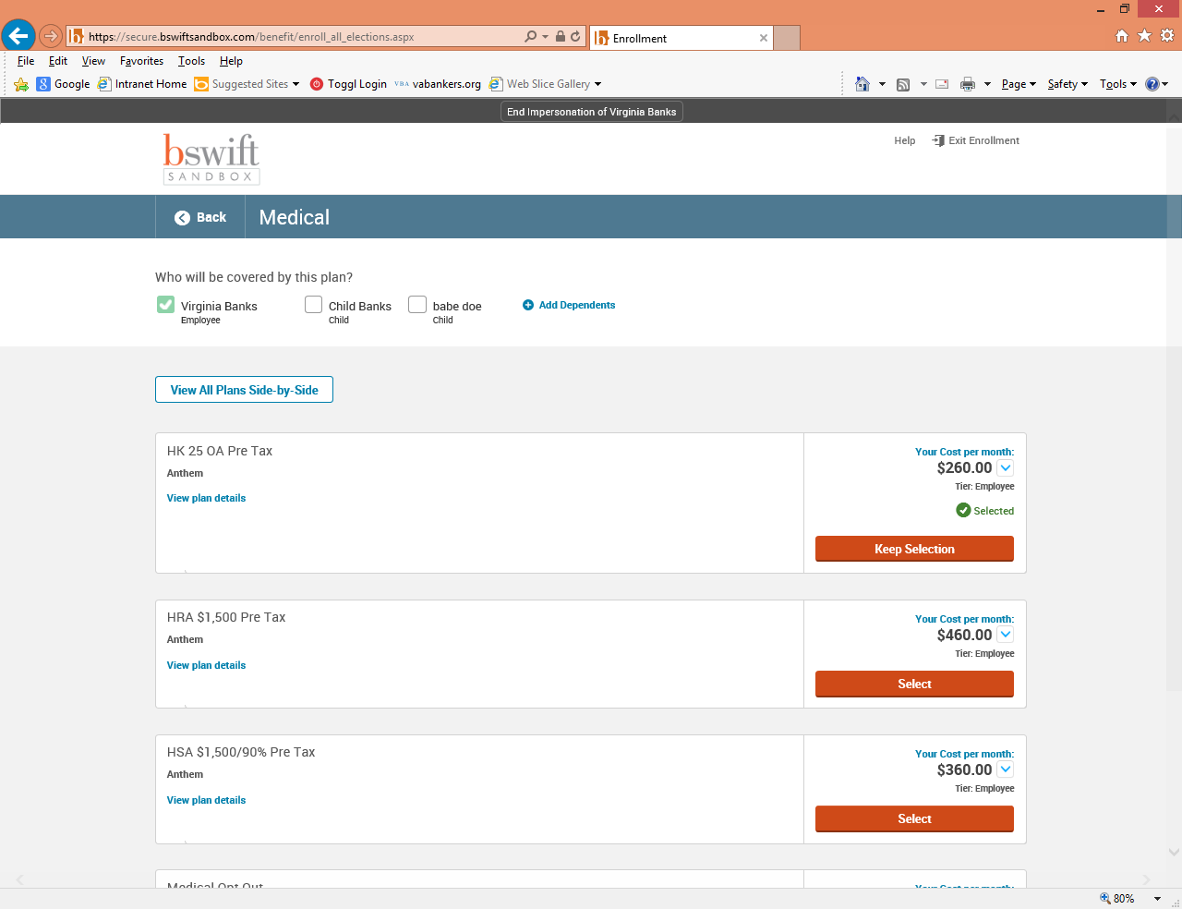
Open Enrollment Instructions – Step 3
You will now be brought to a benefits screen and be able to elect which plans you want for each benefit type (i.e. medical, dental, vision, etc.). Click on view plan options and confirm who will be covered by this plan and click continue. Make election and click on “keep selection” or “select button” for each plan type. A checkmark next to the plan type will appear showing that you have selected a plan for that benefit type.

Slide 61
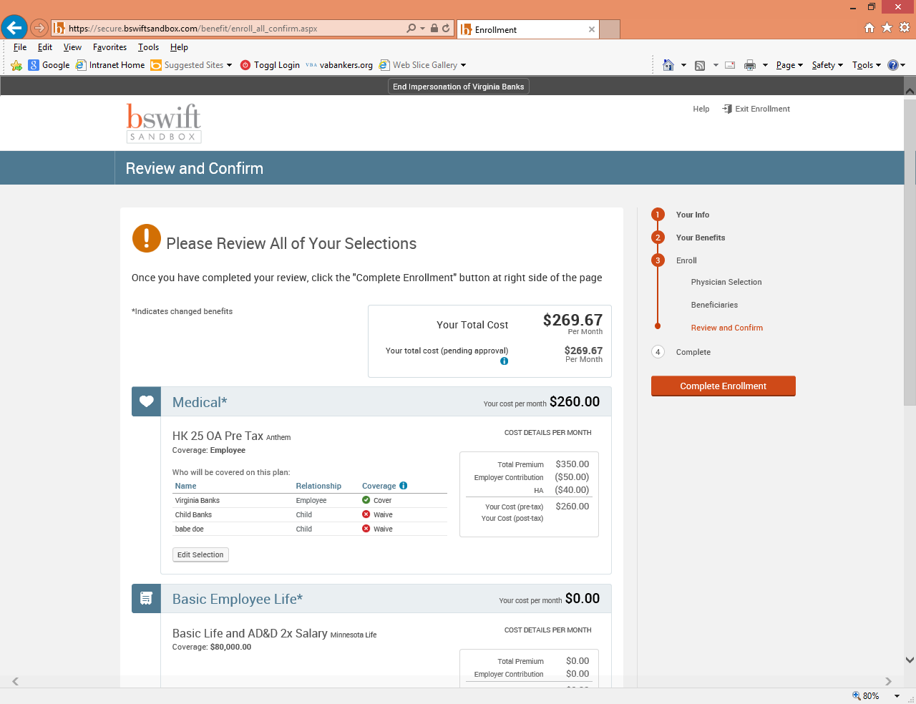
Open Enrollment Instructions – Step 4
After electing all of your plans, you will be brought to a confirmation screen. This will display all your selections. Please make sure that all your selections are correct. If not, you can click on a specific section from the menu bar at the right in order to make changes in a specific section. After making sure all your selections are correct, please read the participation statement and select the “I agree, and “Complete Enrollment” button to the right of the page.

Slide 62
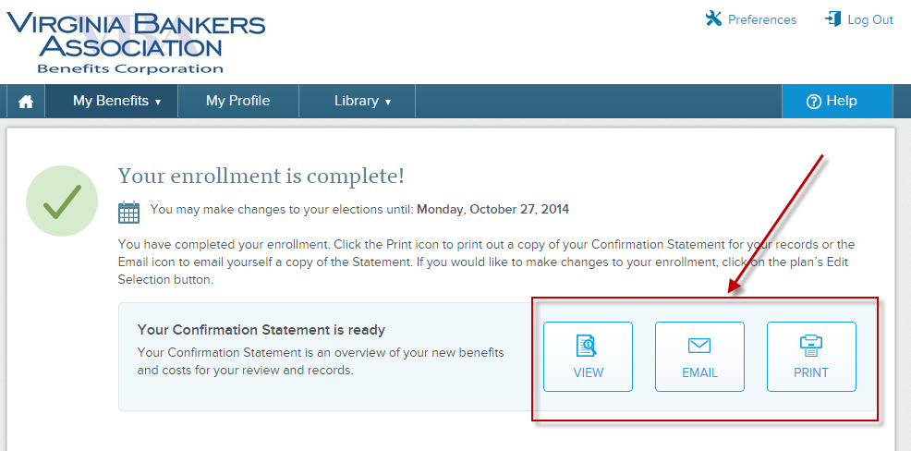
Open Enrollment Instructions – Step 5
Now your enrollment is complete! On the next page, you may view the confirmation statement, email it to your preferred email address on file, or print it. Enjoy your benefits!

Slide 63
Questions about benefits or open enrollment?
Contact:
VBA Benefits Corporation
1-800-643-5599

